Slide 1
Predicting early readmissions for diabetes patients using clinical records from 130 US hospitals
Capstone Project 1 for Springboard Program

Slide 2
Problem statement
Although diabetic patients represent about 8% of the US population, they account for 23% of hospitalizations (8.8 million) each year.
Hospitalization is major cost driver for diabetes patients.
Readmission after a hospital discharge is a high-priority healthcare quality measure and target for cost reduction.

Slide 3
Who might care?
Physicians, healthcare researchers, and health plan insurance companies might be interested in using a model to predict the readmission outcome for diabetic patients.
Based on the predicted probability of early readmission, early interventions can be done to patients such as
discharge education;
further lab testing to ensure stabilized glucose level; and
home care reminders of medications.

Slide 4
Data Source
The dataset for this study was obtained from the Health Facts database, which was an extract representing 10 years (1999–2008) of clinical care at 130 hospitals and integrated delivery networks throughout the United States.
It was later adjusted to suit for a diabetes research and was released on behalf of the Center for Clinical and Translational Research, Virginia Commonwealth University on UCI Repository.

Slide 5
Description of the dataset
Table 1. Meta Descriptions for 50 Variables (N=101,766)
Number of Variables | Class | Example
2 | identifications | encouter id
5 | patient demographics | race
3 | admission/discharge status | admission scource
7 | numeric values of events | number of lab tests
24 | medications | insulin taken or not
8 | others | payer code
1 | target outcome | readmission or not

Slide 6
Data Wrangling Steps
Missing Values
2 variables are filtered out due to too many missing observations:
Weight (numeric; 97% values missing); and
Payer code (17 categories; 40% values missing).

Slide 7
Data Wrangling Steps
Outliers
Majority of the features are categorical, and
No extreme values were seen for numeric variables after checking their range.

Slide 8
Data Wrangling Steps
Duplicate Patients and Deaths
There are duplicate patient ids so the same patient may have multiple encounters in the dataset. Using results of same individuals tend to bias the true association so duplicates were dropped.
Additionally, patients who were discharged to hospice or discharged to a death were also deleted.
Finally, 69,970 encounters were left for the study.

Slide 9
Data Wrangling Steps
Transformation of Categorical Features
Dummy features were created for categorical variables such as race and gender.
Several categorical variables were re-grouped based on their readmission rates visualized by bar plots (see the next slide).

Slide 10
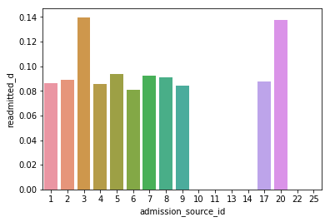
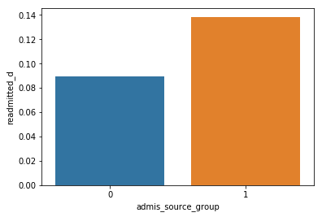
Figure 1. Readmission Rates among Patients with Different Admission Sources (before and after regrouping)

Slide 11
Data Wrangling Steps
Creation of Features
Medication changed or not based on 24 medication records
Charlson Comorbidity Score (CCI) to take into account the clinical characteristics (disease severity) of the patients, by grouping and mapping of ICD-9 codes to a CCI scores.

Slide 12
Inferential Statistics and Feature Selection
Dummy features
2 sample proportion z-tests were applied using the proportions_ztest from statsmodels.stats.proportion.
Features with p-value<0.05 were retained.

Slide 13
Inferential Statistics and Feature Selection
Categorical features
Chi-squared test was chosen since we can compare if distribution of the observed counts in each class is significantly different than the expected counts (proportional to class counts).
Features with p-value<0.05 were retained.

Slide 14
Inferential Statistics and Feature Selection
Continuous features
To test for significance impact of continuous features on binary outcomes, Logit model from statsmodels.discrete.discrete_model was applied.
Features with p-value<0.05 were retained.

Slide 15
Table 2. Included Significant Features and Test P-values
Features | p-values | Features | p-values
race_? | 0.012 | glipizide_Down | 0.007
race_Caucasian | 0.001 | glipizide_No | 0.006
race_Other | 0.012 | dischar_group | 0.000
max_glu_dummy | 0.014 | ad_type_group | 0.021
A1Cresult_dummy | 0.011 | med_spec_group | 0.000
diabetesMed_d | 0.000 | admis_source_group | 0.006
Alc_nonch | 0.008 | diag_group | 0.000
med_up | 0.004 | time_in_hospital | 0.000
med_down | 0.000 | num_lab_procedures | 0.000
insulin_Down | 0.000 | num_procedures | 0.000
insulin_No | 0.000 | num_medications | 0.000
insulin_Up | 0.008 | number_emergency | 0.008
metformin_No | 0.001 | number_inpatient | 0.000
metformin_Steady | 0.003 | number_diagnoses | 0.000
metformin_Up | 0.040 | CCI | 0.000

Slide 16
Machine Learning and Prediction
Overview
A supervised classifier is needed to train the data and predict the binary outcome.
In case the imbalanced data would affect the model performance especially in this study we are more interested in the minority outcome (<10% of patients were readmitted), over sampling will be applied.

Slide 17
Machine Learning and Prediction
Metrics selection
People in healthcare industries would prefer a prediction model that can identify most of the early-readmission cases, and tolerate some extent of low prediction score. E.g., high recall and moderate precision.
Therefore, AUC score will be used to train models and recall will be evaluated among different probability thresholds

Slide 18
Machine Learning and Prediction
Different machine learning models
Cross-validation scores and test score were returned for each model fit.
For the first DecisionTree model, the results are as followed:
CV AUC Scores: 0.66091814, 0.64988475, 0.63991324, 0.64551209, 0.63448754
Test AUC Score: 0.60903298
RandomForest did better as both the CV AUC and test AUC increased.

Slide 19
Machine Learning and Prediction
Parameter Tuning
Parameter tuning was applied for the logistic regression and Xgboost regression models with the GridSearchCV approach.

Slide 20
Machine Learning and Prediction
Exploring the threshold
Explore the probability threshold of the model to see if we can have more early readmission included without reducing too much AUC value.
Some threshold value with their AUC and confusion matrix are shown in the next slide

Slide 21
Exploring the threshold
******** For p = 0.46 ******** Our AUC is 0.614 [[9005 6930] [ 523 1035]] ******** For p = 0.47 ******** Our AUC is 0.619 [[9455 6480] [ 552 1006]] ******** For p = 0.48 ******** Our AUC is 0.622 [[9912 6023] [ 588 970]]
******** For p = 0.49 ****** Our AUC is 0.621 [[10358 5577] [ 635 923]] ******** For p = 0.5 ****** Our AUC is 0.621 [[10784 5151] [ 676 882]] ******** For p = 0.51 ****** Our AUC is 0.619 [[11207 4728] [ 722 836]]

Slide 22
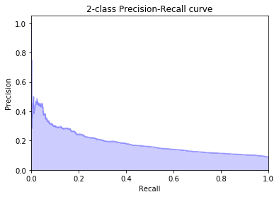
Figure 2. Precision-Recall Curve for Different Thresholds

Slide 23
Conclusions
Recall vs. Precision: even the recall is 0, the precision cannot be improved much. So we can bear to lower the precision, which means we can bear with predicting more patients as early-readmitted who actually would not, so that the recall will be higher.
A lower threshold (<0.5), e.g., a threshold of 0.45 would identify around 2/3 of the early-readmitted patients with this model;
Among all the patients predicted with this model as early-readmitted in the future, 7/8 of them will actually not be early-readmitted.
Further screening process can be applied to these patients to filter out the right person that will have early-readmission.

