Slide 1
Advanced Debugging with WinDbg and SOS
Sasha Goldshtein CTO, SELA Group
blog.sashag.net www.selagroup.com
@goldshtn @SelaHQ

Slide 2
45 Minutes From Now, You’ll Know How To:
Capture crash and hang dumps
Pinpoint basic crash causes from dumps
Inspect heap objects and graphs to find memory leaks
Identify deadlocked threads

Slide 3
Dumps 101

Slide 4
A dump is a snapshot of a running process. You can save it, move it around, and analyze it later. You can’t “debug” it.

Slide 5
Two types of dumps: Crash = the program has crashed. Hang = the program hasn’t crashed. Yet.

Slide 6
Sysinternals Procdump: take dumps easily, anywhere, and with no pun intended.

Slide 7
Crash Root Cause From A Dump

Slide 8
Drag and drop a dump file into Visual Studio. Click the green button. Voila, it works.* * Nitpicker’s corner: you need symbols and sources to be lined up properly.

Slide 9
Joe the IT admin: You will install Visual Studio on my boxen over my dead body. Good day. I said “good day”.

Slide 10
Take 2: Drag and drop a dump file into WinDbg. Hmm. Now what?
Notes:
Commands demonstrated:
.loadby sos clr
!printexception
!clrstack -a

Slide 11
Memory Leaks: The Easy Way
Not in this talk. Shell out $500 for a decent memory profiler.

Slide 12
Memory Leaks: The Hard Way

Slide 13
What we need: 1. A list of all heap objects 2. A diff of heap objects between dumps 3. Why these heap objects won’t die
Notes:
Commands demonstrated:
!dumpheap –stat
!dumpheap –mt <mt> -short
!objsize
!gcroot
.foreach …
!traverseheap
Also, CLR Profiler integration – you can open the heap log from !traverseheap in CLR Profiler.

Slide 14
Deadlocks

Slide 15
What we need: 1. What is thread X waiting for 2. Which thread owns sync object Y
Notes:
Commands demonstrated:
!syncblk
!clrstack
kb
!dlk (from sosex.dll)
!wct_thread (from wct.dll)

Slide 16


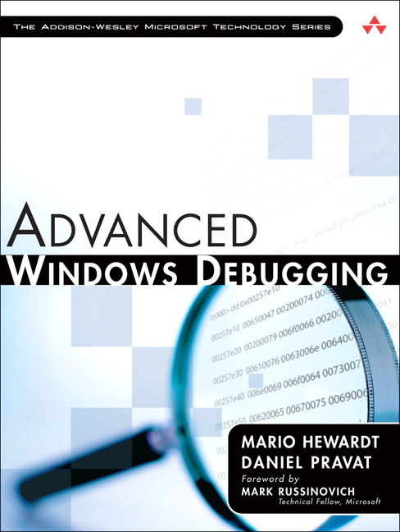

I WANT MOAR!!!!
Capture dumps automatically when an app crashes
Find memory leaks due to managed-native interop
Identify cross-process and systemwide deadlocks
Pinpoint stuck finalizers that accumulate to a leak
…dozens of additional debugging scenarios

Slide 17
Thank you for hanging out! Any questions?
Sasha Goldshtein
CTO, SELA Group Materials for this talk:
blog.sashag.net s.sashag.net/dnconf13
@goldshtn

