Slide 1
CSE627 Project
Felix Liu

Slide 2
Final Result
The Algorithm uses a U-net + Iterative method (3 iterations) for training.
In the next few slides, qualitative and quantitative results will be displayed
For qualitative results, 4 selected images of its noisy inputs, soft images, predicted images and ground truth will be presented. All 500 images can be viewed in the ‘Prediction’ folder, along with their soft images.
For quantitative results, Node Precision & Recall and Training loss will be presented

Slide 3
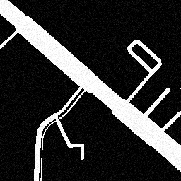
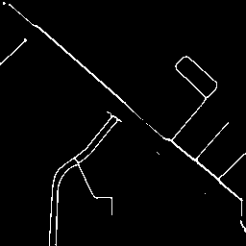
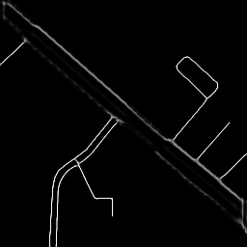
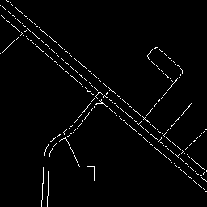
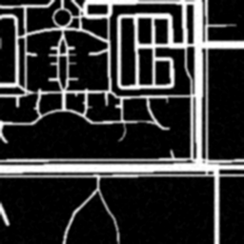
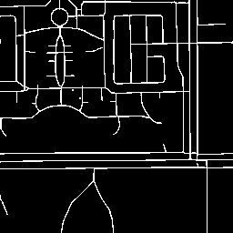
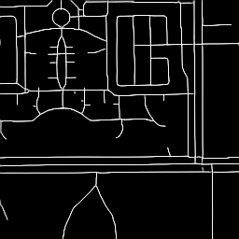
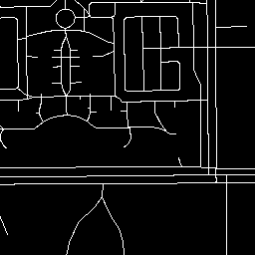
Final Qualitative Results #0, 12, 24, 36
Noisy Input
Model Prediction
Intermediate soft image
Ground truth

Slide 4


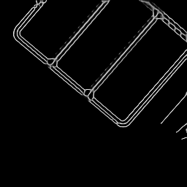

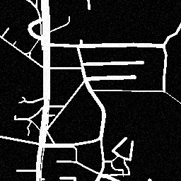
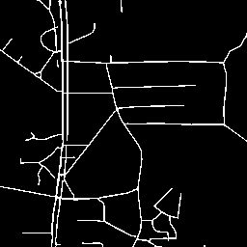
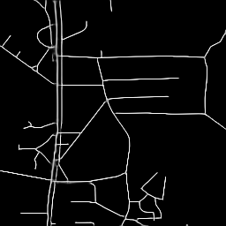
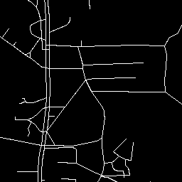
Final Qualitative Results
Noisy Input
Model Prediction
Intermediate soft image
Ground truth

Slide 5
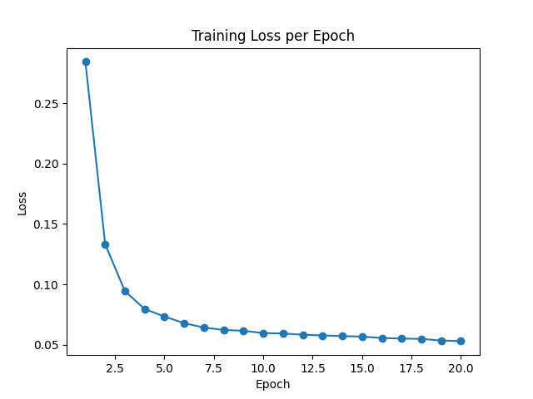
Training Loss

Slide 6
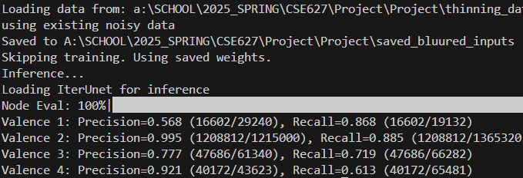
Node Precision and Recall

Slide 7
Experimental Set Up
The project is being dissected into the following steps
Data Generation
Design Model Architecture
Set Training Setup
Check Quantitative and Qualitative Result
Design Iterations
Final Result

Slide 8
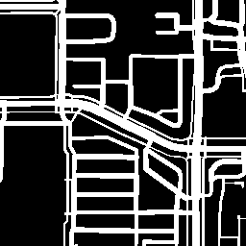
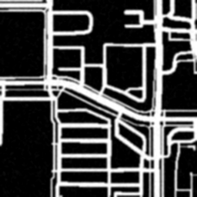
Data Generation
The original data generated is clear and clean
Want to generate noise, blurry data
original data
noise, blurry data

Slide 9
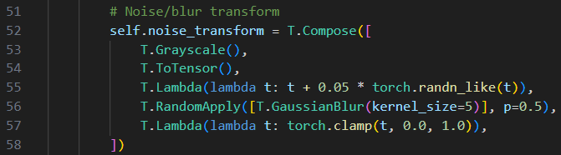
Data Generation – generate noise
Following lines turns original image to grey scale, then to Tensor
Adds per-pixel Gaussian noise (0.05)
50% chance have a 5x5 size of gaussian Blur (mimicking bad resolutions or shoots taken)
Clamps result to valid range

Slide 10
Model Architecture – base U-net
The baseline is to Implement a U-net
Input
Input shape: (1, 256, 256) - a greyscale (256, 256) image
Output: (1, 256, 256) – a probability map, predict 1-channel skeleton logits
Encoder Structure (Each block = MaxPool(2x2) → DoubleConv)
Final down4 reduces by factor of 16
Layer | Input Channels | Output Channels | Output Size
inc | 1 | 64 | (64, 256, 256)
down1 | 64 | 128 | (128, 128, 128)
down2 | 128 | 256 | (256, 64, 64)
down3 | 256 | 512 | (512, 32, 32)
down4 | 512 | 1024 → 512 | (512, 16, 16)

Slide 11
Model Architecture – base U-net
Bottleneck
After down4, hit deepest feature level - (512, 16, 16)
Decoder
Each up uses bilinear up sampling + double conv
Layer | Skip Connection | Output Channels | Output Size
up1 | from down3 | 256 | (256, 32, 32)
up2 | from down2 | 128 | (128, 64, 64)
up3 | from down1 | 64 | (64, 128, 128)
up4 | from inc | 64 | (64, 256, 256)

Slide 12
Model Architecture – base U-net
Output
Output layer
Summary
Total Depth: 5 levels
Activation: ReLu
Normalization: BatchNorm2d
UpSampling: Bilinear
Final output: 1-channel logit map
Layer | Input Channels | Output Channels | Output Shape
outc | 64 | 1 | (1, 256, 256)

Slide 13
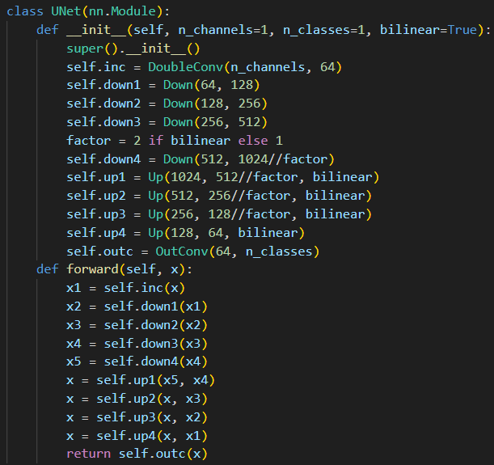
Model Architecture – base U-net
Unet Class defined

Slide 14

Initial Training Set-up
Loss Function
MSELoss on distance-transformed targets
Optimizer
Adam
Learning rate = 1$⋅{10}^{−3}$
Batch Size & Epoch
8 images per batch, 20 epochs
Validation
20% of the 500 images

Slide 15
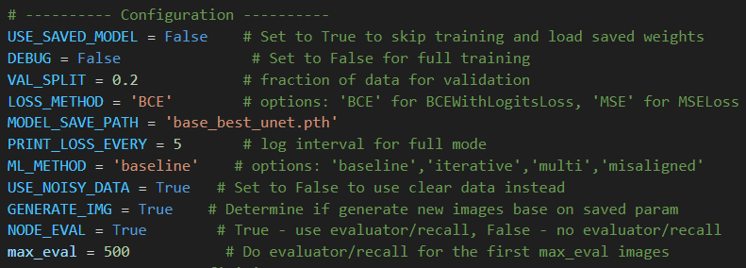
Training Set-up – QOL parameters
Set serval checkpoints parameters for the ease of re-producing images, evaluate losses, changing training set-ups without re-train the model again

Slide 16
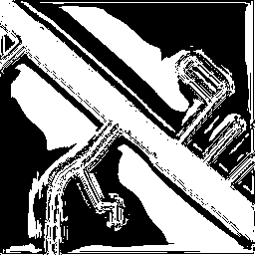

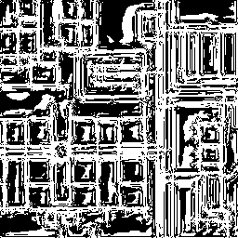
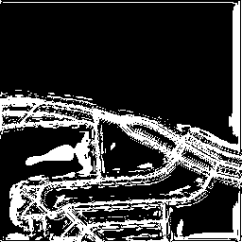

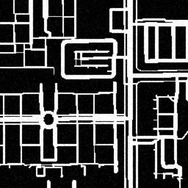
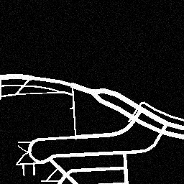
Baseline Result - Qualitative Results
Visually can recognize the shape of the road
Very bad predictions, way to thick and has random white parts

Slide 17
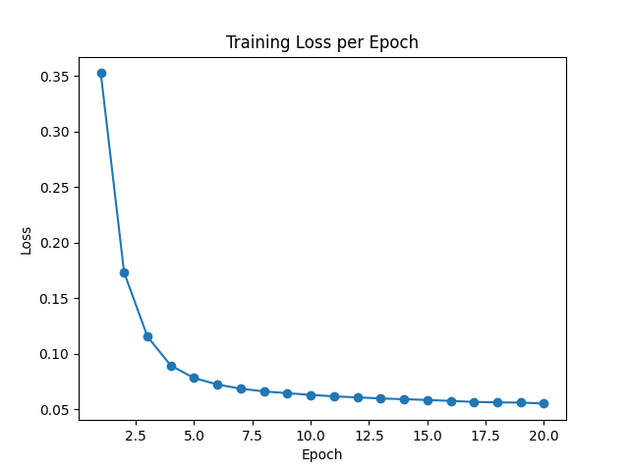
Baseline Result - Quantitative Results
Converging fast

Slide 18
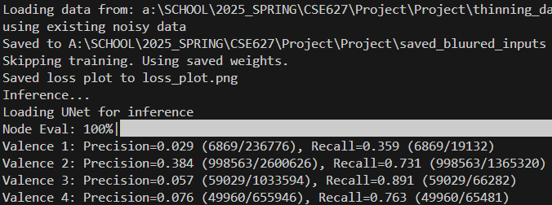
Baseline Result - Quantitative Results
Overall Poor Precision
Extremely poor at
Valence 1: dead end
Valence 3: T – intersection
Valence 4: All-way intersections

Slide 19
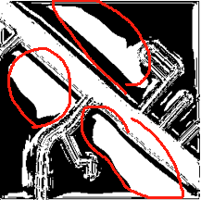
Reasoning – Poor performance
Not resistance to noise at all
Model thinks scattered noises are roads
However, do not want to reduce noise level, need the model to be robust
MSEloss and U-net’s natrue
It encourages smooth, continuous outputs
Does not penalize false positives strong enough
In skeletonization, most pixel are zeros, which is against a smooth output style

Slide 20

Design iterations – Baseline → ${\text{Baseline}}^{+}$
Binary Cross-Entropy Loss
logits Applies a sigmoid internally.
Compares predicted probability vs. ground-truth (0 or 1).
Penalizes incorrect predictions more when the model is confident but wrong.

Slide 21

Implementation of BCELoss
Concept
Applies a sigmoid internally.
Compares predicted probability vs. ground-truth (0 or 1).
Penalizes incorrect predictions more when the model is confident but wrong.
Code implementation

Slide 22
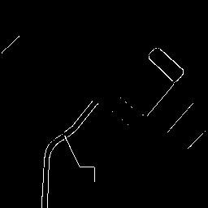

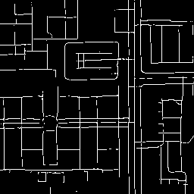
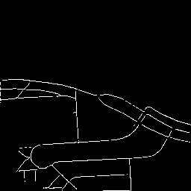

${\text{Baseline}}^{+}$ Result - Qualitative Results
Visually can recognize the road
Wider roads disappears, with discontinuity on thinner roads sometimes

Slide 23
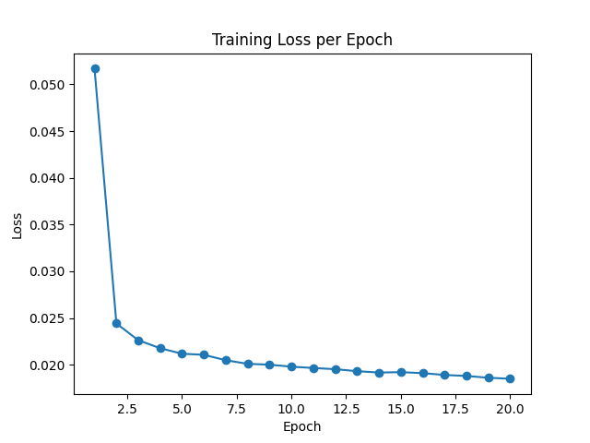

${\text{Baseline}}^{+}$ Result - Quantitative Results
Loss is low and is converging fast.

Slide 24
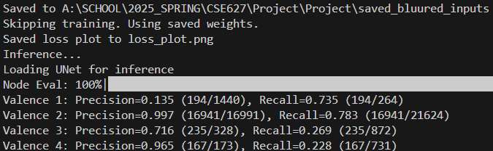
${\text{Baseline}}^{+}$ Result - Quantitative Results
Did Quick quality check on first 10 images (Takes long time for entire 500 images)
Poor accuracy on finding
Valence 1: Single pixel (dead end)
Not so good on finding
Valence 3: T - Intersection

Slide 25

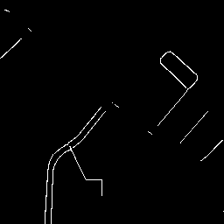
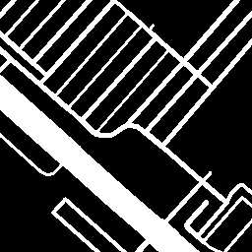
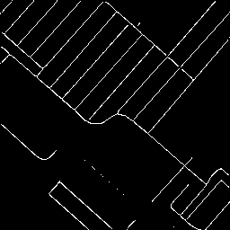

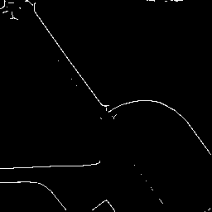
Reasoning – Poor performance on thicker roads
Ambiguity in Ground Truth
Baseline model uses supervised loss, it treat each pixel independently
Penalize incorrect predictions equally when model is confident but wrong

Slide 26
Design iterations
Uses iteration method
Slowing ‘eats away’ thicker roads in each iteration and make them appear like thinner roads

Slide 27
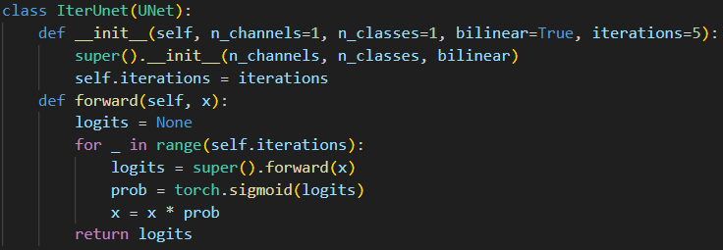
Implementation of iterative method
Concept
Applies U-net repeatedly (same weight)
Each iteration, modulates input by current prediction
Eventually thin out thicker roads
Code implementation

Slide 28
Implementation of iterative method
Inherits U-net as superclass
Since applies U-net repeatedly
Iteration set to 5
Applies sigmoid(logits) to do a soft prediction in the mid-way
Soft – masking the logits to probabilities
Can change threshold later on to determine what can be shown on the output

Slide 29
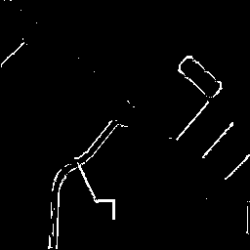

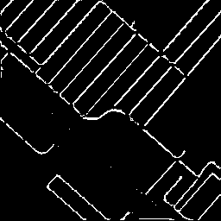
Iteration Method - Result
Wider roads almost completely disappear

Slide 30
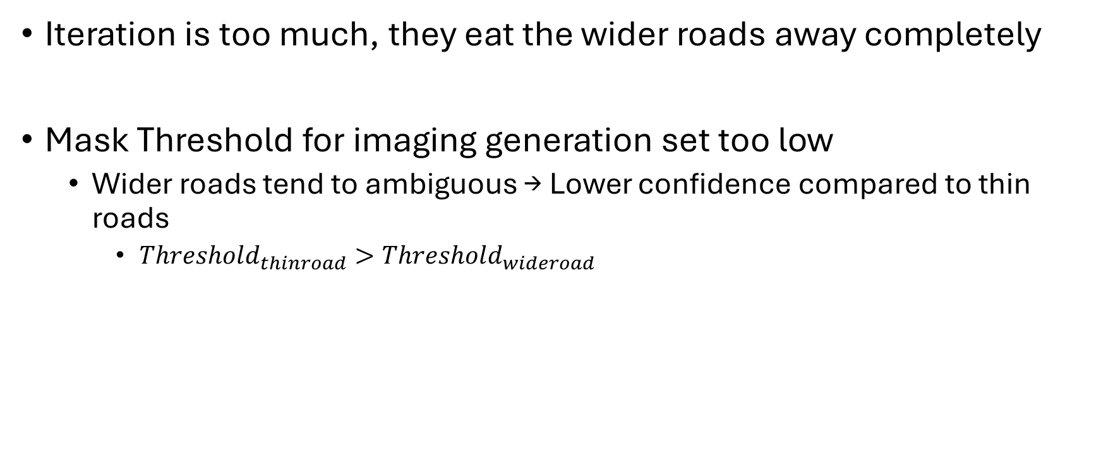
Reasoning - Poor performance on wider roads
Iteration is too much, they eat the wider roads away completely
Mask Threshold for imaging generation set too low
Wider roads tend to ambiguous → Lower confidence compared to thin roads
$Threshold_{thinroad}>Threshold_{wideroad}$

Slide 31
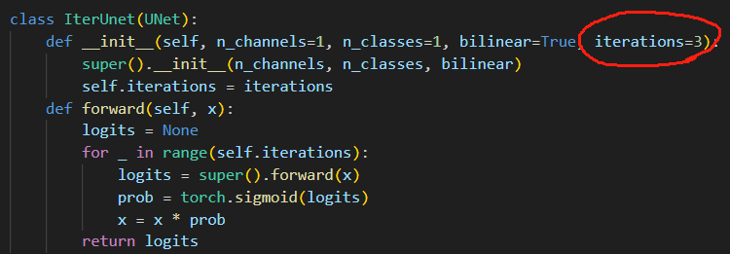

Design iterations – Iteration → ${\text{Iteration}}^{+}$
Reduce iteration levels
Lower Mask Threshold

Slide 32
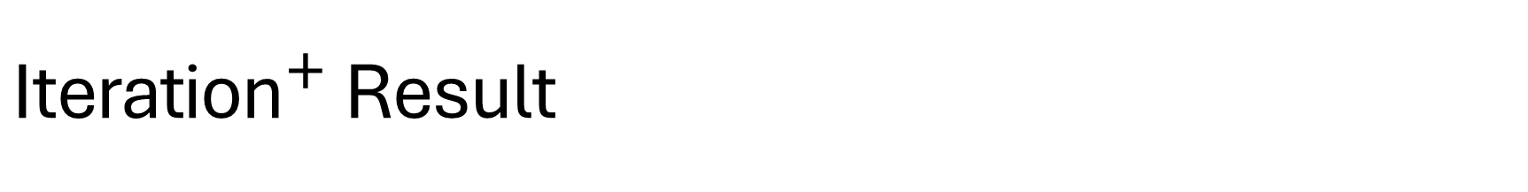
${\text{Iteration}}^{+}$ Result
These result are shown in the First Few Slides (3, 4, 5, 6)

Slide 33
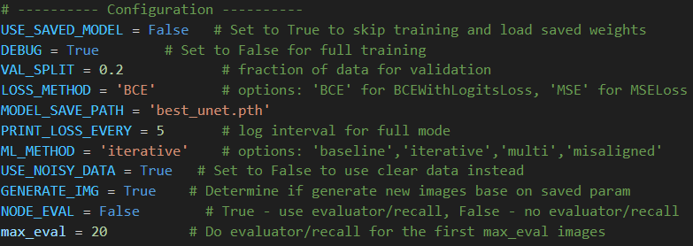
Ablation Study
All training runs are done under Where:
it applies a simpler version of U-net
1 down and 1 up
Fewer Training images
Uses first 20 images
No validation split
Configurations can be seen at the top-left
Left middle image will be compared as input and ground truth

Slide 34
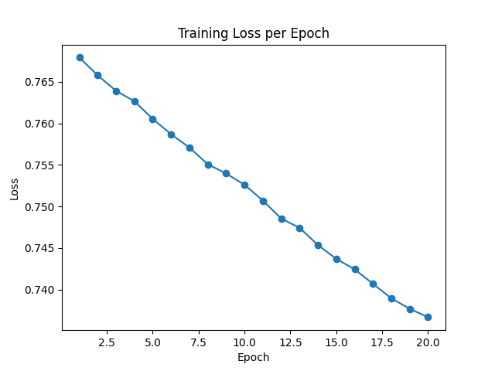
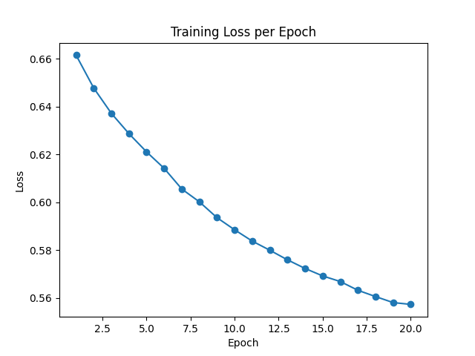
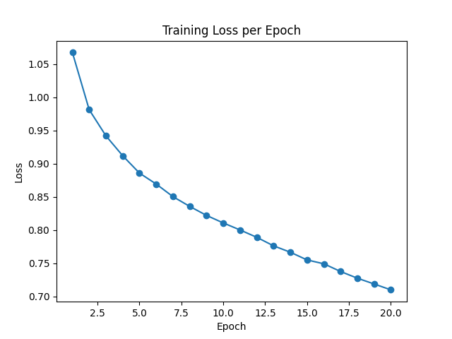
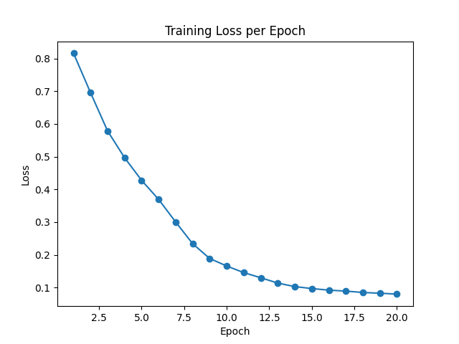
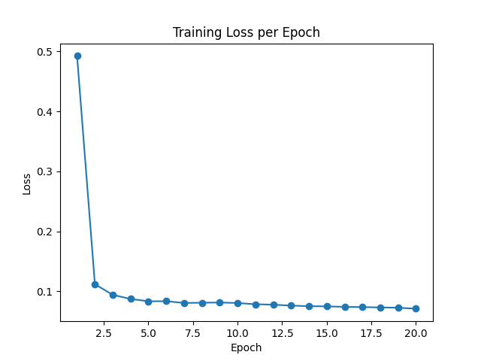





Ablation Study – Learning rate
How learning rates affect convergencies and predictions
Lr = 1e-5
Lr = 1e-4
Lr = 1e-3
Lr = 1e-2
Lr = 1e-1

Slide 35
Ablation Study – Learning rate
Large learning rate
Fast convergence
Risk being over confident
Being overconfident in background pixels, suppressing protentional thin structures
Result
Loss appears to be nice
Prediction are empty or sparse

Slide 36
Ablation Study – optimizer
Optimizer | Description | Pros | Potential Use Case
AdamW | Decouples weight decay from gradient update | More reliable regularization than Adam | Often preferred in segmentation tasks
RMSprop | Normalizes gradient by moving average | Good for noisy gradients | Works well in recurrent or noisy setups
Adagrad | Adapts learning rate based on parameter history | Fast convergence for sparse data | Less common now; can stall due to learning rate decay
SGD (Stochastic Gradient Descent) | Basic optimizer with momentum | More stable generalization; less aggressive than Adam | Try when Adam overfits or diverges

Slide 37








Ablation Study – optimizer
SGD
AdamW
RMSprop
Adagrad

Slide 38
Ablation Study – optimizer
Prediction performance
AdamW has the closet form of prediction
Convergence
All except SGD converged more rapidly
Need larger size of data too see the real difference
Limited by computing power

Slide 39
Conclusion
Successfully implemented a deep learning pipeline to skeletonize road networks from noisy thick OSM-derived images
Bassline U-net performed well except for wider roads
Iterative U-net variant introduced to thinning wider roads
Evaluation using BCEloss, node precision/recall, and visual inspection confirming meaningful structure predilection

