Slide 1
Science that matters

Slide 2

Marte Mele
Education
2008 – 2011 Ph. D. in Biomedical Research. University Pompeu Fabra, Barcelona. Cum Laude.
2006 – 2007 M. Sc. in Biomedical Research. University Pompeu Fabra, Barcelona.
2000 – 2005 B. Sc. in Biology (with Honours). University of Barcelona, Barcelona.
Research
2019-Present – Group Leader at the Life Sciences Department of the Barcelona Supercomputing Center
2014 – 2018– Postdoc at the Rinn lab at Harvard University. Cambridge. MA.
2011 – 2014. Postdoc at Guigó Lab at the Centre for Genomic Regulation (CRG). Barcelona. First year, also affiliated with Marques-Bonet lab (IBE) at the Evolutionary Biology Institute (IBE). Barcelona.

Slide 3
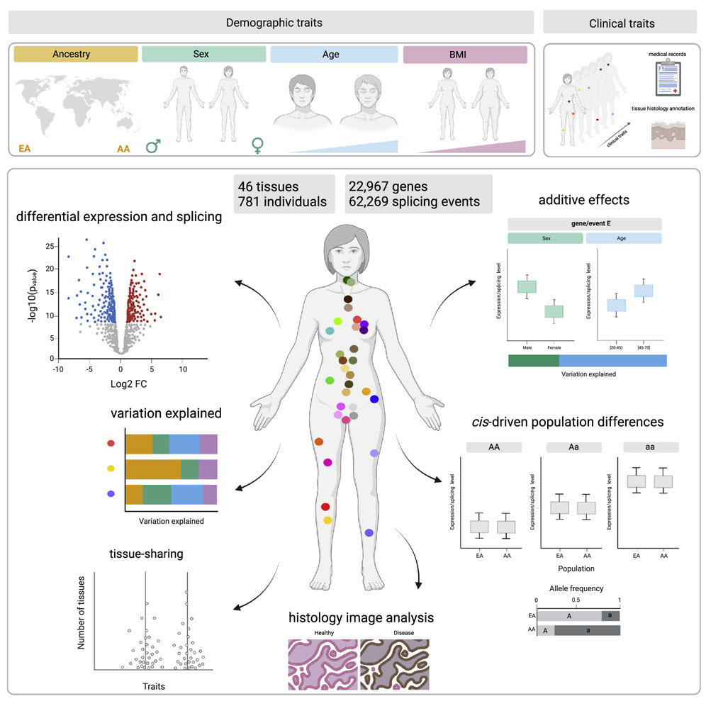
The landscape of expression and alternative splicing variation across human traits
Garcia-Perez, et al. Cell Genomics. 2023.

Slide 4
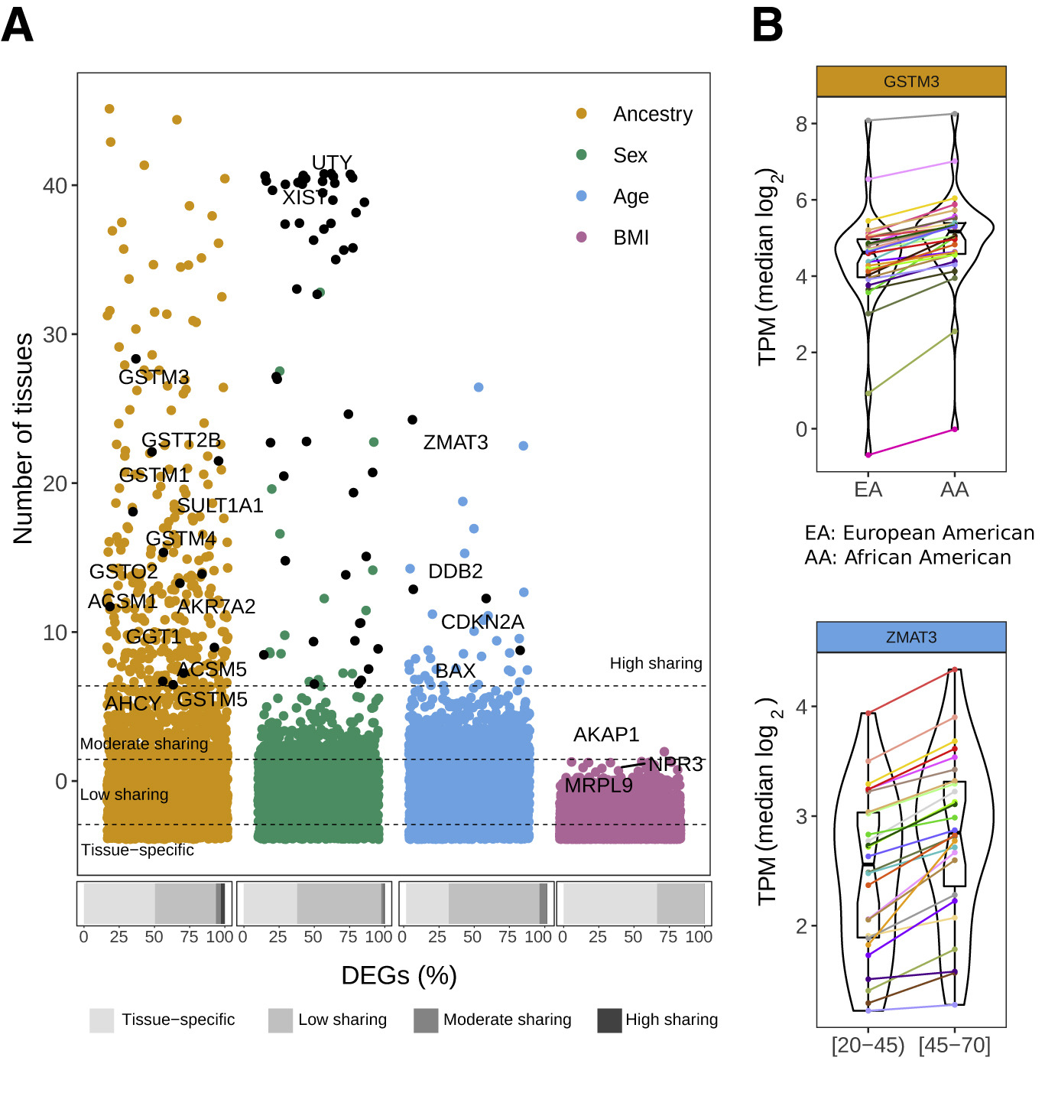
Tissue sharing of DEGs and contribution of genetic variants to expression differences between human populations
GSTM3 is linked to a slight increase in various cancers, including pancreatic cancer(胰腺癌) and hepatocellular carcinoma(肝癌细胞), and has been identified as an independent prognostic factor in gastric cancer where its deficiency impedes DNA mismatch repair.
ZMAT3 is a direct transcriptional target of p53 (TP53) and plays a critical role in the p53-dependent growth regulatory pathway by inhibiting tumor cell growth and contributing to apoptosis.

Slide 5

Eva Maria Novoa
Education
2012 Ph. D. in Biomedicine
2007 B. Sc. in Biochemistry
Research
2018- Present – Group Leader at the Center for genomic regulation
2012 – 2018– Postdoc at Computational Biology laboratory at Massachusetts Institute of Technology (USA) and RNA Biology laboratory at the Garvan Institute of Medical Research (Australia).

Slide 6
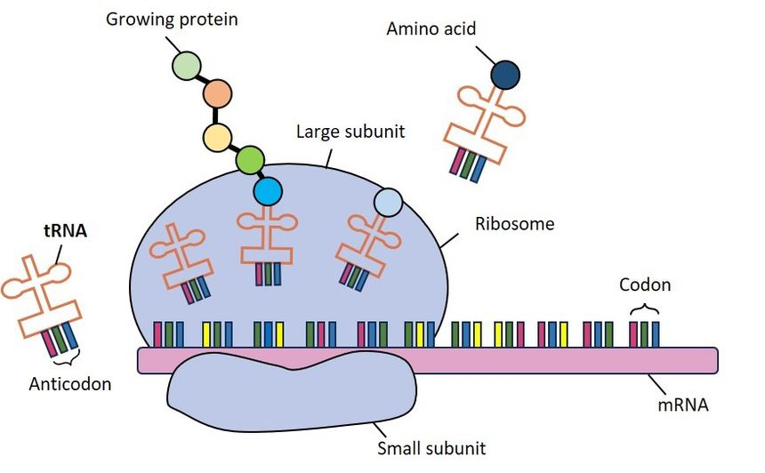
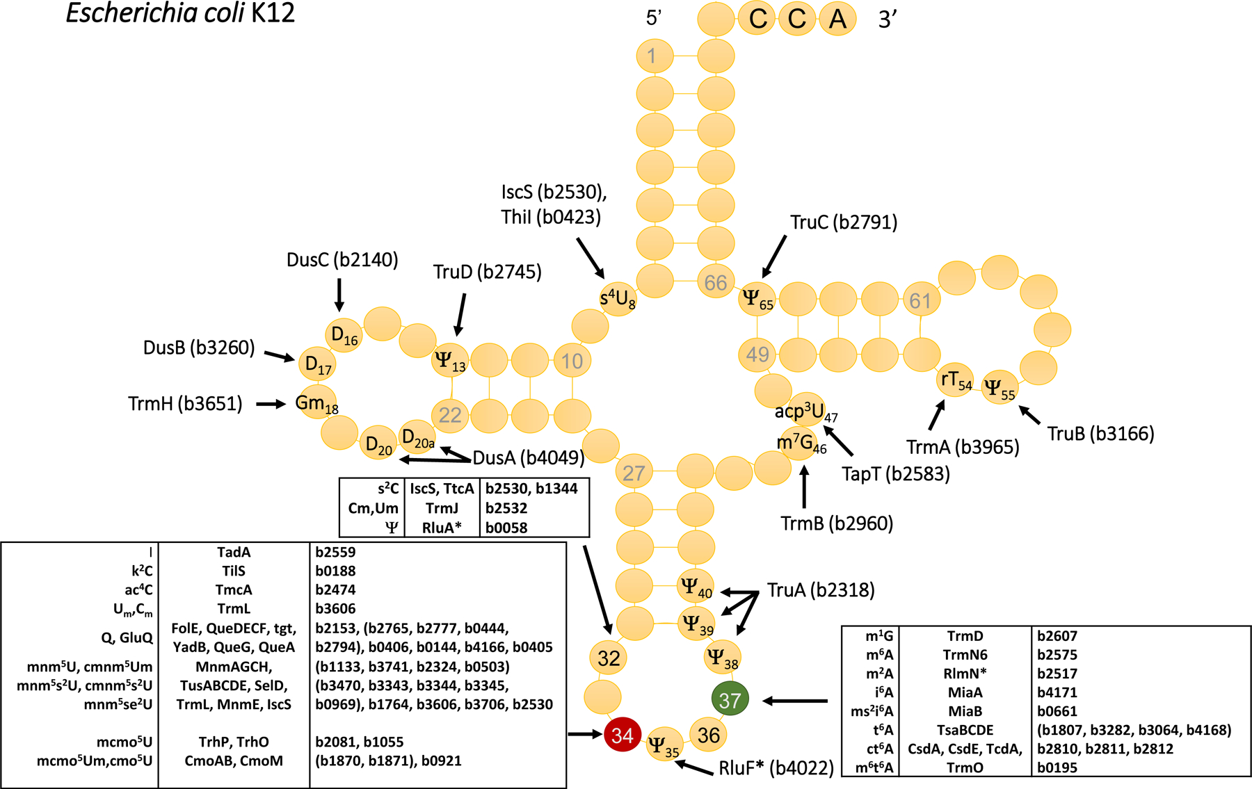
Transfer RNA is highly modified

Slide 7
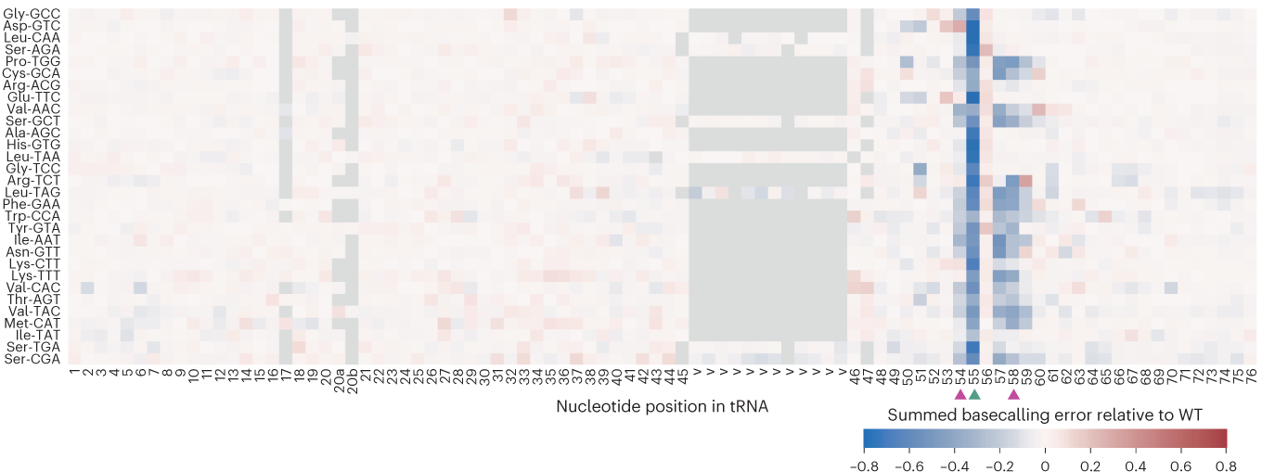
Exploring tRNAs and their modifications and crosstalk using Nano-tRNAseq MC Lucas, EM Novoa. 2023

Slide 8

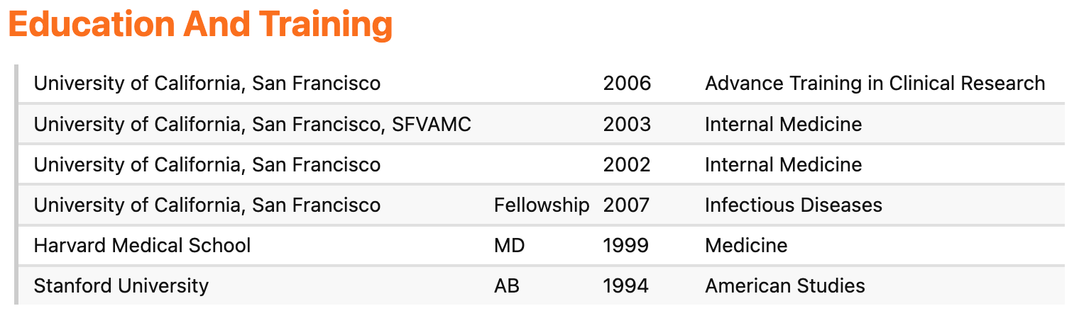
Annie Luetkemeyer

Slide 9
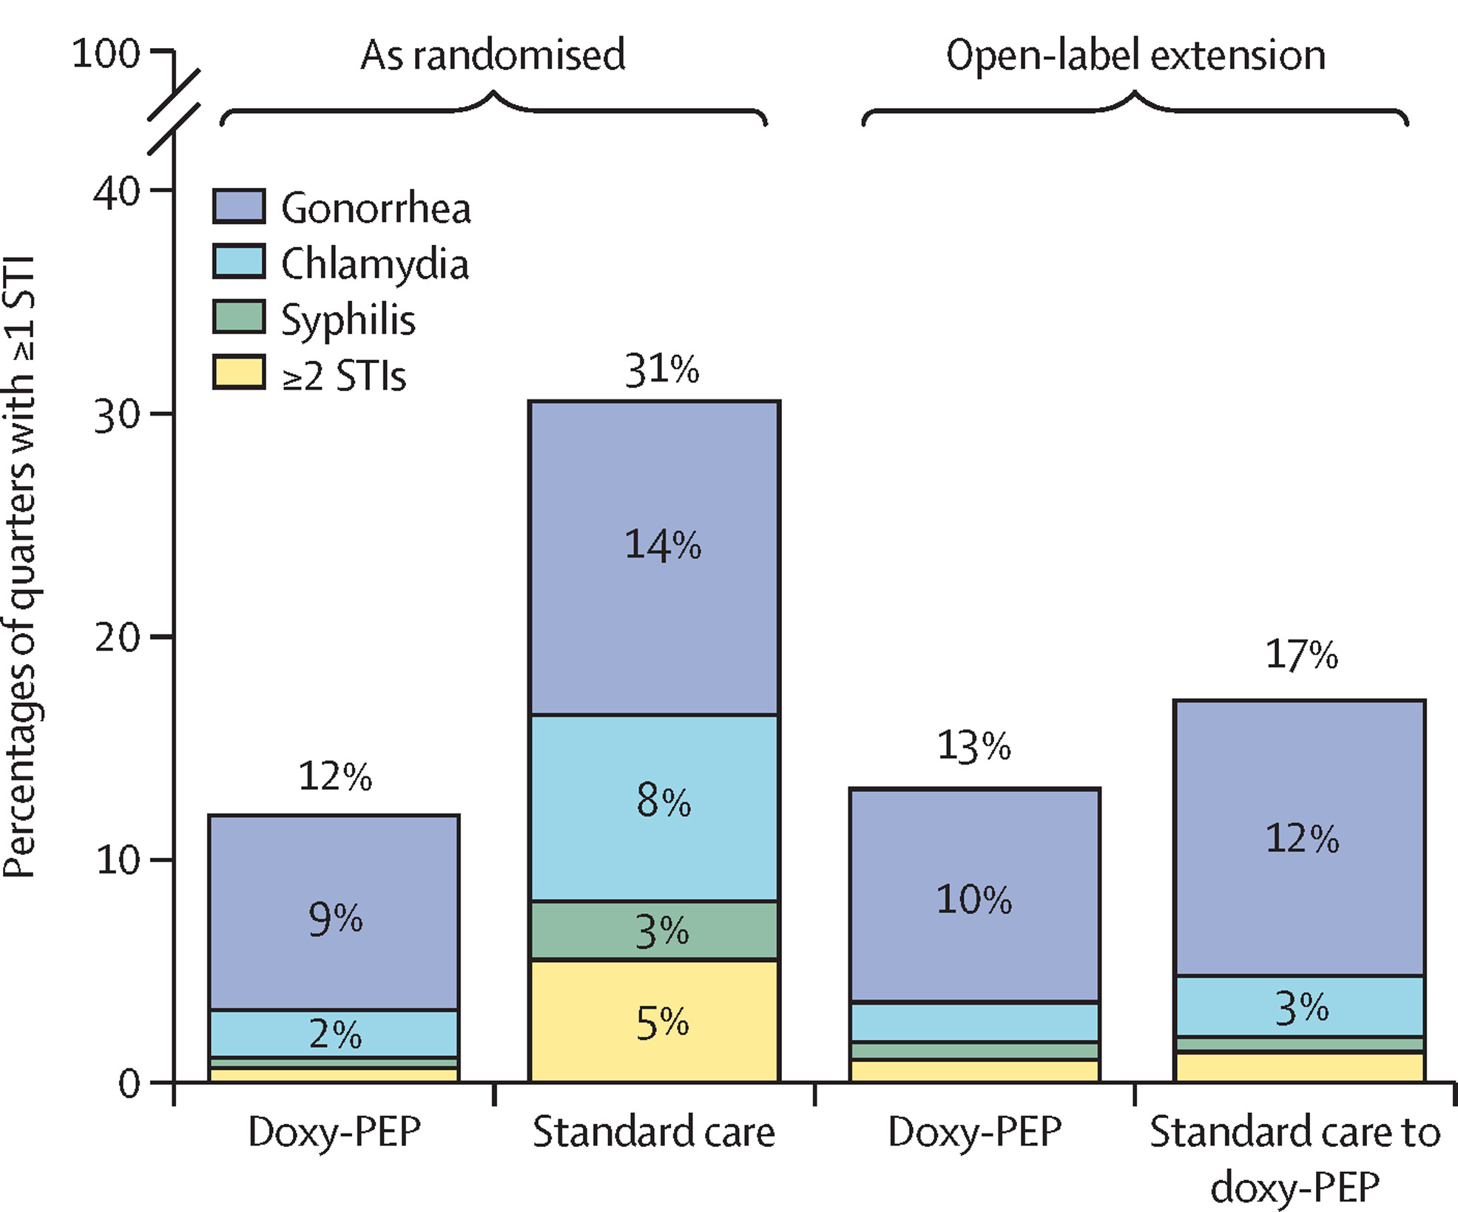
Doxycycline to prevent bacterial sexually transmitted infections in the USA Anne F Luetkemeyer, et al. 2025

Slide 10
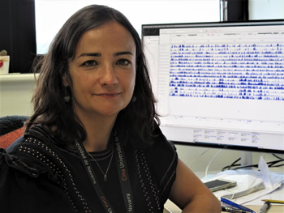
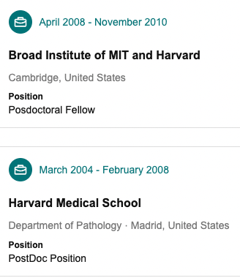
Maite Huarte
2021 –
Cima Universidad de Navarra, Spain
Preferential dedication to the study of the role of noncoding RNAs in the regulation of cancer genome expression and stability.

Slide 11
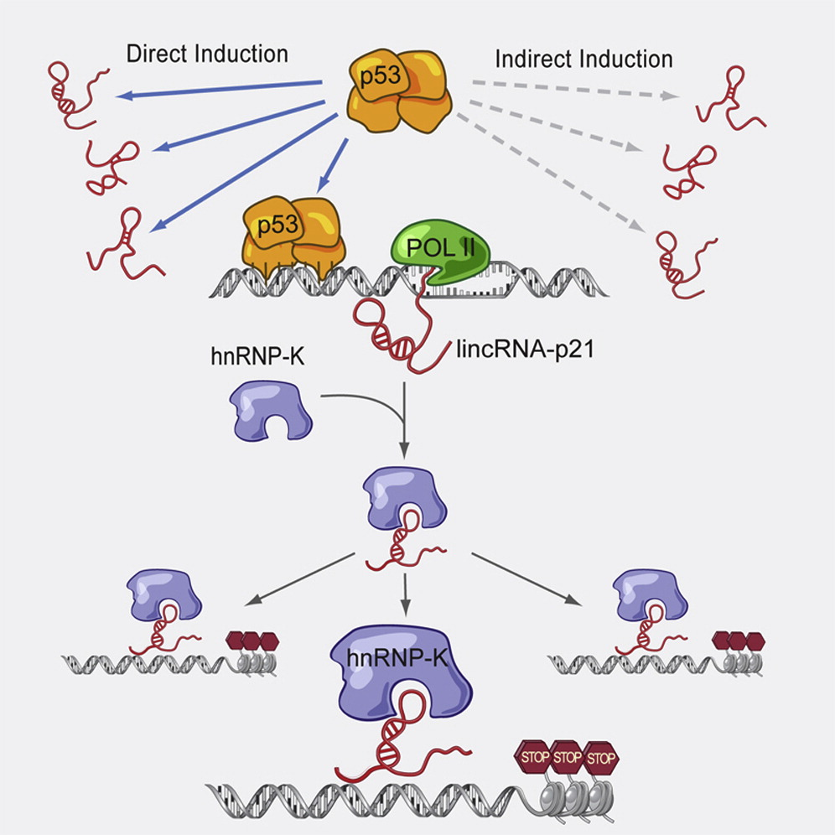
A Large Intergenic Noncoding RNA Induced by p53 Mediates Global Gene Repression in the p53 Response Huarte, et al. Cell. 2010.

