Slide 1
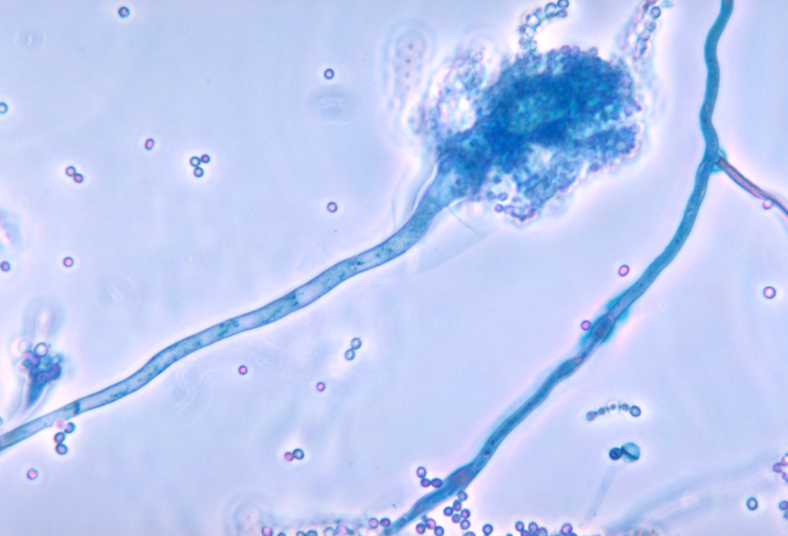
RNA regulation in host-fungal interactions:
Investigation of the host epitranscriptome and fungal small RNAs
PAN Xiaoqing | Leibniz-HKI 21.07.2026
Image from https://en.wikipedia.org/wiki/Aspergillus_fumigatus#/media/File:Aspergillus_fumigatus_01.jpg
Notes:
1

Slide 2
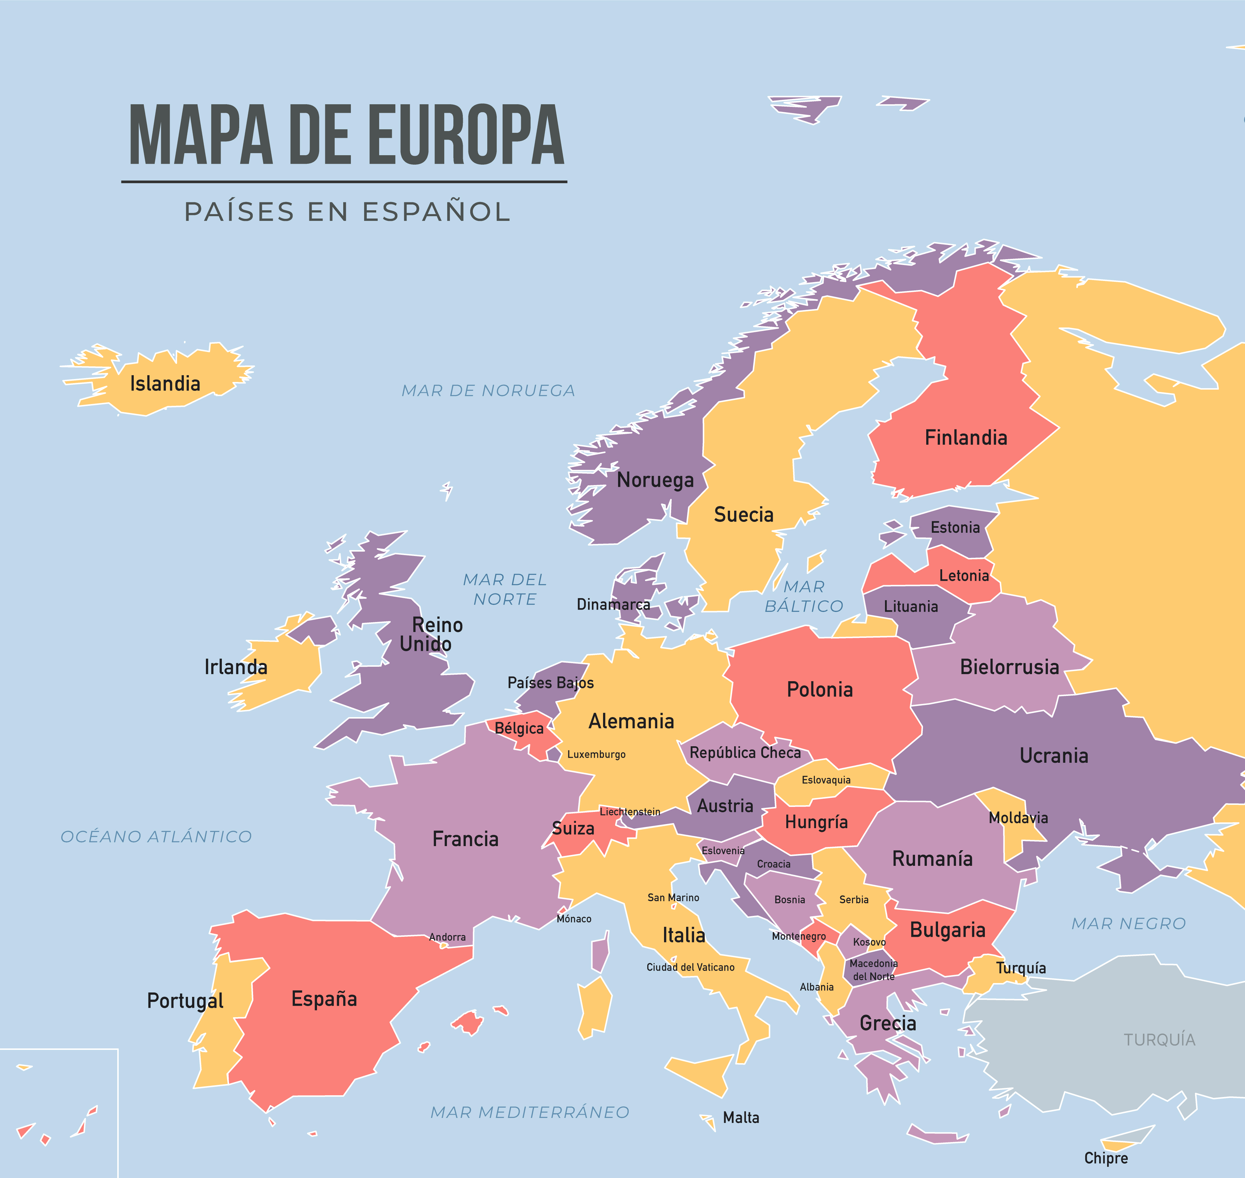

Jena, Germany
Leibniz Institute for Natural Product Research and Infection Biology

Slide 3
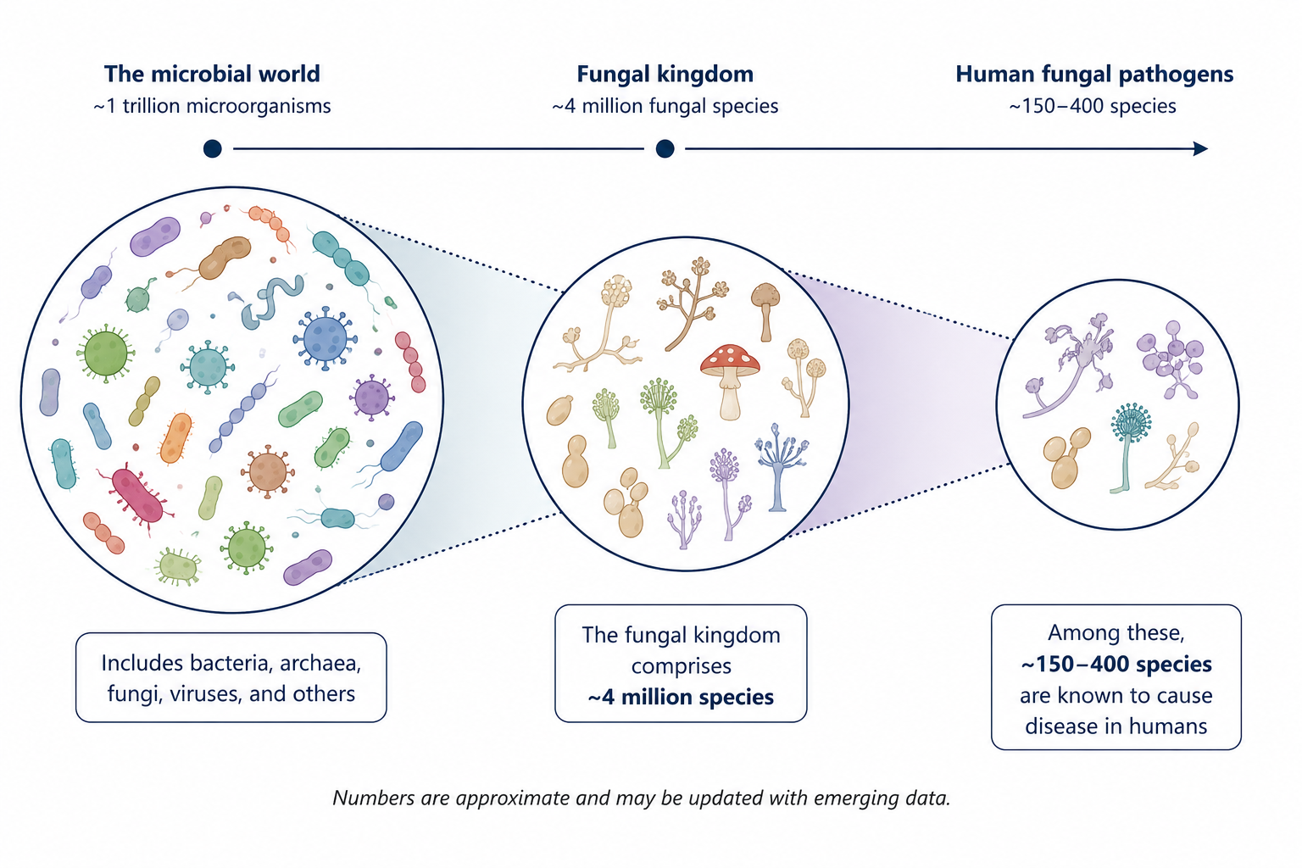
We should be worried about human fungal pathogens
A small subset causes the majority of fungal diseases.
Hawksworth, Lücking, et al. Microbiol Spectr. 2017.
Stop neglecting fungi. Nat Microbiol. 2017.
3
Notes:
I study microbiology, which is a huge concept.There’s roughly one trillion microorganisms on this planet, and this includes bacteria, archaea, fungi, viruses, and many others.But if you focused on the fungal kingdom, 4 million fungal species, which is still a lot.This includes environmental fungi like mushrooms or plant fungal pathogens.What I am interested is human fungal pathogens, and a number of this category has narrowed down to 150 to 400 species, and such small subset causes the majority of fungal diseases.

Slide 4
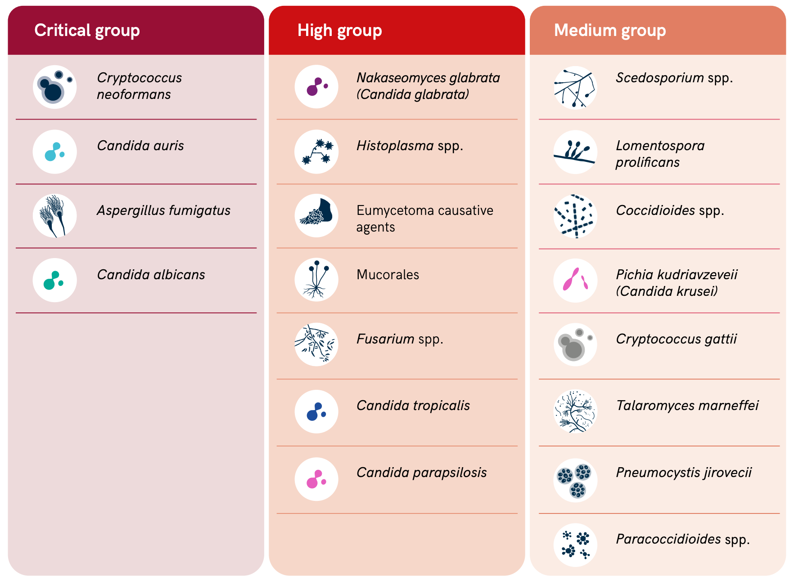
WHO released a list of threatening fungi in 2022
Each year
1 Billion infections
3.8 Million death
WHO Report. 2022.
Denning. Lancet Infect Dis. 2024.
4
Notes:
Fungi can infect more than 1 billion people globally and cause 3.8 million deaths each year. And realizing this, actually, in 2022, WHO released a list of threatening fungi.Which you can see is not that many, but this list cause the majority of the fungal diseases. And for my PhD work, I Mainly focused on three fungal pathogens.

Slide 5
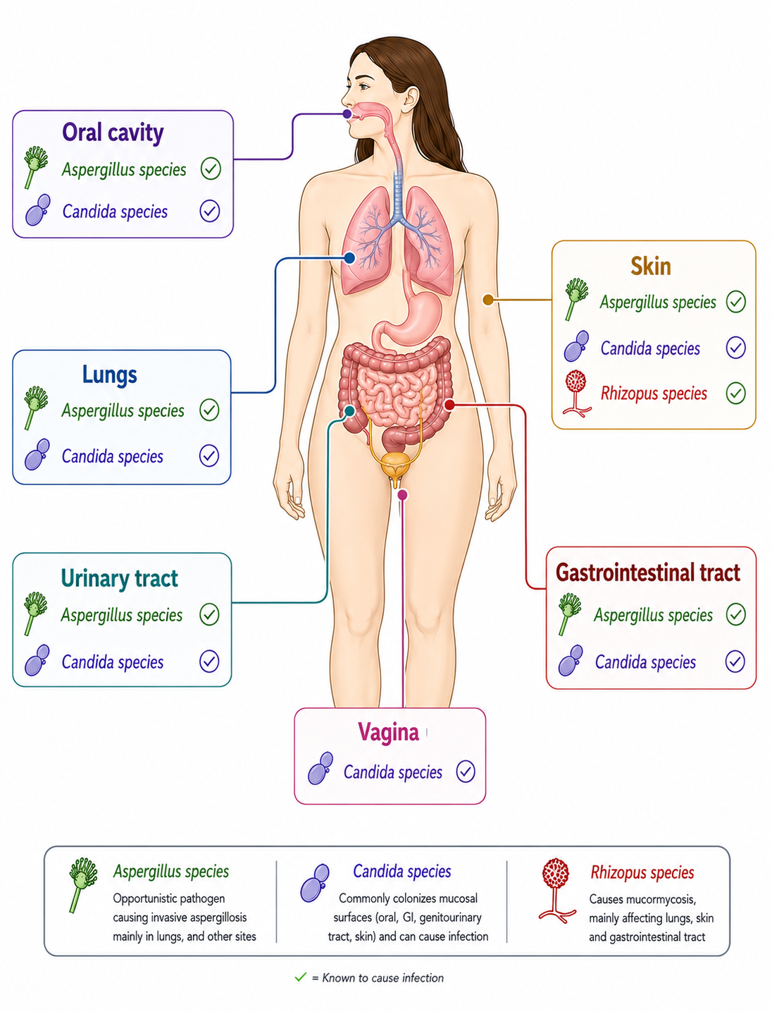
Fungi infect >1 billion people each year
And kill ~3.8 million/year
Aspergillus fumigatus
Opportunistic pathogen causing invasive aspergillosis mainly in lungs and other sites.
Candida albicans
Commonly colonizes mucosal or surfaces and can cause infections.
Rhizopus oryzae
Causes mucormycosis mainly affecting lungs, skins, and Gastrointestinal tract.
5
Notes:
Aspergillus fumigatus is an opportunistic pathogen causing invasive aspergillosis mainly in lung and other sides. Candida albicans commonly colonizes mucosae or surfaces and can cause infections. Rhizopus oryzae causes mucormycosis mainly affecting lungs, skins and Gastrointestinal tract. As you can see here, on the right side, the fungi can Infect multiple human tissues, like oral cavity, lungs, gastrointestinal tract, vagina, skins, and many, many others.

Slide 6
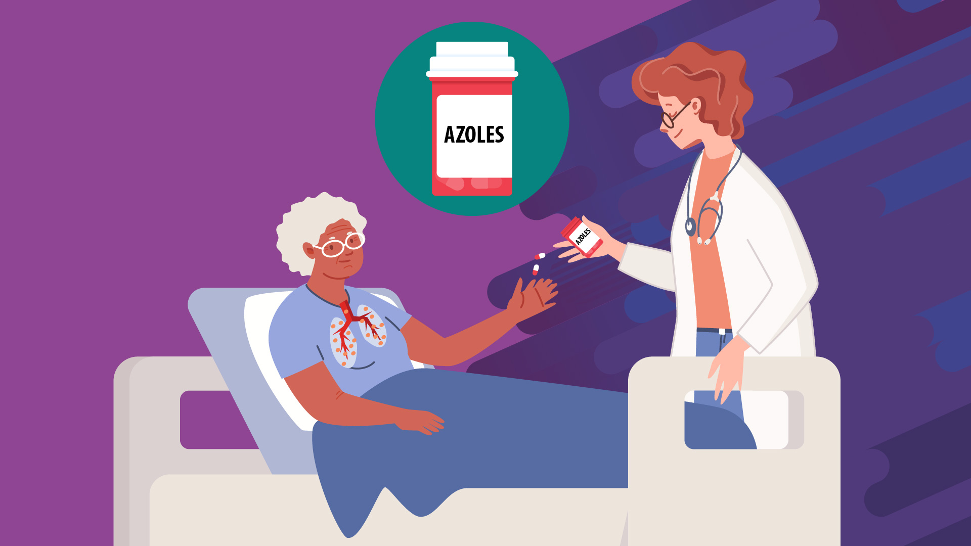
Limited antifungal agents urge us to develop novel antifungal therapies
Diagnoses & treatments
Limited options (Azoles, echinocandins, polyenes)
Increasing resistance
WHO Report. 2022.
6
Notes:
Within the years, scientists have developed diagnoses and treatments for fungal diseases. But the antifungal agents are limited to three major categories, and of course, within a year, fungi have developed increasing resistance, and that’s why it urges us to develop novel antifungal therapies, which is of course, a long term goal.

Slide 7
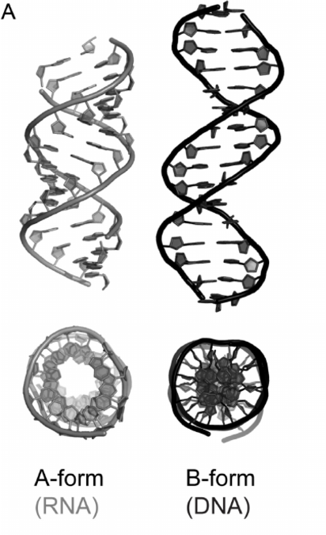
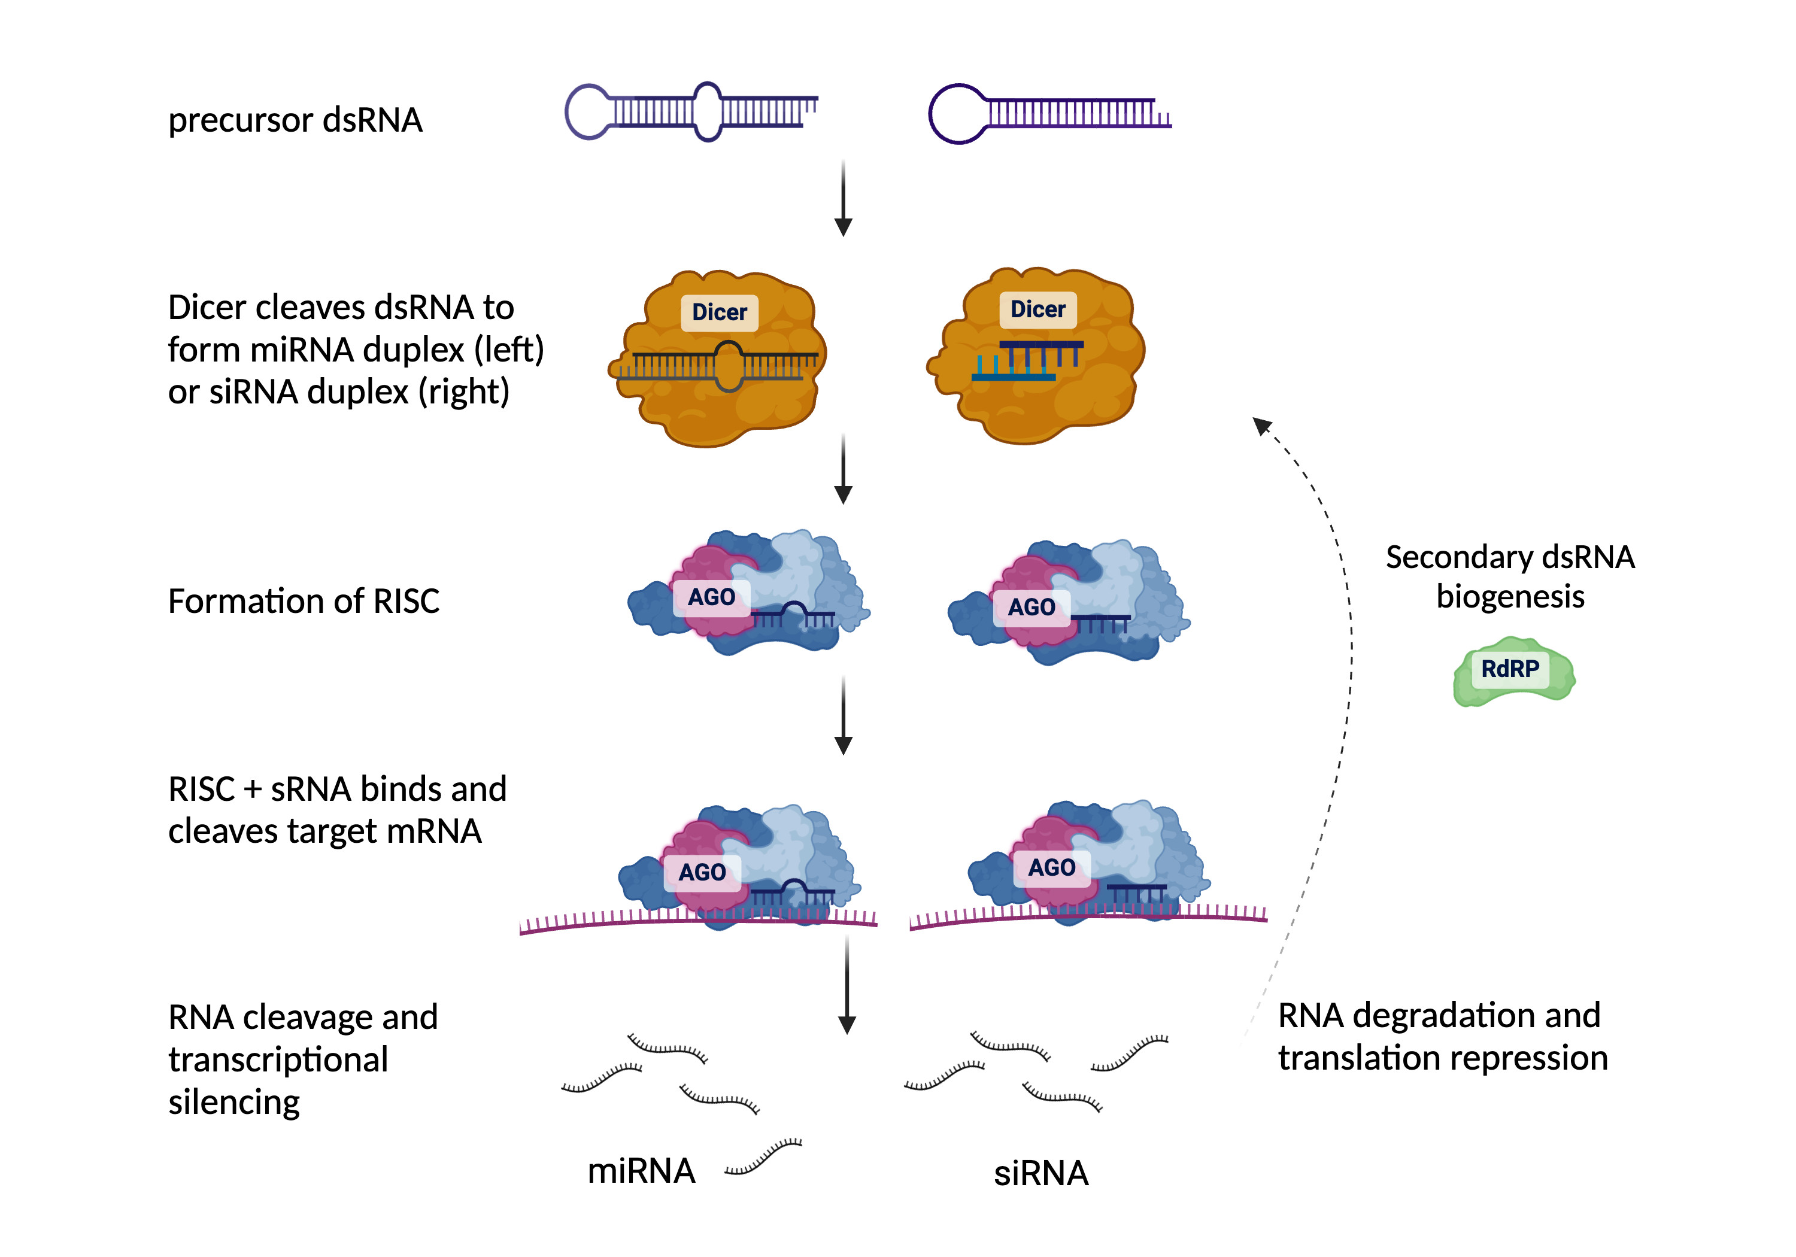
Double-stranded RNA (dsRNA) can be a novel antifungal therapy.
RNA interference (RNAi)
Major groove is deeper and narrower
Minor groove is wider and shallower
Dicer cleaves dsRNA to form siRNA duplexes.
I. Anosova, et al. 2015
7
Notes:
What you may not know is RNA can also sometimes base pair into so called A form double stranded RNA, and compare to the typical B form DNA, double stranded RNA is major groove is deeper and narrower, while minor groove is wider and shallower. this is the main feature proteins bind to double stranded RNA. And when they bind together, they start to have functions in the cells. For example, RNA interference, or RNAi for short, is a basic is a conserve mechanism which has been found in many organisms, including humans, including some fungi. It usually starts with a precursor double stranded RNA, and then dicer proteins recognize and cleaves double stranded RNA to form small RNA duplexes. After that, argonaute proteins take over one of the strands and guide to the target mRNA, and this will eventually cause gene silencing. We think it’s worth exploring because it can be a novel antifungal therapy with gene silencing to kill some specific genes in the fungi.

Slide 8
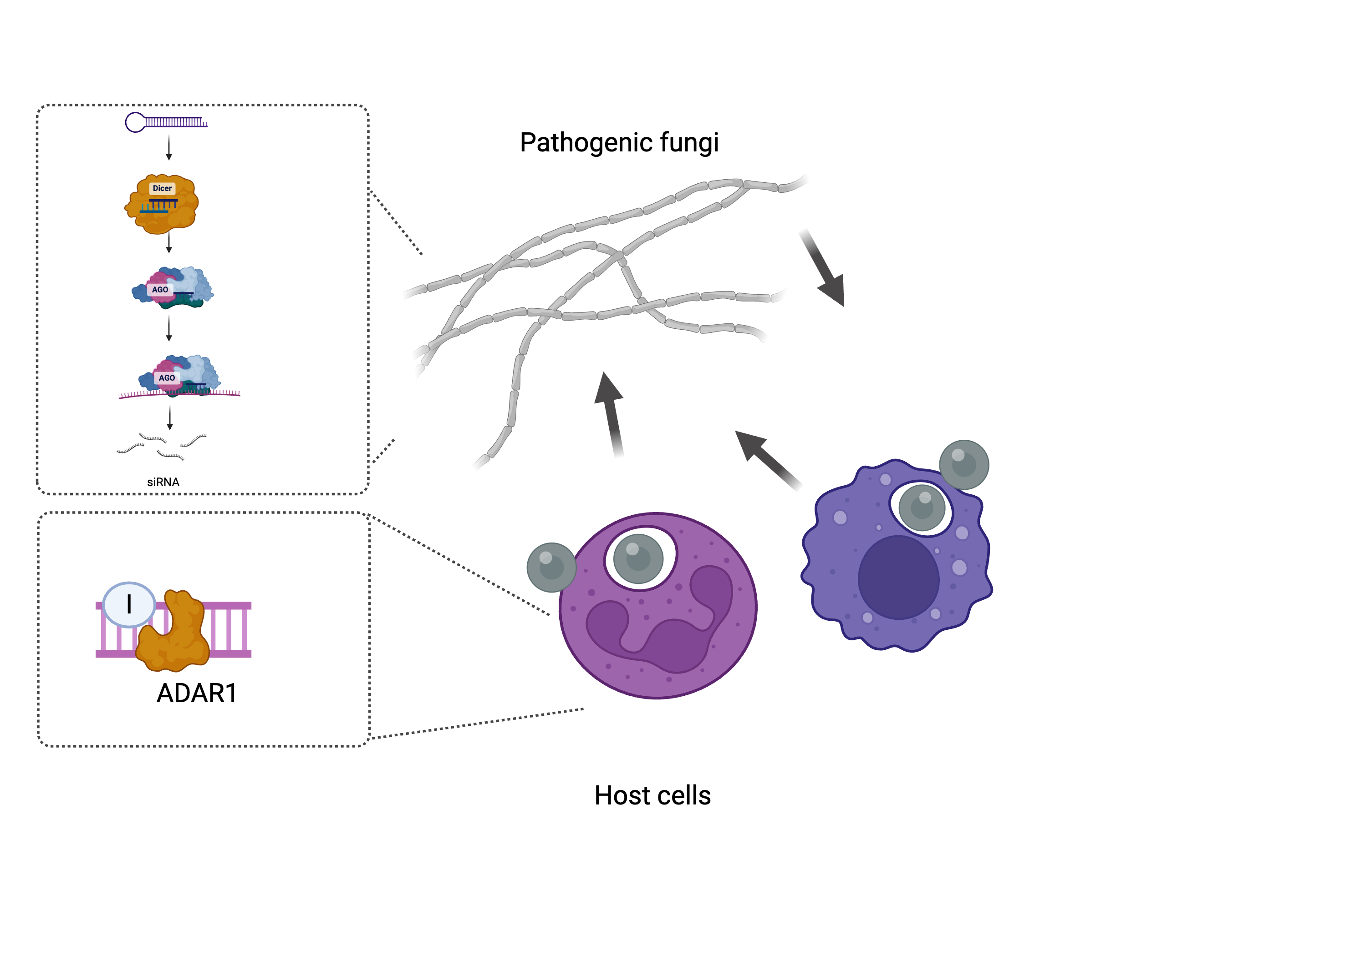
Double-stranded RNA (dsRNA) metabolism during host-fungal interactions
Project A: the role of dsRNA-initiated RNA interference (RNAi) in the pathogenic fungus Aspergillus fumigatus
Project B: the role of dsRNA binding protein ADAR1 in host cells
8
Notes:
That’s basically the idea of my first project to investigate double stranded RNA- initiated RNA interference in the human fungal pathogen Aspergillus fumigatus.

Slide 9
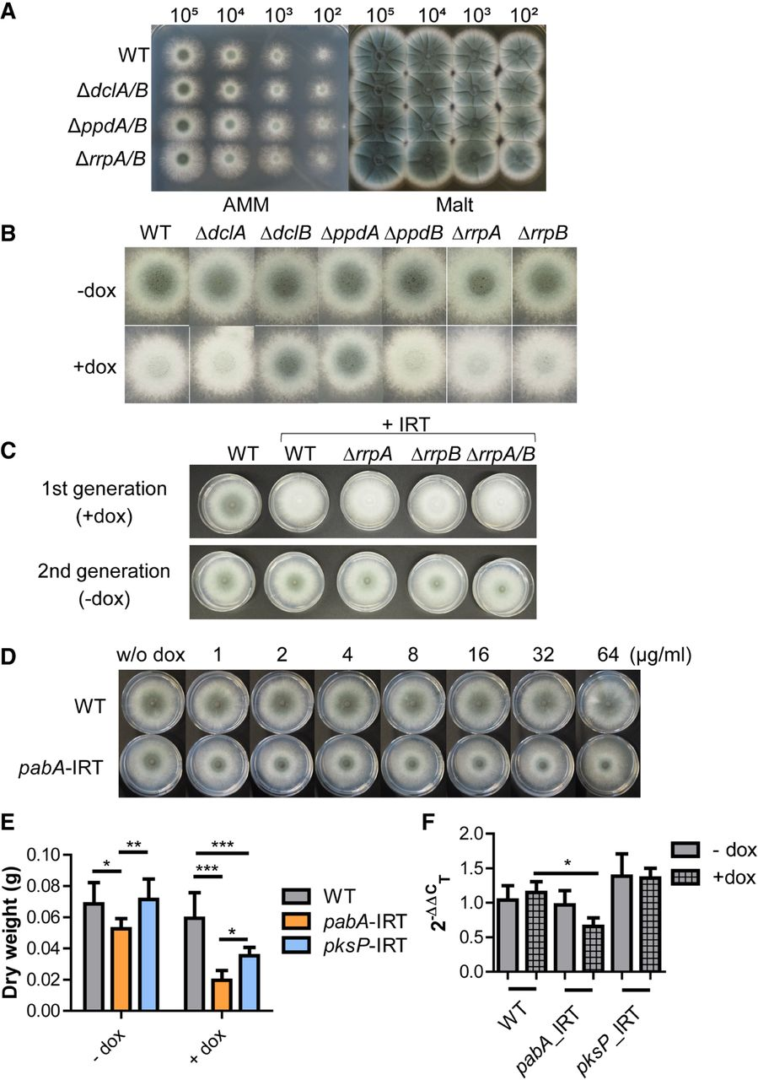
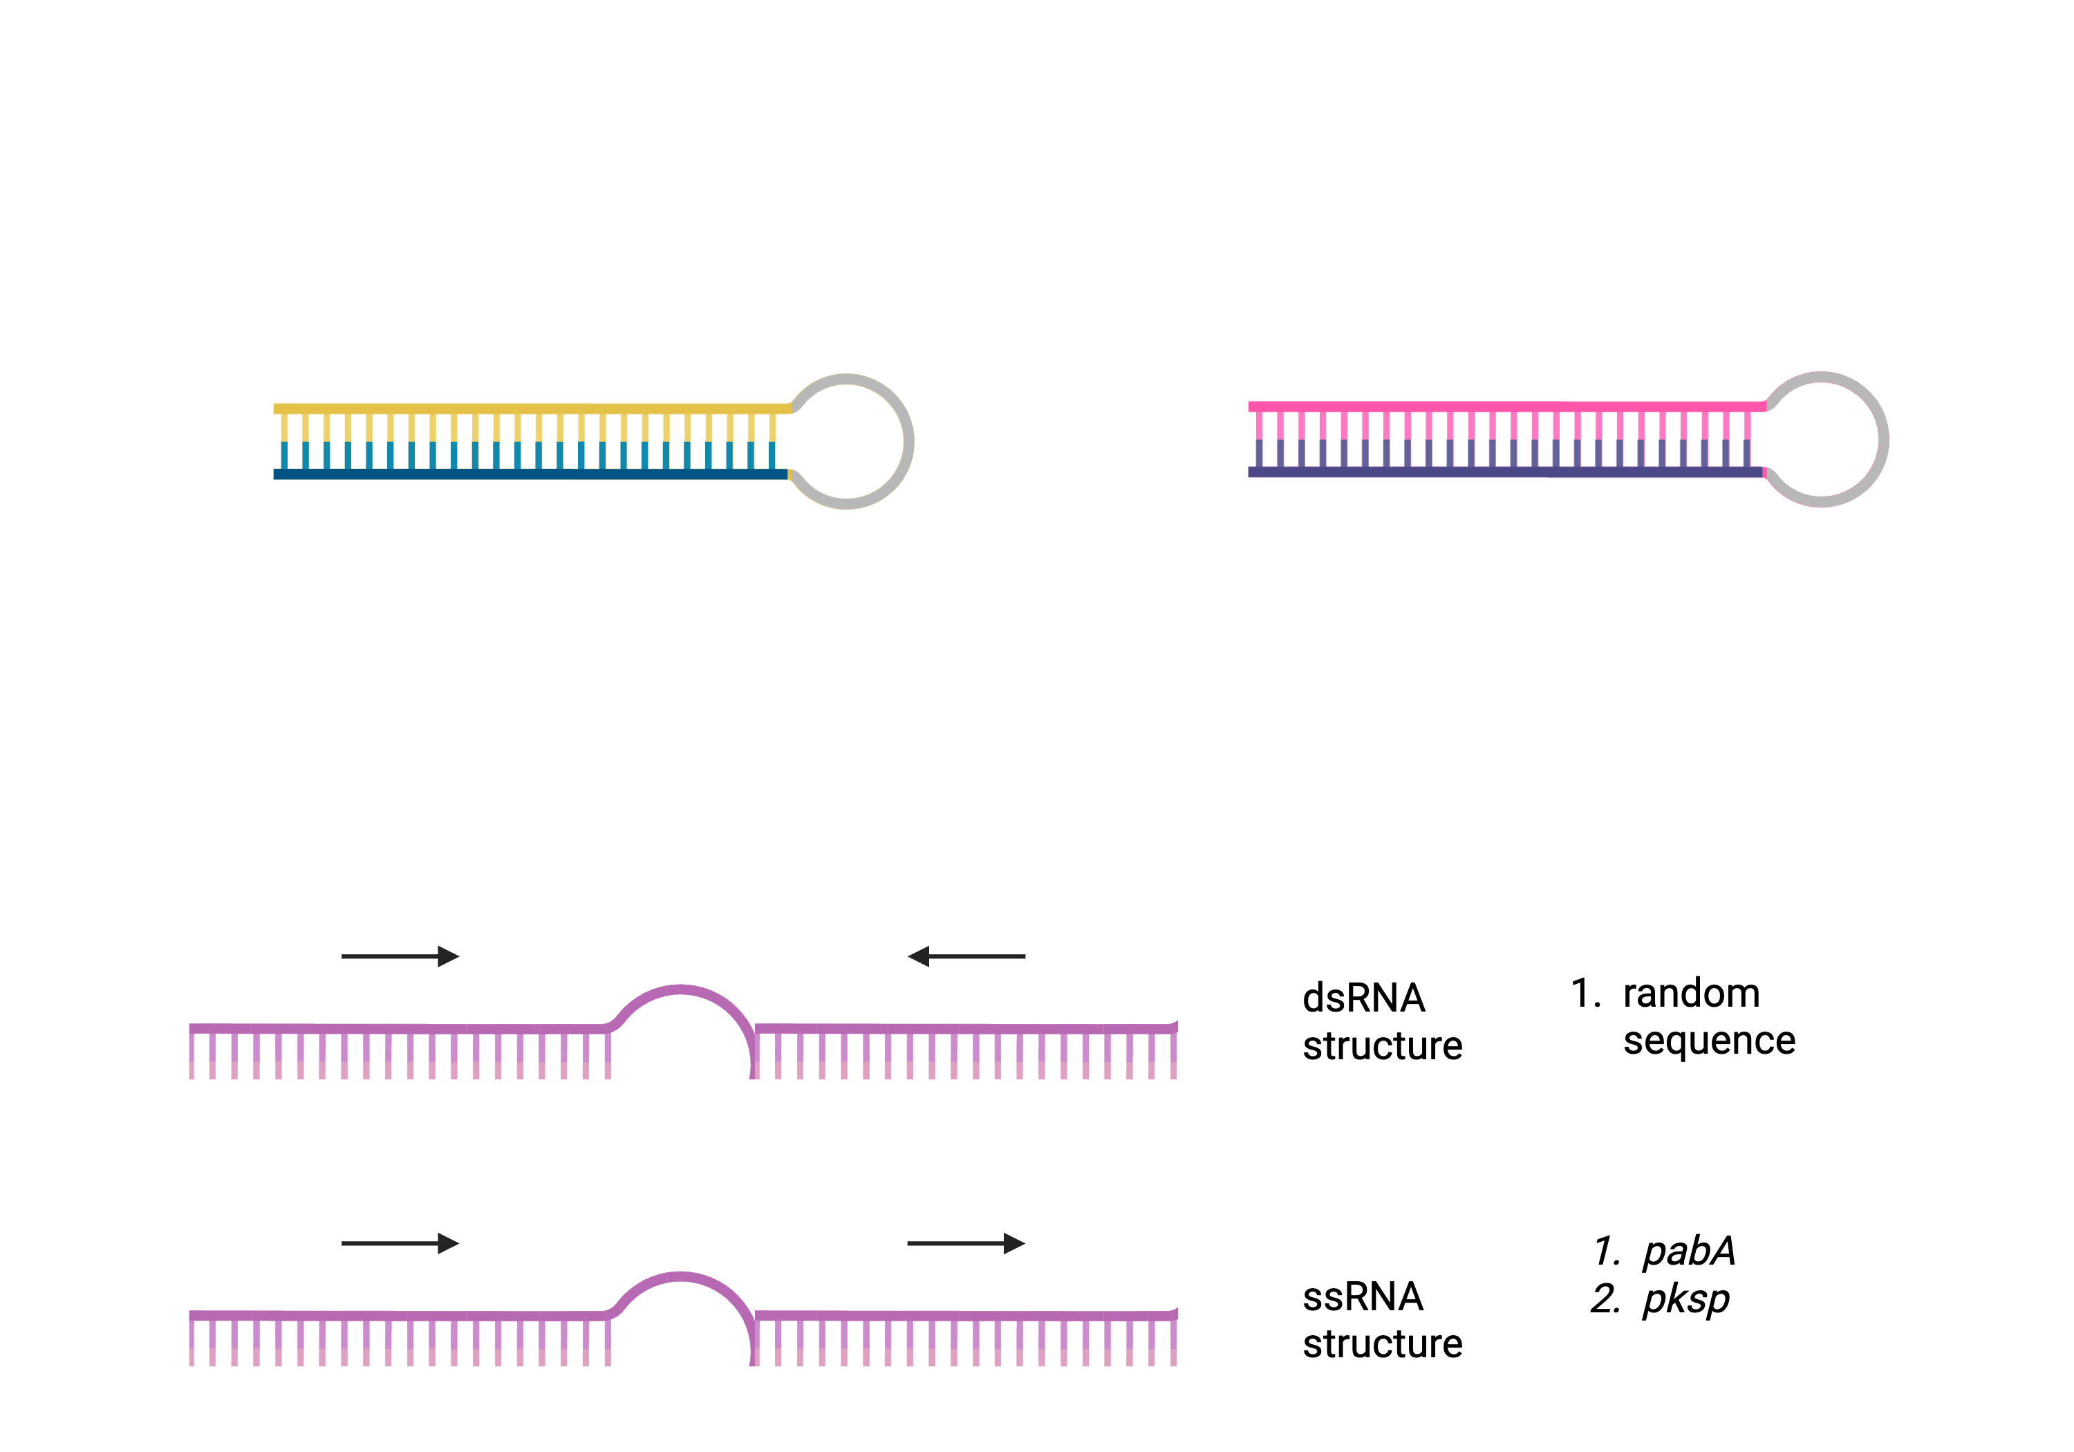
Overexpression of an IRT gene inhibits the fungal growth
tet^{ON} promoter
Inverted-repeat transgene (IRT)
gene
spacer
gene
Dicer-like protein
Gene silencing
conditionally essential gene (pabA)
nonessential gene (pksP)
Mouyna, et al. FEMS Microbiol Lett. 2004.
Kelani, et al. RNA. 2023.
9
Notes:
But sometimes the promoter is leaky.

Slide 10
Is the fungal growth arrest RNAi-dependent?
10

Slide 11
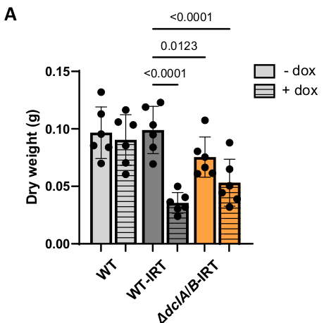
Fungal growth arrest is RNAi-independent
✖️
Dicer cleaves dsRNA
No gene silencing
pksP-IRT
Pan, Kelani, et al. Mol Micro. 2026.
11
Notes:
To answer that, we did a simple dry weight measurement of the fungal hyphae. Three strains, wt, wt-IRT and dclAB-iRT, y axis is the dry weight. Dox here is to induce the IRT structure. No dox, the strains supposedly should look like wt, but sometimes the induction of the promoter is liqky. When we looked at the cols with dox, the dry weight in irt overexpression strains were both lower compared with the wt. and if you could still remember, we observed sRNAs in wt-irt strain but not in dclAB-irt strain. This suggests that overexpression of the irt gene might inhibit the fungal growht, which is sRNA-indendent.

Slide 12
How is the IRT leading to growth inhibition?
12

Slide 13
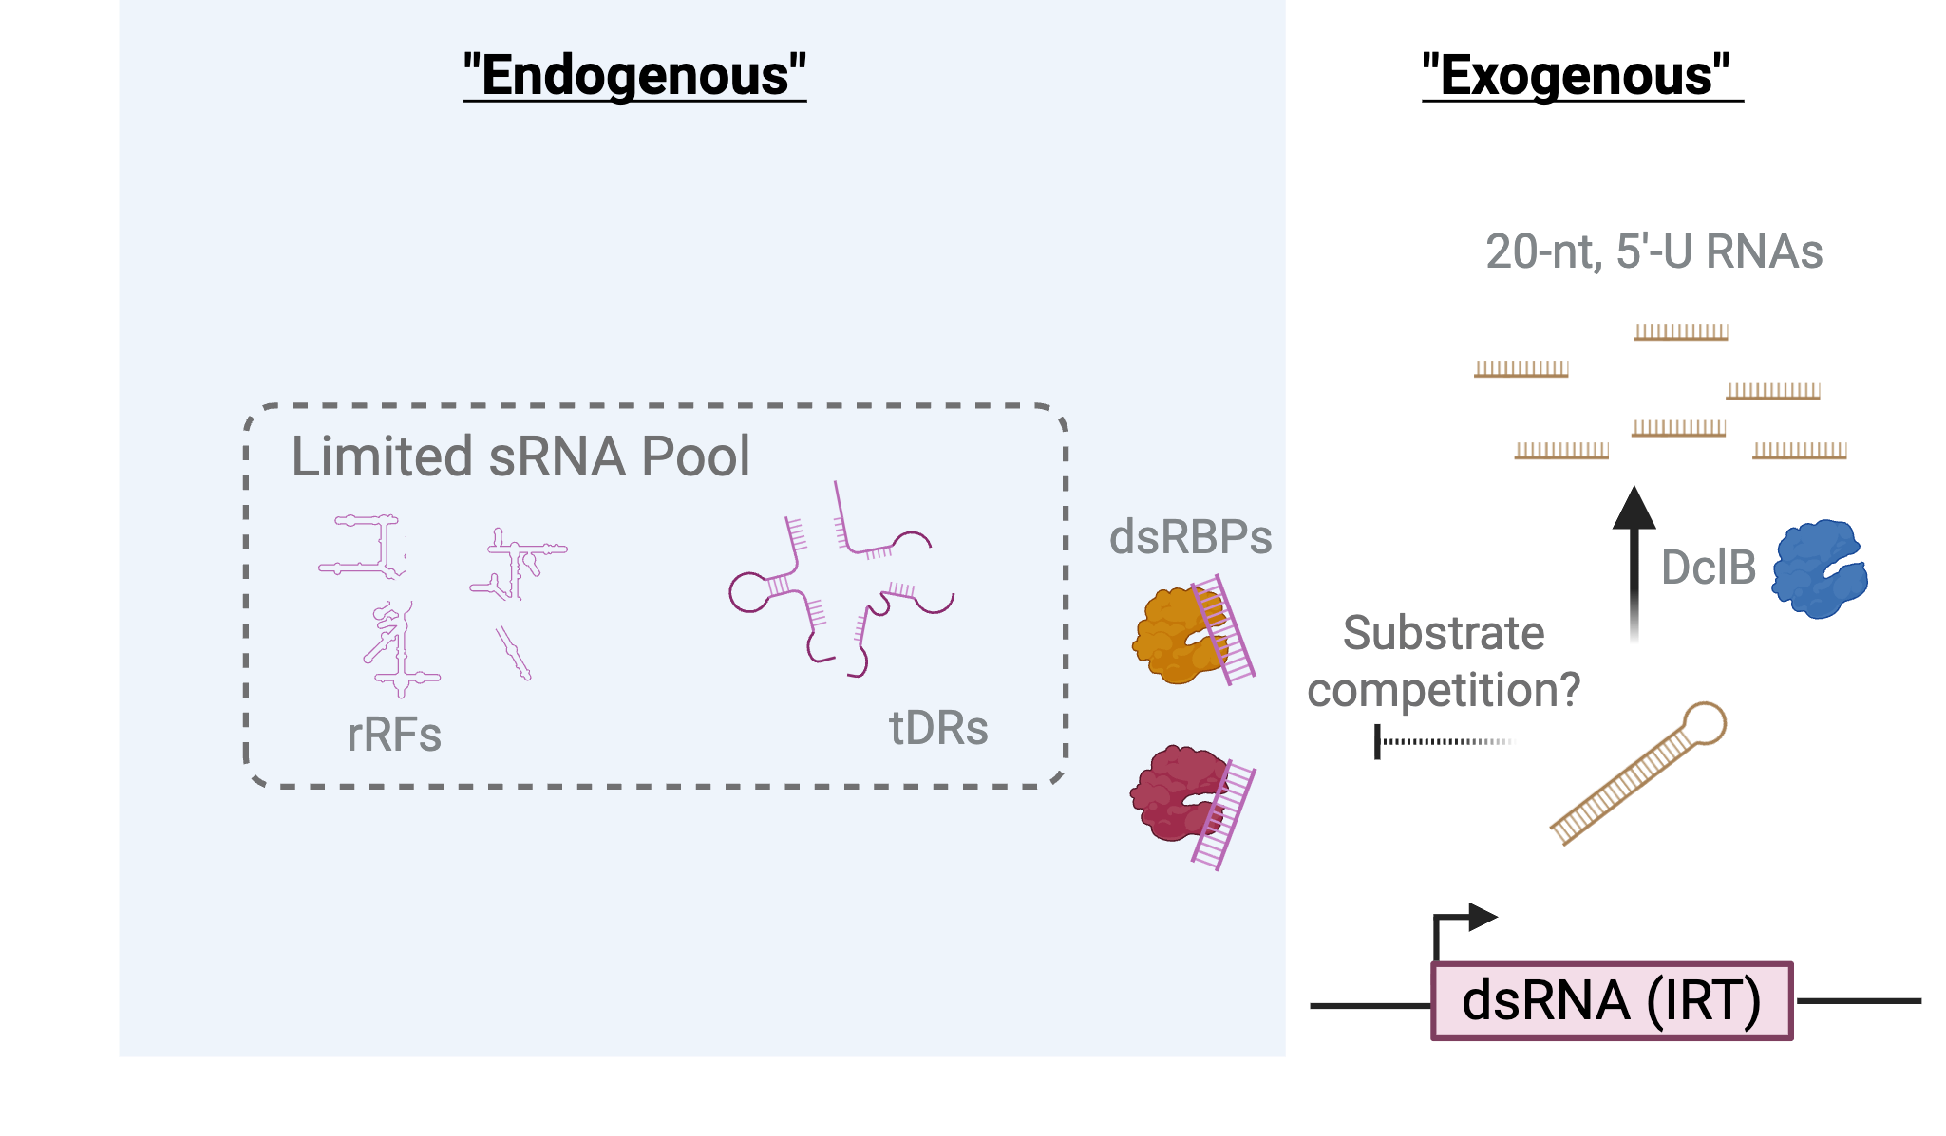
dsRNA overexpression limits fungal growth independent of Dicer
DsRNA overexpression limits fungal growth.
A. fumigatus produces Dicer-dependent 20-nt 5’ U sRNAs.
Pan, Kelani, et al. Mol Micro. 2026
13

Slide 14
Double-stranded RNA (dsRNA) metabolism during host-fungal interactions
Project A: the role of dsRNA-initiated RNA interference (RNAi) in the pathogenic fungus Aspergillus fumigatus
Project B: the role of dsRNA binding protein ADAR1 in host cells
14
Notes:
Next, I would like to move to my second project, which focuses on the host cells. The human system is much more complex. For example, proteins that bind to double stranded RNA, humans have twice the number than fungi.And I was mainly focusing on The interaction of double stranded RNA and its binding protein, ADAR1.

Slide 15
Do ADAR1-mediated dsRNA levels change during fungal challenges?
15

Slide 16
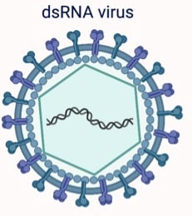
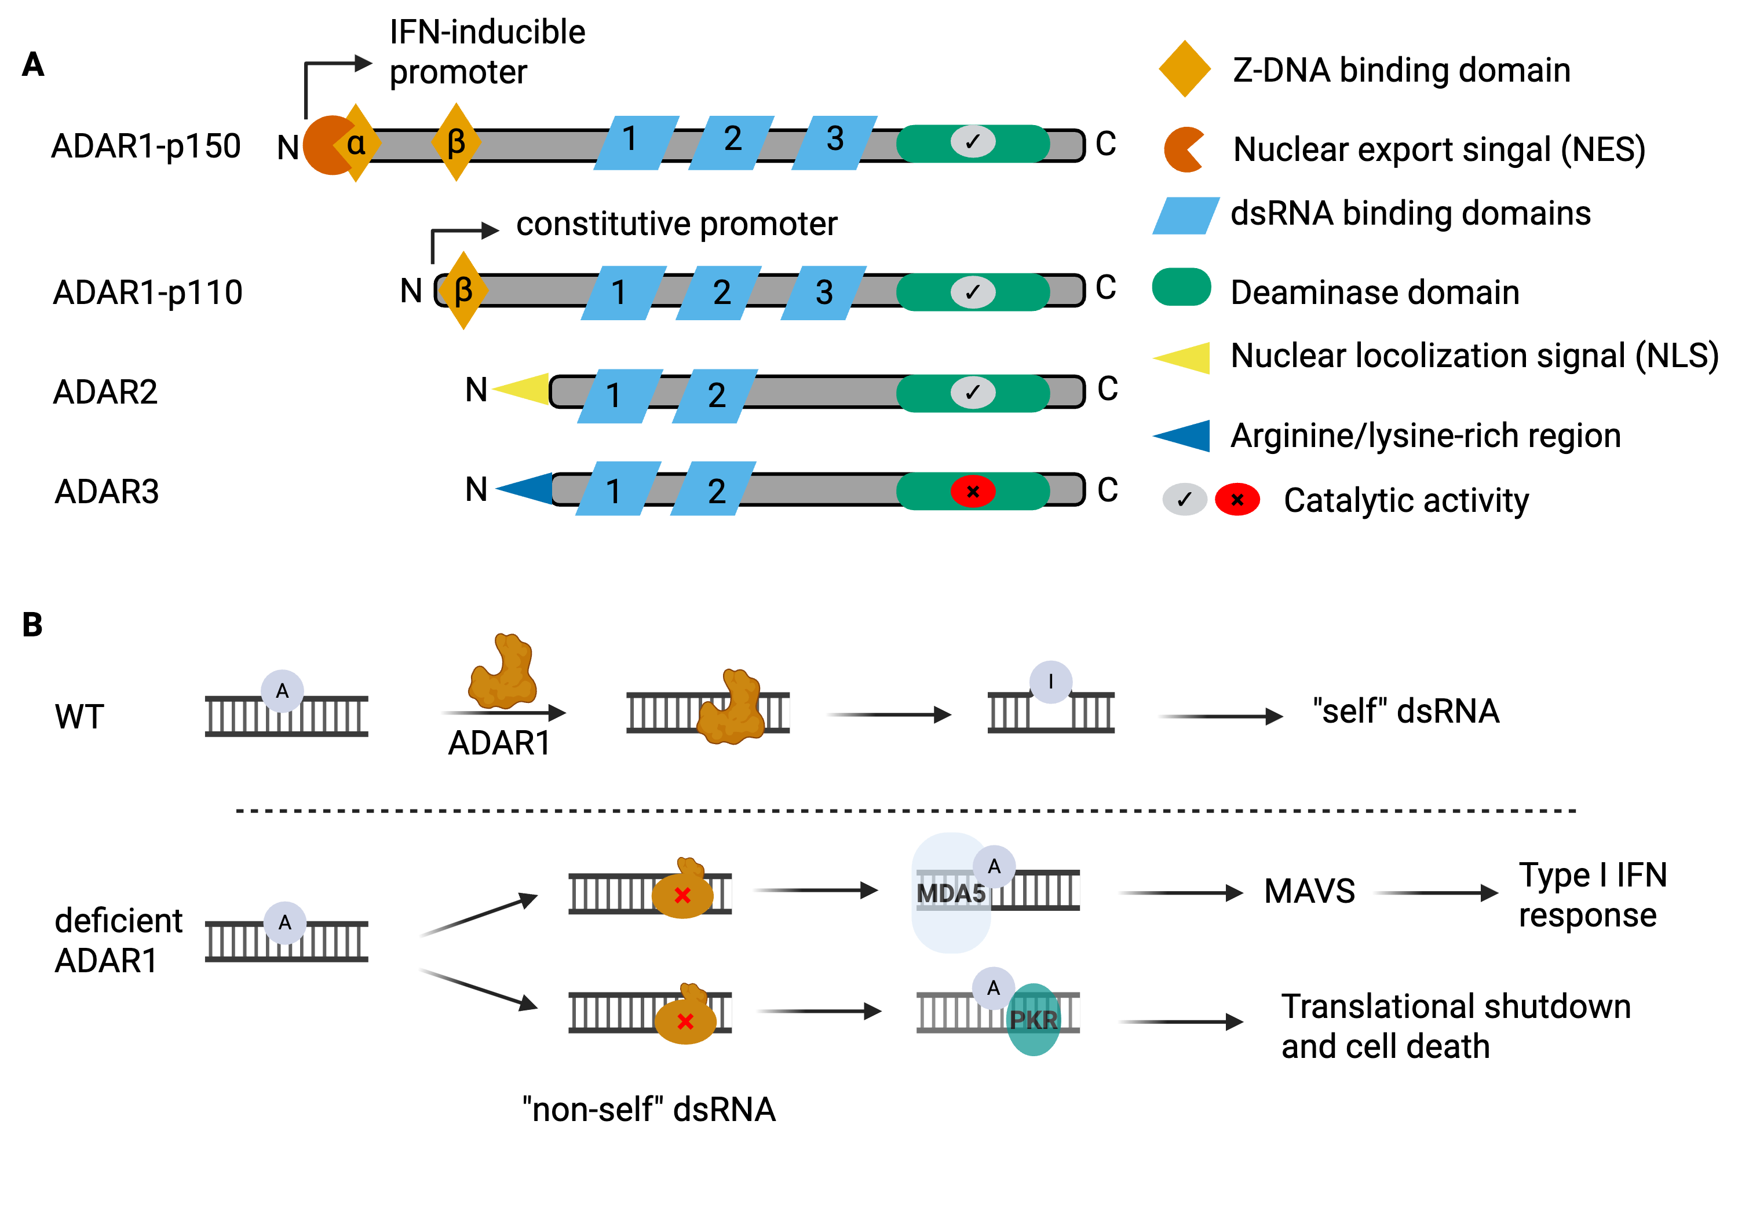
ADAR1 is an important modulator of the human immune response
ADAR1: Adenosine deaminase acting on RNA 1, a dsRNA binding protein (RBP)
A-to-I RNA editing
MDA5: melanoma differentiation-associated protein 5, a dsRNA sensor
PKR: Protein Kinase R, a dsRNA sensor
MAVS: Mitochondrial antiviral-signaling protein, acts as a switch to activate antiviral defenses and inflammation
16
Notes:
it’s an important modulator of the immune response. ADAR1 usually binds to whatever dsRNA that is close to it, and deaminates A (adonize) to I (inosine), this is called A-to-I RNA editing. The host considers the deaminated dsRNA as self. However, the ADAR1 is deficient, there won’t be any “self” “non-self” discrimination, eventually this will trigger IFN response and cell death.
16

Slide 17
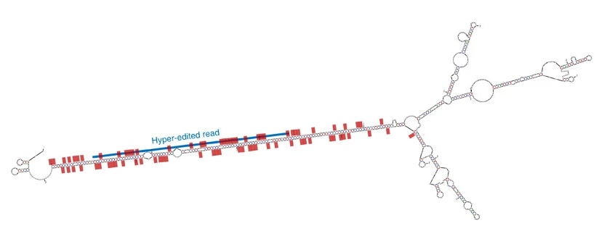
ADAR1-mediated hyper editing occurs in long dsRNA derived regions
Standard A-to-I RNA editing
Detected by different tools
Hyperediting: extensive A-to-I RNA editing
Porath, et al. Nat Commun. 2014.
17

Slide 18
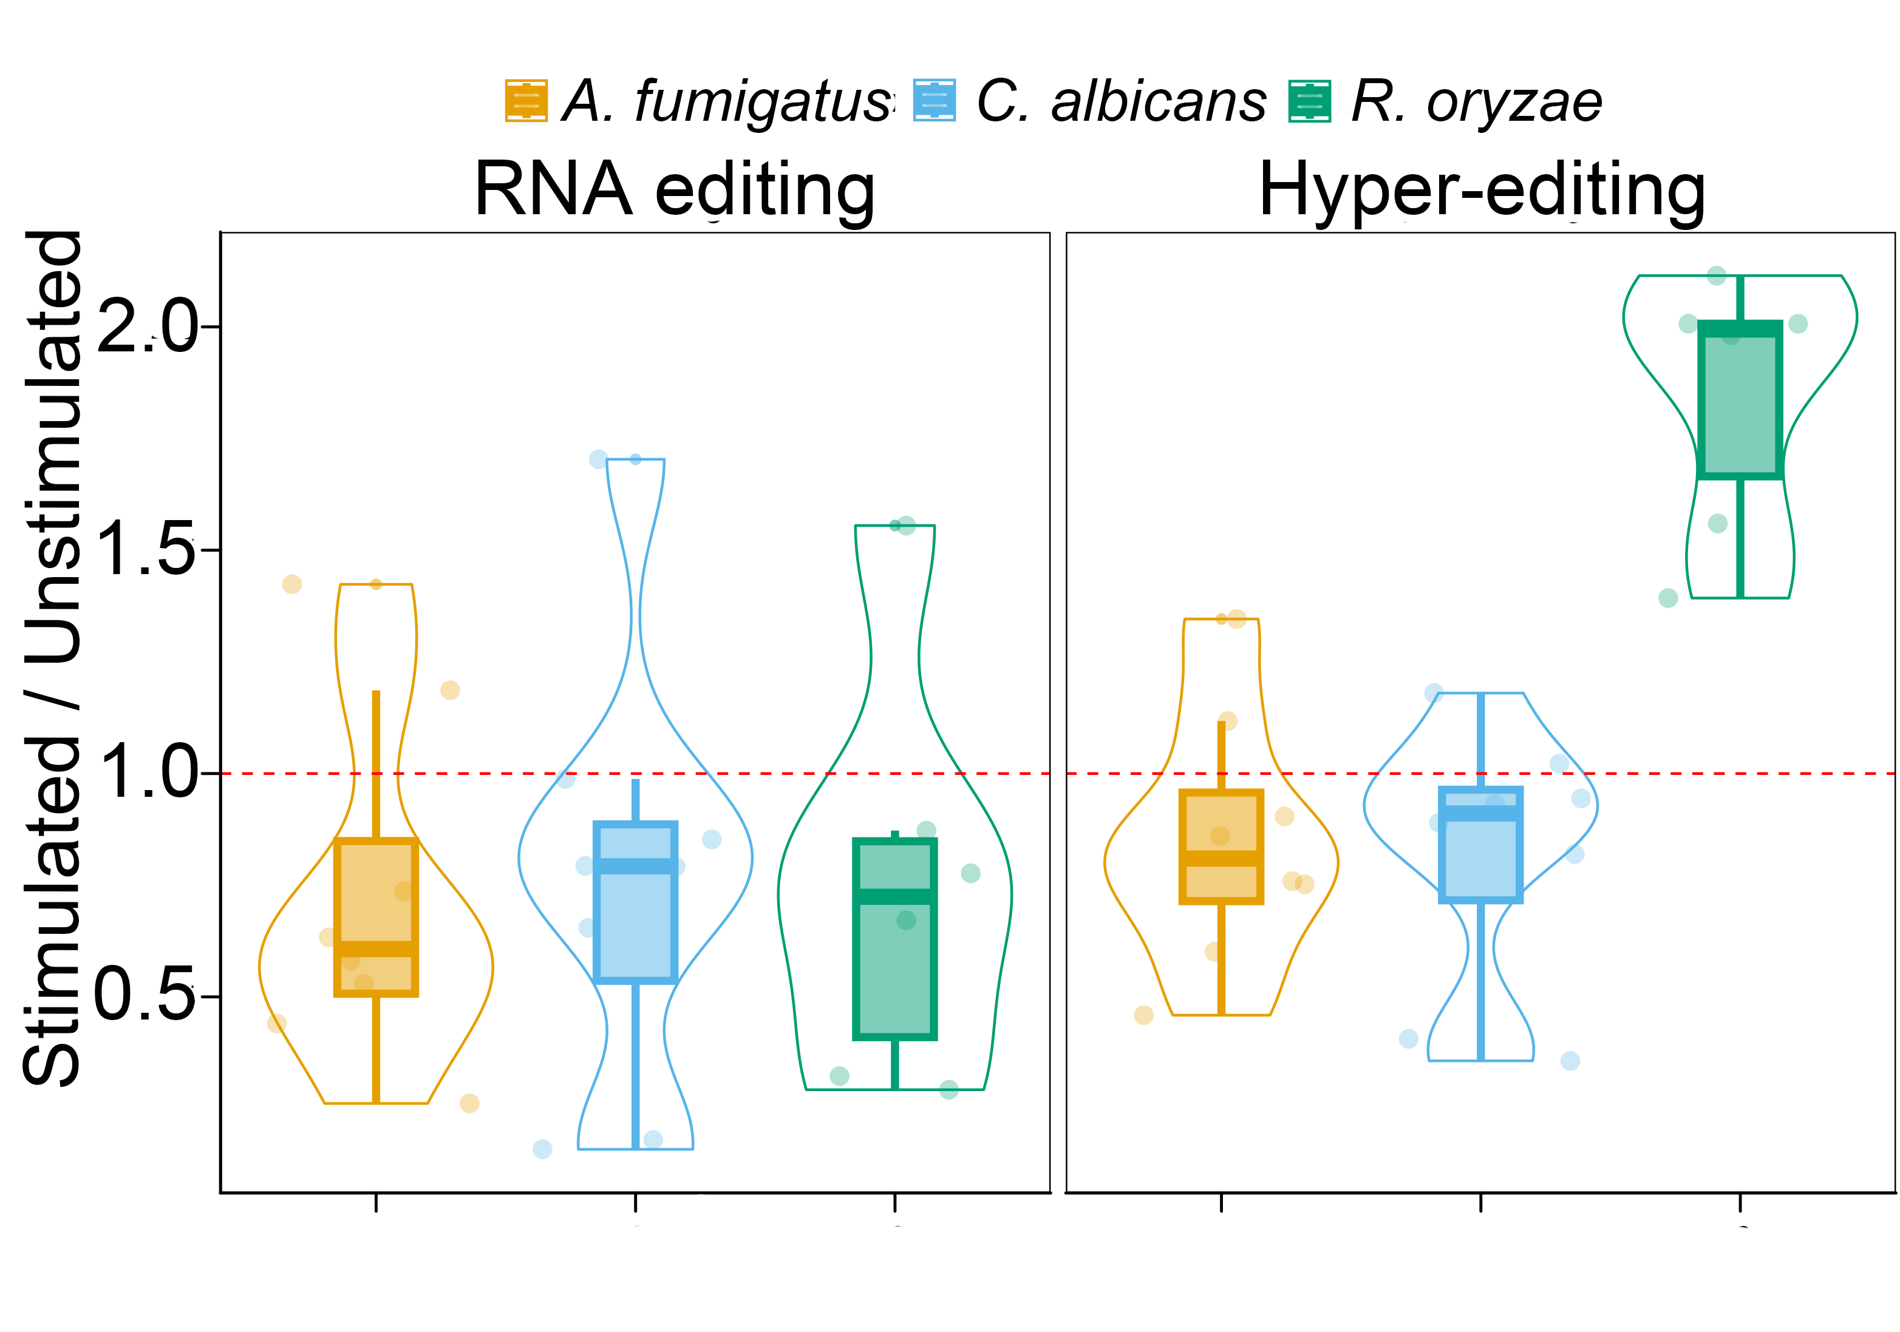
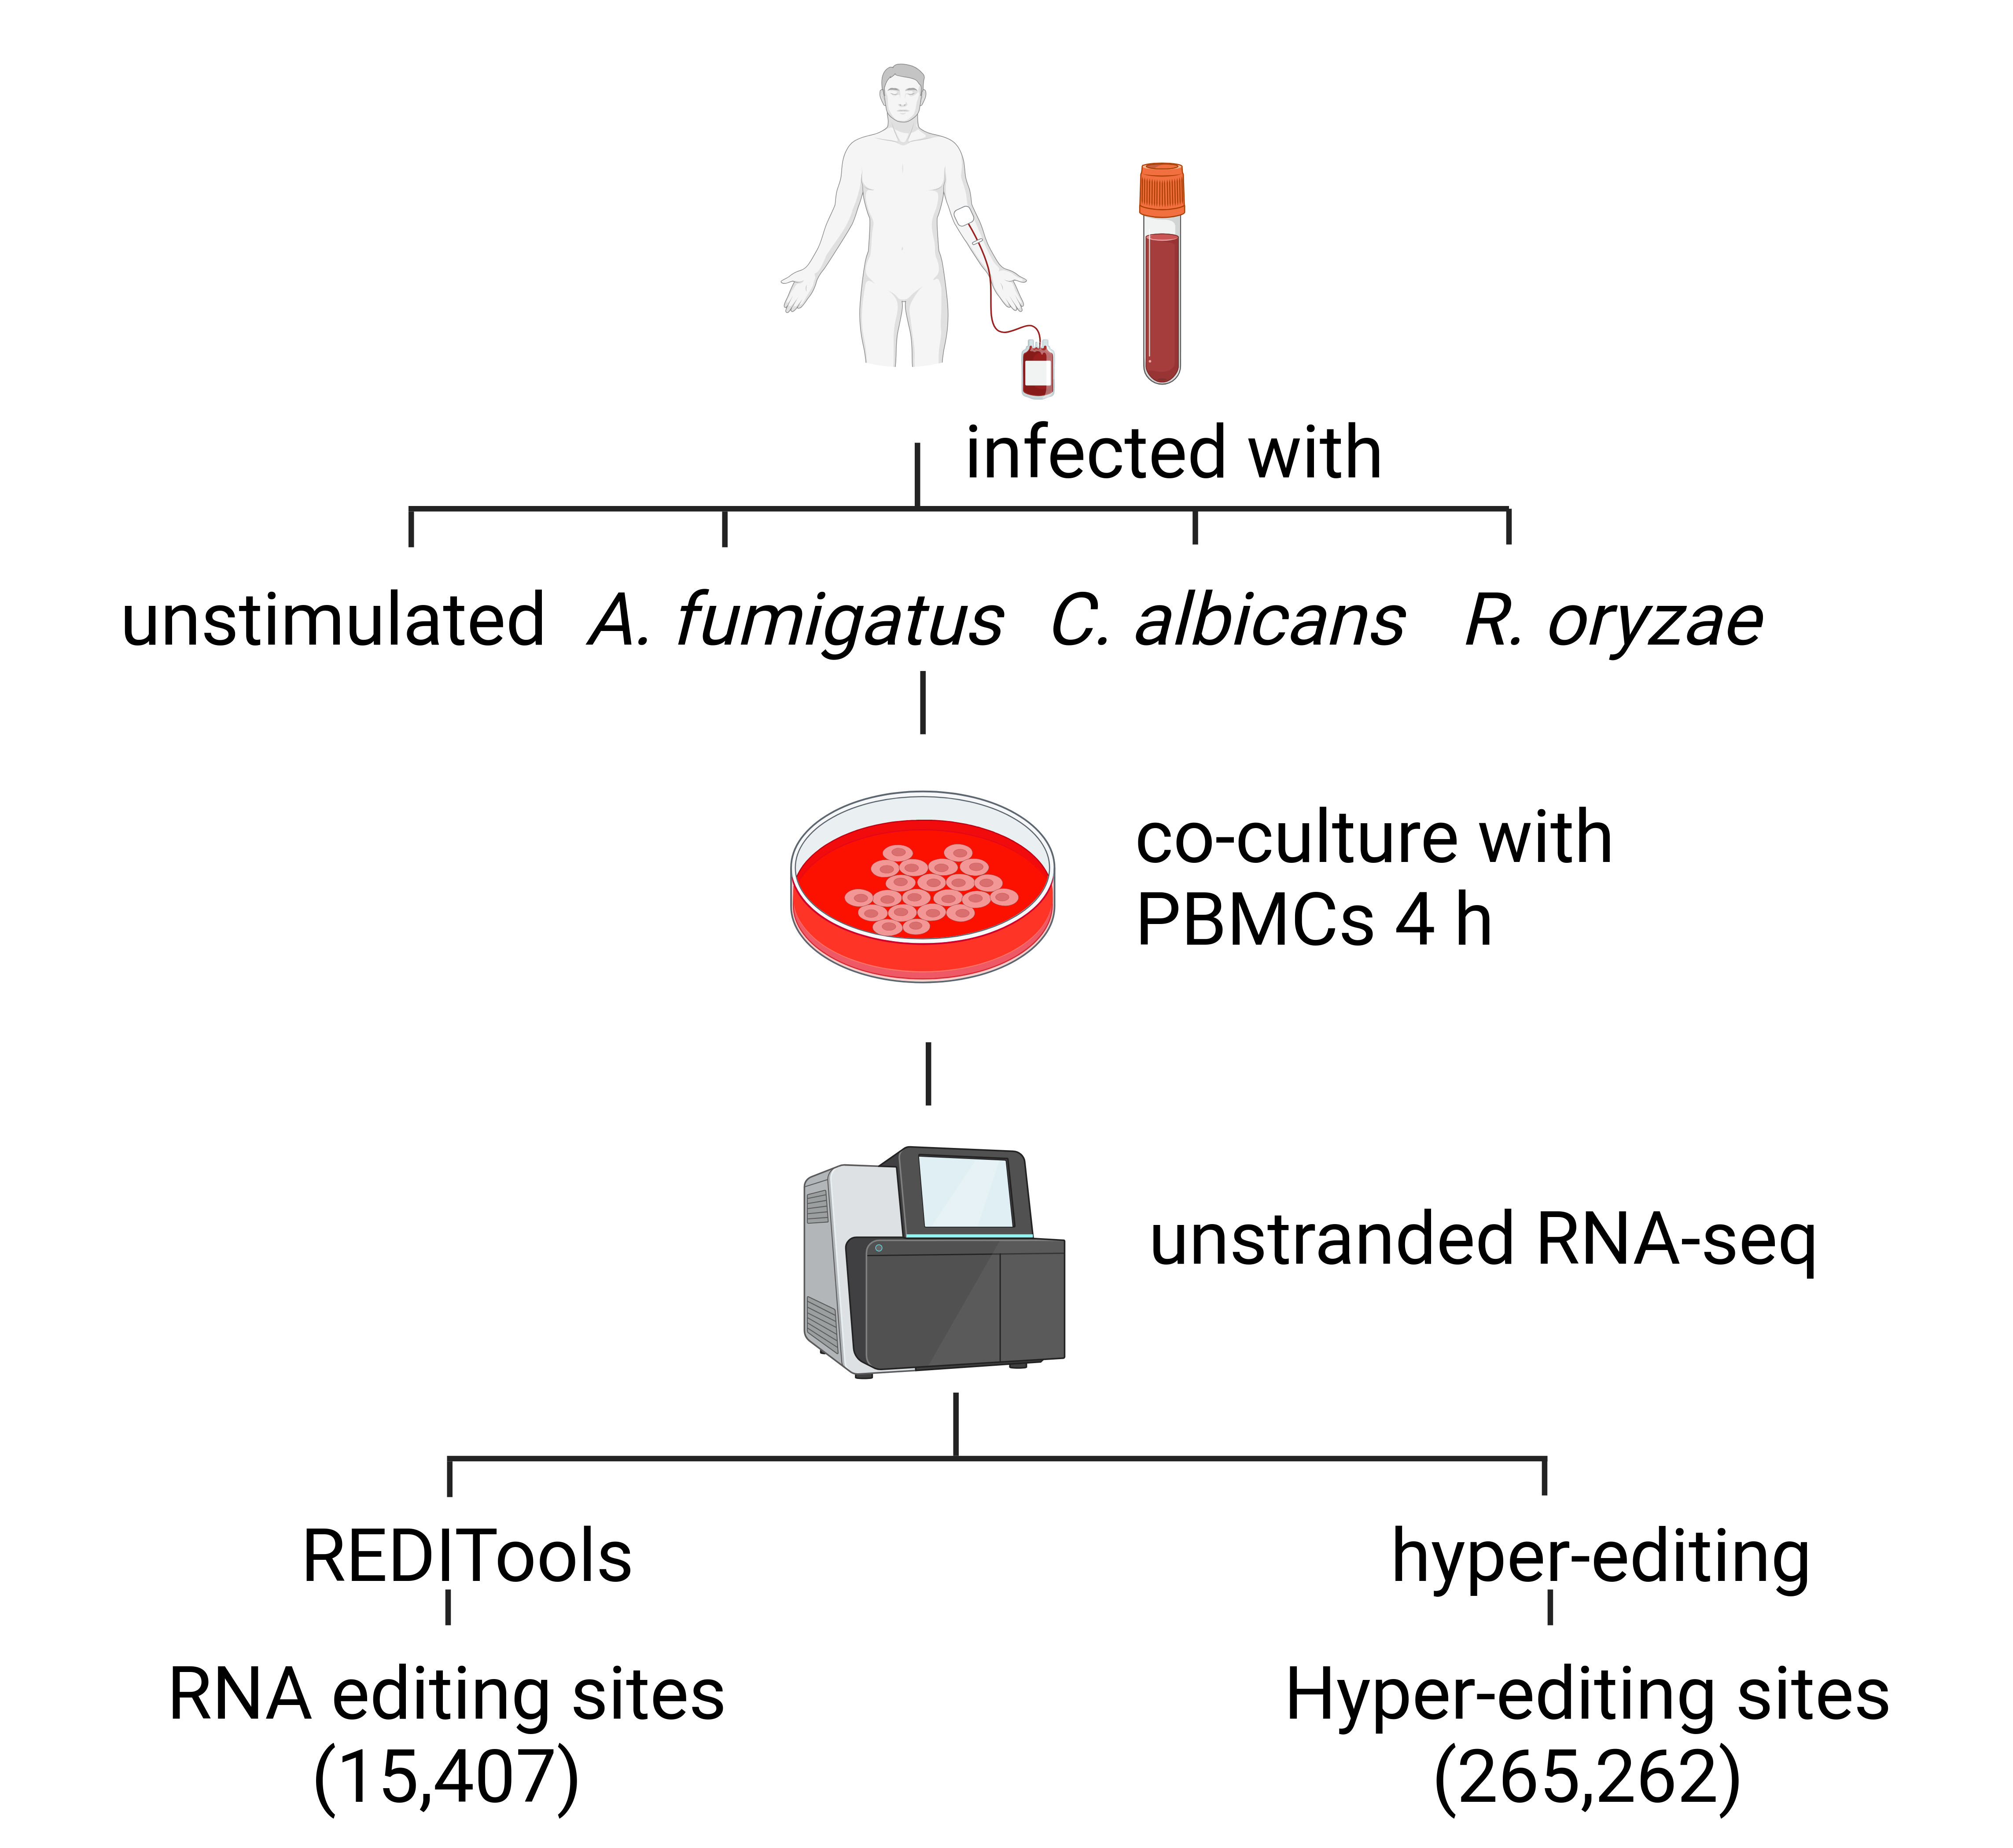
PBMCs show different A-to-I RNA editing patterns upon fungal stimulations
A-to-I
2
1
0
PBMC: Peripheral Blood Mononuclear Cell
Bruno, et al. Comput Struct Biotechnol J. 2020.
18

Slide 19
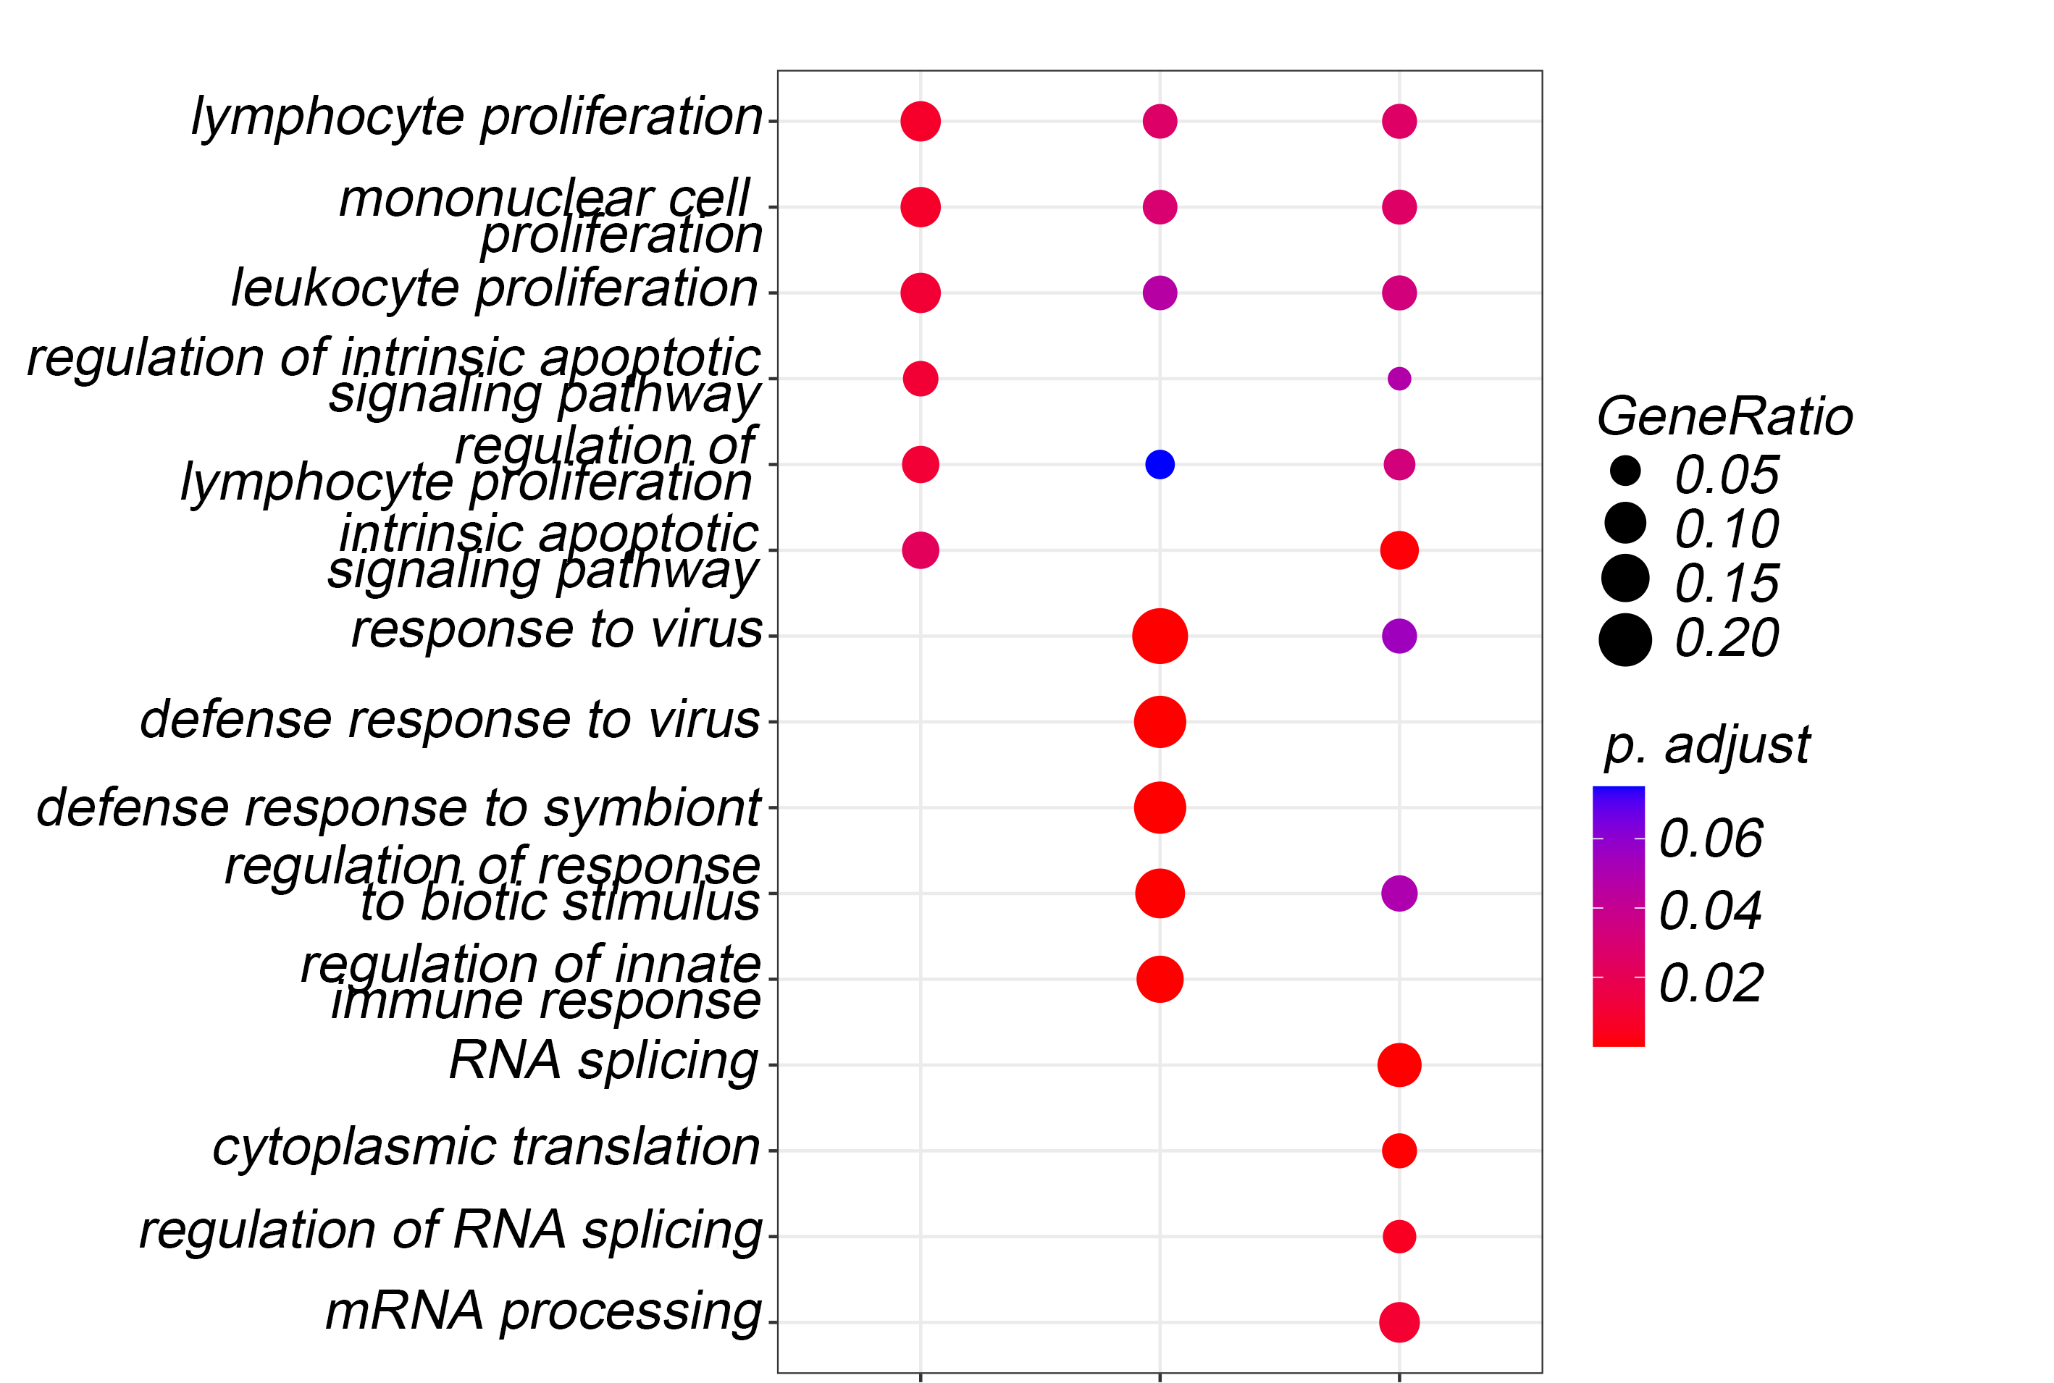
Human A-to-I editing patterns reveal RNA splicing associated pathways upon R. oryzae stimulation
A. fumigatus
C. albicans
R. oryzae
19
Notes:
The A to I editing pattern is representative of all the overall transcriptome. Since we are Studying growing cells, we expect to find sizing cell preparation. CL becomes encourages the interferon response, and we see editing of interferon response genes. But splicing signal was surprising.

Slide 20
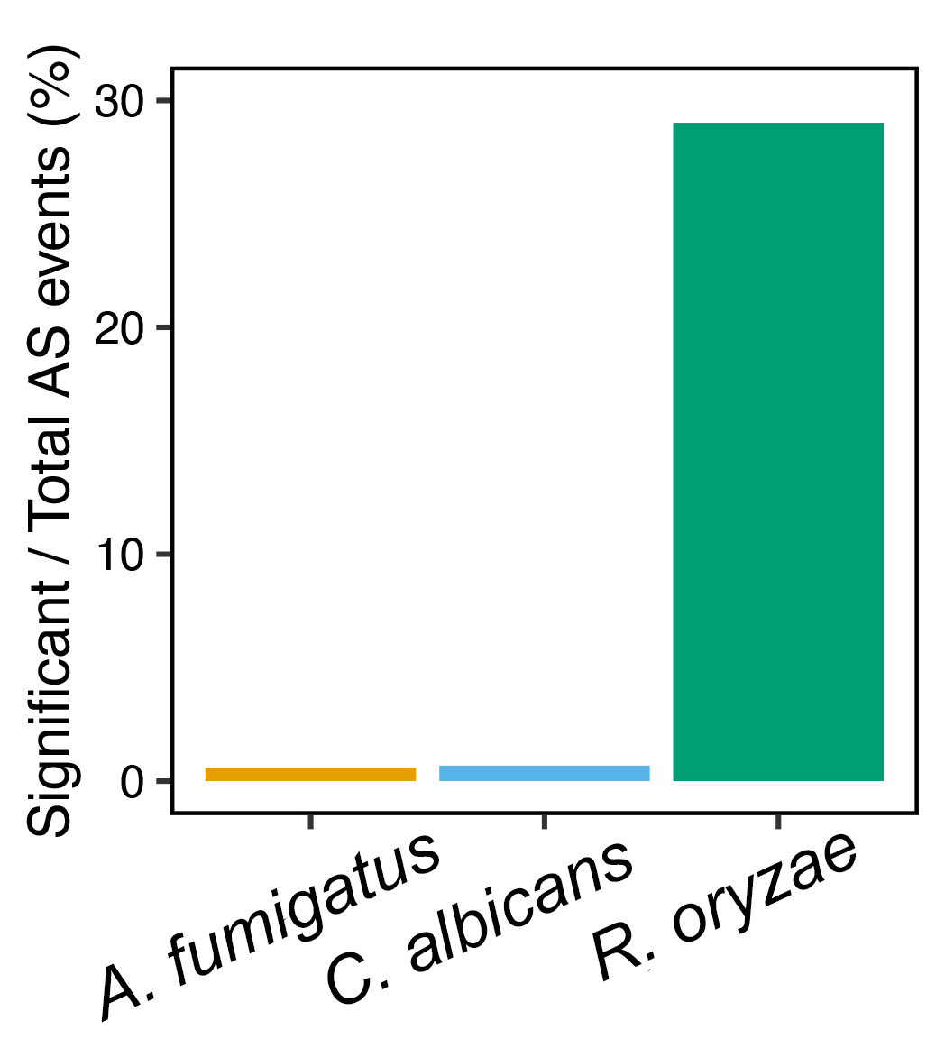
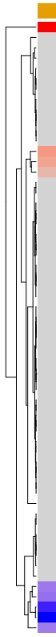
The host alternative splicing (AS) landscape changes in response to R. oryzae coincubation.
A. fumigatus
C. albicans
R. oryzae
PPARGC1A
HSPA8
EIF4A3
BCAS2
RBFOX3
RBM24
SRSF7
JMJD6
STRAP
XAB2
SRSF2
SAP18
LGALS3
WT1
RRAGC
SNRPD2
SF3B5
SMN1
ZPR1
RBM11
HABP4
SNU13
DDX39A
SNRPF
SF3A2
YBX1
RNF113A
DDX5
SRSF5
C9orf78
SRRM4
HNRNPU
SFPQ
SRSF6
RALY
TCERG1
HTATSF1
CLASRP
U2AF1L4
YTHDC1
FAM50A
PQBP1
RBFOX1
SF3B6
PPIL3
ARVCF
WTAP
GEMIN6
GEMIN5
RBM47
ZC3H13
TIA1
PUS7
NOVA2
ESRP2
RSRC1
CELF4
AFF2
ELAVL4
log2FoldChange
log2FoldChange
-4 -2 0 2 4 6
-4 -2 0 2 4 6
Tool: DESeq2
Tool: rMATS-turbo
20

Slide 21
What is the role of alternative splicing during fungal challenges?
21

Slide 22
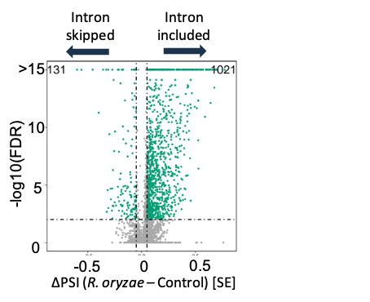
R. oryzae-induced intron retention is associated with YBX1 and SRSF2 binding motifs.
RNA binding motif analysis by rMAPS
Intron retention (RI)
Spliced-in
Spliced-out
YBX1
YBX1
SRSF2
YBX1 (Y box binding protein 1) stabilises messenger RNAs SRSF2 (Serine and Arginine Rich Splicing Factor 2) is responsible for pre-mRNA splicing, regulating gene expression, and maintaining genomic stability
FDR: False Discovery Rate
PSI: Percent Spliced In
22

Slide 23
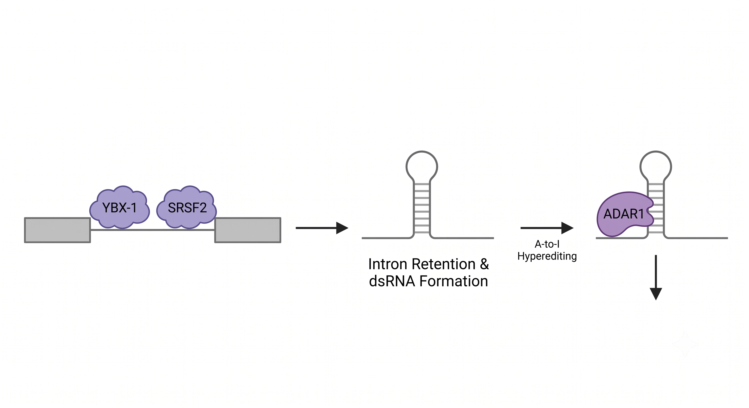
Intron retention results in more structured RNA.
YBX1
YBX1
Introns included
Introns skipped
SRSF2
RI
-0.5
-0.4
-0.3
-0.2
-0.1
Minimum Free Energy / nt
More structured
Less structured
Tool: RNAfold
We hypothesized that structured RNA could be substrates for hyper editing
23

Slide 24
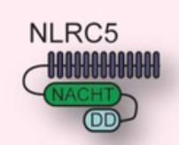
Exon skipping results in truncated NLRC5
NLRC5: NOD-like receptor family CARD domain containing 5
a cytosolic pathogen recognition receptor
Tool: NCBI, rmats2sashimiplot
NLRC5
C
N
NLRC5-SE
C
MHC class I
N
NACHT
RNI-like
Substrate Binding Site
NACHT: a conserved NTPase domain that serves as a core ATP-binding module
RNI-like domain (Ribonuclease Inhibitor-like) is a structural motif containing leucine-rich repeats (LRRs)
24
Notes:
When studying host-pathogen interactions, one of the most interesting topics is how fungi deliver signals to the host, and how host sense the signals and trigger immune response. In the host, there’s a type of proteins called pathogen recognition receptor. They can recognize when a pathogen invades.NLRC5 belongs to this family and is localized in cytoplasm.

Slide 25
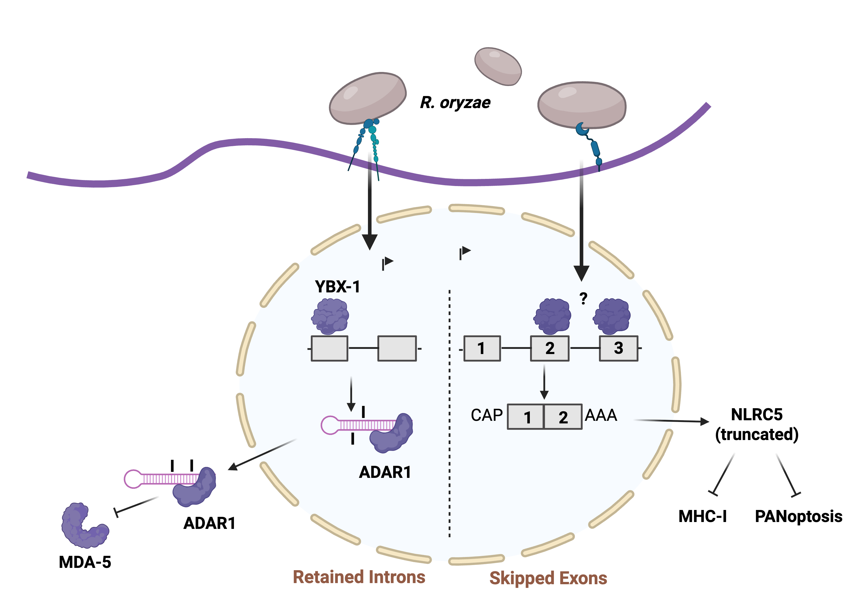
R. oryzae incubation results in disrupted RNA splicing and increased hyper editing
MHC-I: major histocompatibility complex class I
PANoptosis: pyroptosis, apoptosis, necroptosis
25

Slide 26
DsRNA regulation is an important layer to understand fungal stimulations
DsRNA overexpression results in fungal growth arrest in A. fumigatus.
R. oryzae incubation results in disrupted RNA splicing in PBMCs, which can further lead to ADAR1-dependent hyper editing.
26

Slide 27
Research Interests
Knebel, et al. Disrupted RNA editing in beta cells mimics early-stage type 1 diabetes. Cell Metabolism. 2024
ADAR1-associated RNA splicing in diabetic patients/mice? Clinical data?
Time frame

Slide 28
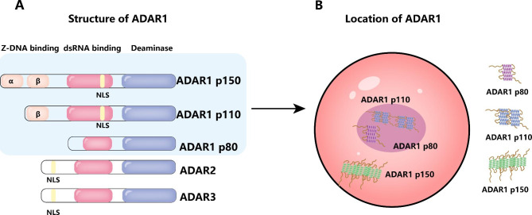
Human PBMCs show different RNA editing patterns upon fungal stimulations
Lu, et al. 2023
Hypothesis: ADAR1 = p110 + p150
The downregulation of ADAR1 upon R. oryzae stimulation might be caused by p150 (cytoplasm located), but p110 (nucleus located) may stay constitutive expression.

Slide 29
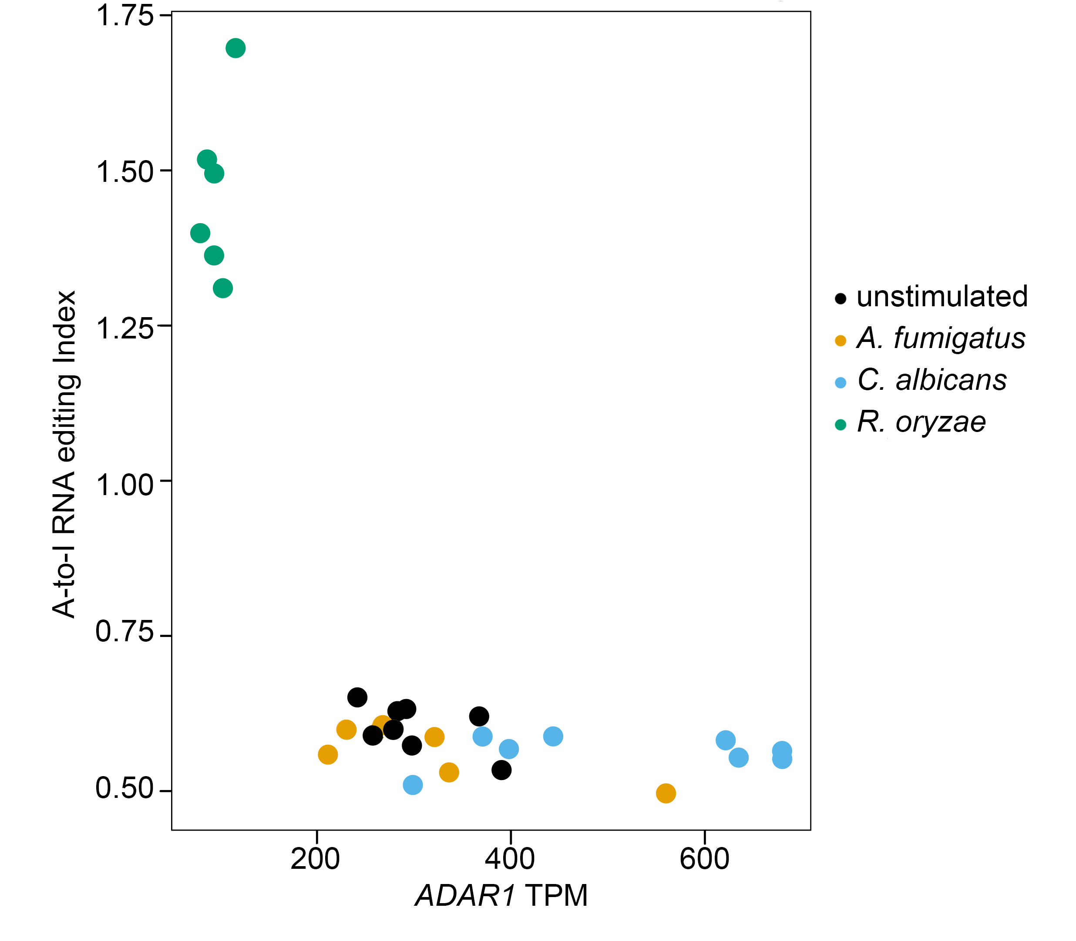
Human PBMCs show different RNA editing patterns upon fungal stimulations
- C. albicans stimulation induces IFN-I response → induce ADAR1-p150 expression
- A. fumigatus stimulation neither induce editing index nor ADAR1 expression
- R. oryzae down-regulation of ADAR1 might be caused by p150 isoform.

Slide 30
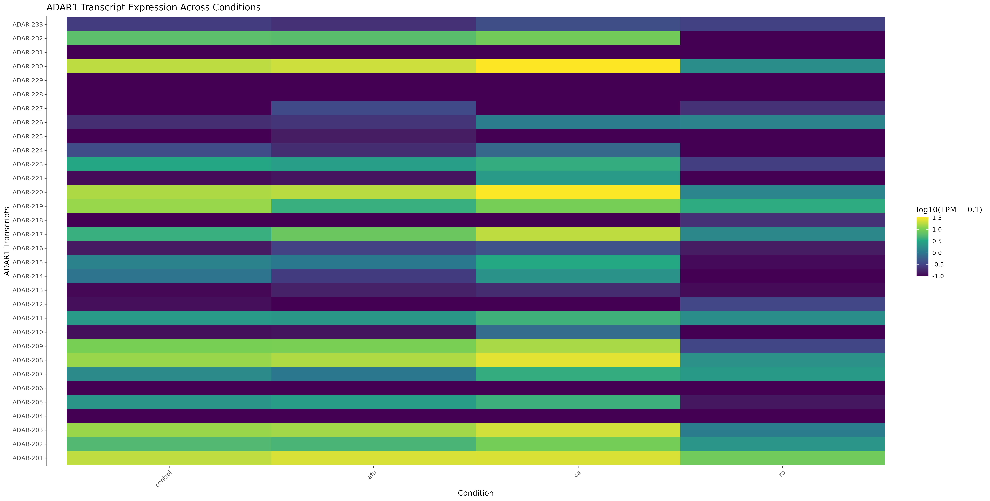
Human PBMCs show different RNA editing patterns upon fungal stimulations
ADAR1-p110
ADAR1-p150
contro
afu
ca
ro
control

Slide 31
1. how is dsRNA recognized by human cells in the immune system?
2. ⁠how is dsRNA recognized by dicer?
3. ⁠how is self and non-self dsRNA differentiated?
4. ⁠how does RNaseIII know which dsRNA to cleave?
5. ⁠how does fungi enter the human body?
6. ⁠for the spores used in infection experiment- how does the no. of spores used to infect match with no. of spores that actually infect the blood (tissues) in an ‘actual’ condition.
7. ⁠are there any better cell lines to use than the one used in the experiment?
8. ⁠what are the virulence profiles of pathogen, of different pathogen??
9. ⁠why R.oryzae has differential splicing but not a fumigatus or albicans?
10. ⁠what effector proteins are known that change gene expression? (effector proteins that could bind to splicing factors)
11. ⁠RNA binding capacity of effector proteins?
12. ⁠did you check if RNA was transferred in this dataset with rhizopus?
13. ⁠Consequence of A to I
14. ⁠what is the biochemistry behind A to I
15. ⁠what are other RNA editing that is known to occur?-in human, fungi, other organisms.
16. ⁠ADAT? what does it do and how does it differ from ADAR?
17. ⁠difference between fungal and human A to I?

