Slide 1
PROPOSAL REPORT
BASC BATMAN'S ATTEMPT TO SAVE CATWOMAN
EN2532 – Robot Design and Competition
13.06.2020

Slide 2
Overall Strategy
We have divided the task into six subtasks.
Line following
Wall following & pillar detection
Circle navigation
Box manipulation and color detection
Ramp navigation
Gate area navigation
We thought of handling each task in a modular manner
Switching between line following and wall following will be done by firing TOF sensors prior to the wall part *
Box manipulation is the most crucial subtask in the competition
Two color sensors will be used
A gripping mechanism for the box
Ramp navigation will be done using a feedback loop of gyroscope and motors

Slide 3
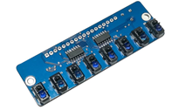
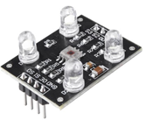

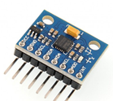
Sensors
The Raykha S8 IR sensor module
The TCS 3200 color sensor modules
2 sensors
one on the gripper to detect the front face
The other sensor to detect the bottom surface
VL530LX TOF sensor for distance measurement
2 sensors on either side for pillar and wall detection
1 sensor in front for the box detection
MPU 6050 Gyroscope

Slide 4
The Processing Unit
Arduino MEGA2560
Arduino modules have a wide range of libraries.
The clock speed, flash memory, RAM and Interrupt count is higher than UNO/NANO
Raykha S8
Arduino MEGA
I2C bus
Motor controller
Gyroscope
Arduino NANO
TOFs

Slide 5
The Processing Unit
Servo motor control for gripper arm
Color sensor control
Calculation based on detected colors
Arduino NANO
Arduino NANO
For Better modularity and debugging, use a separate controller for the box handling mechanism.
A debugging interface, indicator LEDs are also connected to the main processor.

Slide 6
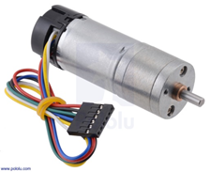
Actuators – Gear motors
According to our calculations for the worst-case scenario in previous assignment (4)
Total weight – 1.5 kg
Torque require for a wheel – 0.777 kgcm
Maximum stall torque - 1.036 kgcm
Maximum power output – 0.144W
Power require in climb down the ramp – 0.11W
Maximum speed need in flat ground – 26.52 rpm
For the above requirements we chose a motor which was Pololu 25D 12V high power 47:1 gear motor with encoders
Main specifications
No load speed & current – 210 rpm, 300 mA
Stall torque & current – 12 kgcm, 5.6A@12V

Slide 7
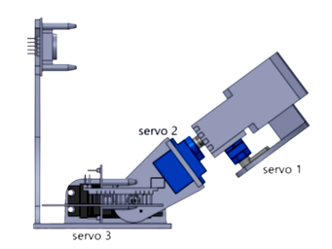
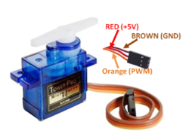
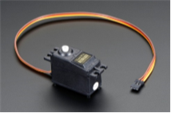
Actuators – Servo motors
According to our previous calculations on servo motors,
Servo1 maximum torque = 0.115 kgcm
Therefore we chose Tower pro SG90 servo for the servo1 & servo2.
Main specifications
Torque – 2.5 kgcm
Operating voltage - +5V
Servo3 maximum torque = 2.047 kgcm
Therefore we chose Tower pro SG5010 servo motor for servo3
Main specifications
Stall torque – 5.5 kgcm (4.8V)
Operating voltage – 4.8 – 6V

Slide 8
Power Plan
The robot will be powered by two Li-Po batteries - dual battery setup
7.4V 2200mAh 25C battery
11.1V 2200mAh 25C battery
Three voltage regulators – all LM2596S
9V supply for drive motors, Arduino MEGA and OLED display
Two 5V supplies for sensors, servo motors and other components
Battery level indicators will be used with both batteries to avoid over-drain of batteries
Two PCBs would be used to minimize the wiring
PCBs will be finalized after breadboard testing
DIP switches will be used to control each component during testing
Alternatives for 9V regulator: XH-M401 module or two XL6009 modules in parallel

Slide 9
Task Delegation
Phase 1: Preliminary design
Pamuditha: peripheral components, robot body, coordination
Tharindu: box collection, color sensing
Yasod: circle navigation, ramp navigation
Vidura: gate area, arena
Thieshanthan: wall following, pillar detection
Yomali: line following, arena

Slide 10
Task Delegation
Phase 2a: Virtual implementations
Schematic and PCB: Thieshanthan, Vidura, Pamuditha,Tharindu
Coding: Pamuditha, Tharindu, Yomali, Yasod
Mechanical design: Yasod, Vidura, Yomali, Thieshanthan
Phase 2b: Actual implementation
Phase 3: Testing
We are currently in the phase 2a.
Task delegation for phase 2b and phase 3 will be decided when the university starts.

