Slide 1
Arduino MEGA 2560 Control
Arduino Nano
TOF sensors x5
Gyroscope sensor x1
Raykha IR sensor module
DC Motor driver module
The Processors:
Arduino MEGA2560
Arduino modules have a wide range of
Libraries.
The clockspeed, Higher flash memory,
RAM and Interrupt count is higher than
UNO/NANO.
A debugging interface, indicator LEDs are also connected to the main processor.
Arduino NANO
For Better modularity and debugging,
Use a separate controller for the
Box handling mechanism.
A sub controller for the box gripping.
Servo motor control for arm grip
The calculation based on colours
Colour sensor control

Slide 2
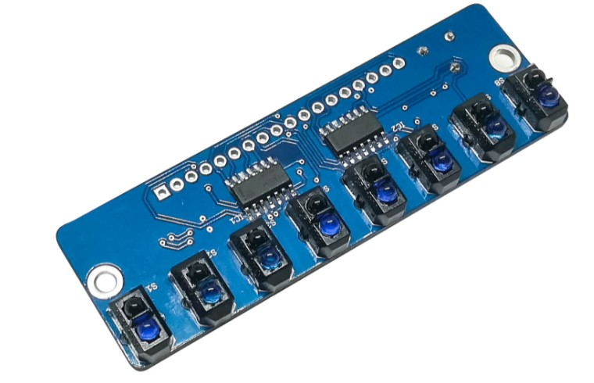
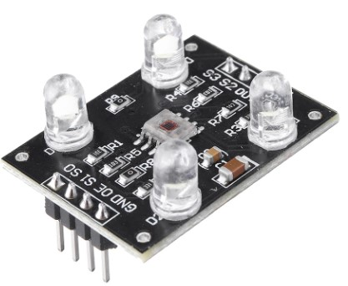
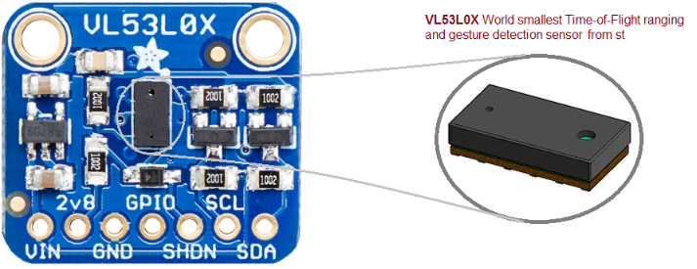
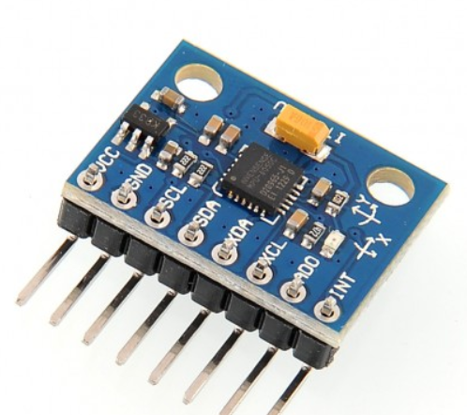
Sensors
The Raykha S8 IR sensor module
The TCS 3200 Colour sensor modules:
2 sensors, one on the gripper to detect the front face
The other sensor to detect the bottom surface.
VL530LX TOF sensor for distance measurement
2 sensors on either side for pillar and wall detection.
1 sensor in front for the box detection.
MPU 6050 Gyroscope

