Slide 1
ACTUATORS

Slide 2
Here we use 2 types of actuators,
Gear motors
Servo motors
GEAR MOTOR
According to our motor calculations for the worst case scenario in previous assignment (4) ,
Total weight – 1.5 kg
Torque require for a wheel – 0.777 kgcm
Maximum stall torque - 1.036 kgcm
Maximum power output – 0.144W

Slide 3
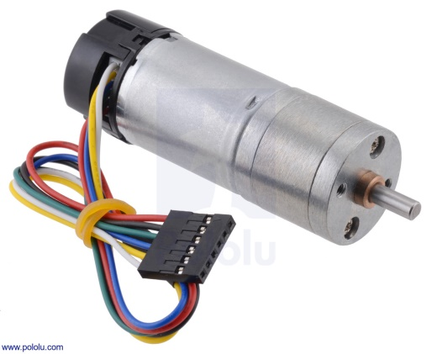
power require in climb down the ramp – 0.11W
Maximum speed need in flat ground – 26.52 rpm
For the above requirements we chose a motor which was Pololu 25D 12V high power 47:1 gear motor with encoders
Main specifications
no load speed & current – 210 rpm, 300 mA
Stall torque & current – 12 kgcm, 5.6A

Slide 4
SERVO MOTORS
Here we use three servos for the robot arm.
According to our previous calculations on servo motors,
For servo1 we need 0.115 kgcm of maximum torque.
Therefore we chose Tower pro SG90 servo for the servo1 & servo2.
Main specifications
Torque – 2.5 kgcm
Operating voltage - +5V

Slide 5
For servo3 we need 2.047 kgcm of maximum torque.
Therefore we chose Tower pro SG5010 servo motor for servo3
Main specifications
Stall torque – 5.5 kgcm (4.8V)
Operating voltage – 4.8 – 6V
Tower pro SG90
Tower pro SG5010

