Slide 1

Model representation
Linear regression with one variable
Machine Learning

Slide 2
Housing Prices
(Portland, OR)
Price
(in 1000s of dollars)
Size (feet²)
Supervised Learning
Given the “right answer” for each example in the data.
Regression Problem
Predict real-valued output

Slide 3
Training set of
housing prices
(Portland, OR)
Size in feet² (x) | Price ($) in 1000's (y)
2104 | 460
1416 | 232
1534 | 315
852 | 178
… | …
Notation:
m = Number of training examples
x’s = “input” variable / features
y’s = “output” variable / “target” variable

Slide 4
Training Set
How do we represent h ?
Learning Algorithm
Size of house
h
Estimated price
Linear regression with one variable.
Univariate linear regression.

Slide 6
Cost function
Linear regression with one variable
Machine Learning

Slide 7
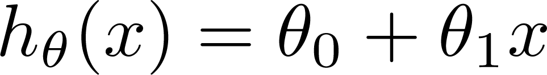

Training Set
Size in feet² (x) | Price ($) in 1000's (y)
2104 | 460
1416 | 232
1534 | 315
852 | 178
… | …
Hypothesis:
‘s: Parameters
How to choose ‘s ?

Slide 8
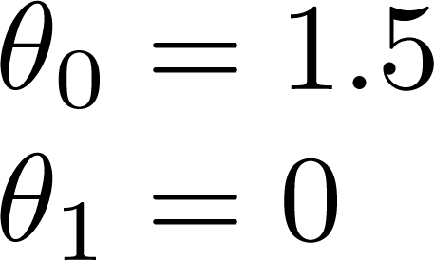
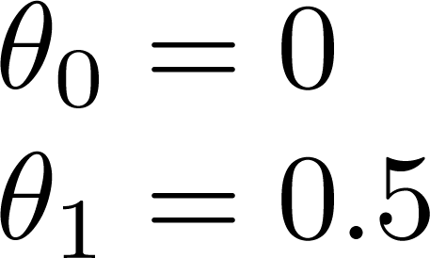
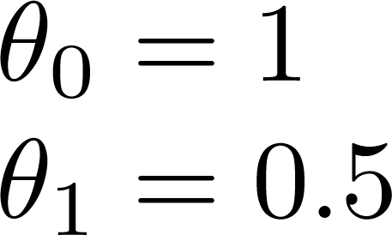

Slide 9
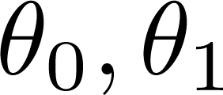


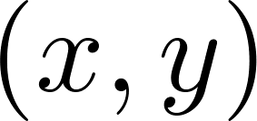
y
x
Idea: Choose so that is close to for our training examples

Slide 11
Cost function intuition I
Linear regression with one variable
Machine Learning

Slide 12
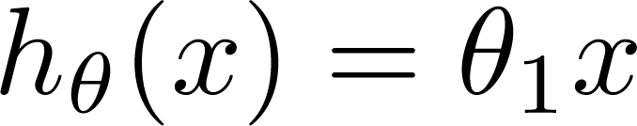

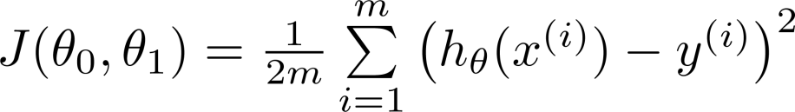
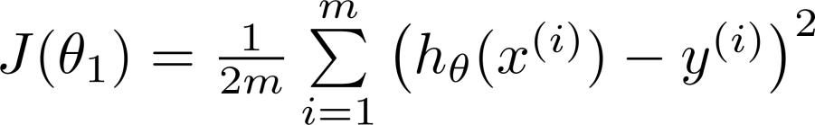
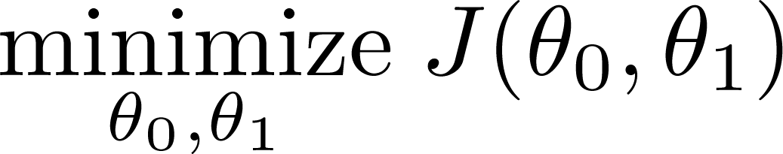
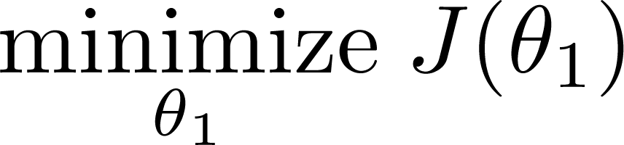
Simplified
Hypothesis:
Parameters:
Cost Function:
Goal:

Slide 13





(for fixed , this is a function of x)
(function of the parameter )
y
x

Slide 14

(for fixed , this is a function of x)
(function of the parameter )
y
x

Slide 15

(for fixed , this is a function of x)
(function of the parameter )
y
x

Slide 17
Cost function intuition II
Linear regression with one variable
Machine Learning

Slide 18
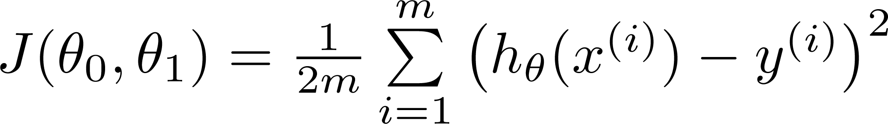
Hypothesis:
Parameters:
Cost Function:
Goal:

Slide 19
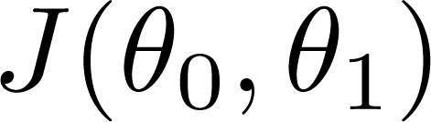


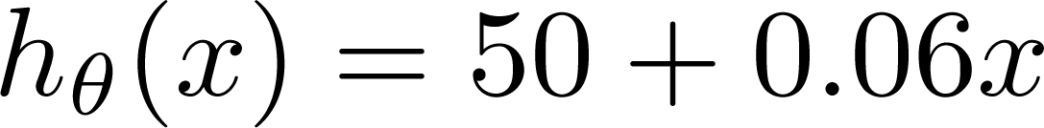
(for fixed , this is a function of x)
(function of the parameters )
Price ($)
in 1000’s
Size in feet² (x)

Slide 20
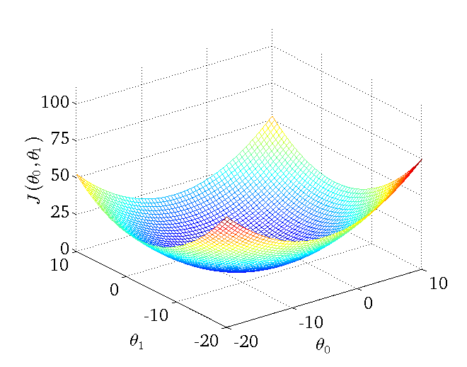

Slide 21
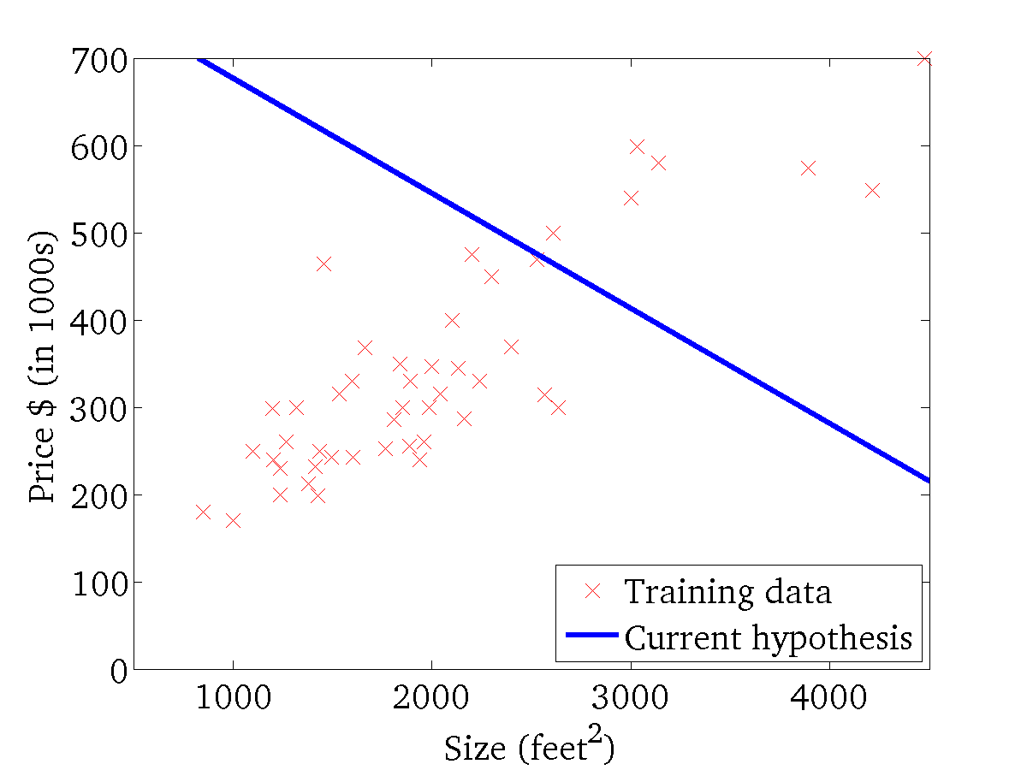
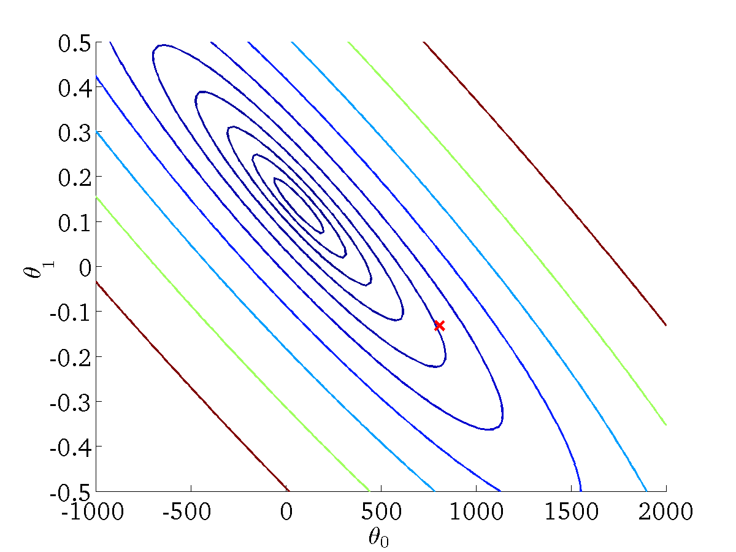
(for fixed , this is a function of x)
(function of the parameters )

Slide 22
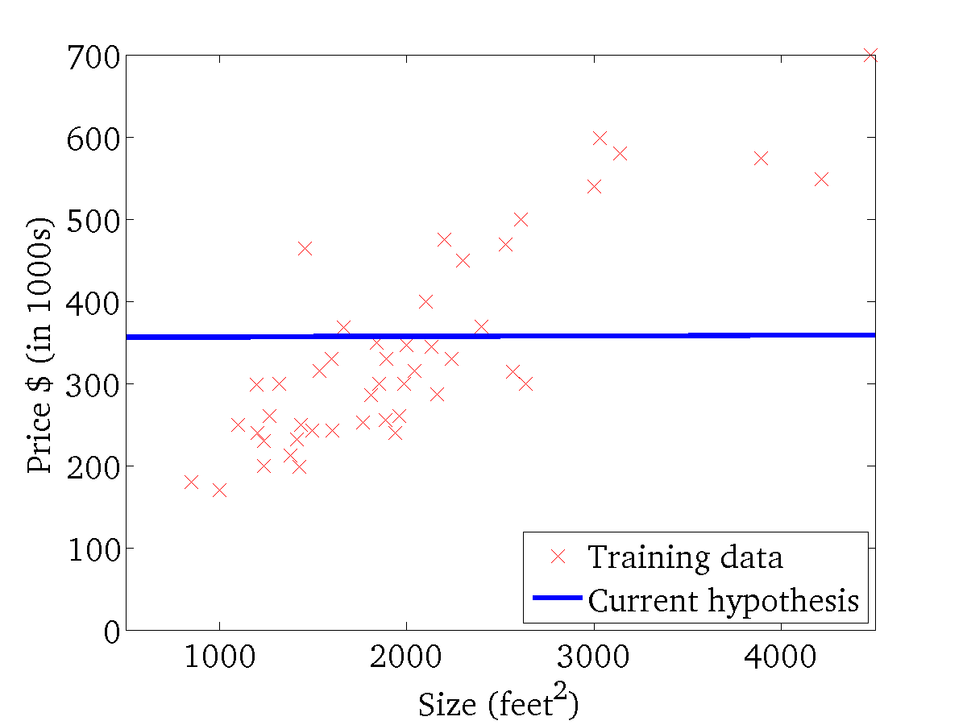
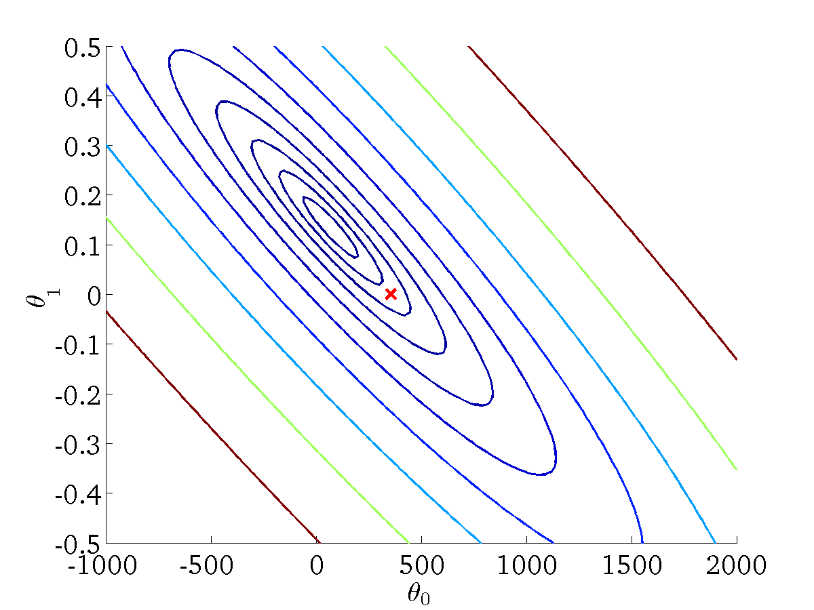
(for fixed , this is a function of x)
(function of the parameters )

Slide 23
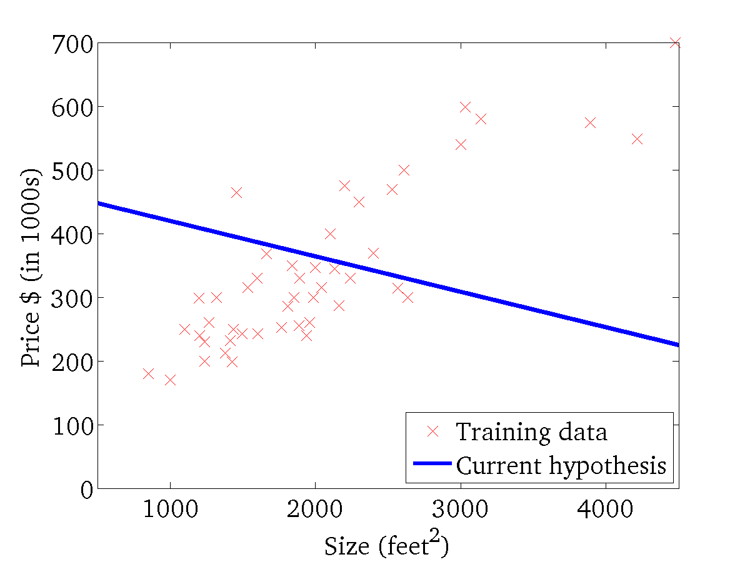

(for fixed , this is a function of x)
(function of the parameters )

Slide 24
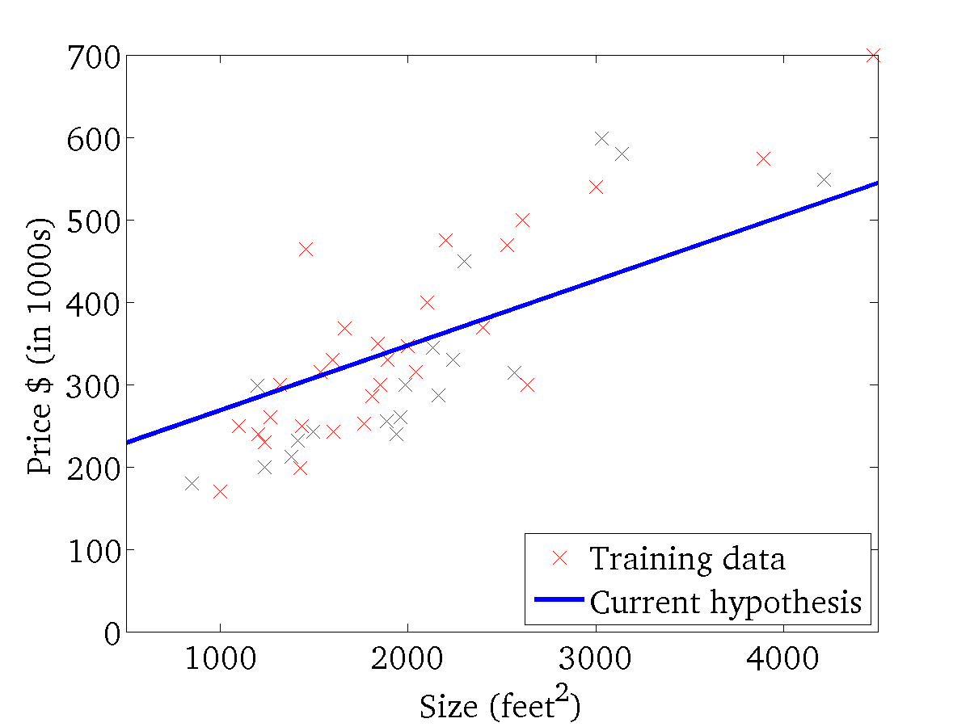
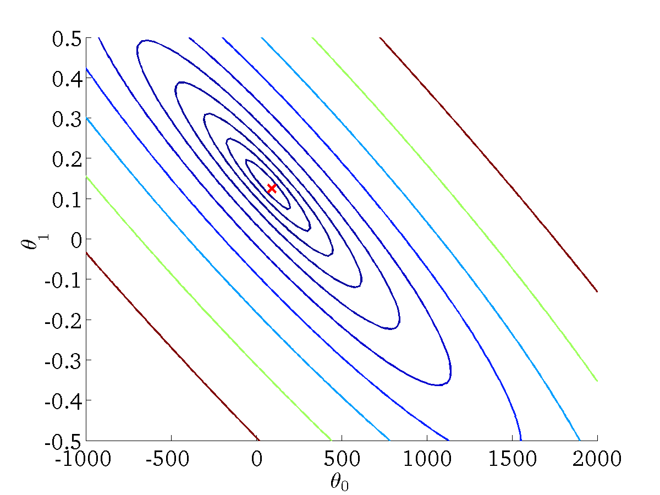
(for fixed , this is a function of x)
(function of the parameters )

Slide 26
Gradient descent
Linear regression with one variable
Machine Learning

Slide 27
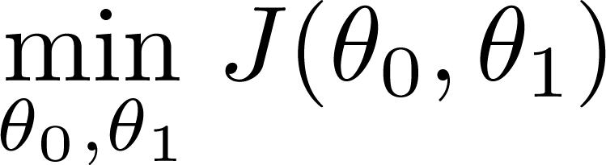
Have some function
Want
Outline:
Start with some
Keep changing to reduce until we hopefully end up at a minimum

Slide 28
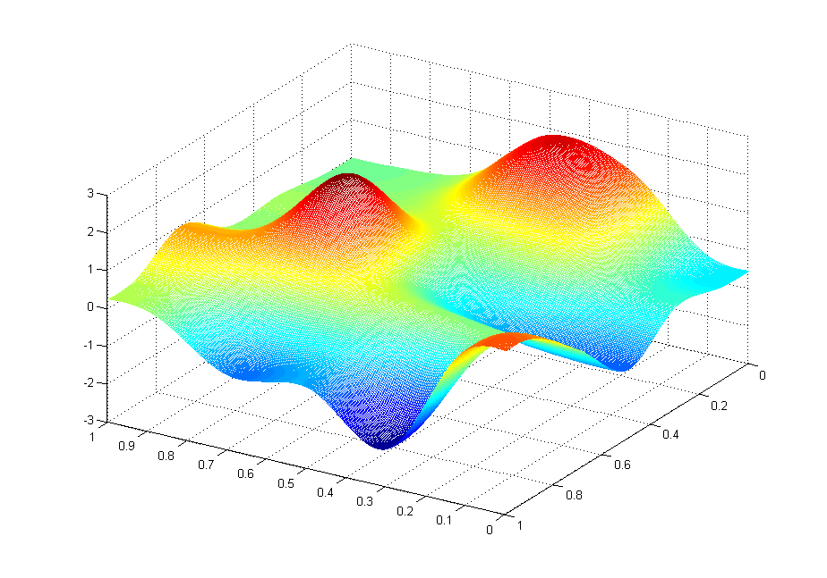
J(θ₀,θ₁)
θ₁
θ₀

Slide 29
J(θ₀,θ₁)
θ₁
θ₀

Slide 30
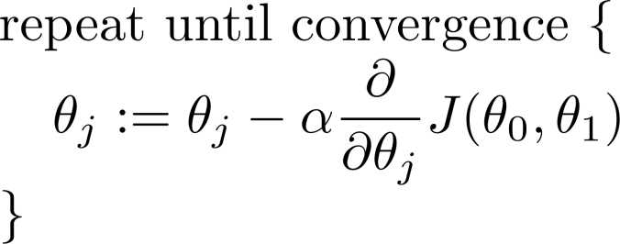
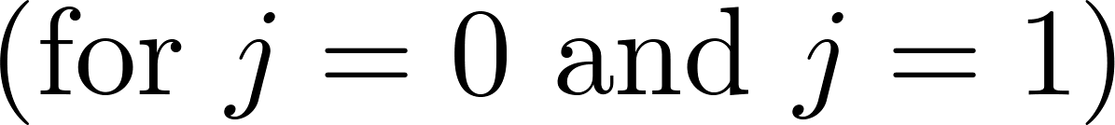
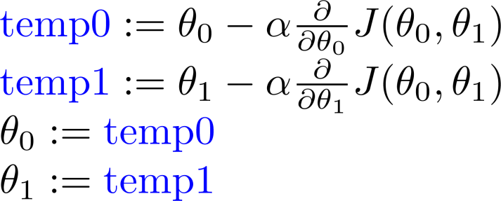
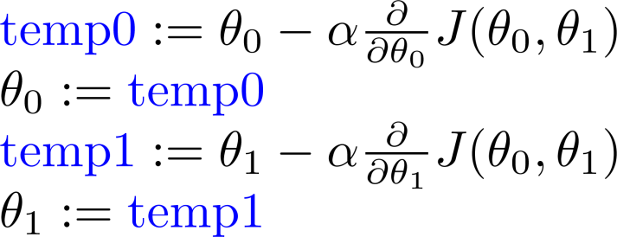
Gradient descent algorithm
Correct: Simultaneous update
Incorrect:

Slide 32
Gradient descent intuition
Linear regression with one variable
Machine Learning

Slide 33
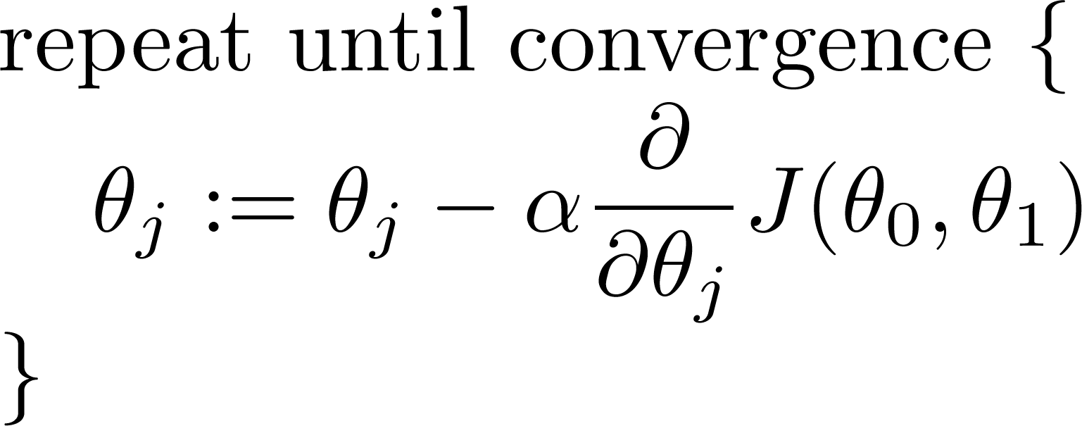
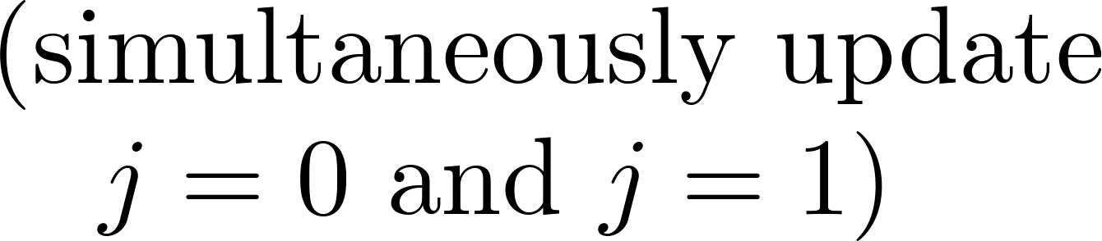
Gradient descent algorithm

Slide 35
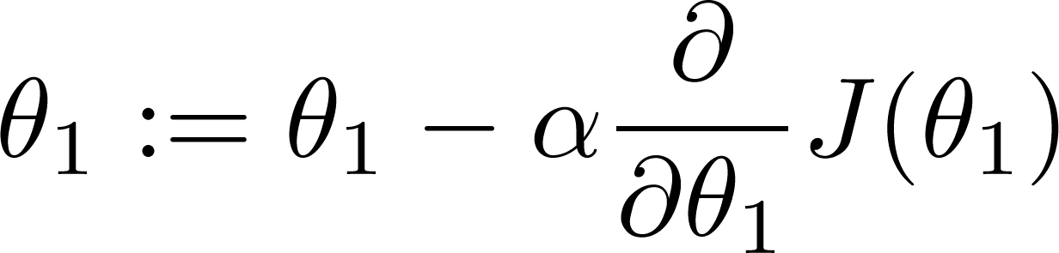
If α is too small, gradient descent can be slow.
If α is too large, gradient descent can overshoot the minimum. It may fail to converge, or even diverge.

Slide 36

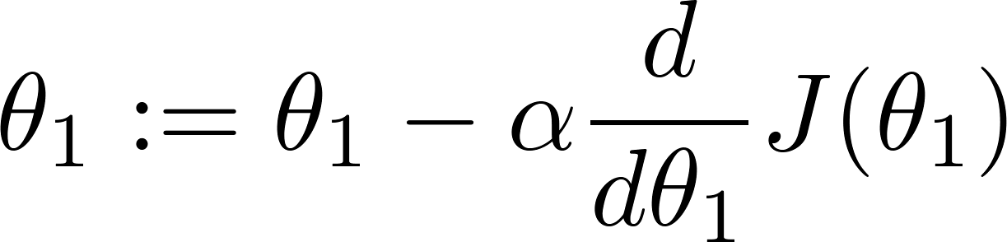
at local optima
Current value of

Slide 37
Gradient descent can converge to a local minimum, even with the learning rate α fixed.
As we approach a local minimum, gradient descent will automatically take smaller steps. So, no need to decrease α over time.

Slide 39
Gradient descent for linear regression
Linear regression with one variable
Machine Learning

Slide 40
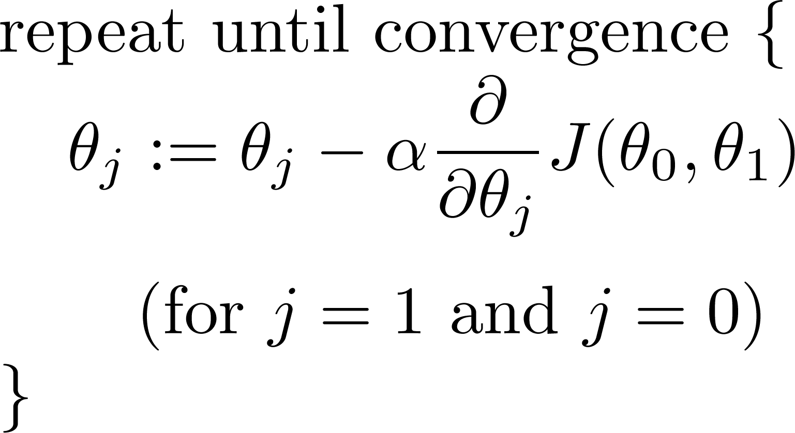
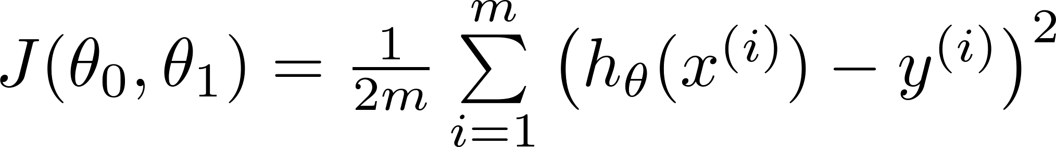
Gradient descent algorithm
Linear Regression Model

Slide 41
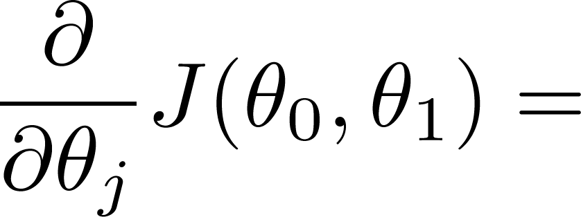
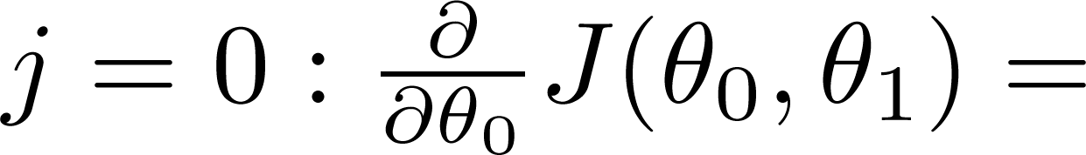
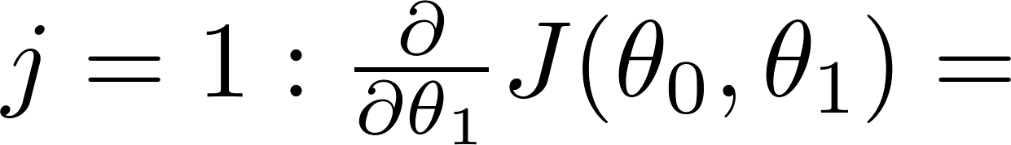

Slide 42
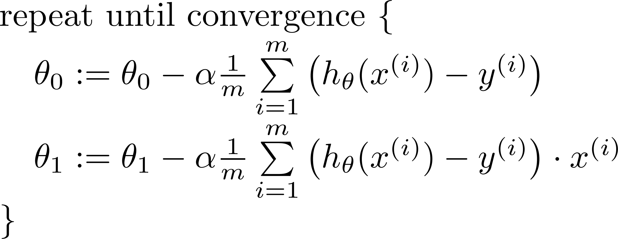

Gradient descent algorithm
update
and
simultaneously

Slide 43
J(θ₀,θ₁)
θ₁
θ₀

Slide 44
J(θ₀,θ₁)
θ₁
θ₀

Slide 46
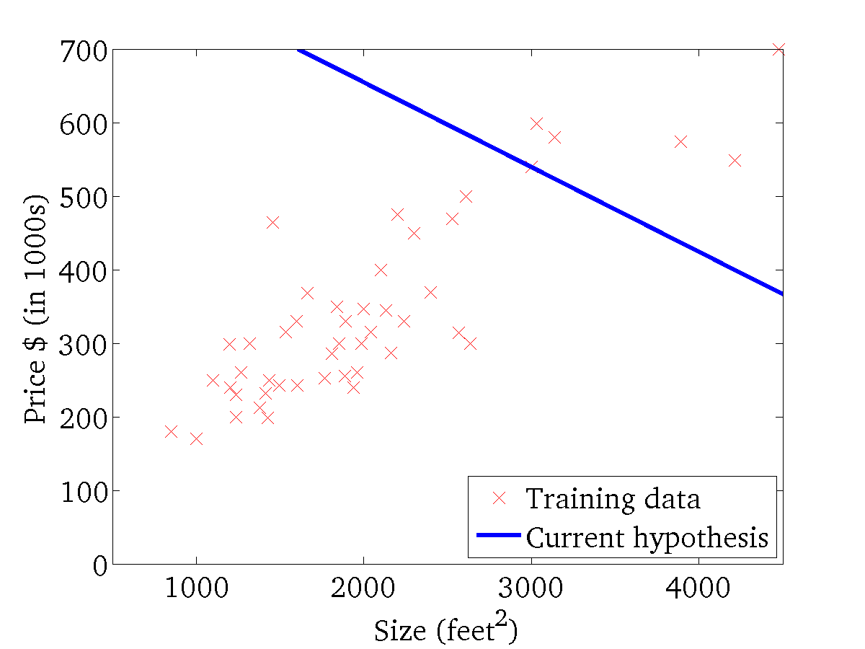
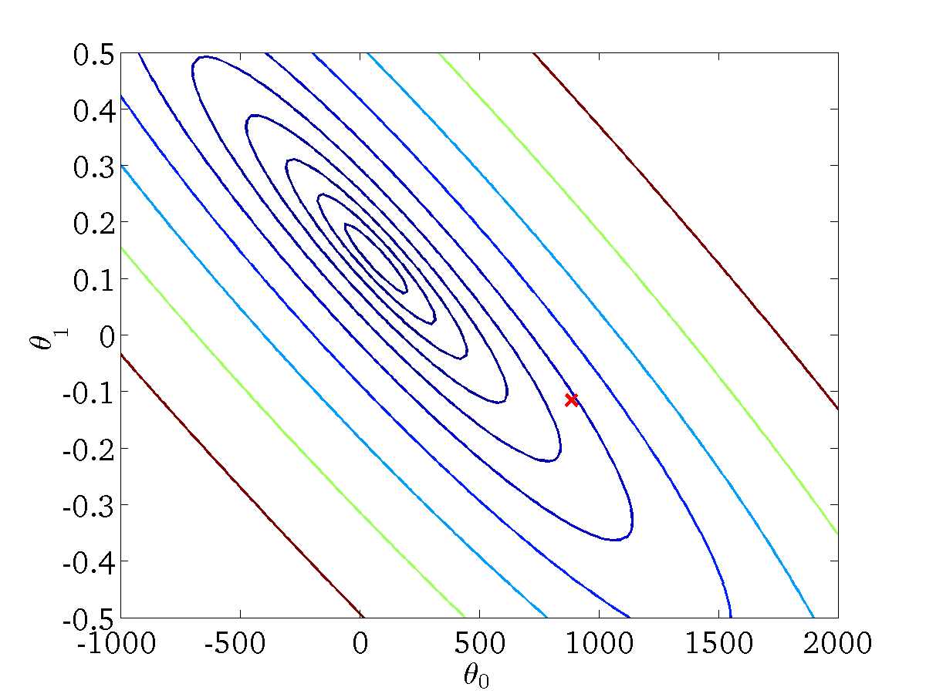
(for fixed , this is a function of x)
(function of the parameters )

Slide 47

(for fixed , this is a function of x)
(function of the parameters )

Slide 48
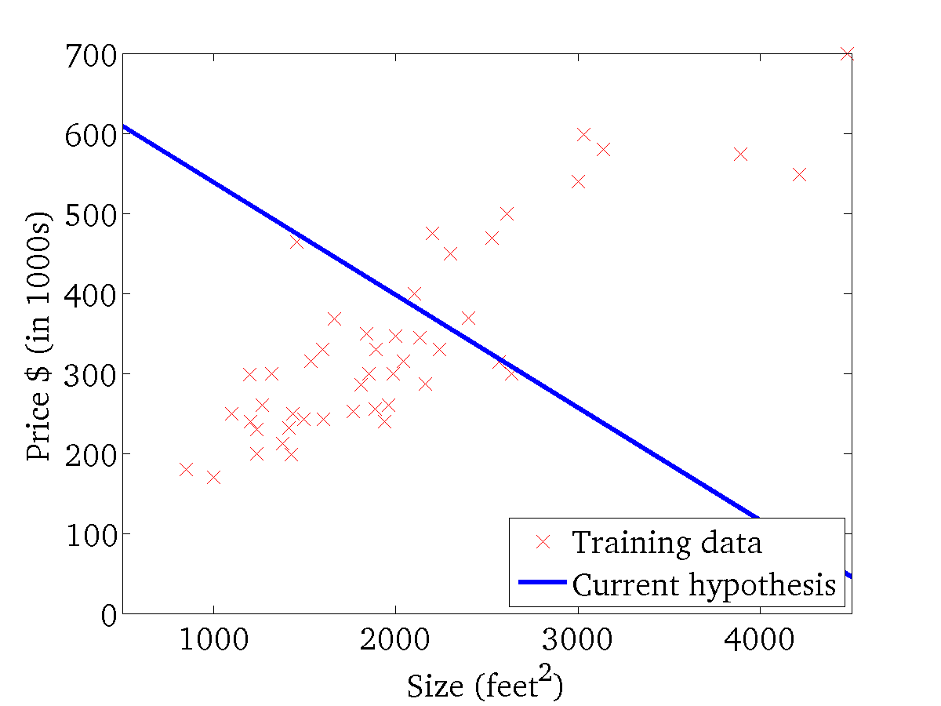
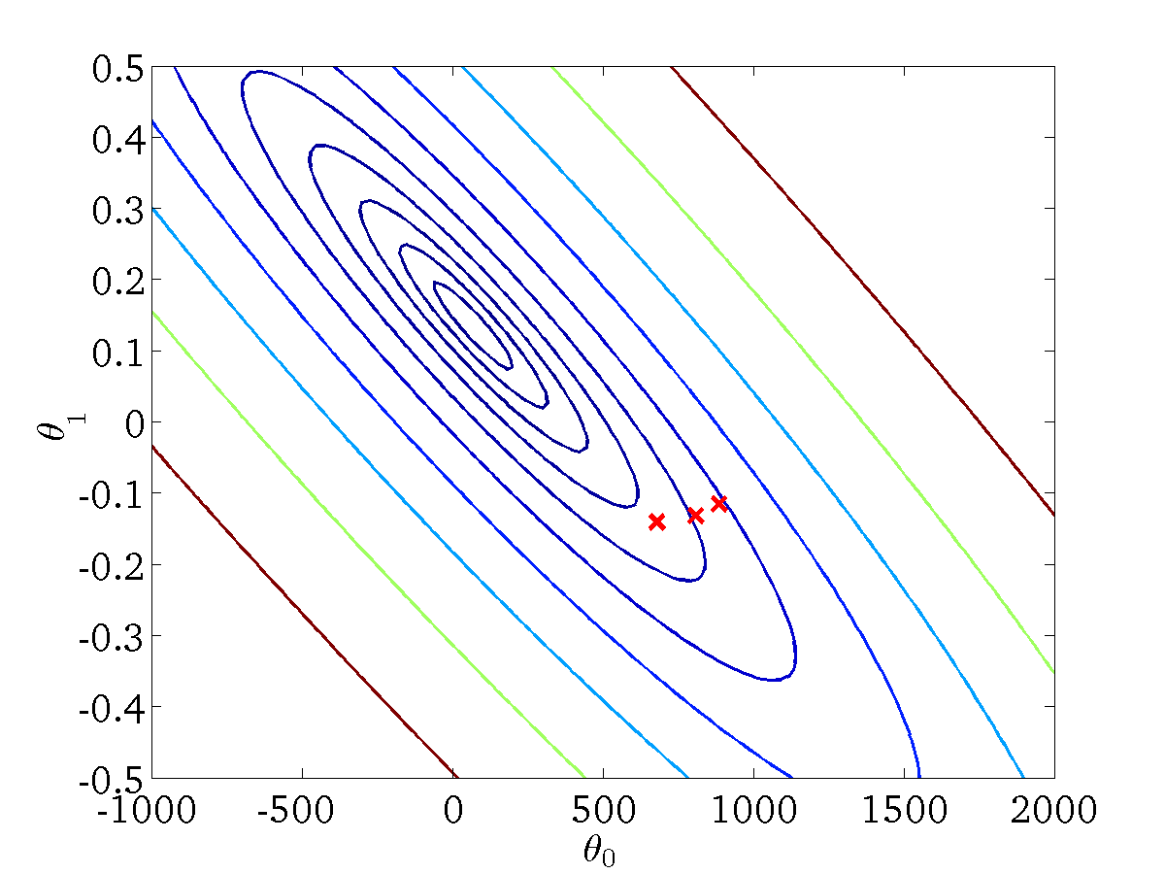
(for fixed , this is a function of x)
(function of the parameters )

Slide 49
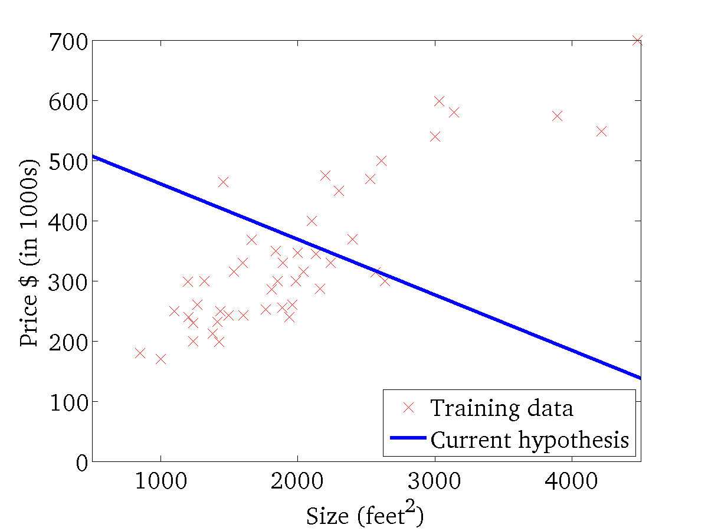

(for fixed , this is a function of x)
(function of the parameters )

Slide 50
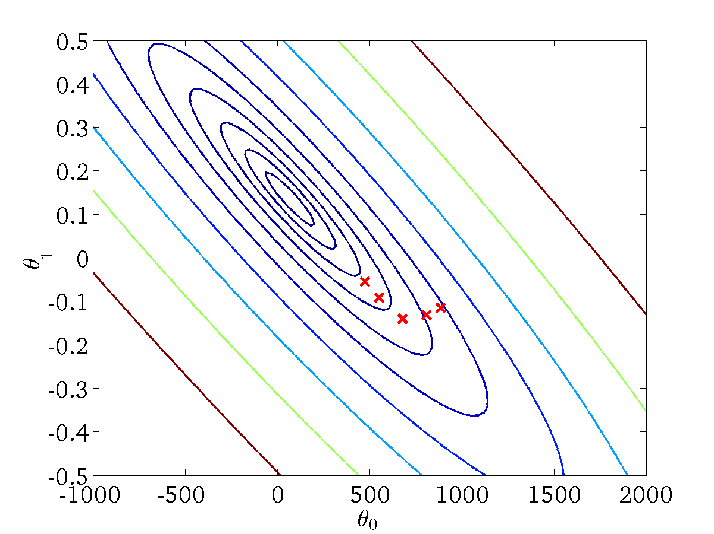
(for fixed , this is a function of x)
(function of the parameters )

Slide 51

(for fixed , this is a function of x)
(function of the parameters )

Slide 52
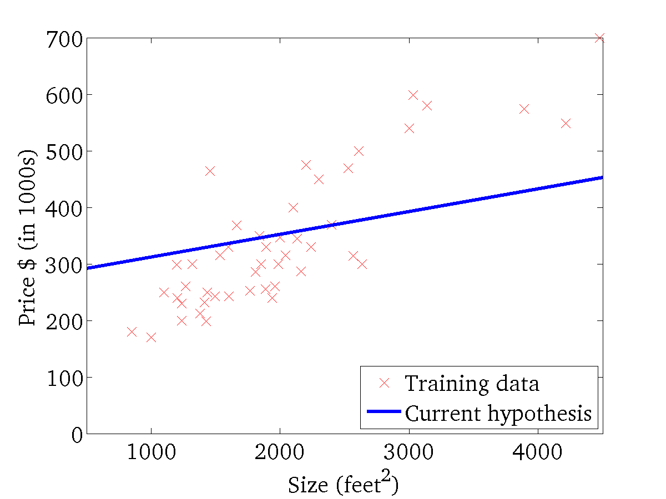

(for fixed , this is a function of x)
(function of the parameters )

Slide 53
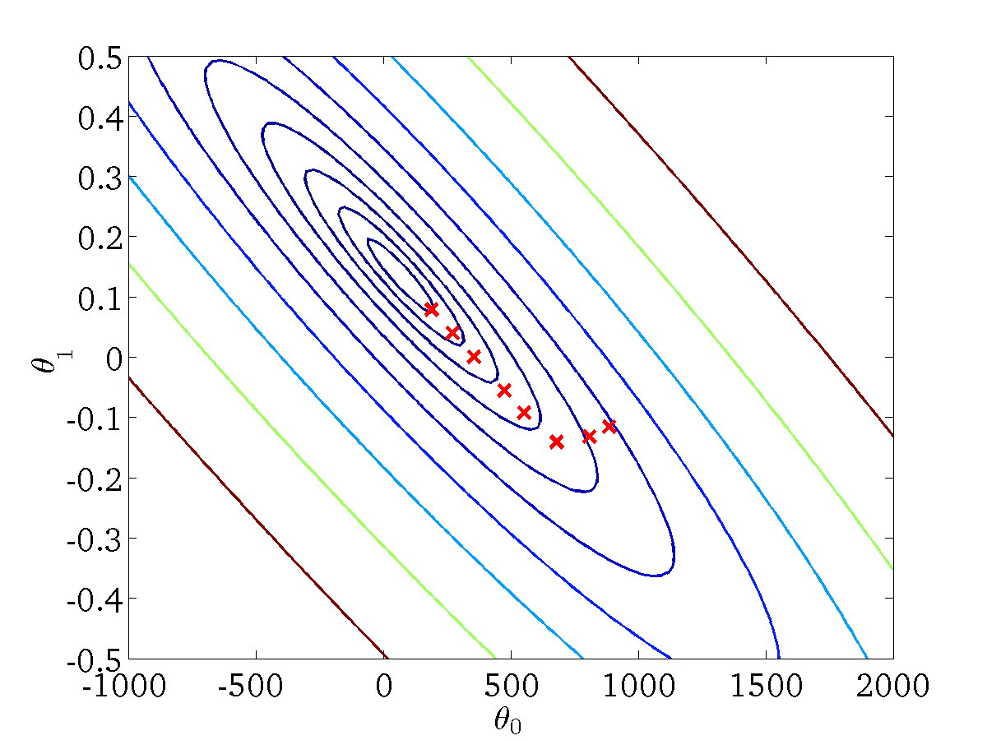
(for fixed , this is a function of x)
(function of the parameters )

Slide 54
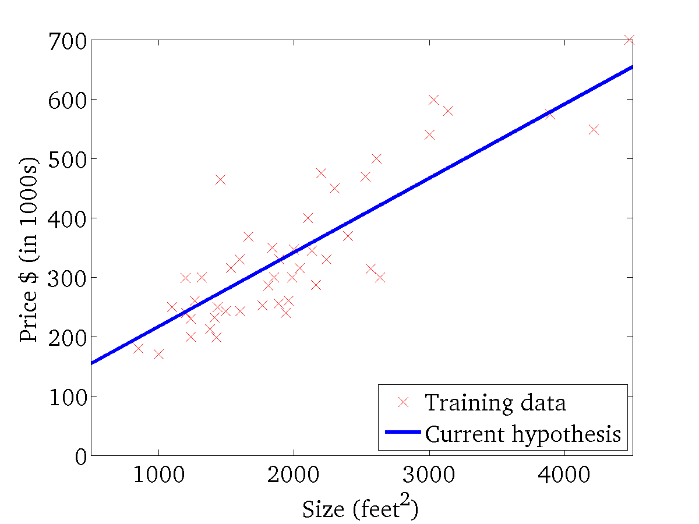

(for fixed , this is a function of x)
(function of the parameters )

Slide 55
“Batch” Gradient Descent
“Batch”: Each step of gradient descent uses all the training examples.

