Slide 1

Matrices and vectors
Linear Algebra review (optional)
Machine Learning

Slide 2
Matrix: Rectangular array of numbers:
Dimension of matrix: number of rows x number of columns

Slide 3
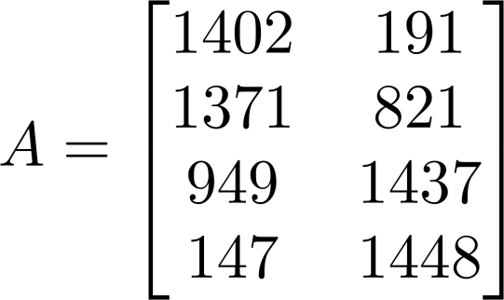
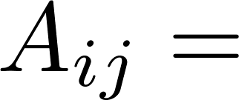

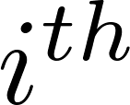

Matrix Elements (entries of matrix)
“ , entry” in the row, column.

Slide 4
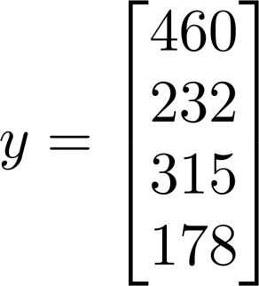
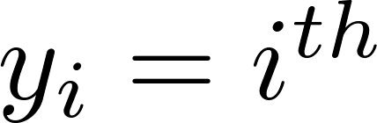
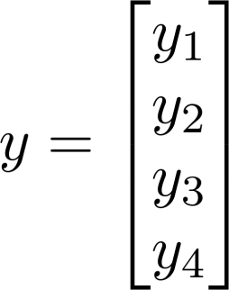
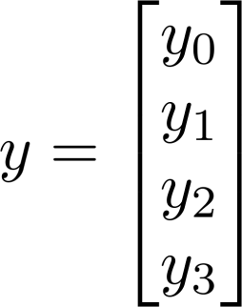
Vector: An n x 1 matrix.
1-indexed vs 0-indexed:
element
n-dimensional vector

Slide 5
Addition and scalar multiplication
Linear Algebra review (optional)
Machine Learning

Slide 6
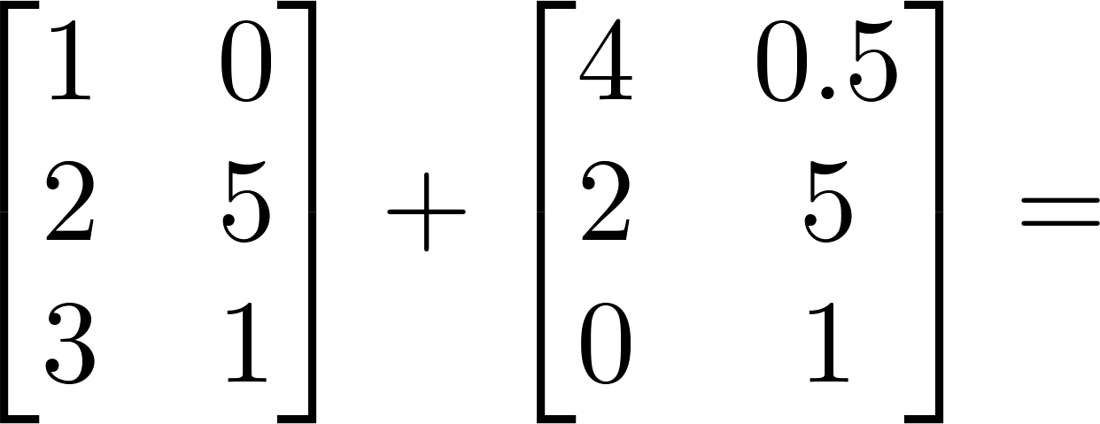
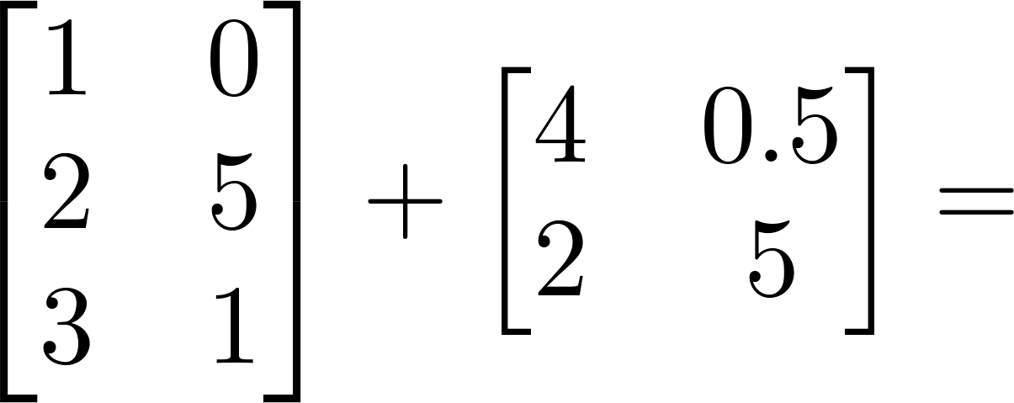
Matrix Addition

Slide 7
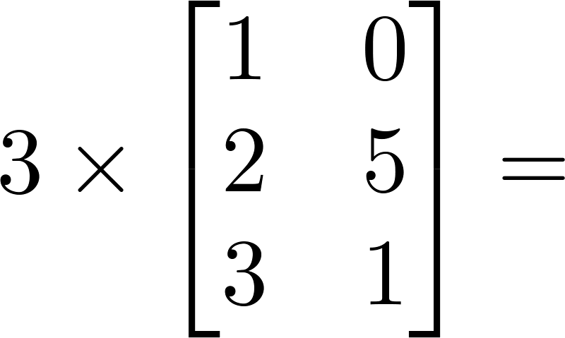
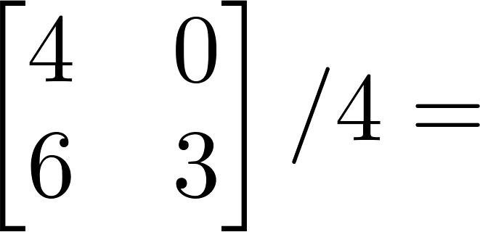
Scalar Multiplication

Slide 8
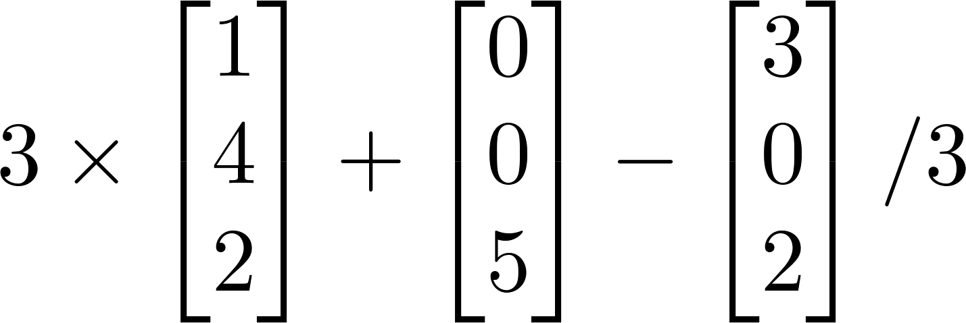
Combination of Operands

Slide 9
Matrix-vector multiplication
Linear Algebra review (optional)
Machine Learning

Slide 10
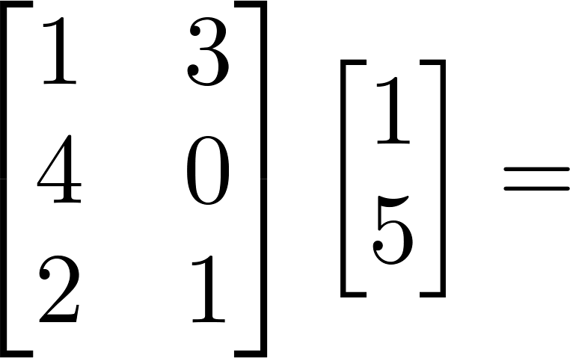
Example

Slide 11
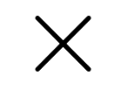
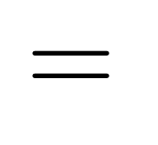



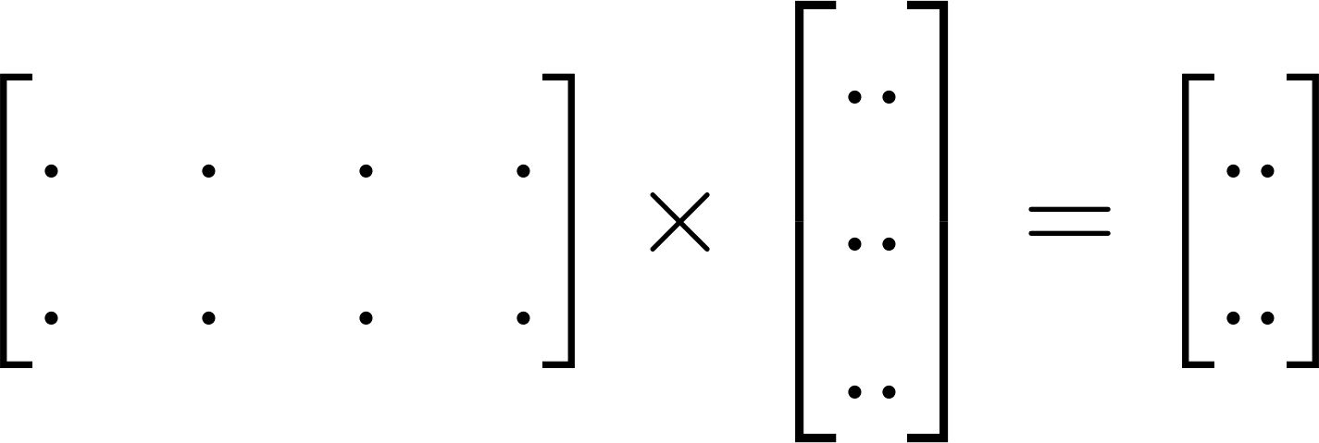

Details:
m x n matrix
(m rows,
n columns)
n x 1 matrix
(n-dimensional
vector)
m-dimensional vector
To get , multiply ’s row with elements of vector , and add them up.

Slide 12
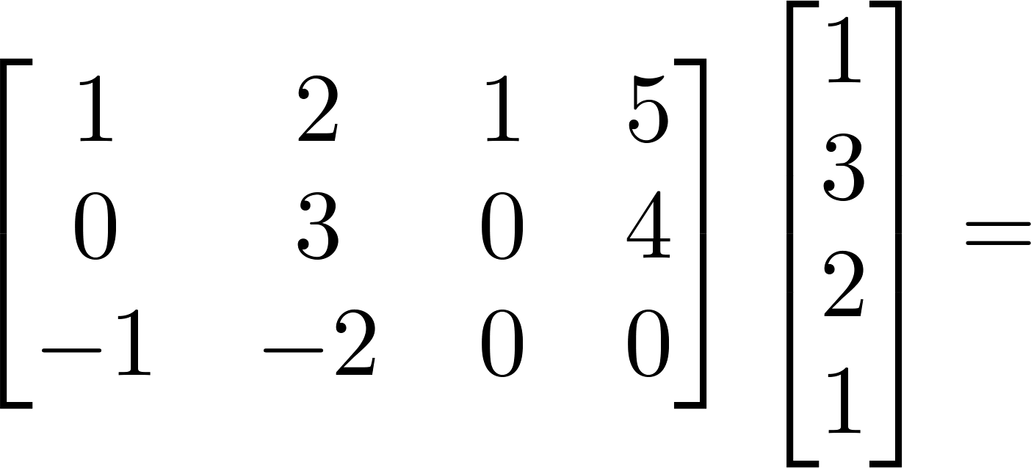
Example

Slide 13
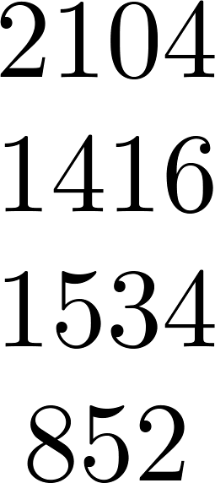
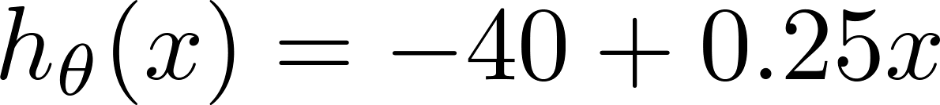
House sizes:

Slide 14
Matrix-matrix multiplication
Linear Algebra review (optional)
Machine Learning

Slide 15
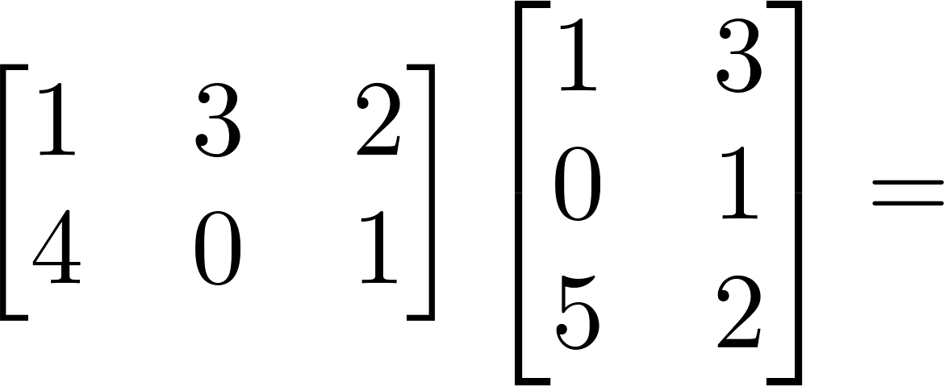
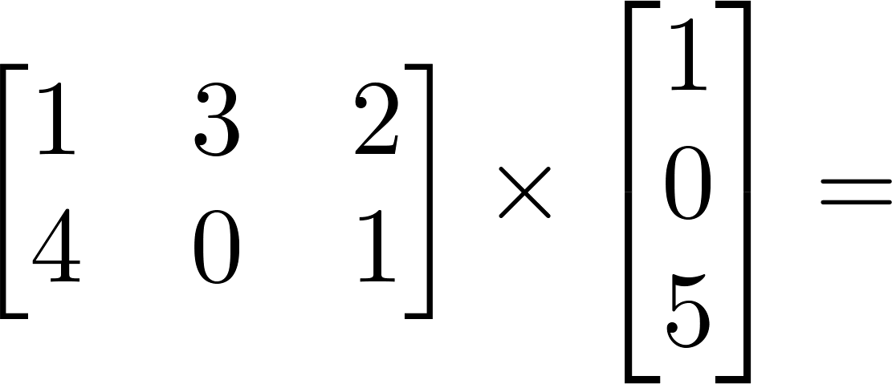
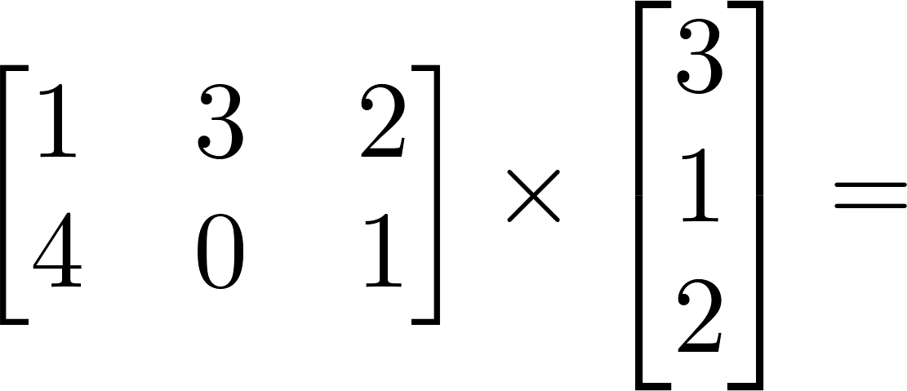
Example

Slide 16



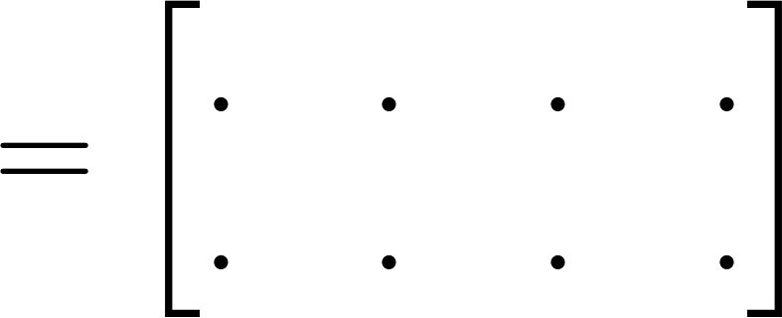

Details:
m x n matrix
(m rows,
n columns)
n x o matrix
(n rows,
o columns)
m x o
matrix
The column of the matrix is obtained by multiplying
with the column of . (for = 1,2,…,o)

Slide 17
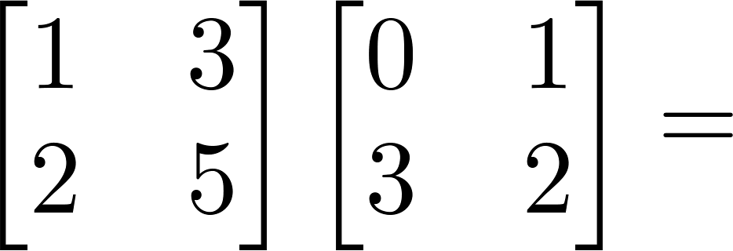
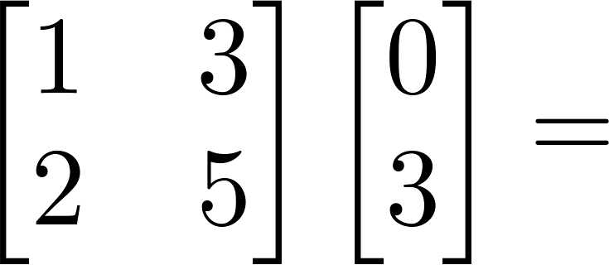
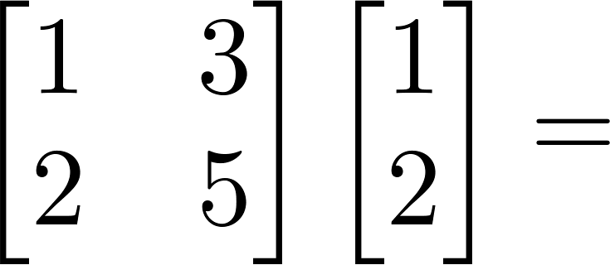
Example
7
2
7

Slide 18
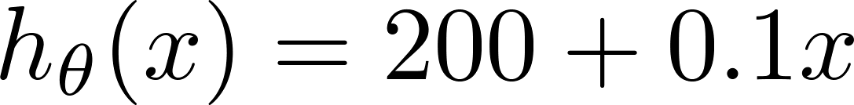
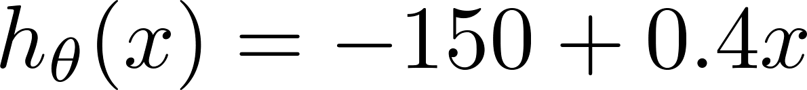
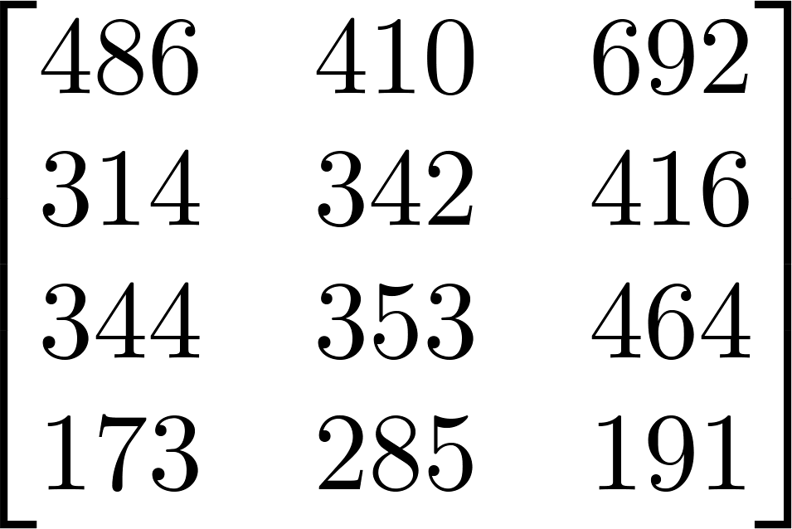
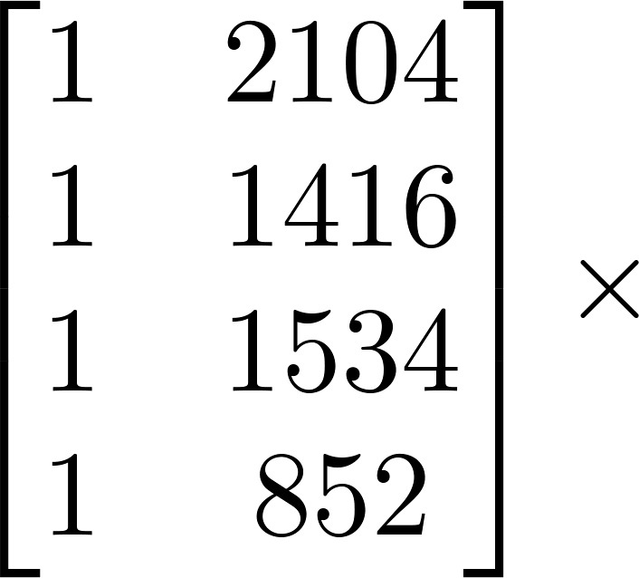
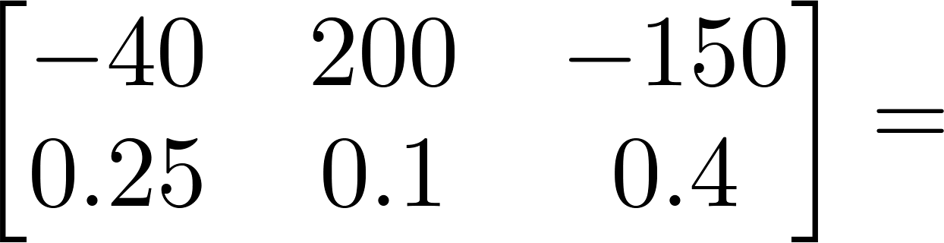
House sizes:
Have 3 competing hypotheses:
1.
2.
3.
Matrix
Matrix

Slide 19
Matrix multiplication properties
Linear Algebra review (optional)
Machine Learning

Slide 20

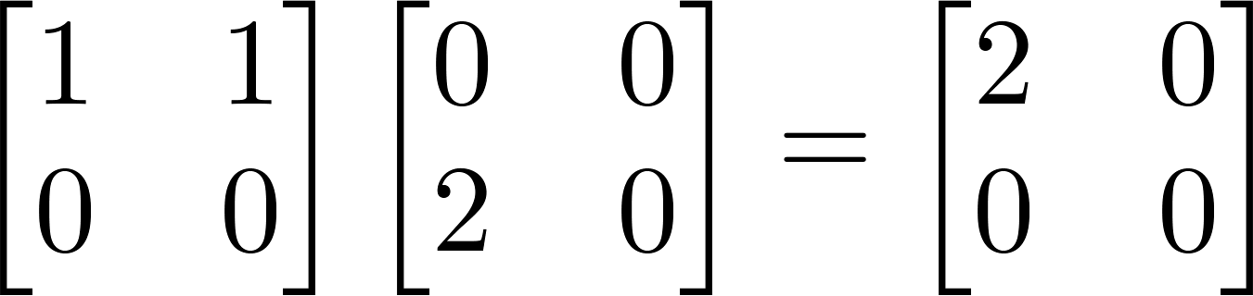
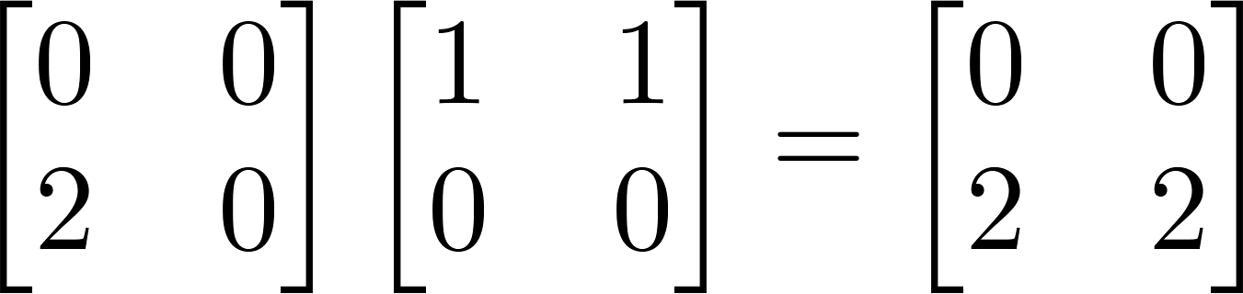
Let and be matrices. Then in general,
(not commutative.)
E.g.

Slide 21





Let
Compute
Let
Compute

Slide 22

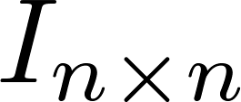
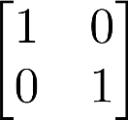
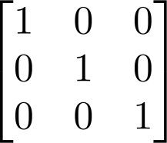
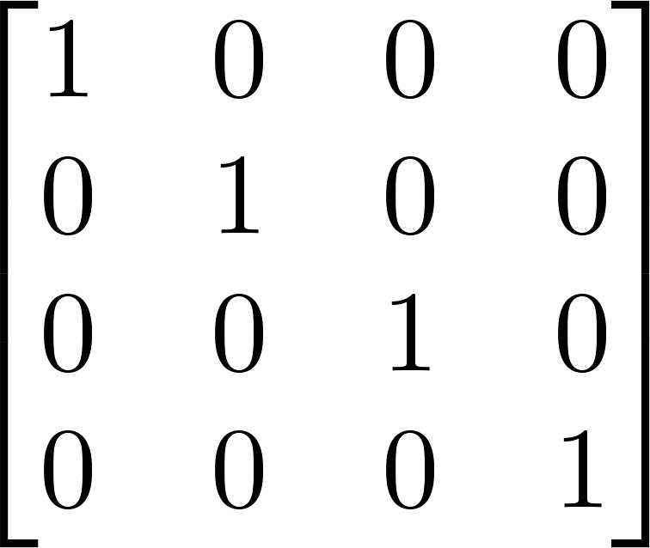
Identity Matrix
Denoted (or ).
Examples of identity matrices:
2 x 2
3 x 3
4 x 4
For any matrix ,

Slide 23
Inverse and transpose
Linear Algebra review (optional)
Machine Learning

Slide 24
Not all numbers have an inverse.
Matrix inverse:
If A is an m x m matrix, and if it has an inverse,
Matrices that don’t have an inverse are “singular” or “degenerate”

Slide 25
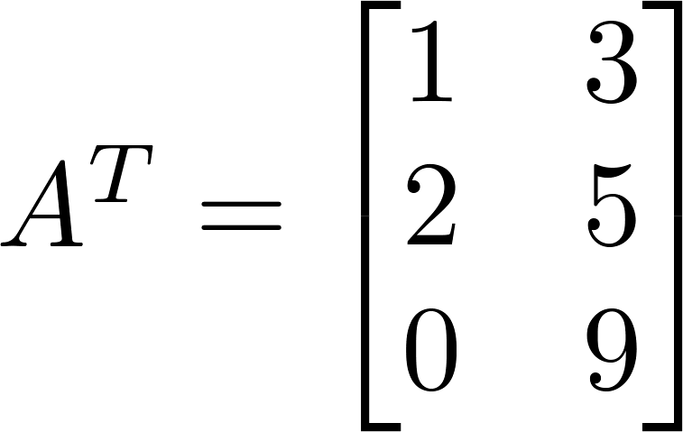
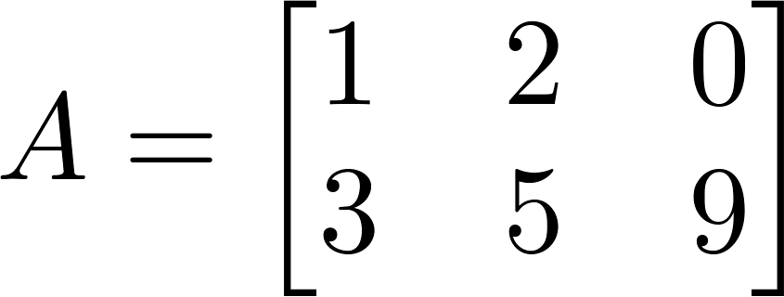

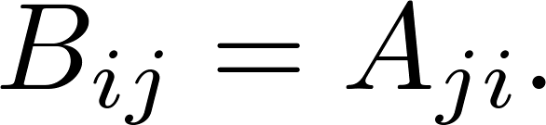
Matrix Transpose
Example:
Let be an m x n matrix, and let
Then is an n x m matrix, and

