Slide 1
Time-Decayed Caching
A Unified Approach to Recency and Frequency-Based Cache Replacement
Pângăleanu Cătălin

Slide 2
Problem Statement

Slide 3
The Cache Replacement Problem
• Modern systems rely heavily on caching for performance
• Limited cache capacity requires intelligent eviction decisions
• Key question: Which item should be evicted when cache is full?
• Eviction policy directly impacts system performance

Slide 4
Existing Cache Replacement Policies
• LRU (Least Recently Used):
▪ Evicts oldest accessed item
▪ Exploits temporal locality but ignores frequency
• LFU (Least Frequently Used):
▪ Evicts least accessed item
▪ Keeps popular items but slow to adapt
• ARC (Adaptive Replacement Cache):
▪ Balances recency and frequency
▪ Self-tuning but very complex state management

Slide 5
Motivation

Slide 6
The Recency vs Frequency Trade-off
• LRU optimizes for recency, LFU optimizes for frequency
• No single policy wins across all workload types
• Workload characteristics vary and change over time
• Need a unified approach that captures both dimensions

Slide 7
Challenges with Existing Solutions
• Real workloads exhibit both temporal and frequency patterns
• Popularity of items changes over time (non-stationary)
• Simple policies optimize for one dimension only
• Adaptive policies (like ARC) add significant complexity

Slide 8
Our Key Insight
A simple, unified approach to recency and frequency
• Recent accesses should count more than old ones
• Frequent accesses still indicate importance
• Combine both dimensions using time decay
• Exponential decay naturally models value depreciation

Slide 9
Proposed Method

Slide 10
Time-Decayed Caching (TDC)
Score(item) = Σ γ^(t_current - t_access)
where γ ∈ (0, 1) is the decay rate
Each access contributes to the item's score, with older accesses weighted less. The item with the lowest score is evicted.

Slide 11
Intuitive Parameter Tuning: Half-Life
γ = 0.5 ^ (1/H)
where H is the half-life (in number of accesses)
Set how many accesses until a hit becomes half as important. Example: T = 100 means after 100 accesses, an old hit contributes only 50% of its original weight.

Slide 12
Algorithm Design
• On cache hit: Update score with decay, +1 for new access
• On cache miss: Evict item with minimum score, insert new item
• Decay rate γ controls recency vs frequency trade-off
• γ → 1: More weight on frequency (LFU-like)
• γ → 0: More weight on recency (LRU-like)

Slide 13
Complexity Analysis
• Naive implementation:
▪ Time: O(n) per query
▪ Space: O(n) for scores and timestamps
• Time complexity can be optimized with min-heap to O(log n)

Slide 14
Evaluation

Slide 15
Experimental Setup
• Compared against: LRU, LFU, ARC
• Synthetic traces: Zipf distribution
• Non-stationary traces: Phase changes with varying hot sets
• Real-world trace: NASA HTTP access
• Cache sizes: 1% to 16% of unique items

Slide 16
Evaluation Metric
Δ(j, c, TDC) = (HR_TDC - HR_j) / HR_TDC × 100%
Delta measures relative improvement of TDC over baseline j. Positive values indicate TDC outperforms the baseline.

Slide 17
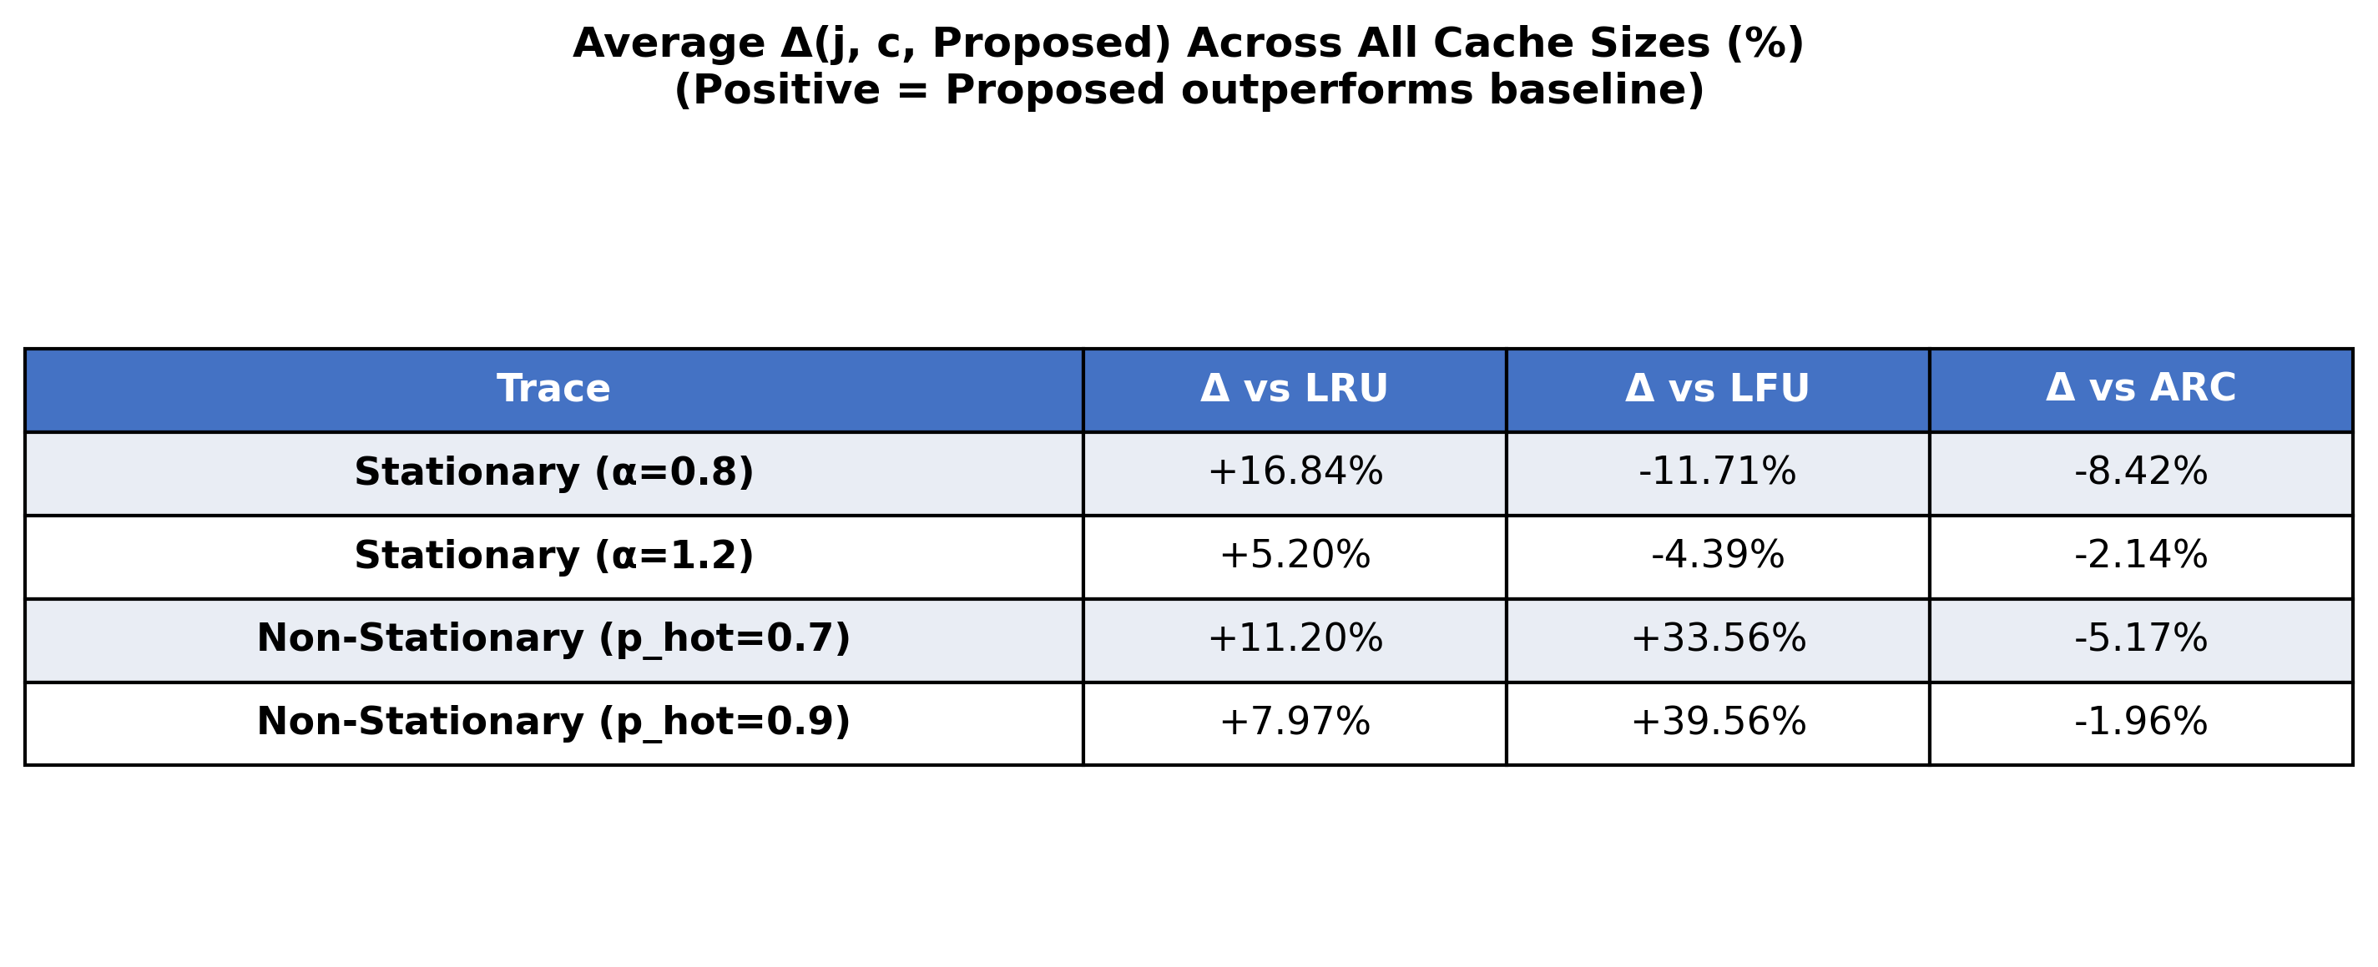
Results: Synthetic Traces
Average Δ across all cache sizes - Positive values indicate TDC outperforms baseline

Slide 18
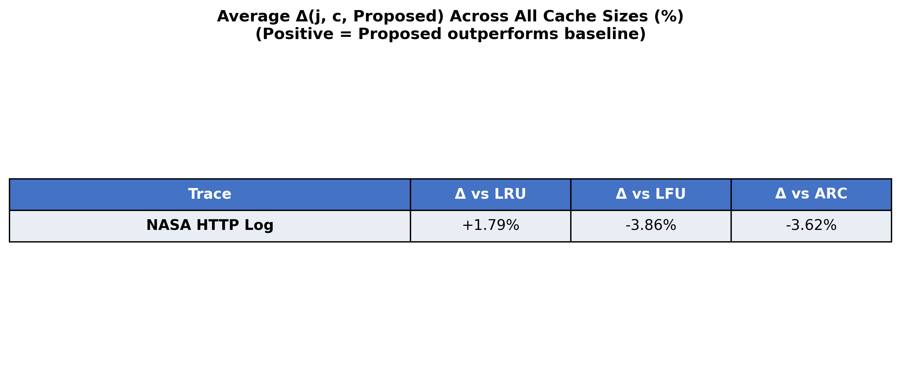
Results: Real-World Trace (NASA HTTP Log)
Performance on real web server access patterns

Slide 19
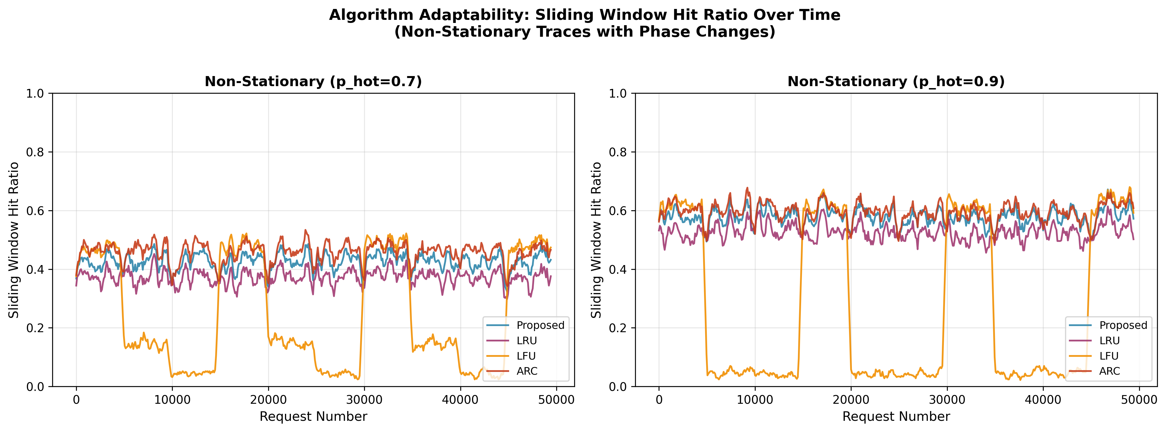
Adaptability: Synthetic Non-Stationary Traces
Sliding window hit ratio over time - Shows adaptation to phase changes

Slide 20
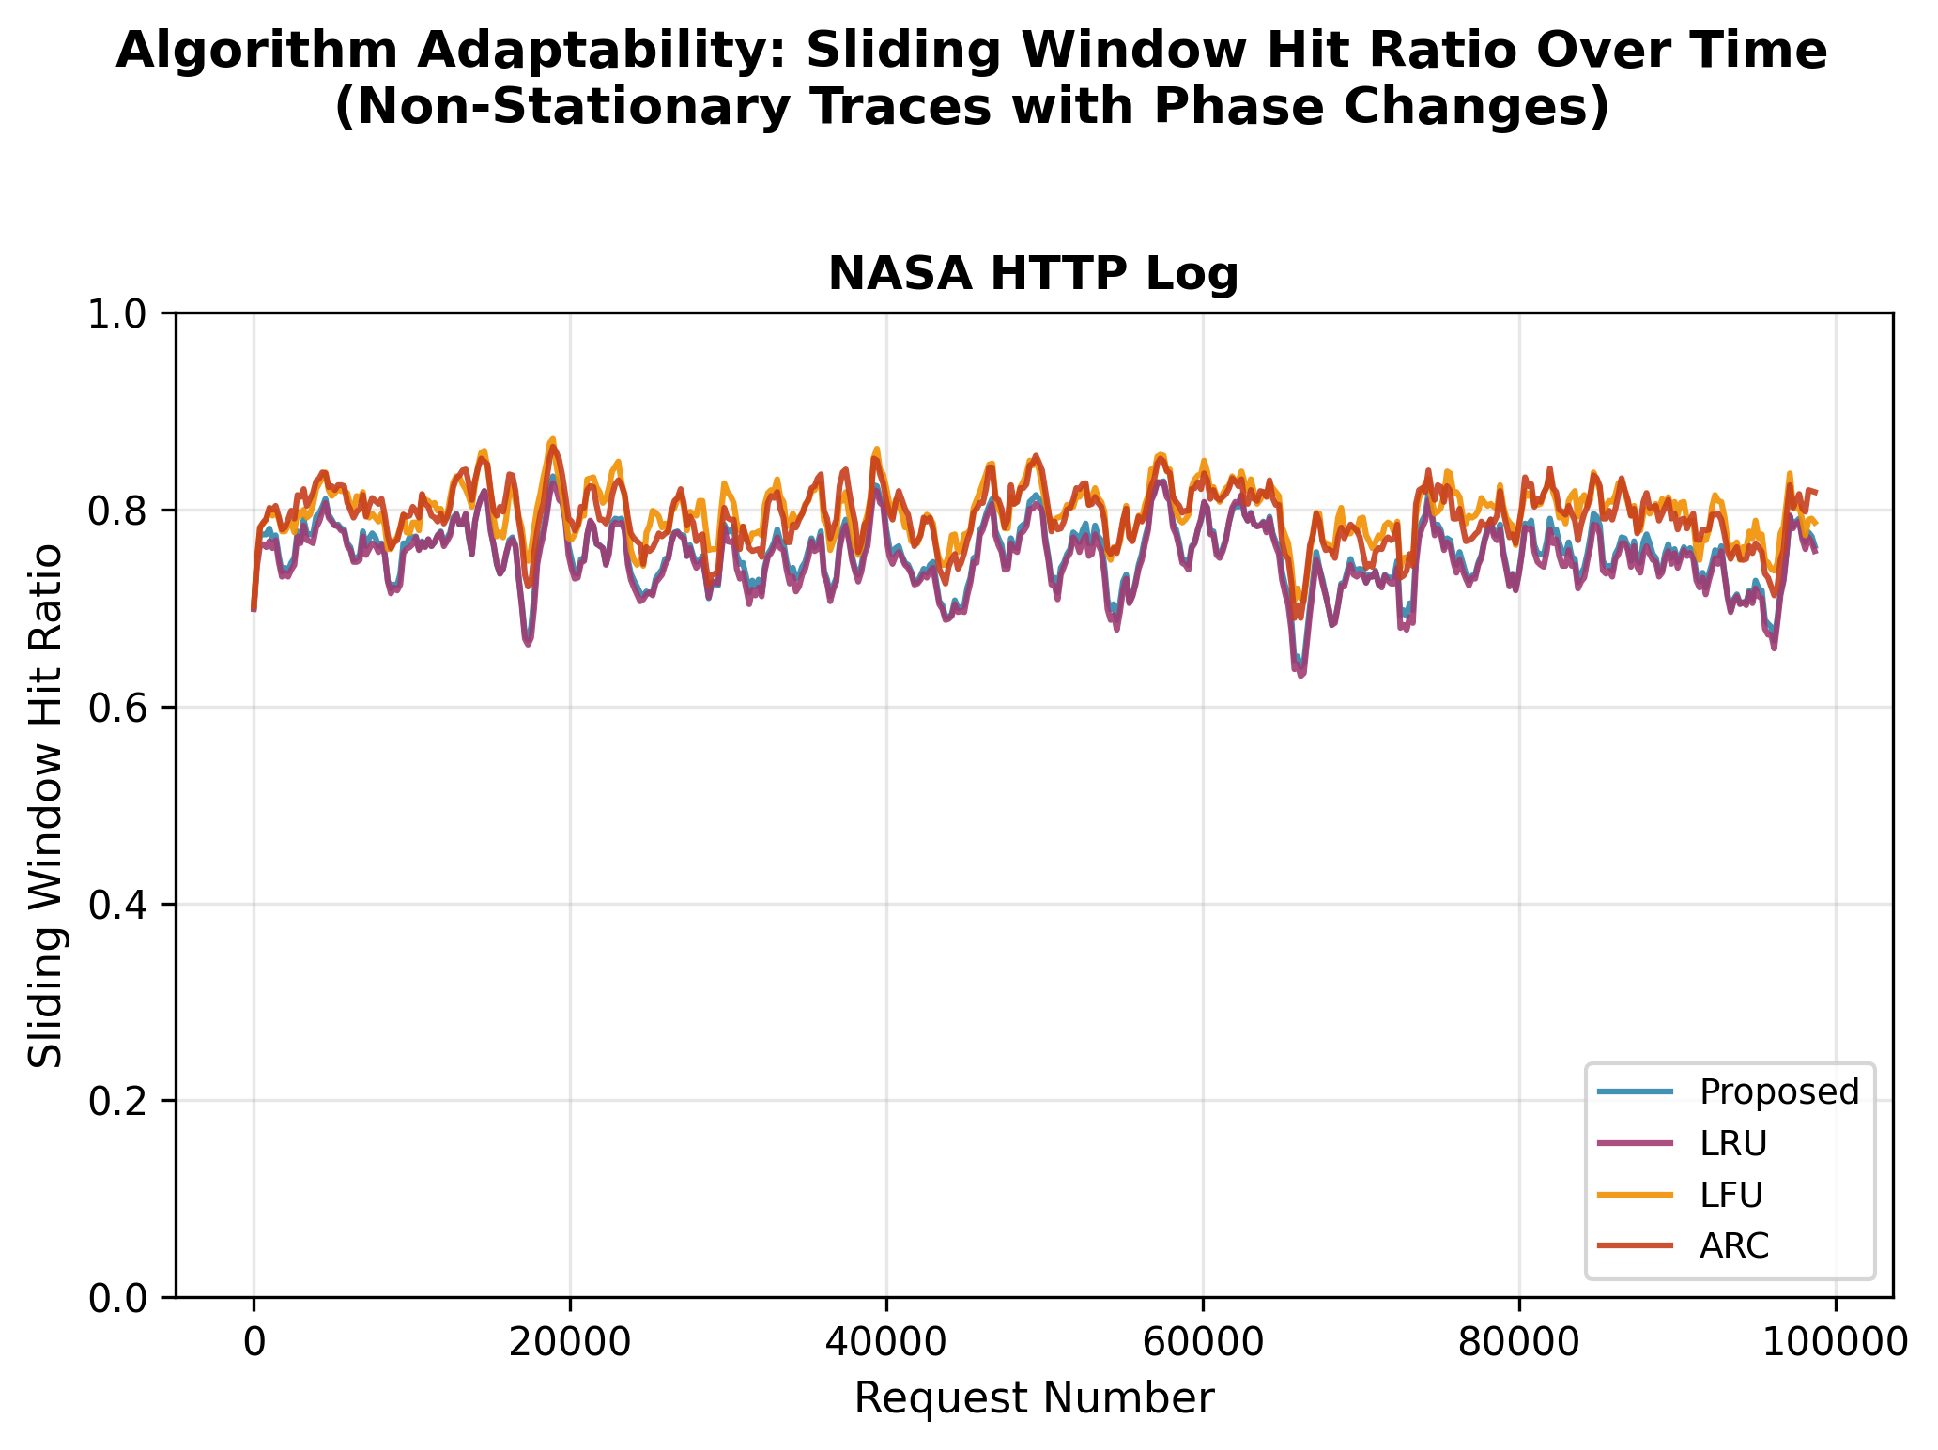
Adaptability: Real-World Trace
Sliding window hit ratio on NASA HTTP log

Slide 21
Conclusions

Slide 22
Key Findings
• TDC outperforms LRU, LFU baselines on non-stationary workloads; comparable performance to more complex ARC
• Competitive performance on stationary workloads
• Single parameter (γ) controls recency-frequency trade-off
• Simple implementation with interpretable behavior

Slide 23
Future Work
• Adaptive decay rate based on automatic workload detection
• Evaluation on larger-scale production traces
• Integration with hierarchical caching systems

Slide 24
Thank You
Questions?

