Slide 1
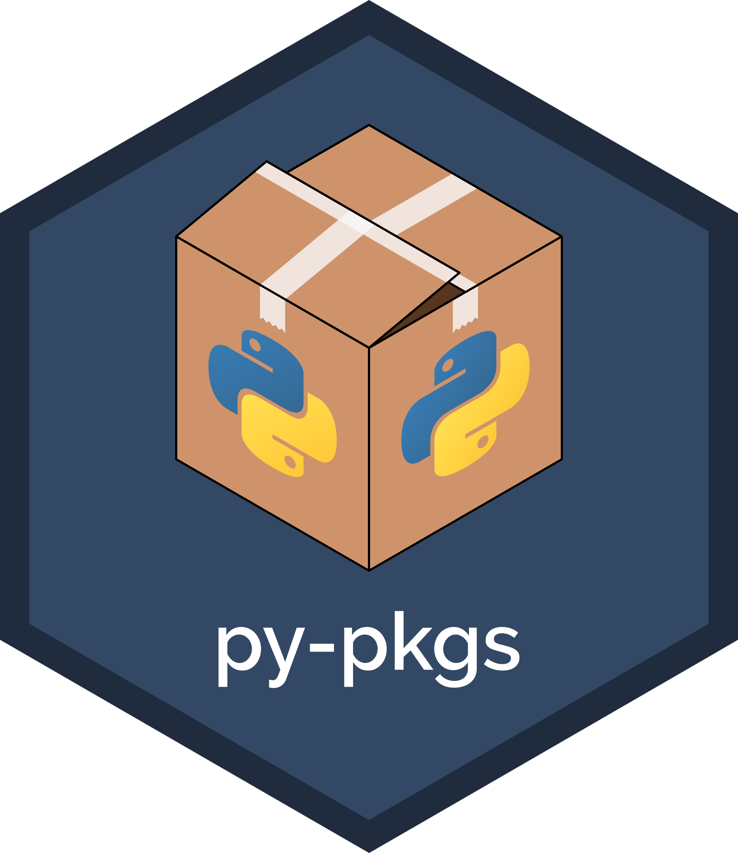
from py-pkgs import CHEAT SHEET
1
Packaging Tools
3
Write Your Code
Documentation can be rendered using sphinx and sphinxcontrib-napoleon:
This Python Packaging cheat sheet will help you build a Python Package in no time! It relies on the following requirements:
Once your Python package is set up, you can start writing your code! Your package may consist of functions, classes, a command line interface, or anything other Python code you wish!
1. Add these tools as package dependencies:
$ poetry add –-dev sphinx sphinxcontrib-napoleon
Tool | Description
poetry | Python dependency & package management tool
GitHub | Online project management & code version control system
cookiecutter | Directory & file templating tool
2. Render docstrings into documentation if required:
4
Tests
4
$ poetry run sphinx-apidoc -f -o docs/source mypkg
Your package should also contain tests to verify that code is working as expected. pytest is an easy to use testing framework, with a typical workflow of:
3. Render package documentation in docs:
2
Package Structure
$ cd docs
$ poetry run make html
1. Add pytest as a development dependency:
4. Upload to Read the Docs following these instructions if desired.
Python packages have a standard structure. poetry and cookiecutter can help you set up this structure quickly with the following steps:
$ poetry add --dev pytest
7
CI/CD
1. Install cookiecutter (if it is not installed):
2. Write tests in mypkg/tests/test_mypkg.py. Guidelines for writing tests can be found here, but they typically look something like this:
6
Releasing
There are many tools available for implementing CI/CD for your package. In py-pkgs, we advocate for GitHub Actions.
The UBC-MDS cookiecutter used in Step 2 provides an option for including pre-mase CI and/or CD workflow files in your package structure, which can be modified as desired and are triggered when you push your package repository to GitHub. Take a look at the CI/CD chapter of py-pkgs for more information.
$ pip install cookiecutter
def test_myfunc():
assert mypkg.myfunc(1, 5) == 6
assert mypkg.myfunc(-1, -5) == -6
Your package should ideally adopt the semantic versioning scheme, e.g., v0.1.0. For help implementing versioning, deprecation, or the release process in general, see the Releasing and Versioning chapter of py-pkgs. Releasing will typically involve the following:
2. Run the UBC-MDS cookiecutter template and follow the prompts:
$ cookiecutter https://github.com/UBC-MDS/cookiecutter-ubc-mds.git
3. Run tests and make sure they are passing:
3. Change into the root directory of your new package (here named “mypkg”) :
$ poetry run pytest
1. Bump package version if required:
4. Calculate test coverage with pytest-cov:
$ poetry version patch/minor/major
$ cd mypkg
$ poetry add –-dev pytest-cov
$ poetry run pytest --cov=mypkg tests/
2. Ensure tests are passing:
8
Acknowledgments
4. Initialize a poetry project:
$ poetry run pytest
$ poetry init
5
Documentation
3. Build package
This cheat sheet was inspired by the Rstudio Cheatsheets. Thanks also to Cookiecutter and Jupyter Book for providing the open-source frameworks to build and support py-pkgs.
You should end up with a directory structure similar to that shown below. If you’re after a package with a command line interface (CLI), see the CLI package chapter of py-pkgs.
The UBC-MDS cookiecutter template provides basic package documentation, such as a README, LICENSE, CONDUCT, CONTRIBUTING file and a populated docs folder.
You will still need to write documentation for your code as necessary, including:
$ poetry build
4. Release to TestPyPI and check you can install your package.
mypkg
├── CONDUCT.rst
├── CONTRIBUTING.rst
├── docs
├── mypkg
├── .gitignore
├── .github
├── LICENSE
├── pyproject.toml
├── README.md
└── tests
$ poetry config repositories.test-pypi https://test.pypi.org/legacy/
$ poetry publish -r test-pypi
$ pip install --index-url https://test.pypi.org/simple/ --extra-index-url https://pypi.org/simple mypkg
1. Inline comments;
2. Block comments;
3. Docstrings.
5. If all is working as expected, release to PyPI:
$ poetry publish
CC BY SA Tomas Beuzen (https://www.tomasbeuzen.com/) & Tiffany Timbers (https://www.tiffanytimbers.com/) • Learn more at https://ubc-mds.github.io/py-pkgs/ • Updated: 2020-08

