Slide 1
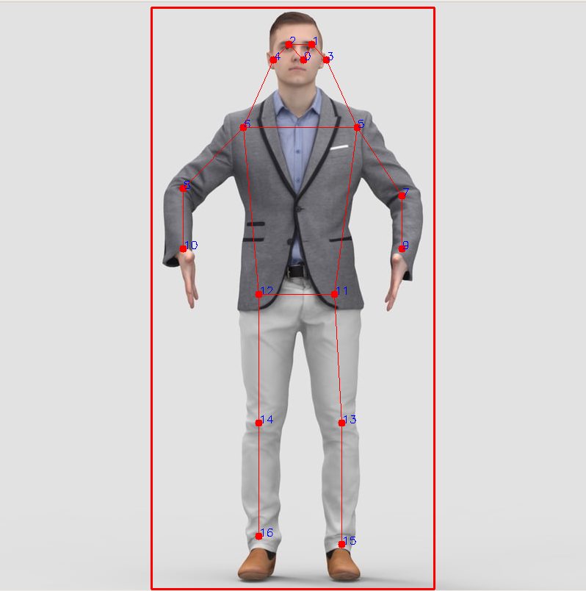
(153,0,76)
(153,0,0)
(204,0,102)
(204,0,0)
(102,0,0)
(255,0,0)

Slide 2
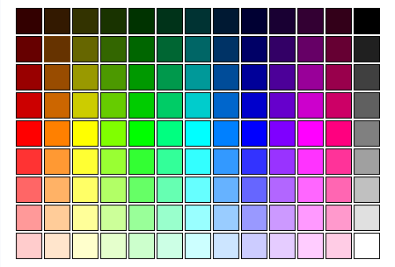
1
(102,0,0)
0
(102,51,0)
2
(102,0,51)
3
(153,0,0)
4
(153,0,76)
5
(204,0,0)
11
(204,102,0)
12
(204,0,204)
6
(204,0,102)
7
(255,0,0)
13
(255,128,0)
14
(255,0,255)
8
(255,0,127)
9
(255,51,51)
15
(255,153,51)
16
(255,51,255)
10
(255,51,153)

Slide 3
1
(102,0,0)
0
(102,51,0)
2
(102,0,51)
3
(153,0,0)
4
(153,0,76)
5
(204,0,0)
11
(204,102,0)
12
(204,0,204)
6
(204,0,102)
7
(255,0,0)
13
(255,128,0)
14
(255,0,255)
8
(255,0,127)
9
(255,51,51)
15
(255,153,51)
16
(255,51,255)
10
(255,51,153)

