Slide 1
SWE20001 Final Project Type Type Mayhem
By:
Sheldon Lai Jian Heng (100086149)
Jason Ang (100087252)
Darren Frederick Chan Chyun Yaw (100085926)

Slide 2
Project Scope
Overall
To extend an unfinished game project from online users of GitHub or from any online source.

Slide 3
Project Scope
Deliverables
A finished game project that satisfies the requirements set by the project owner and is inline with the project goals.

Slide 4
Project Scope
Justification
To create a game that helps people develop their keyboard typing skills in a fun and interesting way.

Slide 5
Project Scope
Constraints
Limited period of time to complete the project. Due date is in Week 12, the last week of May.
Team members have differing responsibilities.
The study, setup, and use of Unity game engine.

Slide 6
Project Scope
Assumptions
That team members are competent in the C# programming language.
That team members are competent in the usage of Visual Studio 2017 IDE.
That team members will stay for the whole duration of the project.

Slide 7
Tools Used
Communication
Slack
Task Management
Trello
Time Tracking
Toggl
Game Engine and Coding
Visual Studio and Unity.

Slide 8
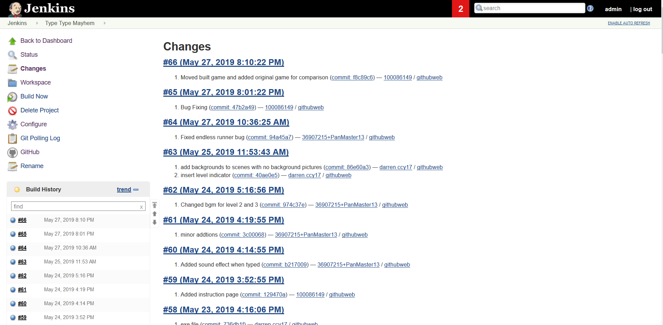
Continuous Integration
We also practiced using continuous integration in the final weeks of the project.

