Slide 1
Family Wallet
·家 庭 钱 包
——Your personal family finance assistant
—— 你私人的家庭财产助理
Track : Java
Grade : 2022
Batch: Batch 1

Slide 2
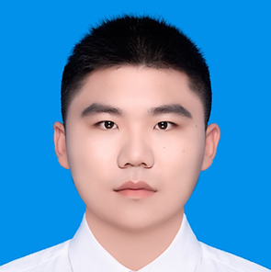
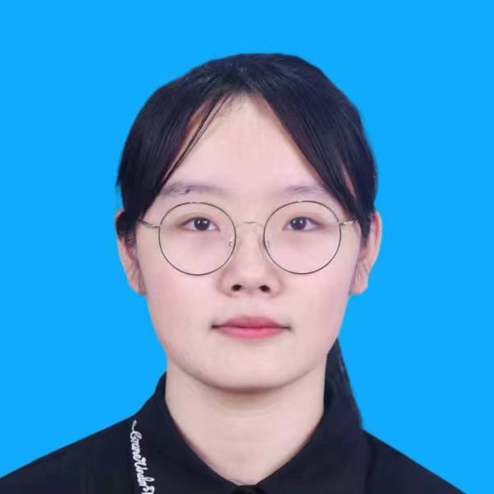
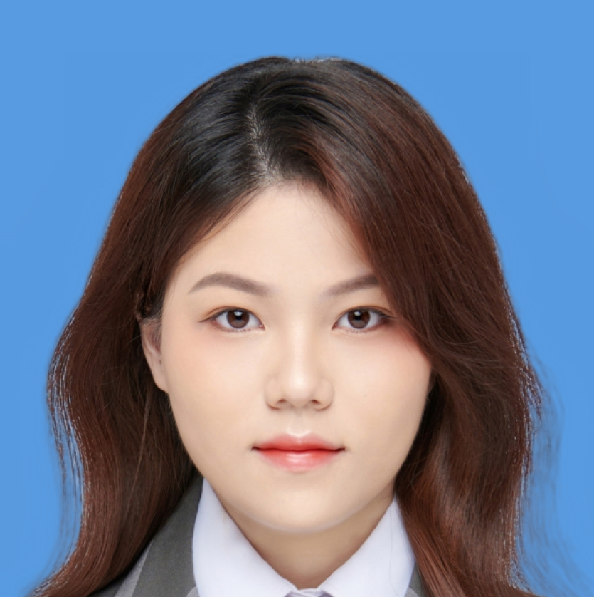

Presenters
Name : Price
ID : 202224120121
Role: Team Leader
Backend Developer
Name: Leah
ID: 202224120148
Role: Frontend Developer
UI Designer
Name: Sue
ID: 202224120147
Role: Database Developer
Name : Zhang
ID : 202224120145
Role: Backend Developer

Slide 3
Directory
·目 录
1. Analyze & Plan
1. 分析 & 计划
2. Division & Action
2. 分工 & 行动
3. Summary & Prospect
3. 总结 & 展望

Slide 4
Part 1
Analyze & Plan
分析 & 计划

Slide 5
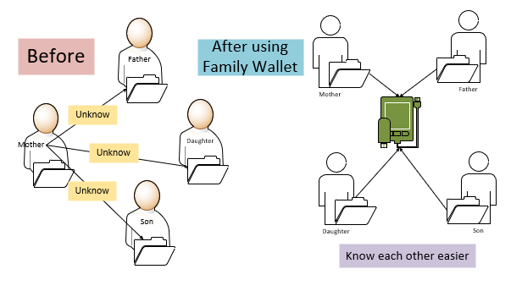
Requirements Analysis
· 需 求 分 析
The family is a collection of members. Transparency in household accounts facilitates the management and overdraft of household assets.
· 家庭是一个成员的集合。因此，家庭财产收支的透明化有助于对财产的投资与管理。
-> Share data
-> Efficient and transparent
-> Co-management
-> Categorized lookup
-> On-demand statistics
· 数据共享
· 高效透明
· 协同管理
· 分类查找
· 按需统计

Slide 6
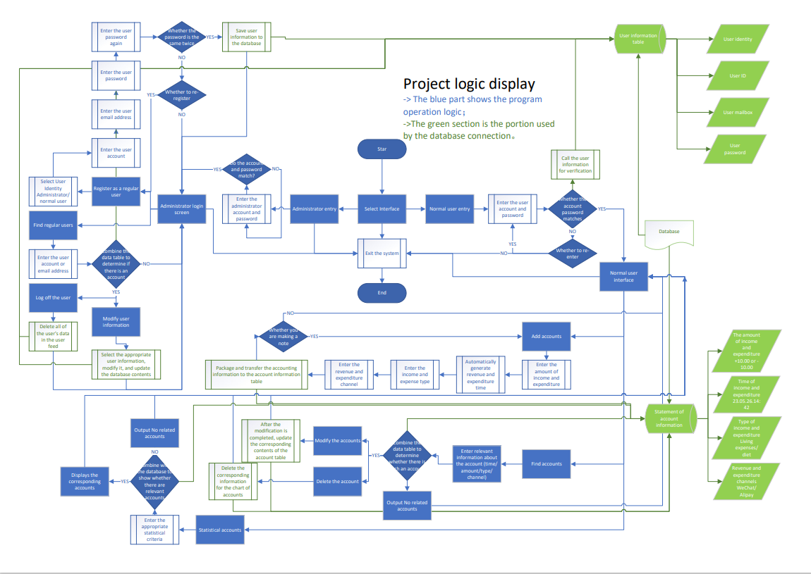
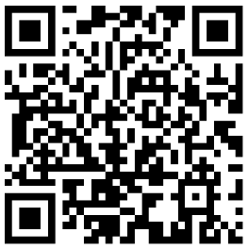
Functional Analysis
· 功 能 分 析
This is the logical framework of the entire program.
· 程序的整体执行框架如图所示。
Scan the QR code to view the high-definition picture
· 扫描此二维码即可查看高清图片。

Slide 7
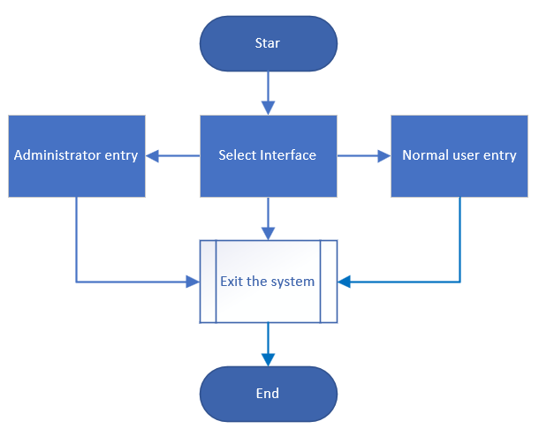
Functional Analysis
· 功 能 分 析
Main Framework :
· 主 框 架 ：
The main framework of the program is simple and consists of three interfaces. These interfaces are the administrator entry, normal user entry, and exit system options, which point to user management, account management, and exit from the system, respectively.
· 程序的主框架十分简易，仅仅由“管理员入口”、“普通用户入口”和“退出系统”三部分组成。它们分别作用于系统的用户管理和账目管理。

Slide 8
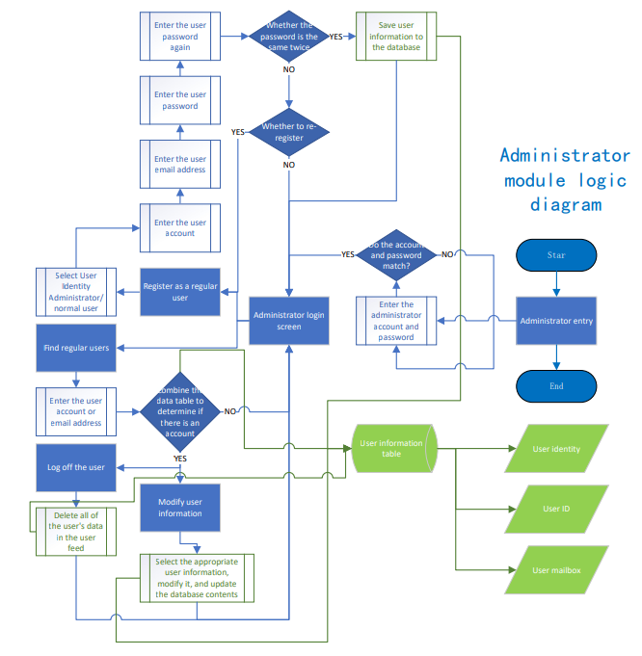
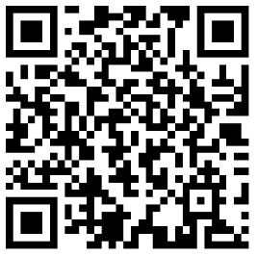
Functional Analysis
· 功 能 分 析
Administrator module ：
· 管理员模块：
This module mainly operates on the user of the system. The program of this module implements the addition, deletion, query, and modification of users through the connection to the database.
· 该模块主要对系统的用户进行操作。该模块通过与数据库的连接实现用户的添加、删除、查询和修改。
Scan the QR code to view the high-definition picture
· 扫描此二维码即可查看高清图片。

Slide 9
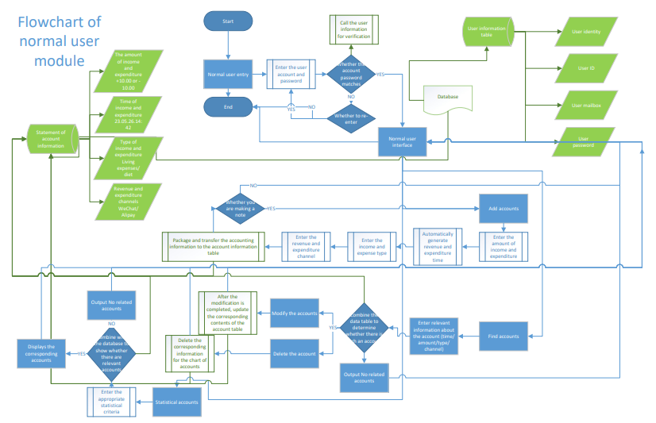
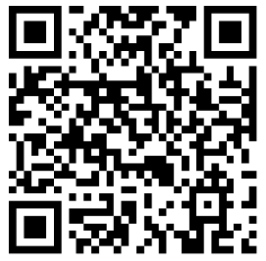
Functional Analysis
· 功 能 分 析
Normal user module ：
· 普通用户模块：
The function of the ordinary user module is to realize the addition, deletion, check and modification of the accounts. Again, we accomplish this by manipulating the database.
· 普通用户模块的功能是实现账户账目的增删、查、改。同样，我们通过与数据库的链接来实现这一操作。
Scan the QR code to view the high-definition picture
· 扫描此二维码即可查看高清图片。

Slide 10
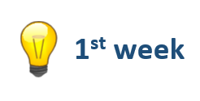



Schedule
· 项 目 计 划
· Conduct project planning
and demand analysis;
· Build and improve the backend code;
· Database design and functional design;
· Expectations and analysis
of the program.
· Analysis and design of UI interface.
· 项目规划，需求分析及预期分析。
· 构建并完善后端代码；· 数据库设计与功能设计；· UI界面的分析与设计。
· Overall improvement and integration of procedures;
· Summary and reflection of the project；
· Preparation of the project‘s report。
· Testing and modification of the project.
· 项目总结与展望；· 汇报材料的准备。
· 项目的整合与改进；测试并修改项目细节。

Slide 11
Part 2
Division & Action
分工 & 行动

Slide 12
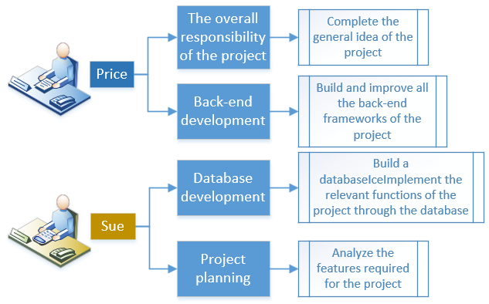
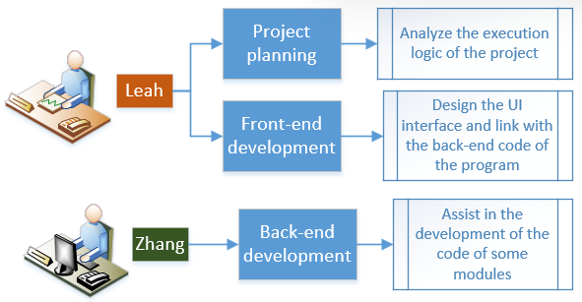
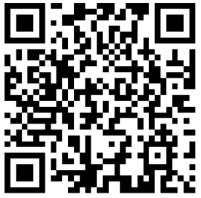
Division of Labor
· 项 目 分 工
Scan the QR code to view the high-definition picture

Slide 13
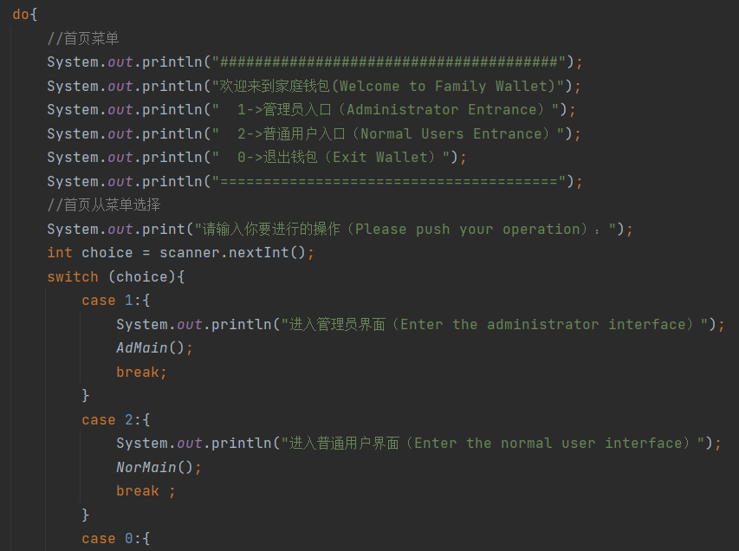
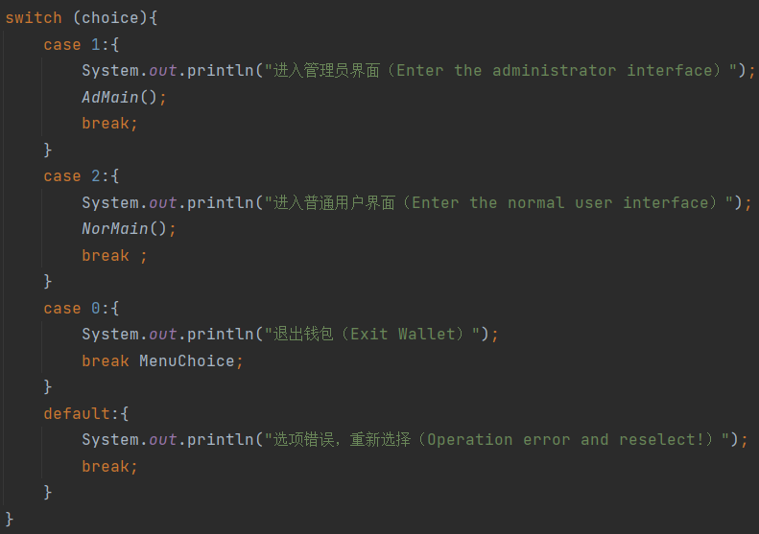
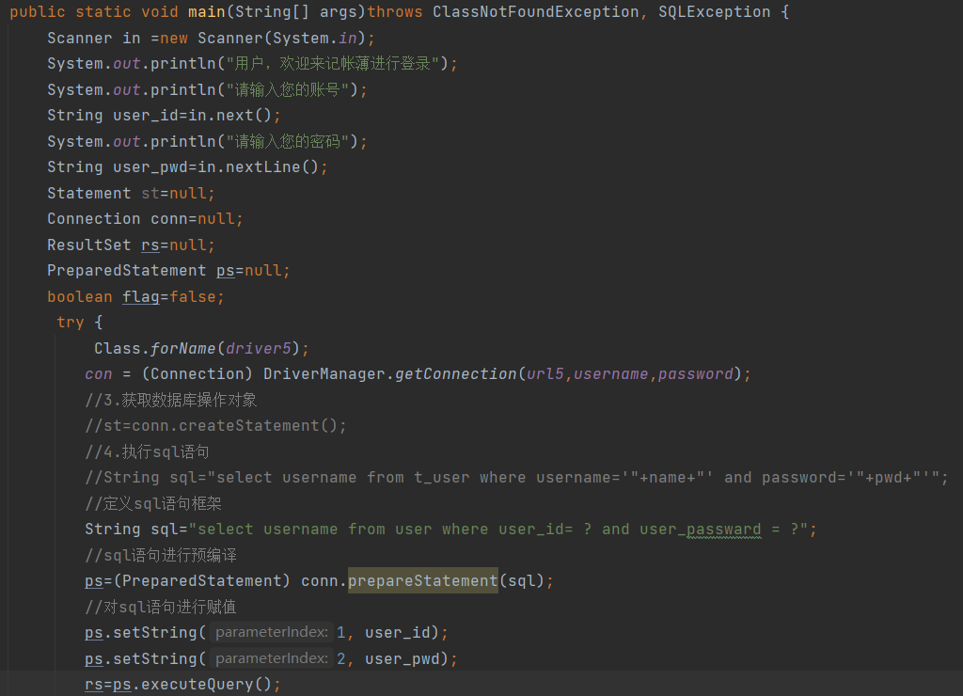
Back-end Development
· 后 端 开 发
In the code on the backend, we used a lot of “switch” statements and “do... while ”statement to implement the underlying functionality of the project. And we completed the development of the back-end code through the modular division of labor.
· 在后端的代码中，我们使用了大量的“switch”语句和“do...while ”语句来实现项目的底层功能。我们通过模块化分工完成了后端代码的开发。

Slide 14
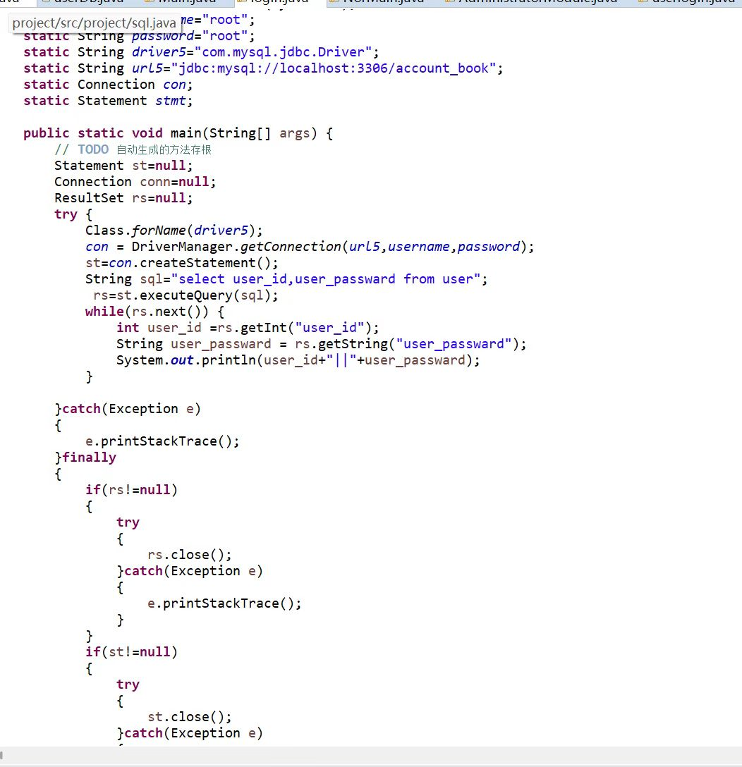
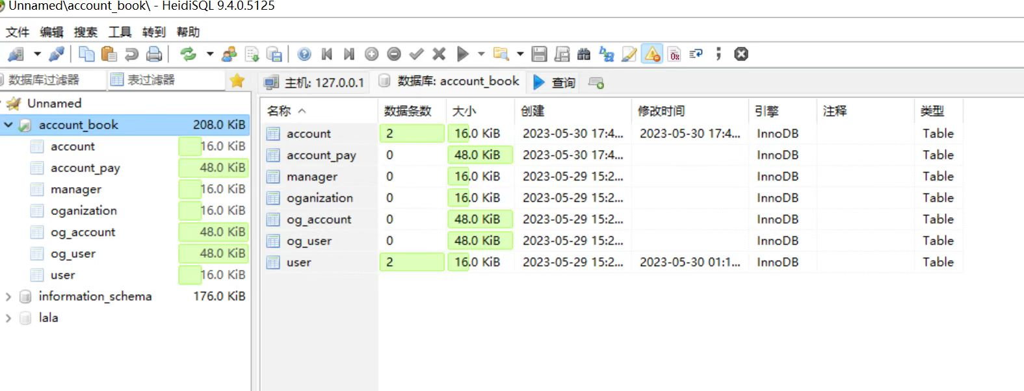
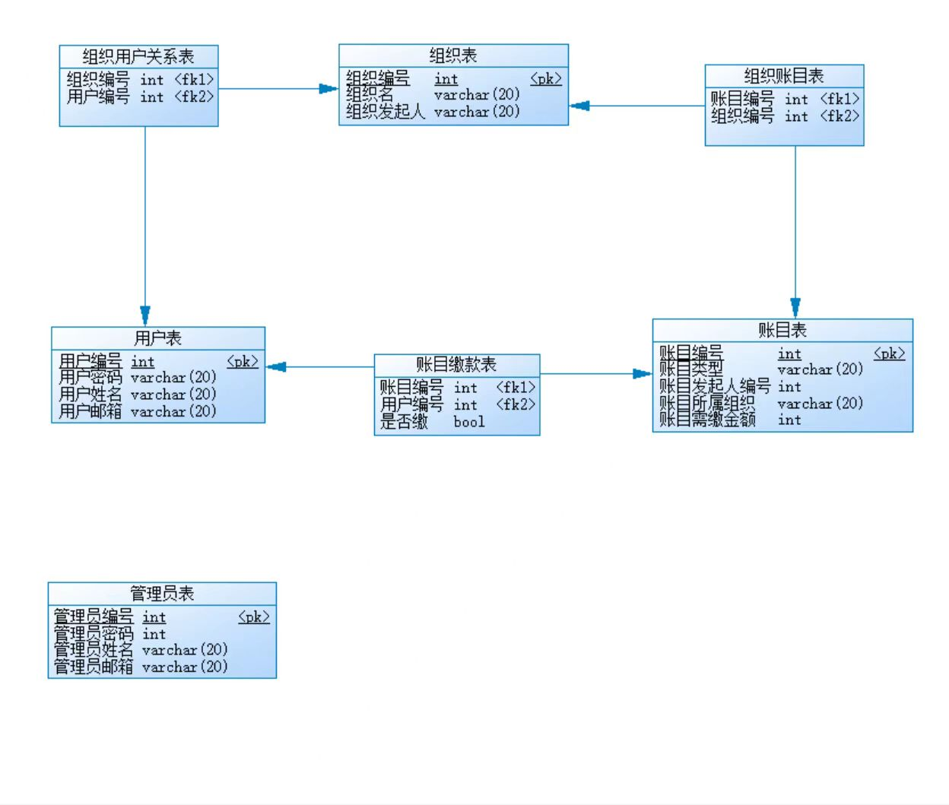
Database Development
· 数 据 库 开 发
First, I used the pd diagram group to build the database file.
After that, I connected to the database with the help of the framework developed by the back-end, and finally realized the project setting of adding, deleting, modifying and checking.
· 首先，我使用 pd 图组来构建数据库文件。随后，我借助后端开发的框架连接数据库，并且实现增删修改查的功能设计。

Slide 15
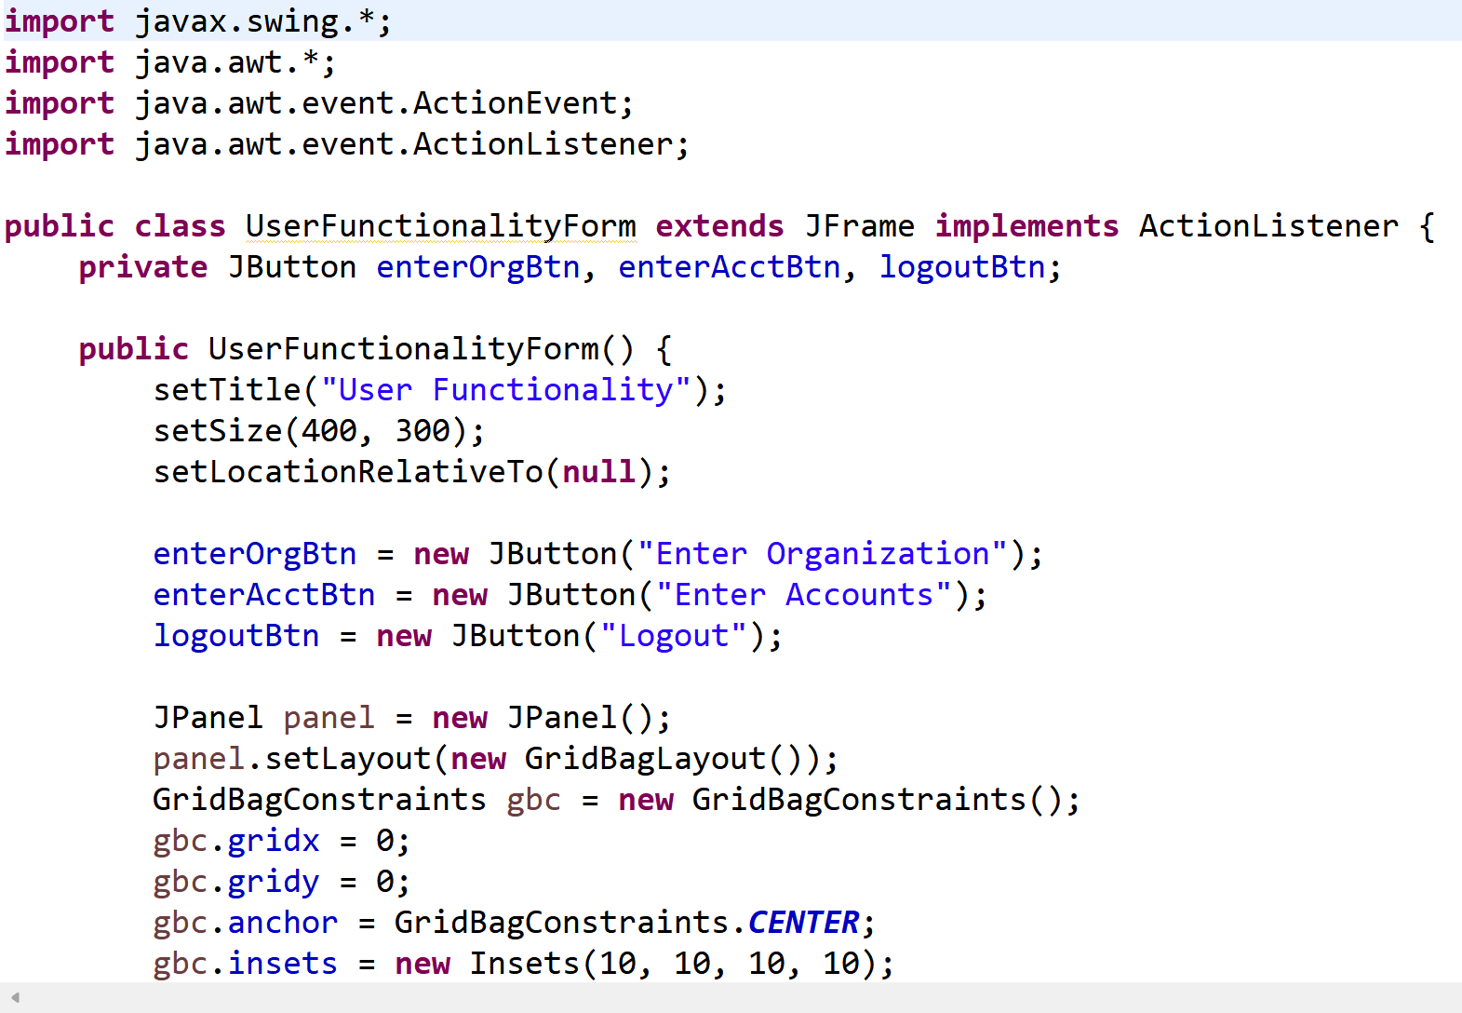
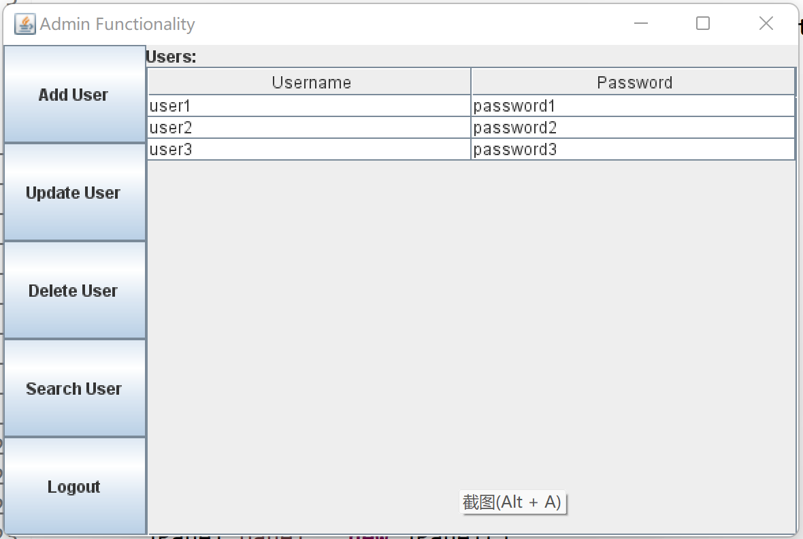
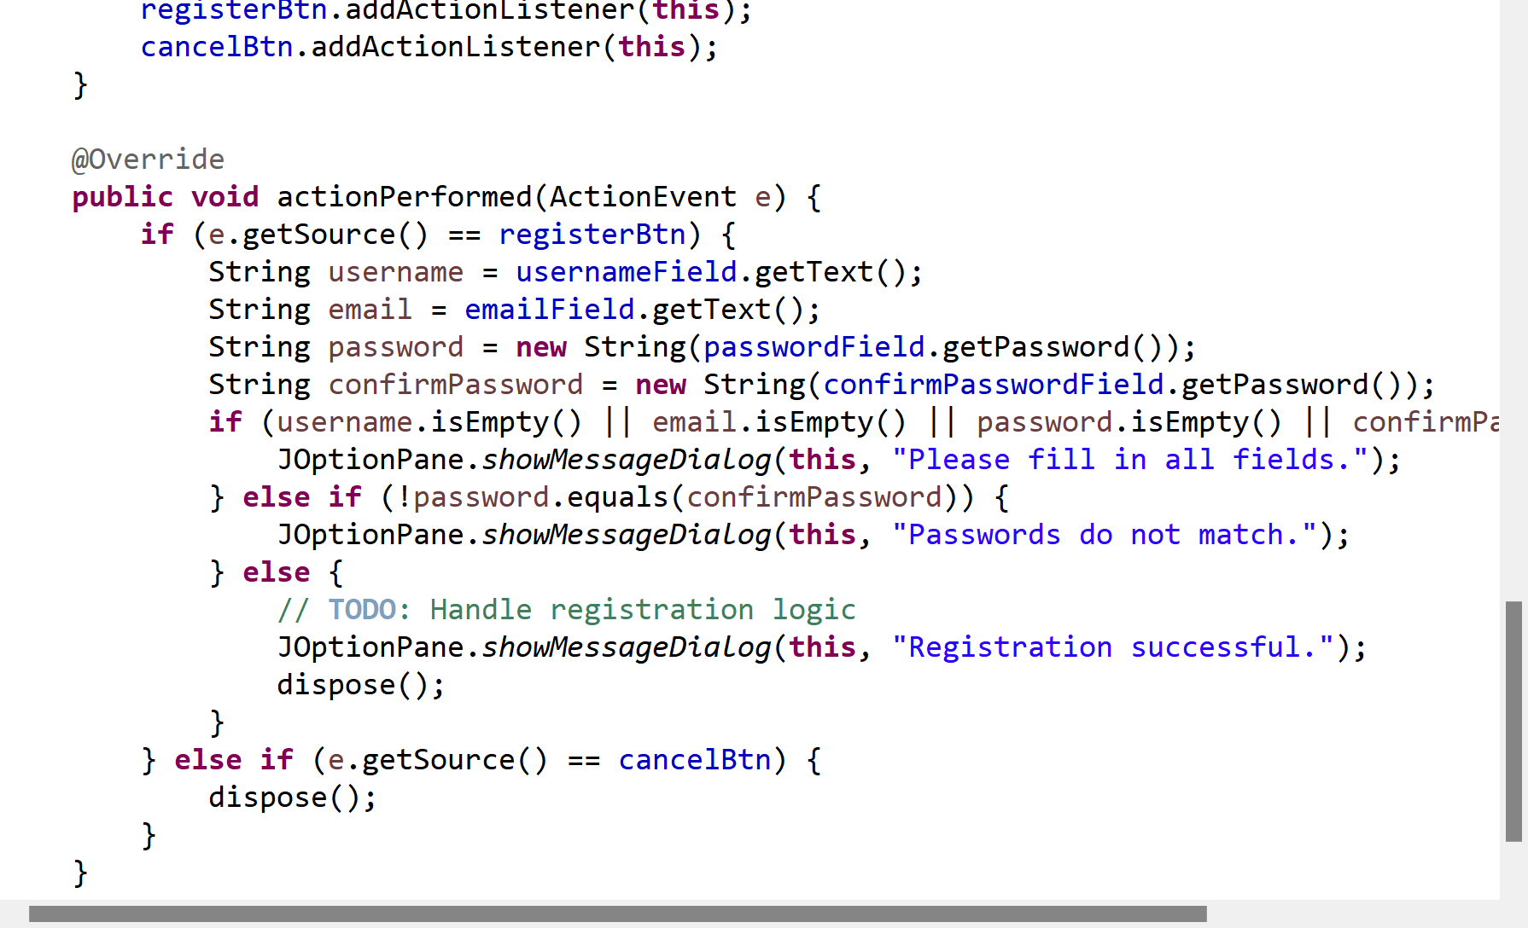
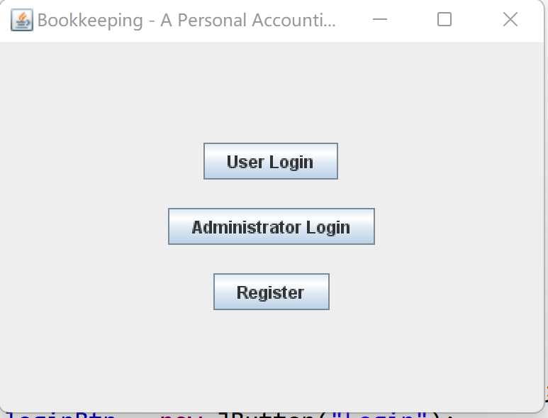
Front-end development
· 前 端 开 发
During the development of the front-end, I used statements such as "JButton" and "JPanel" a lot to visualize the function. Finally, the display effect of adding, deleting, modifying and checking functions is realized.
· 在前端的开发过程中，我大量使用诸如“JButton”和“JPanel”之类的语句来可视化函数。最终将增删改查的功能以图像显示出来。

Slide 16
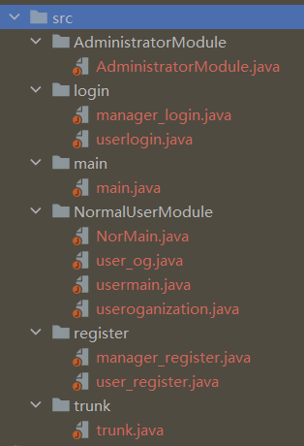
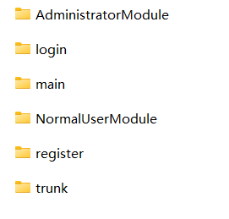
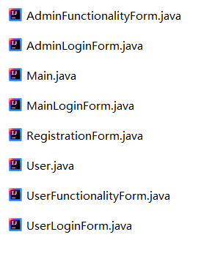
Collaborative Development
· 协 同 开 发
Through the collection of the code of each module, the code of each module is connected with one code to achieve the integration of the program.
· 通过对每个模块的代码进行采集，将每个模块的代码与一个代码连接起来，实现程序的集成。

Slide 17
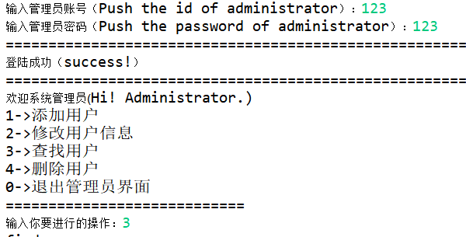
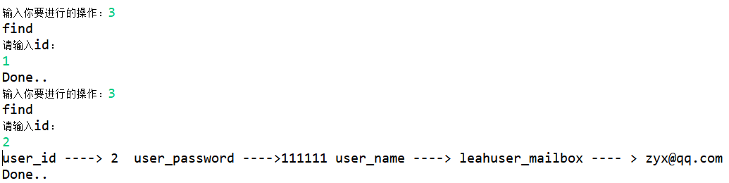
Project Testing
· 项 目 测 试
To ensure the viability of the code, we tested the project with a large number of examples. It turns out that our code is ready for release.
· 为了确保代码的可行性，我们使用大量实例对项目进行了测试。事实证明，我们的代码已做好了发布的准备。

Slide 18
Program Showcase
Show Time ！

Slide 19
Part 3
Summary & Prospect
总结 & 展望

Slide 20
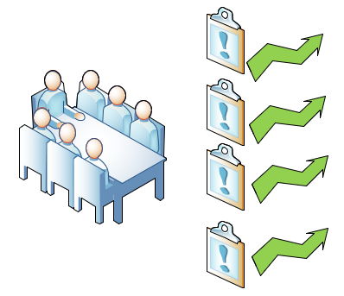
Problem Response
· 问 题 处 理
During development, many statements were in areas that we did not cover. Starting from scratch will inevitably have some things that are not well understood, such as the implementation of the event listening function. Therefore, in order to complete the project, we looked up a lot of materials, and after learning, we finally implemented the relevant functions.
· 在开发过程中，遇到了许多我们未曾涉及的领域。在第一次完成中，我们遇到了许多困难，比如事件监听功能的实现。为了完成项目，我们查找了大量资料，最终实现了相关功能。

Slide 21
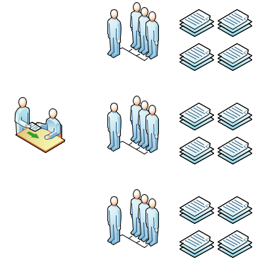
Project Summary
· 项 目 总 结
In the completion of this project, we learned more about Java's syntax and gained a better understanding of the use of databases.
Java JDBS
Swing MySQL
· 在这次项目的实现中，我们进一步了解了Java、JDBS、Swing、数据库等相关知识。
In addition, through teamwork, we understand the relevant steps of enterprise development procedures and the knowledge and experience of modular development.
· 此外，我们了解了企业对程序的开发步骤并且对模块化开发有了一定的认知。

Slide 22
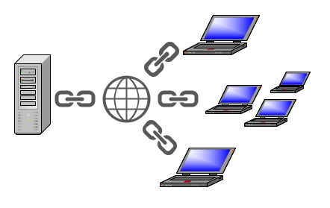
Project Outlook
· 项 目 展 望
It is hoped that the project can run on mobile and can be linked to platforms such as WeChat and Alipay to achieve the purpose of accounting automatic updates to reduce human operation.
· 希望项目未来可以与微信、支付宝等移动平台进行关联；并且与其收支信息相关联，最终达到账目可以自动地添加、删除和修改的功能。

Slide 23


