Slide 1
Hospital Information
System
医院信息管理系统
Team
The Group Of Extraordinary IQ & Appearance
队伍
智商颜值爆表队
Track
Common
赛道
普通赛道
Grade
2022
年级

Slide 2
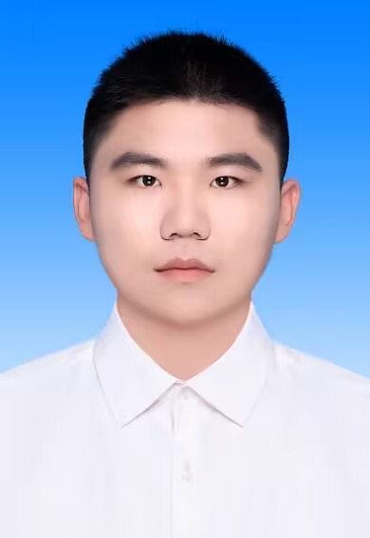
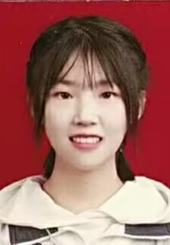
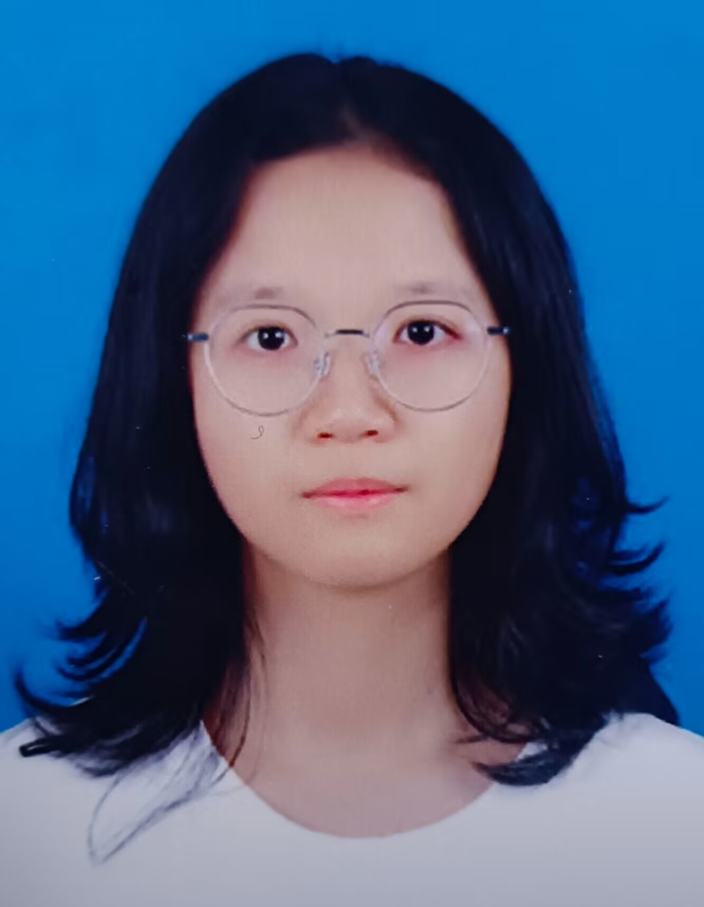
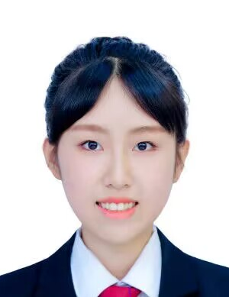
Group Members
组 员
Name
Pan Qifan
Name
Zhao Ruotong
Name
Zeng Liyao
Name
Zhang Jiaqi
姓名
潘琦藩
姓名
赵若彤
姓名
曾黎瑶
姓名
张嘉琪
ID
ID
ID
ID
202224120121
202224120149
202224120101
202224120141
学号
学号
学号
学号
Role
Role
Role
Role
Leader,Programmer
Amanuensis
Designer
Analyst
职务
队长，程序员
职务
文案编写
职务
项目设计
职务
项目分析

Slide 3
Menu
目 录
Ⅰ. The Introduction Of Item
Ⅰ.项目介绍
Ⅱ. The Design Of Item
Ⅱ.项目设计
Ⅲ. The Highlights Of Item
Ⅲ.项目亮点
Ⅳ. The Expectation Of Item
Ⅳ.项目展望

Slide 4
Introduction
The Reason Of Choice
选题缘由
· Background
As development of the time and advancement of the society, the health gradually becomes a topic to which everyone pays widely attention. However, the traditional hospital information system doesn’t adapt the needs for people. Luckily, the developing information technology adapt to which we need, changing our work and life. In this way, we ought to change or update old system to adapt the need of developing society.
时代背景
随着时代发展，社会进步，健康逐渐成为大家关注的话题
但是传统意义上的医疗服务管理体系已经不能适应当前社会发展的需要了
而信息技术的发展恰好适应了时代的需求，改变了人类的生产和生活方式
因此，我们要完善现有的医疗信息管理系统
使其更好的适应社会发展需求

Slide 5
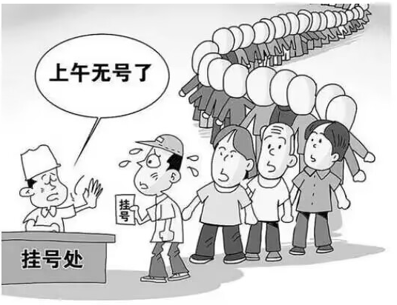
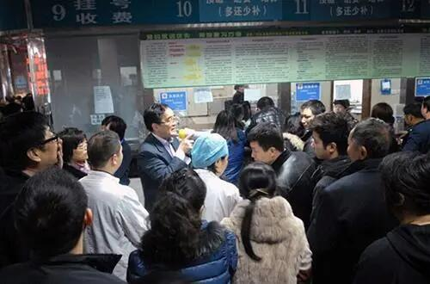
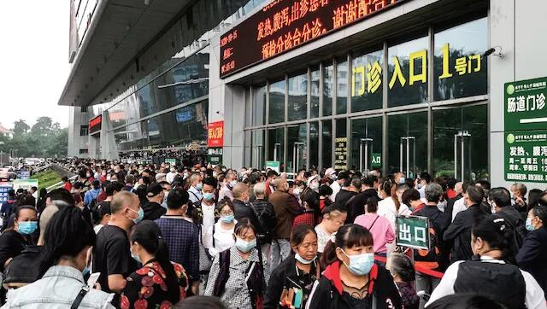
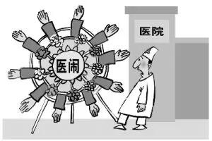
Introduction
The Disadvantage Of Traditional System
传统系统的弊端
· Medical resources are unevenly distributed.
·医疗资源分布不均
· The price of drugs is not transparent.
·药品价格不透明
· The data is large and complex.
·业务数据量大且复杂
· Process isn’t optimized and visiting time is too long.
·就诊流程不够优化，就诊时间长

Slide 6
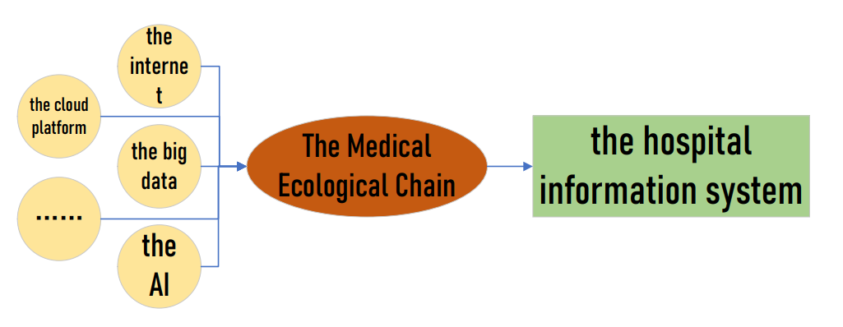
Design
The Concept Of Design
设计理念
Depending on the internet, the big data, the AI, the cloud platform and so on, we could reset the new Medical Ecological Chain and perfect the hospital information system which adapts the need of society. In this way, we can come true an easier process, a more pellucid experience and a more efficient administration management. Realize the control of the patient in the end.
借助于互联网、大数据、人工智能、云平台等新科技时代的产物，重新建立新的医疗生态链，完善
一款适应社会需求的医院管理系统.
实现简易的流程，透明的体验，高效的管理。真正实现以患者为中心。

Slide 7
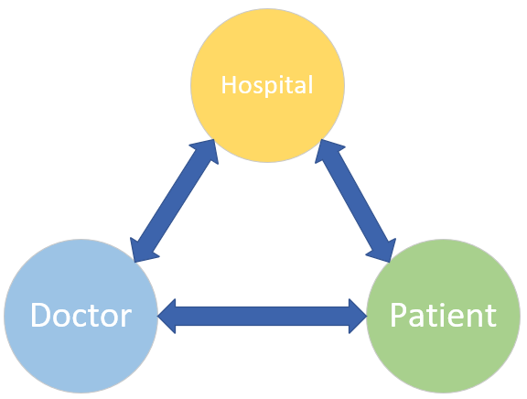
Design
The Analysis Of Demand
需求分析
· The analysis of target: Attain on the experience of visiting doctor visual and transparency. Improve the efficiency of hospital management.
·目标分析：达到可视化、透明化的就医体验及高效化的医院管理。
· The analysis of value: Promote the building of hospital information, and make management in hospital integrated. It not only promotes working automation and management standard, but also improves the quality of medical care.
·价值分析：有效促进了医院信息化建设，实现了医院内部管理一体化，提高了医院医务办公自动化水平、工作效率和
管理水平，改善了医疗质量
· The need of users:
①Hospital Management: Require all departments’ system integration to improve connectivity,
working-efficiency and management-standard.
②Patient Visiting Doctor: Require to design an easy and comprehensive interface to
make everyone registers, understand myself or family message and more message of
medicines.
·用户需求：
①医院管理方面：要求将各科室的系统进行整合，使其互联互通，通过各科室之间的信息共享，提高
医院的管理水平和工作效率。
②患者就诊方面：要求设计简洁但又全面的界面，使各年龄层的患者都能轻松的挂号、了解自己或
家属的基本诊疗情况、了解可视化透明化的药品信息。

Slide 8
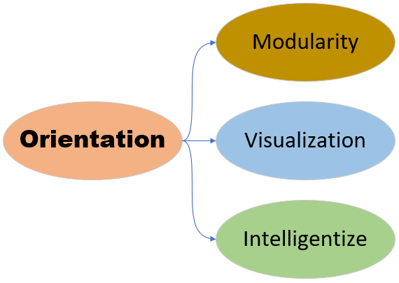
Design
The Orientation Of Design
设计思路
信息处理的模块化
设计思路
信息处理的可视化
信息处理的智能化

Slide 9
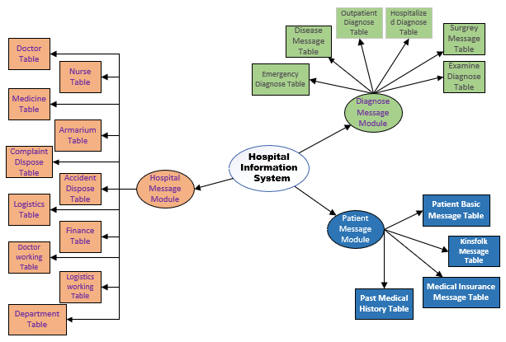
Design
The Orientation Of Design
The Modularity Of Message Manage
信息处理的模块化
We divide all message into Hospital Message Module, Patient Message Module, Diagnose Message Module and depend on these types to make the message stockpile. In this case, the stockpile and management of message could easier execute.
我们将医院的整体信息分为“院务信息模块”、
“诊断治疗模块”、“患者信息模块”三大类。
并且按照三大类型对所获取的信息进行归档分类，
进一步优化对信息的存储和管理，使筛选信息更易执行。

Slide 10
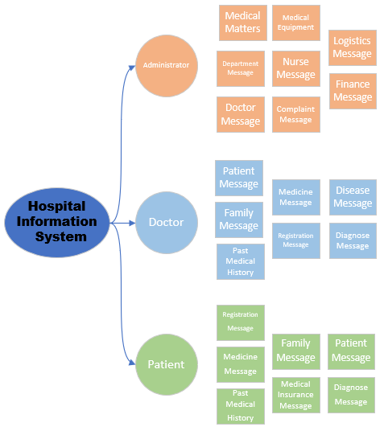
Design
The Orientation Of Design
The Visualization Of Message Manage
信息处理的可视化
This system rely on picture to show the process of disposing message. Every users can understand the rate of progress directly across disposing flow chart, forecasting or planning the next in time.
该系统以图像的方式表示信息处理的过程。
各用户可借助“处理流程图”直观的了解当前的进程，
并且及时对下一步行为做出预判与计划。

Slide 11
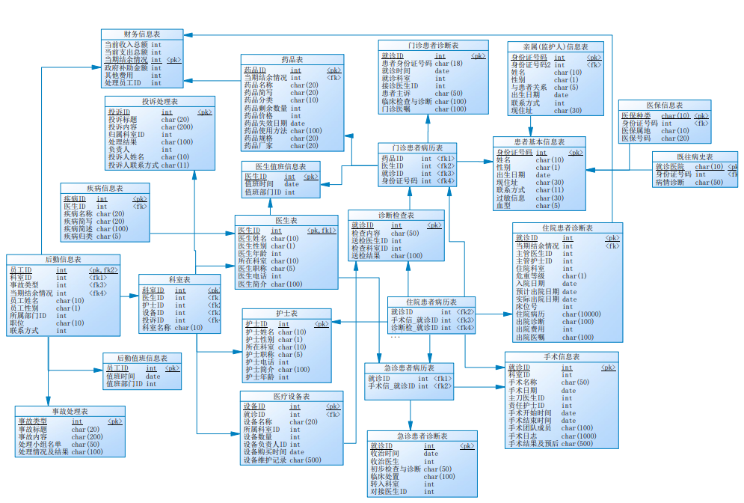
Design
The Orientation Of Design
The Intelligentize Of Message Manage
信息处理的智能化
When design the databases, we try our best to simplify the message which pushed users in order to make users award visualized message. In the condition of users’ privacy, we make all message overtest and most transparency to guarantee every users’ right to known.
在数据库设计时，对各用户端推送的信息进行最大
程度的简化，使得各用户可直观的获取自己需求的
信息。
在保护各方隐私的条件下，极大限度的将就诊流程
和院务管理信息公开透明化，充分保障各方的知情权。

Slide 12


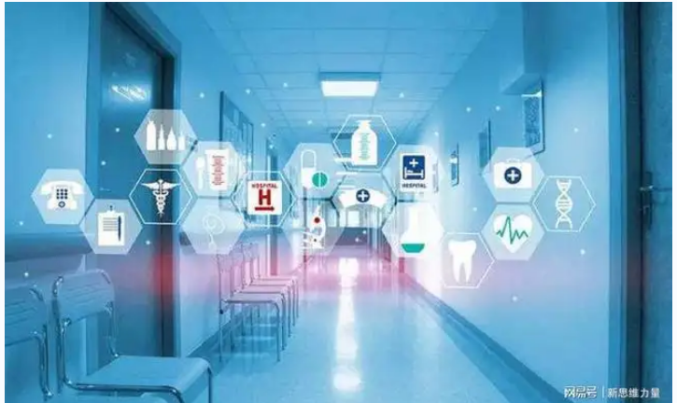

Highlights
The Advantage Of System
系统优势
1. Standardize the development of hospital across pellucid message.
2. Facilitate more accurate of message management.
3. Make more convince and quicker experience for patients across Smart Service
1. 通过透明化的信息规范了医院的发展
2. 便于医院更精细化的信息管理
3.通过智慧服务让患者感受更加方便和快捷

Slide 13
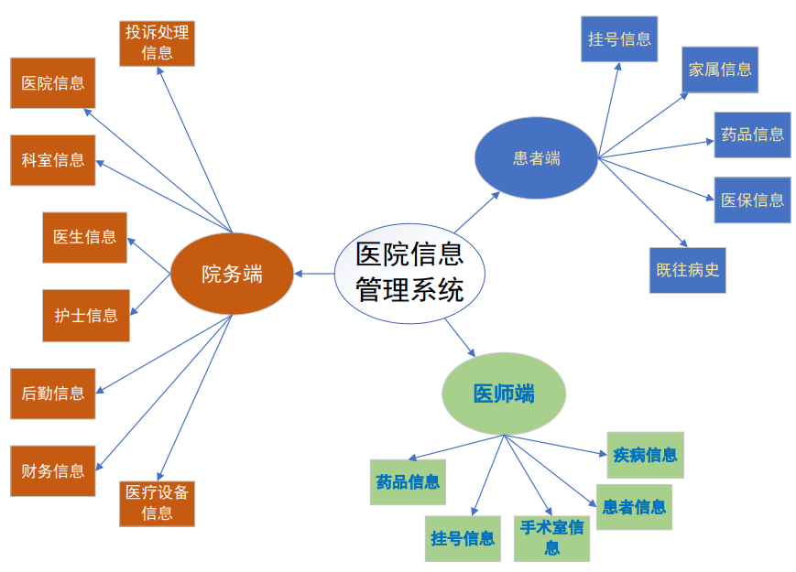
Highlights
The efficient of information reception. Make management, diagnose and visiting-doctor message integrate after disposing them by cloud computing in this system and pushing useful message for every user’s system.
The visual of information dispose. Every departments and patients could understand own message processes so that they can plan next behavior earlier.
The succinct of information output. Greatly reduced the useless message for every user’s system. And every user can get the need of message directly.
信息接受方式的高效化。将医院管理、诊治、就医等信息的获取进行
有机的结合，借助本信息接受方式的高效化。将医院管理、诊治、
就医等信息的获取进行有机的结合，借助本系统进行云端处理后，
进程，提前知道下一步的诊疗行为。
信息处理过程的可视化。医院各部门及患者可以看到自我信息的处理
将各类信息有选择的放到客户端中。
信息输出结果的简洁化。极大程度地减少了放到客户端中的繁琐无用的信息，
各用户可以直观的接收自我需要的信息。

Slide 14
Summarize & Expectation
总结与展望
Through this project, we learned that we must not only apply what we have learned, but also we should innovate. In the process of continuous improvement of the project, not only what the teaching content of the teachers is constantly mastered and innovated, but also the cooperation between the team is becoming more and more tacit.
Thanks for the help of the teacher teaching during this time, due to the limited time and knowledge, the relevant content of some projects is not all perfect, I believe that our group will live up to expectations, improve the project as soon as possible, and strive to submit a beautiful answer.
通过本次项目，我们明白了不仅要应用好所学的内容，同时还要有
所创新。在不断完善项目的过程中，不仅老师的教学内容在不断的
熟练掌握并加以创新，而且团队之间的配合越来越默契。
小组合影
谢谢这段时间老师教学的帮助，因时间和知识有限，有些项目的相关
内容没有全部完善，我相信我们组定不负期望，早日将项目完善的
更好，努力交上一幅美丽的答卷。

Slide 15


