Slide 1

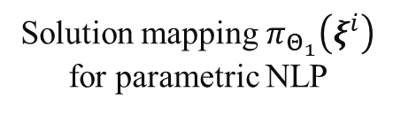

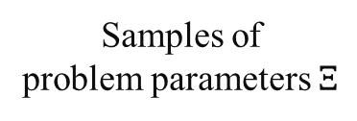

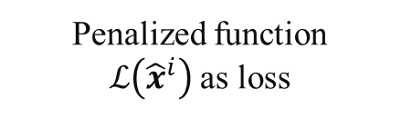
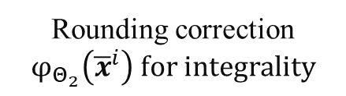

$$ξ^{i}$$
$$ξ^{i}$$
$${\overline{x}}^{i}∈ℝ^{n_{r}+n_{z}}$$
$${\hat{x}}^{i}∈ℝ^{n_{r}}×ℤ^{n_{z}}$$
Samples of problem parameters $Ξ$
Solution mapping $π_{Θ_{1}}\left(ξ^{i}\right)$ for parametric NLP
Rounding correction $φ_{Θ_{2}}\left({\overline{x}}^{i}\right) for integrality$
Penalized function $ℒ\left({\hat{x}}^{i}\right)$as loss

Slide 2
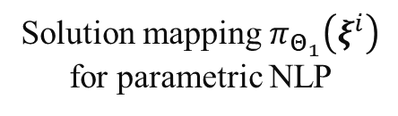
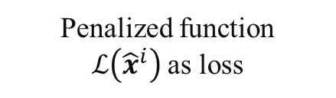
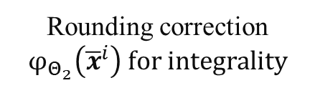
$$ξ^{i}$$
$$ξ^{i}$$
$${\overline{x}}^{i}∈ℝ^{n_{r}+n_{z}}$$
$${\hat{x}}^{i}∈ℝ^{n_{r}}×ℤ^{n_{z}}$$
Samples of problem parameters $Ξ$
Solution mapping $π_{Θ_{1}}\left(ξ^{i}\right)$ for parametric NLP
Rounding correction $φ_{Θ_{2}}\left({\overline{x}}^{i}\right) for integrality$
Penalized function $ℒ\left({\hat{x}}^{i}\right)$as loss

