Slide 1
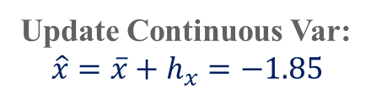

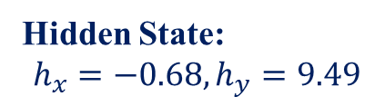
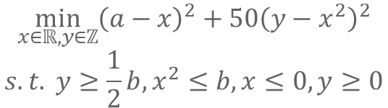

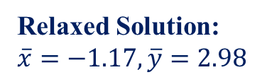

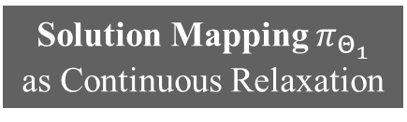
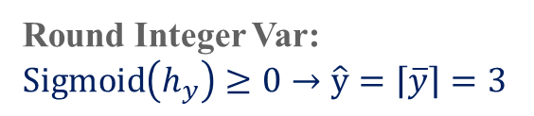
$$\min_{x∈ℝ,y∈ℤ}{{\left(a−x\right)}^{2}+50{\left(y−x^{2}\right)}^{2}}$$
$$s.t. y≥\frac{1}{2}b,x^{2}≤b, x≤0, y≥0$$
Solution Mapping $π_{Θ_{1}}$ as Continuous Relaxation
Input: $a=3.83,b=6.04$
Hidden State:
$$h_{x}=−0.68,h_{y}=9.49$$
Relaxed Solution:
$\overline{x}=−1.17,\overline{y}=2.98$
Neural Network $φ_{Θ_{2}}$
Update Continuous Var:
$${\hat{x}=\overline{x}+h}_{x}=−1.85$$
Round Integer Var:
$\operatorname{Sigmoid}\left(h_{y}\right)≥0→\hat{y}=\left\lceil \overline{y}\right\rceil =3$
Loss Function: $ℒ_{Obj}+λ∙ℒ_{Penalty}$

Slide 2
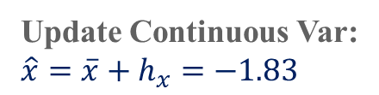

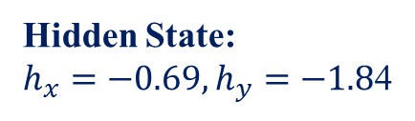


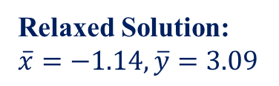


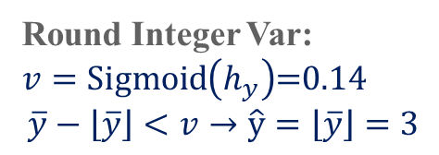
$$\min_{x∈ℝ,y∈ℤ}{{\left(a−x\right)}^{2}+50{\left(y−x^{2}\right)}^{2}}$$
$$s.t. y≥\frac{1}{2}b,x^{2}≤b, x≤0, y≥0$$
Solution Mapping $π_{Θ_{1}}$ as Continuous Relaxation
Input: $a=3.83,b=6.04$
Hidden State:
$h_{x}=−0.69,h_{y}=−1.8$4
Relaxed Solution:
$\overline{x}=−1.14,\overline{y}=3.09$
Neural Network $φ_{Θ_{2}}$
Round Integer Var:
$v=\operatorname{Sigmoid}\left(h_{y}\right)$=0.14
$$\overline{y}−\left\lfloor \overline{y}\right\rfloor <v→\hat{y}=\left\lfloor \overline{y}\right\rfloor =3$$
Update Continuous Var:
${\hat{x}=\overline{x}+h}_{x}=−1.83$
Loss Function: $ℒ_{Obj}+λ∙ℒ_{Penalty}$

