Slide 1

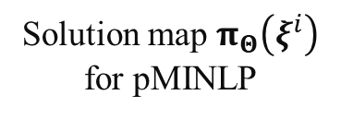

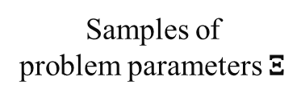

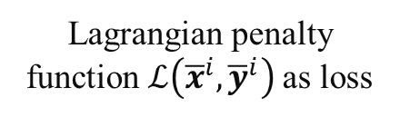
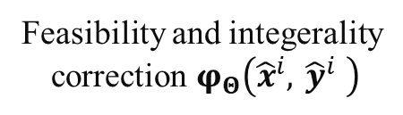
$$ξ^{i}$$
${\hat{x}}^{i},$ ${\hat{y}}^{i}$
$${\overline{x}}^{i},{\overline{y}}^{i}$$
Samples of problem parameters $Ξ$
Solution map $π_{Θ}\left(ξ^{i}\right)$ for pMINLP
Feasibility and integerality
correction $φ_{Θ}\left({\hat{x}}^{i}, {\hat{y}}^{i} \right)$
Lagrangian penalty function $ℒ\left({\overline{x}}^{i},{\overline{y}}^{i}\right)$as loss

