Slide 1
MOHS AI
Predicting which Mohs cases
will need
≥13 sections,
before the patient sits down.
408
procedures
0.891
CV-AUC
91.4%
high-conf accuracy
1.5 cm²
SHAP threshold
Yagiz Alp Aksoy · Simon Lee · Gilberto Moreno-Bonilla
Australasian Society for Dermatology · 2026
mohs.panacea-i.com

Slide 2
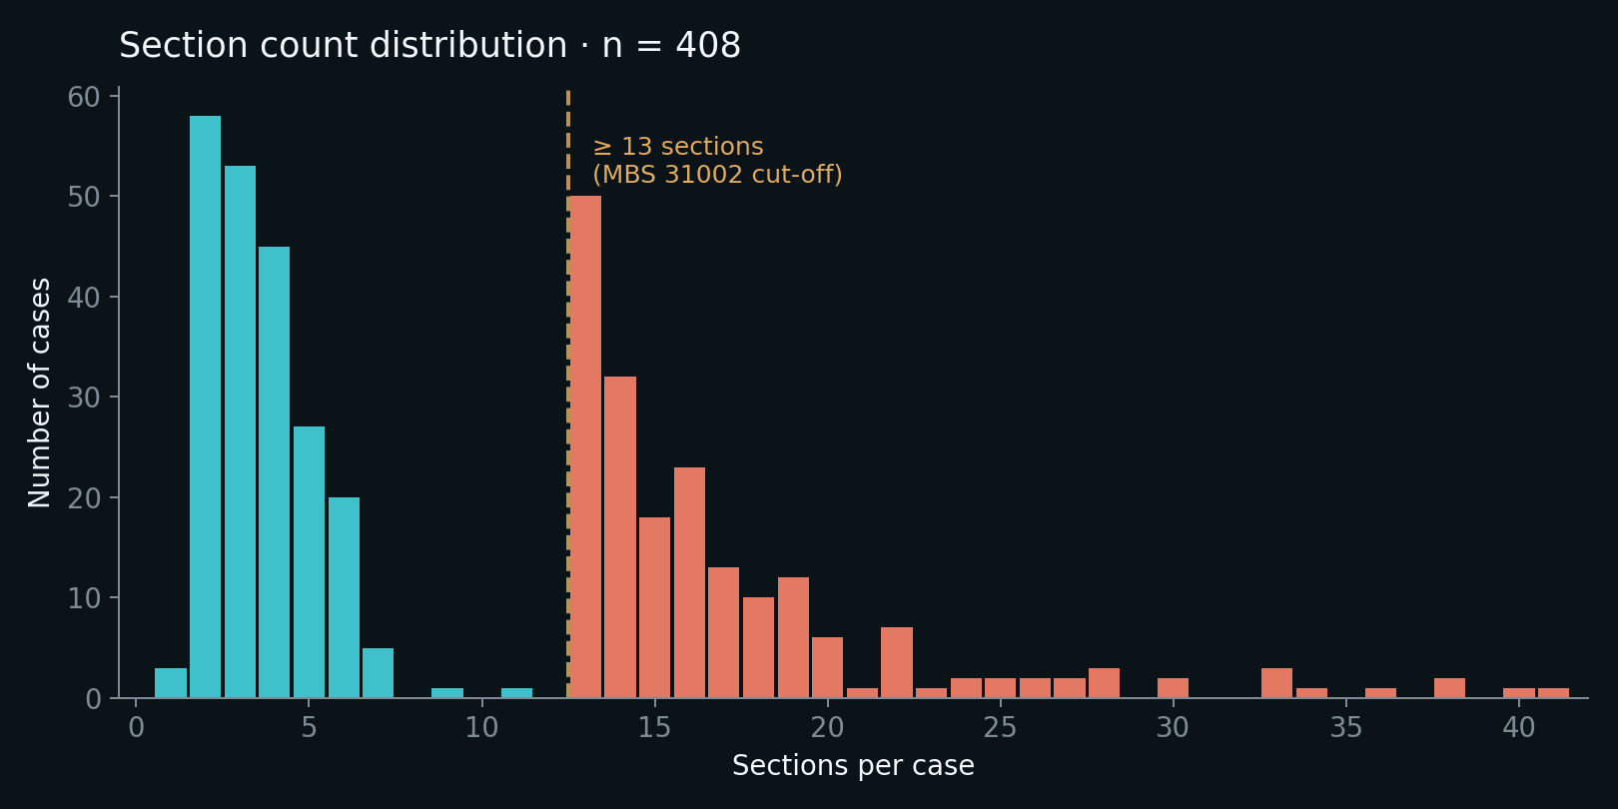
THE QUESTION
Section count varies wildly — and we can't currently predict it.
1 → 41
sections per case in this cohort
≥13
MBS 31002 cut-off · longest cases
47.8%
of cases needed ≥13 sections

Slide 3
COHORT & METHODS
408 consecutive Mohs procedures · pre-operative features only
408
16
30
80 / 20
consecutive procedures
pre-operative variables
ML algorithms tested
train · test split, 5-fold CV
Cohort highlights
Predictors used
Mean age
68.5 ± 12.9 yrs
Demographics (age, sex, smoking) Tumour (size X, Y, area, type, recurrence, aggressive histo) Anatomy (body site, zone, unit, laterality) Surgeon (experience, see-and-do)
Male
57.8%
BCC
89.9%
Head & neck
93.4%

Slide 4
HEADLINE RESULT
CV-AUC
0.891
95% CI 0.849 – 0.934 · stacking ensemble · n = 408
Test-AUC 0.884 · F1 0.81 · 30 algorithms compared

Slide 5
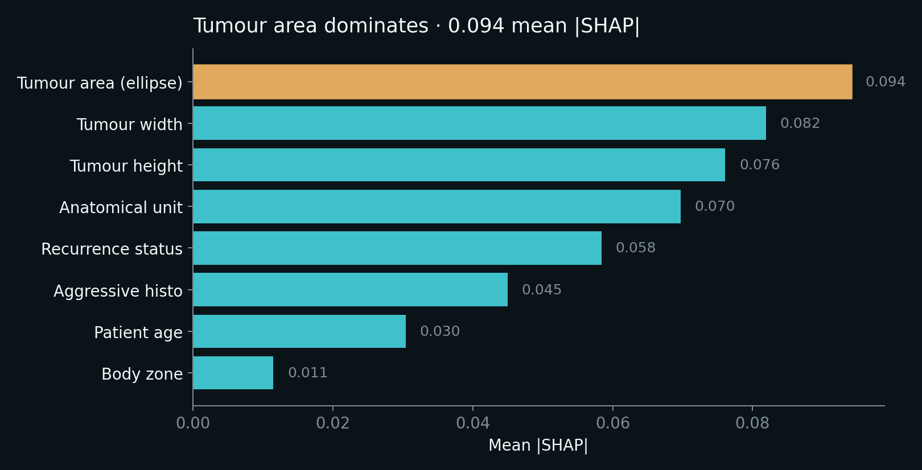
WHY THE MODEL DECIDES
Tumour area dominates every other feature
Area
is nearly as informative as the next two combined.
Recurrence + aggressive histo
are the next clinically actionable signals.
Surgeon experience
did not contribute meaningfully — likely selection bias.

Slide 6
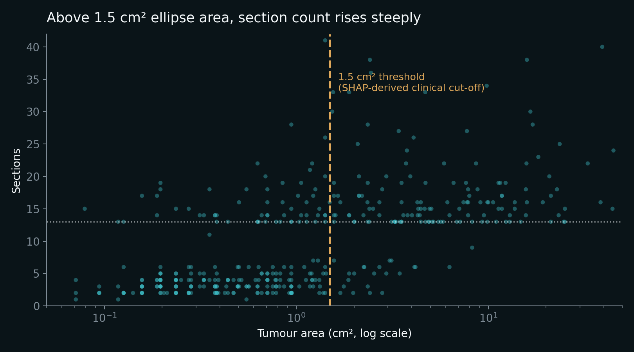
CLINICAL TAKE-AWAY
Above ~1.5 cm² ellipse area, probability of ≥13 sections climbs steeply.
Ellipse area
= π × (X/2) × (Y/2)
e.g. 18 × 12 mm
→ 1.70 cm²
A practical rule clinicians can use at first consultation, before any imaging or biopsy results return.

Slide 7
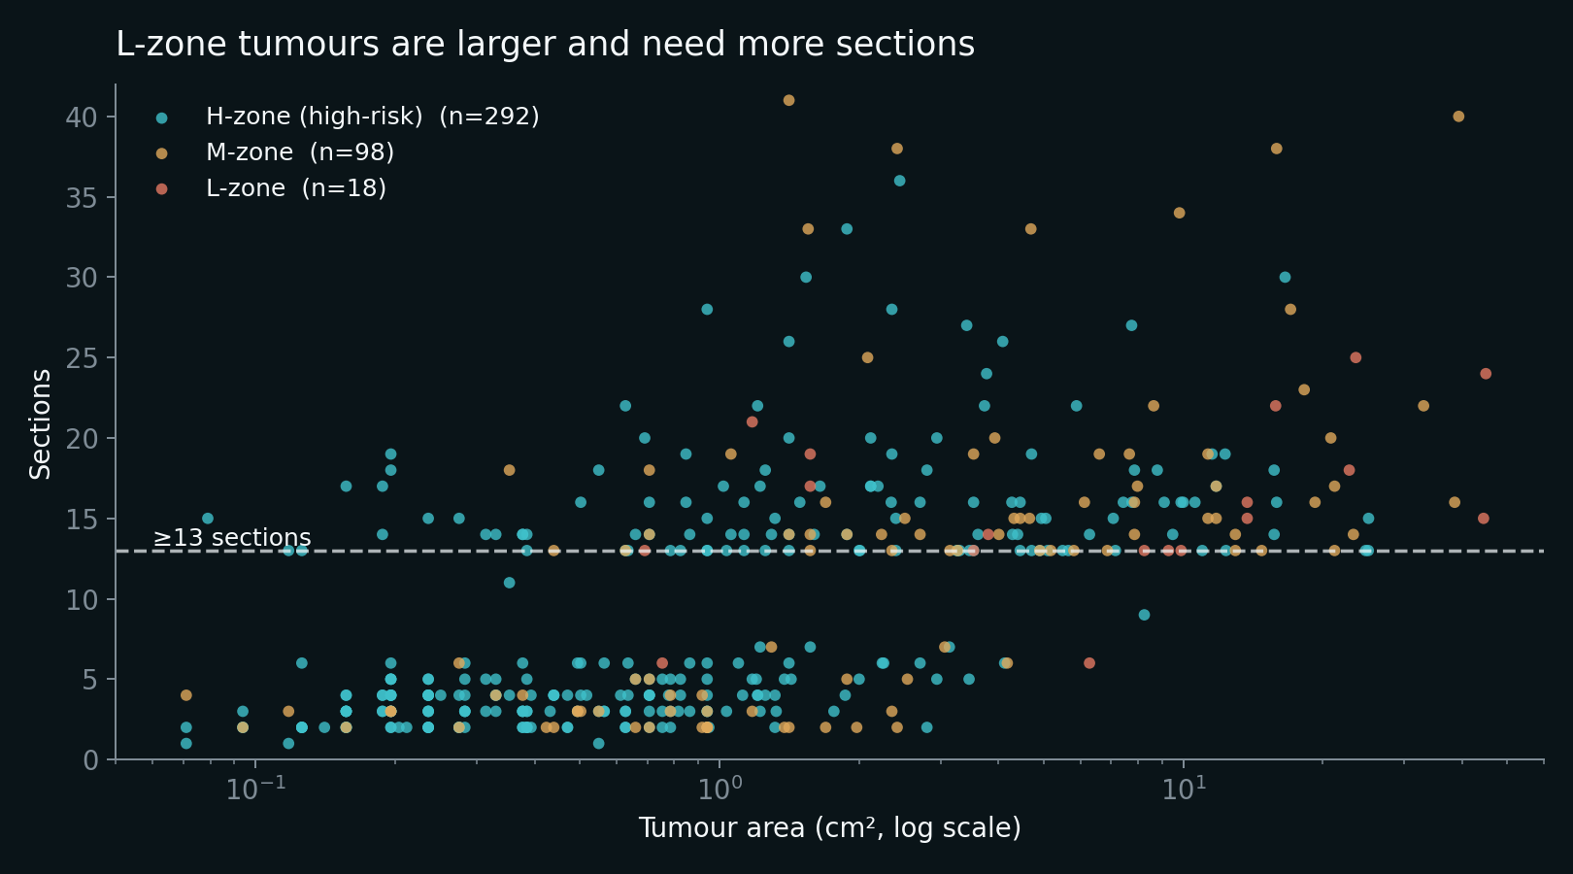
THE COUNTER-INTUITIVE FINDING
H-zone is anatomically high-risk — yet needs fewer sections than L-zone.
H-zone n=291
9.0 sections · 42% ≥13
mean tumour 2.12 cm²
M-zone n=100
11.5 sections · 59% ≥13
mean tumour 4.80 cm²
L-zone n=17
15.7 sections · 89% ≥13
mean tumour 12.55 cm²

Slide 8
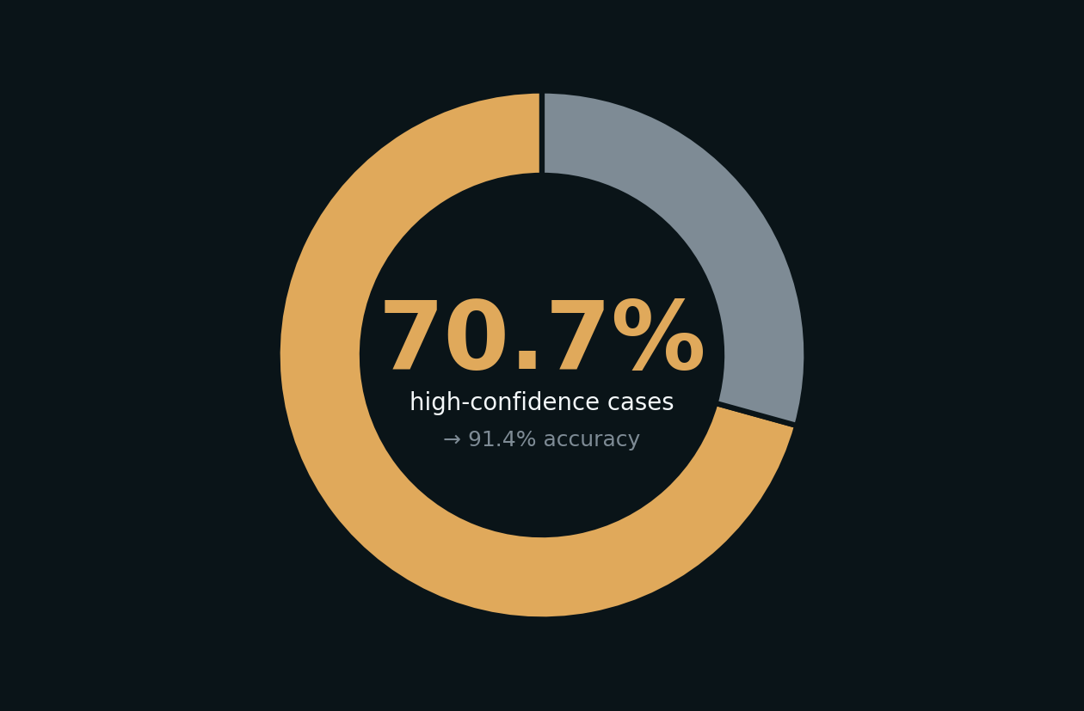
EXPLAINING THE PARADOX
Sections per stage tell us what's really happening.
3.0
8.6
H-zone sections / stage
L-zone sections / stage
Surgeons take smaller, more conservative slices on cosmetically sensitive territory (stages did not differ by zone, p = 0.11).
70.7% high-confidence cases → 91.4% accuracy on those.

Slide 9
Now let's open the tool.
mohs.panacea-i.com
Live ensemble · per-model breakdown · threshold visual · MBS billing · OR scheduler

Slide 10
BACKUP
Backup · Predictor
Insert screenshot of
mohs.panacea-i.com/predictor
Probability ring with 95% CI band · ensemble breakdown · per-feature factor bars · MBS code preview

Slide 11
BACKUP
Backup · Why / SHAP dependence
Insert screenshot of
mohs.panacea-i.com/why
Live tumour-area sweep with 1.5 cm² annotation · per-case waterfall from cohort baseline

Slide 12
BACKUP
Backup · H-zone paradox explorer
Insert screenshot of
mohs.panacea-i.com/zones
Toggle between mean sections and mean tumour area — bars flip · interactive scatter of all 408 cases

Slide 13
BACKUP
Backup · Clinical tools — day scheduler
Insert screenshot of
mohs.panacea-i.com/tools
Multi-room Mohs day Gantt with patient names, arrival times, lunch break, CSV export

Slide 14
BACKUP
Backup · Evidence — 30-model leaderboard
Insert screenshot of
mohs.panacea-i.com/evidence
Filter by family · sort by CV-AUC, Test-AUC, F1, Brier · stacking ensemble tops the table

Slide 15
LIMITATIONS & CONCLUSIONS
Three sentences to take home.
1
Pre-operative ML predicts ≥13 sections at AUC 0.89.
Using only features any clinician already records at first consultation.
2
Tumour area is the dominant predictor.
Clean threshold near 1.5 cm² ellipse area.
3
Anatomical risk-zone label is not destiny.
Size drives sections, not 'H' vs 'L'. Pattern needs external validation.
Limitations · single-centre · L-zone n = 17 · external validation pending — collaborators welcome.

Slide 16
Thank you.
mohs.panacea-i.com
Open to test · open to collaborate. External validation invitation: your-email@your-domain.com
Aksoy, Lee, Moreno-Bonilla. Development and Validation of Machine Learning Models for Predicting 13 or More Sections in Mohs Micrographic Surgery. 2026.

