Slide 1
TOP LEVEL
GCDODE
HARDWARE
HOST CONTROLLER
MCU
0/1
DRIVERS
0/1
BINARY
STEP & DIR SIGNALS
SOFTWARE
ACTUATORS
MOTORS
PART

Slide 2


$x=\frac{−b±\sqrt{b^{2}−4ac}}{2a}$L
HOST CONTROLLER
XYZE COORDINATES
GCDODE
PARSER
$$L=\sqrt{{dx}^{2}+{dy}^{2}+{dz}^{2}}$$
BRESENHAM ALGORITHM
INVERSE FUNCTION
±dx
±dy
±dz
±de
t=f⁻¹(L)
L=f(t)
LENGTH
VELOCITY
integration
dt = tn – tn-1
+
STEP & DIRECTION
V=f(t)
PULSE DURATION
CONFIG
ACCEL
JERK
VELOCITY PROFILE
10
00
11
00
dt / ISR freq
8bits
BINARY DATA
ITERATIONS
+
DRIVERS SIGNAL

Slide 3
MCU
MCU CODE
PORT FORWARDING
MOTION 1 BYTE
DRIVERS SIGNAL
Signal
XYZE = STEP + DIR = 4Bits + 4Bits = 8Bits = 1Byte = 1 number 0-254
DIR
STEP
BINARY DATA
DRIVERS
ISR LOOP VELOCITY CONTROL
Frequency
SIGNAL FREQUENCY
Counter = 0 => MAX Step Rate
Counter = 254 => MIN Step Rate
MOTORS
Counter = 255 => Command
PRINTING

Slide 4
MCU MEMORY ALLOCATION
97 bytes
uint8_t
uint8_t
uint8_t
uint8_t
uint8_t
uint8_t
uint8_t
uint8_t
uint8_t
0 - 254
0 - 255
0 - 254
0 - 255
0 - 254
0 - 255
255
……………………………………
0 - 254
0 - 255
iterations
signals
iterations
signals
iterations
signals
command
bytes that contain data for commands
iterations
signals
ISR LOOP 25KHz
n = n + 1
VOID LOOP()
If n == iterations && n != 255
Temp monitoring and control
Real-time XYZ Tracking
External termination tracking
Serial/SD Data buffering
Commands execution
uint8_t
0 - 255
signal
STEPS
DIRECTION
0
0
0
0
0
0
0
0
X
Y
Z
E
X
Y
Z
E

Slide 5
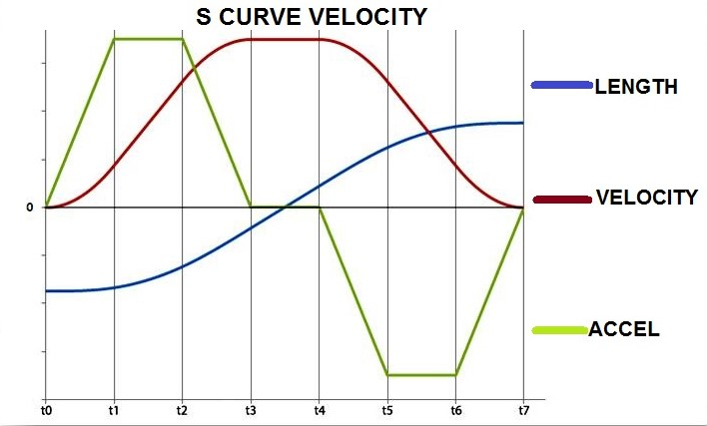
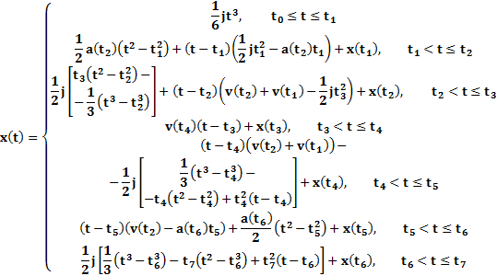
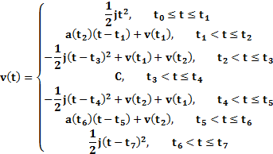
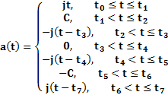
S-CURVE PROFILE

Slide 6
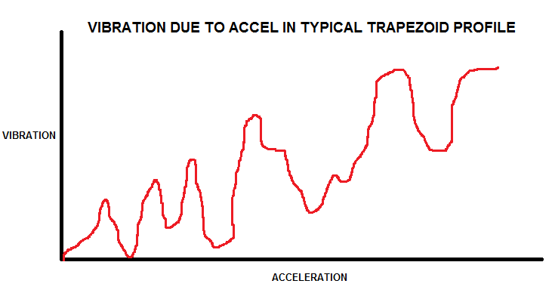
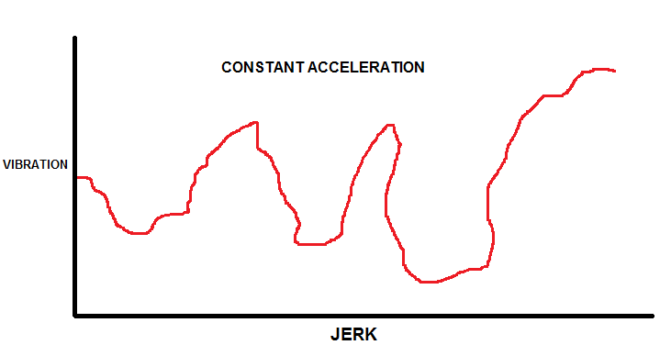
JERK
a2 > a1 high acceleration reduces the total printing time
v2 > v1 generated vibrations due to high acceleration a2
v2 > V low with correct jerk (j2) tuning the vibrations are eliminated at V low
a2
V high
v3
v2
v2
v1
V low
v1
a1
a2
j1
j2

Slide 7
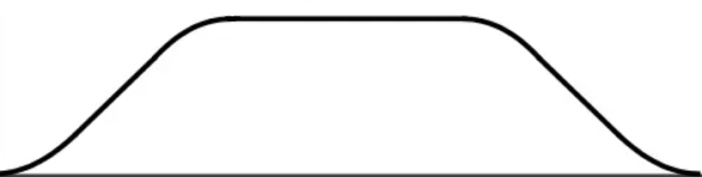
CURVE DETECTION
Post-processing algorithm to increase the printing quality and prevent the formation of blobs during sequential movements.
Velocity Profile Curve Detection OFF
Velocity
move1
move2
move3
move4
X-Y PLANE
Y [mm]
15°
15°
time
move2
move3
Velocity Profile Curve Detection ON: Threshold 20°
move1
40°
move4
Velocity
move1 + move2 + move 3
move4
X [mm]
time

