Slide 1


FinFET & FD-SOI Technologies
[116] Design of VLSI Systems
Group 02: Antonios KAPETANIOS [10417] and Panagiotis PAPADOPOULOS [10697]
14 December 2025

Slide 2
Contents
FinFET
Technology overview
“Comprehensive Review of FinFET Technology: History, Structure, Challenges,Innovations, and Emerging Sensing Applications”, K. Karimi et al. [1]
“FinFET to GAA MBCFET: A Review and Insights”, R. R. Das et al. [2]
FD-SOI
Technology overview
“A Novel 1T-APS Using 22nm FD-SOI Technology With Record High Tunable Sensitivity Range”, H. Xie et al. [3]
“A Wideband Sub-6GHz Transceiver Front End for 5G Base Stations in 22-nm FD-SOI CMOS”, C. Elgaard et al. [4]
References

Slide 3
FinFET
Technology overview
“Comprehensive Review of FinFET Technology: History, Structure, Challenges, Innovations, and Emerging Sensing Applications”, K. Karimi et al. [1]
“FinFET to GAA MBCFET: A Review and Insights”, R. R. Das et al. [2]

Slide 4
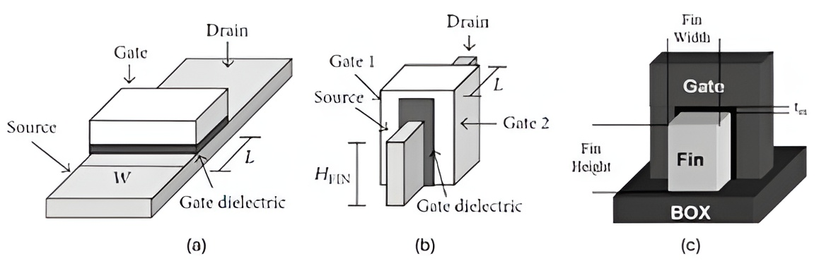
Introduction to FinFET Technology
FinFET = Three-dimensional multi-gate MOSFET
Developed to overcome short-channel effects in planar CMOS
H_{Fin} (fin height) controls drive current
W_{Fin} (fin width) controls electrostatics
Figure FinFET.1: Structure Schematic of (a) planar MOSFET and (b) FinFET. (c) Demonstrating HFin as fin height and WFin as fin width. Figure taken from Karimi, K.; Fardoost, A.;Javanmard, M. Comprehensive, Review of FinFET Technology: History, Structure, Challenges, Innovations, and Emerging Sensing Applications. Micromachines 2024, 15, 1187.

Slide 5
Historical Development
1904
Invention of Bipolar Junction Transistor
Vaccum Tube
1958
Development of First Integrated Circuit
1956
Design of Insulated-Gate Field Effect Transistor (aka MOSFET)
Fabrication of first quasi planar FinFET device
2001
1948

Slide 6
FinFET
Technology overview
“Comprehensive Review of FinFET Technology: History, Structure, Challenges, Innovations, and Emerging Sensing Applications”, K. Karimi et al. [1]
“FinFET to GAA MBCFET: A Review and Insights”, R. R. Das et al. [2]

Slide 7
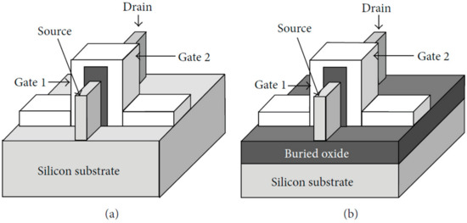
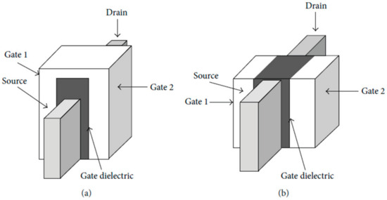
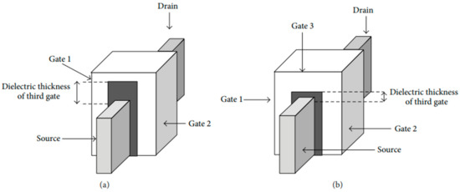
FinFET Classifications
Figure FinFET.2: Structure schematic of (a) Bulk FinFET and (b) SOI FinFET
By substrate: Bulk vs SOI FinFET (Fig. 5)
By gate type: Short-Gate (3-terminal) vs Independent Gate (4-terminal) (Fig. 6)
By dielectric geometry: Double-Gate vs Tri-Gate (Fig. 4)
Tri-Gate = lower capacitance + better performance
Figure FinFET.3: Structure schematic of (a) SG FinFET and (b) IG FinFET
Figure FinFET.4: Schematic of (a) DG FinFET and (b) tri-gate FinFET.
Figures taken from Karimi, K.; Fardoost, A.;Javanmard, M. Comprehensive, Review of FinFET Technology: History, Structure, Challenges, Innovations, and Emerging Sensing Applications. Micromachines 2024, 15, 1187.

Slide 8
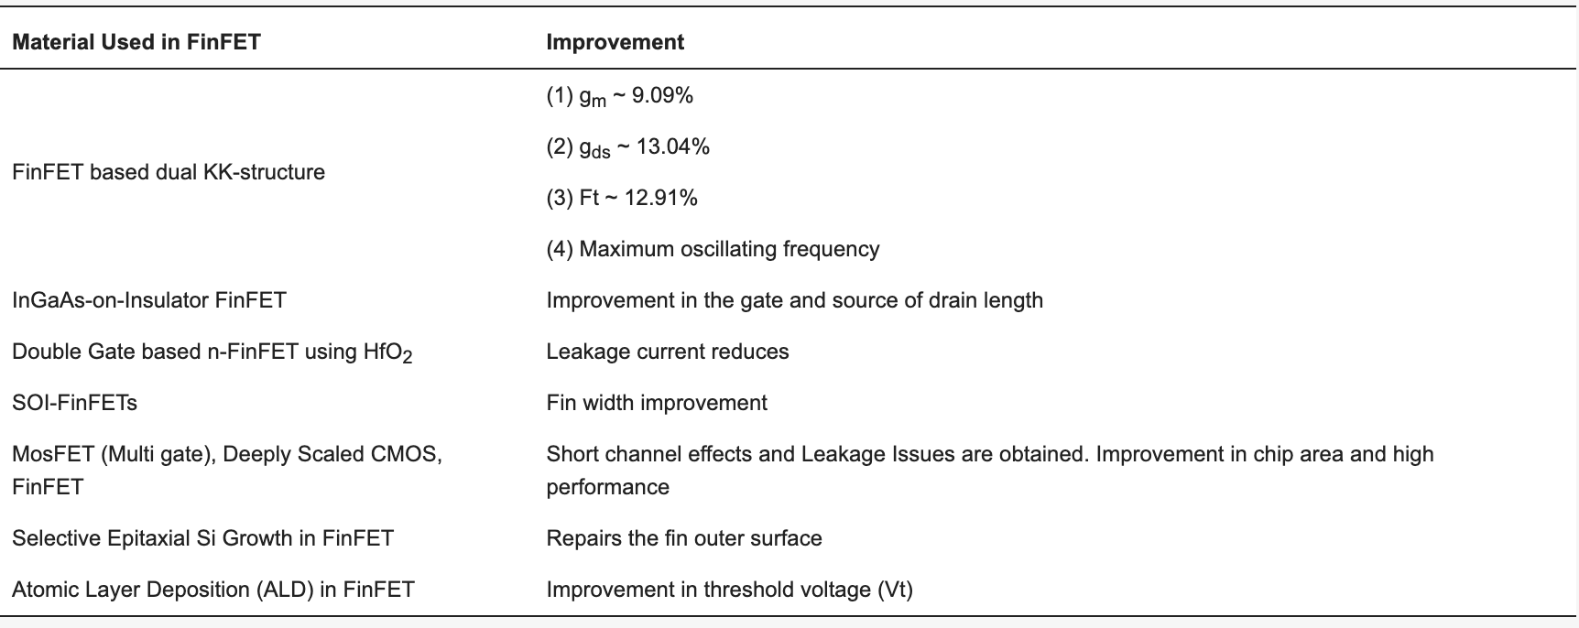
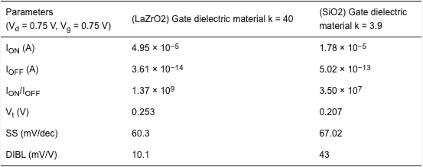
Materials in FinFET Fabrication
Gate dielectrics: HfO₂, LaZrO₂ → high-k, low leakage
Channel materials:
SiC₃C: maximum ratio of I_{ON}/I_{OFF} (1.90 × 10¹¹) and minimum I_{OFF} (7.00 × 10⁻¹⁹ A)
GaN and GaAs → better DIBL qualities
GaSb → worst SCE characteristics
CNT and Graphene → can improve:
Ratio of I_{ON}/I_{OFF}
Speed
Energy consumption
Table FinFET.1: Improvements made by using each material in FinFET fabrication
Table FinFET.2: The impact of SiO₂ and LaZrO₂ gate dielectric material usage in n-FinFET device efficiency.
Tables taken from Karimi, K.; Fardoost, A.;Javanmard, M. Comprehensive, Review of FinFET Technology: History, Structure, Challenges, Innovations, and Emerging Sensing Applications. Micromachines 2024, 15, 1187.

Slide 9
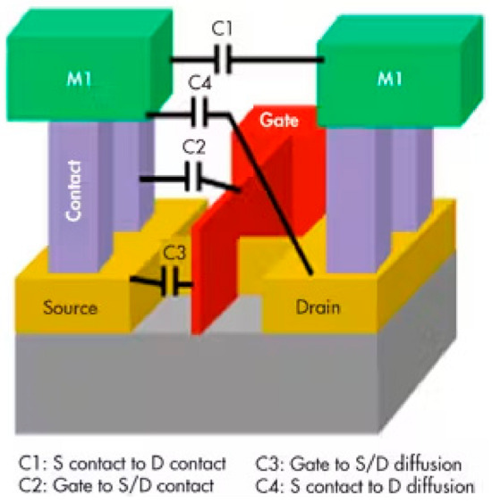
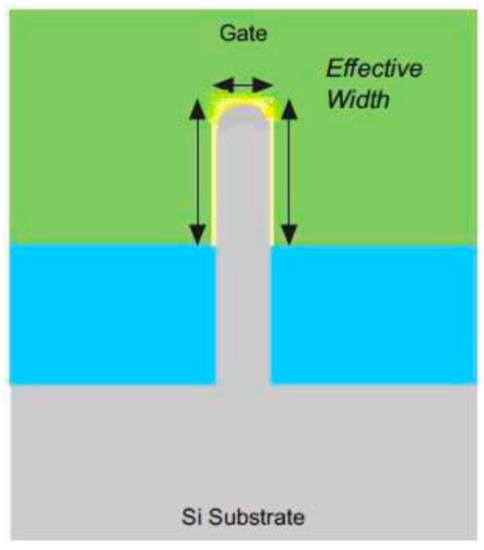
Key Challenges
Parasitic capacitances ↑ → slower switching
Corner leakage → “corner effects”
Quantum effects → mobility loss in ultra-thin fins
Complex lithography and self-heating
Figure FinFET.5: Parasitic capacitances of a FinFET
Figure FinFET.6: Cross-sectional view of a Tri-FinFET with curved fin corners
Figures taken from Karimi, K.; Fardoost, A.;Javanmard, M. Comprehensive, Review of FinFET Technology: History, Structure, Challenges, Innovations, and Emerging Sensing Applications. Micromachines 2024, 15, 1187.

Slide 10
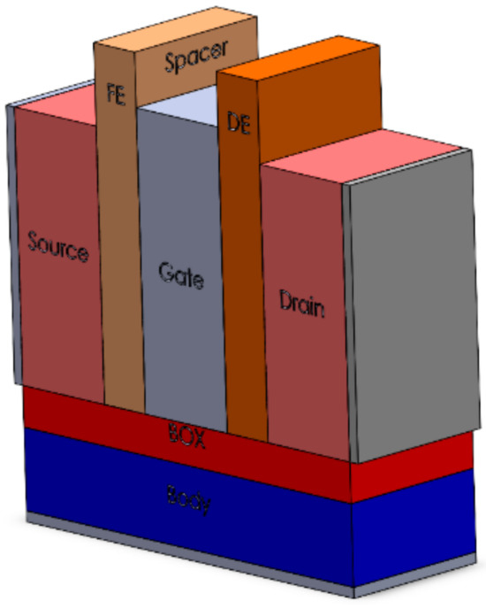
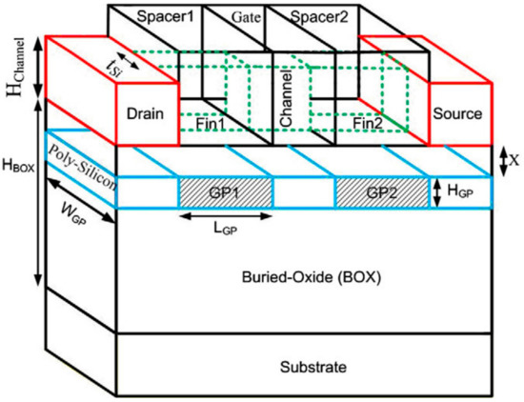
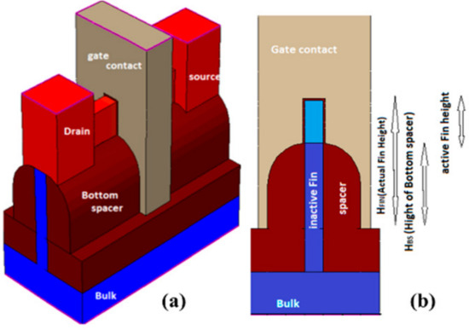
Recent Innovations
Ground-Plane FinFET (GP-FinFET): lower DIBL
Bottom-Spacer FinFET: better SCE & thermal control
Negative Capacitance FinFET: ferroelectric spacer → higher I_{on}, lower SS
Figure FinFET.7: Three-dimensional view of the GP-FinFET structure schematic
Figure FinFET.8: Three-dimensional view of the most effective structure of Negative Capacitance FinFET with Ferroelectric Spacer
Figure FinFET.9: (a) 3D view and (b) side view of the structure of bottom spacer FinFET
Figures taken from Karimi, K.; Fardoost, A.;Javanmard, M. Comprehensive, Review of FinFET Technology: History, Structure, Challenges, Innovations, and Emerging Sensing Applications. Micromachines 2024, 15, 1187.

Slide 11
FinFET
Technology overview
“Comprehensive Review of FinFET Technology: History, Structure, Challenges, Innovations, and Emerging Sensing Applications”, K. Karimi et al. [1]
“FinFET to GAA MBCFET: A Review and Insights”, R. R. Das et al. [2]

Slide 12
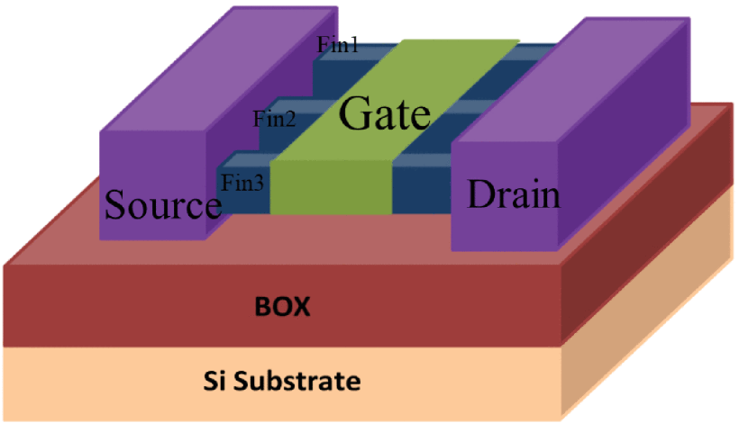
Multi-Fin FinFET
Multiple ‘‘fins’’ or channels // between the Source and Drain
Higher number of charge carriers traverse from source to drain simultaneously → enhanced speed
Industry Standard
Figure FinFET.10: Schematic diagram of M-FinFET. Figure taken from R. R. Das, T. R. Rajalekshmi and A. James, "FinFET to GAA MBCFET: A Review and Insights," in IEEE Access, vol. 12, pp. 50556-50577, 2024, doi: 10.1109/ACCESS.2024.3384428.

Slide 13
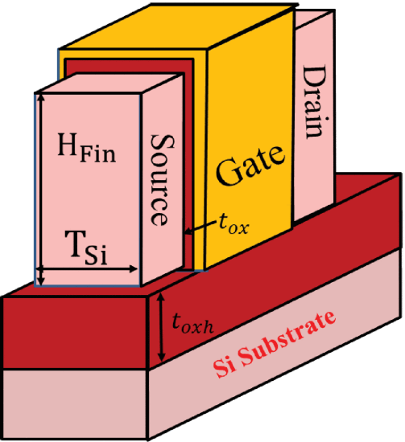
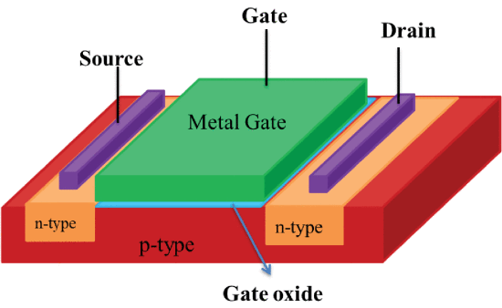
Motivation: Limitations of Planar MOSFETs
At < 32nm: strong SCE, leakage currents ↑, threshold voltage variation ↑
Gate control weak → poor electrostatics and power inefficiency
Need for multi-gate structures (MuGFETs)
Figure FinFET.11: The planar MOSFET semiconductor device.
Figure FinFET.12: Schematic diagram of conventional FinFET.
Figures taken from R. R. Das, T. R. Rajalekshmi and A. James, "FinFET to GAA MBCFET: A Review and Insights," in IEEE Access, vol. 12, pp. 50556-50577, 2024, doi: 10.1109/ACCESS.2024.3384428.

Slide 14
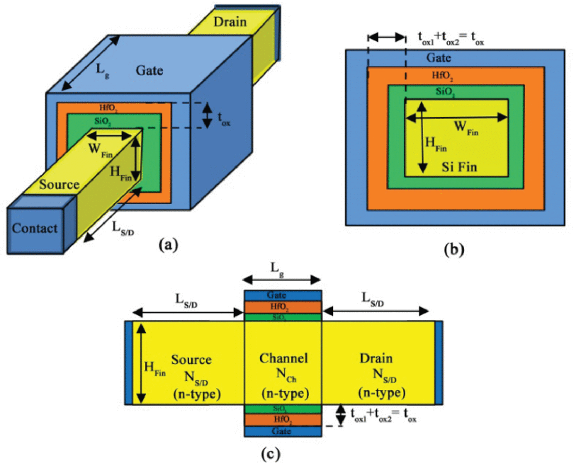
Conclusion
FinFETs provide low power and scalability down to ≈ 5 nm
Remaining issues: thermal management, manufacturing cost
Next step → GAA (Gate-All-Around FET)
Figure FinFET.13: Schematic diagram of GAA structure along (a) Vertical and
horizontal view (b) & (c). Figure taken from R. R. Das, T. R. Rajalekshmi and A. James, "FinFET to GAA MBCFET: A Review and Insights," in IEEE Access, vol. 12, pp. 50556-50577, 2024, doi: 10.1109/ACCESS.2024.3384428.

Slide 15
Where the Industry Stands Today
Company | Current Node (2024-2025) | Next-Gen Target | Technology in Use | Adoption Timeline
Samsung | 3 nm (3GAE / 3GAP) – world’s first GAA MBCFET chips (since 2022)[9] | 2 nm GAA MBCFET | GAA MBCFET (3 nm) + FinFET legacy nodes | First gen GAA → 2022 2nd gen → 2023 2 nm planned 2025
TSMC | 3 nm FinFET (N3 series) [10] | 2 nm GAA Nanosheet (N2) | FinFET | Developing GAA for ~2026 launch
Intel | Intel 4 / Intel 3 FinFET | 2 nm “Intel 20A” = RibbonFET (GAA) [11] | FinFET | GAA introduction ~2024 (20A node)
Table FinFET.3: Technology used by Samsung, TSMC and Intel

Slide 16
FD-SOI
Technology overview
“A Novel 1T-APS Using 22nm FD-SOI Technology With Record High Tunable Sensitivity Range”, H. Xie et al. [3]
“A Wideband Sub-6GHz Transceiver Front End for 5G Base Stations in 22-nm FD-SOI CMOS”, C. Elgaard et al. [4]

Slide 17
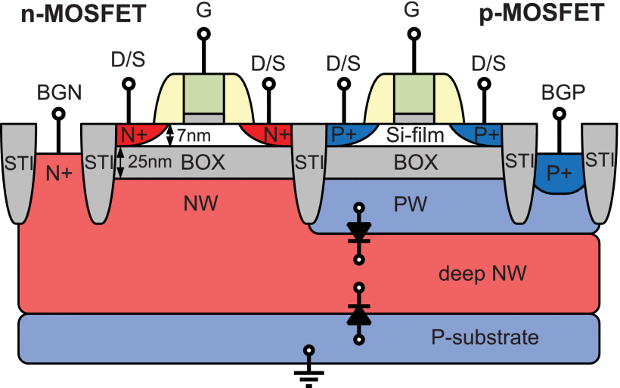
Fully Depleted-Silicon On Insulator: Overview
Thin Si channel (body) depleted of free carriers.
Back-gate V_{th} control [5][6][8]
Reduced:
Junction capacitance [5]
Leakage current [5]
Power consumption [5]
Output conductance g_{ds} [15]
Increased:
transconductance-to-drain-current ratios, g_{m}/I_{d}, [15]
Intrinsic voltage gain A_{v}=-g_{m}r_{ds}
Figure FD-SOI.1: Cross-section of the n- and p-channel MOSFETs with back-gate wells and deep n-well in 28nm UTBB FD-SOI CMOS process [13] .

Slide 18
FD-SOI
Technology overview
“A Novel 1T-APS Using 22nm FD-SOI Technology With Record High Tunable Sensitivity Range”, H. Xie et al. [3]
“A Wideband Sub-6GHz Transceiver Front End for 5G Base Stations in 22-nm FD-SOI CMOS”, C. Elgaard et al. [4]

Slide 19
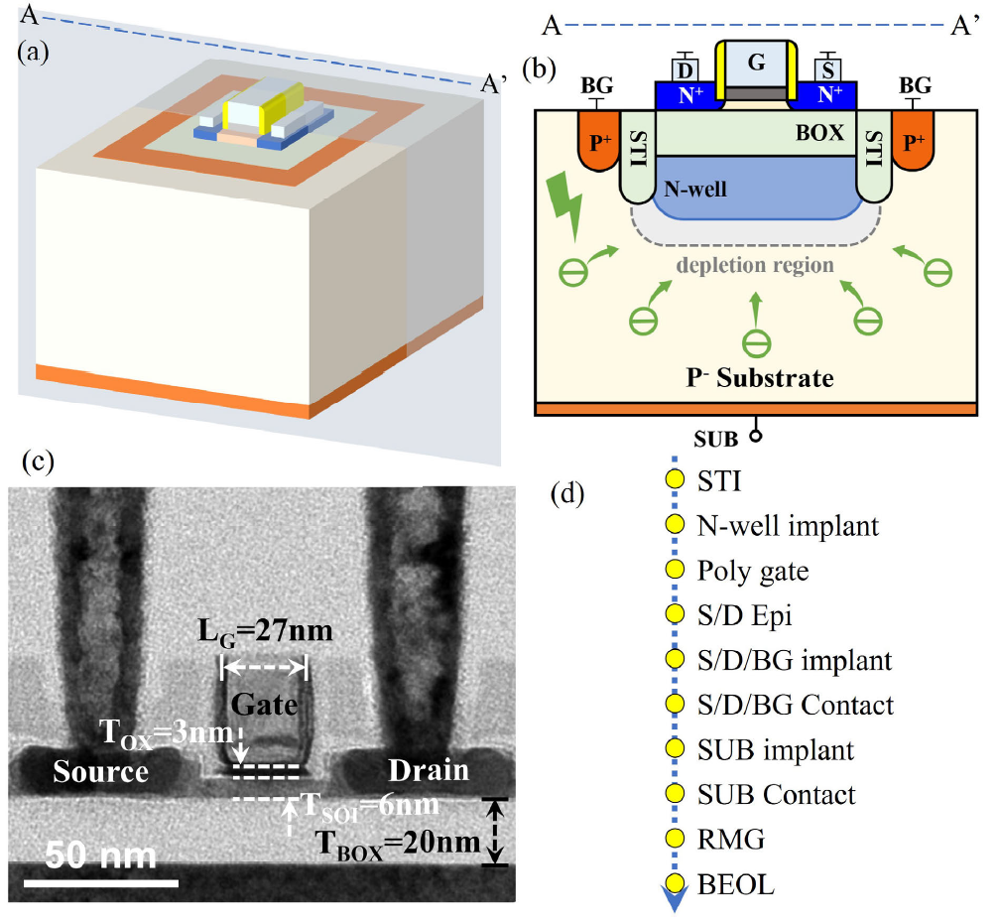
1T-APS Using 22nm FD-SOI Technology
Negative BG and SUB voltage pulse act as reset.
Maximum load-stored is controlled mainly by BG.
BG and SUB voltage regulation pushes or extracts photoelectrons from the depletion region.
Figure FD-SOI.2: (a) Schematic 3D structure and (b) 2D cross-section of 1T-APS. (c) XTEM image and (d) the simplified process flow. Taken from [3].

Slide 20
FD-SOI
Technology overview
“A Novel 1T-APS Using 22nm FD-SOI Technology With Record High Tunable Sensitivity Range”, H. Xie et al. [3]
“A Wideband Sub-6GHz Transceiver Front End for 5G Base Stations in 22-nm FD-SOI CMOS”, C. Elgaard et al. [4]

Slide 21
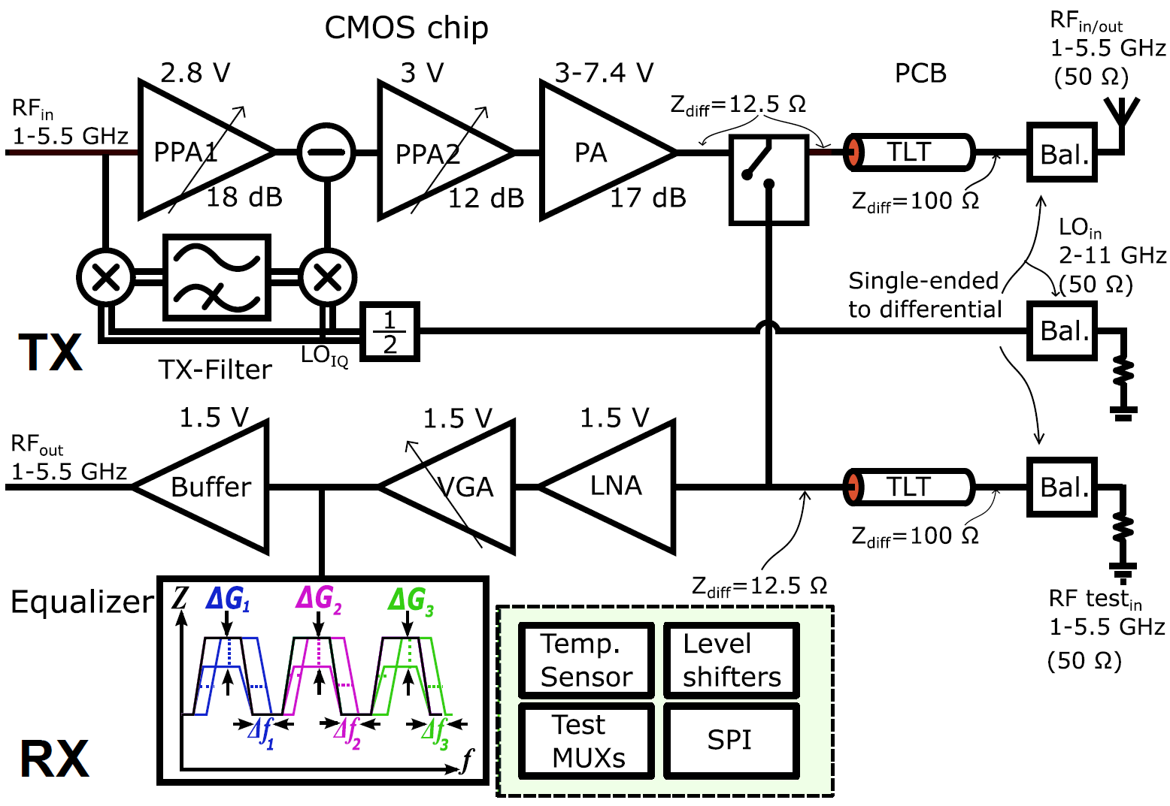
Simplified Integrated TRx Schematic
Tx
Rx
Figure FD-SOI.3: TRx schematic [4].

Slide 22
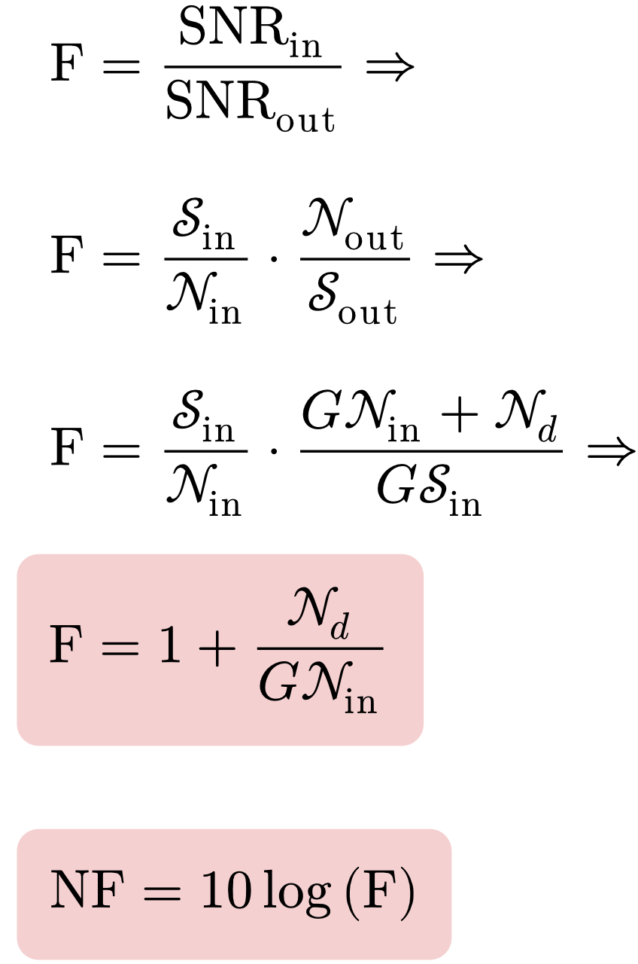
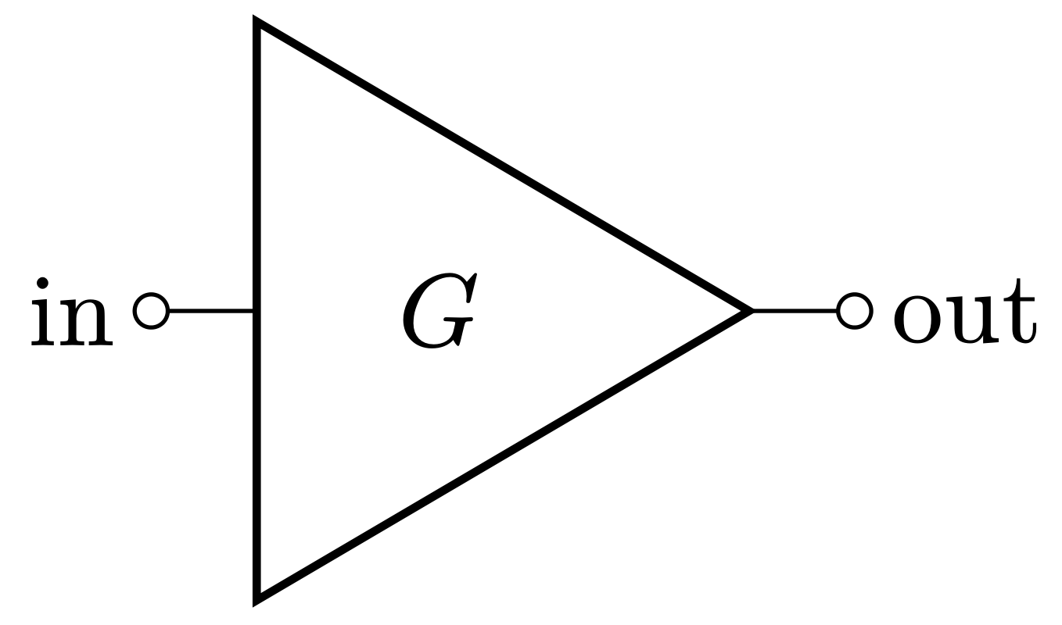
Noise measures [16]
𝒮_{in}, 𝒮_{out} : input and output signal power, respectively.
𝒩_{in}, 𝒩_{out}, 𝒩_{d} : input, output and device-added noise power, respectively.
Noise factor: F.
Noise figure: NF.
LNA proposed by [4]:
NF≦1.05dB for 𝑓≧1GHz
min(NF)≅0.9dB

Slide 23
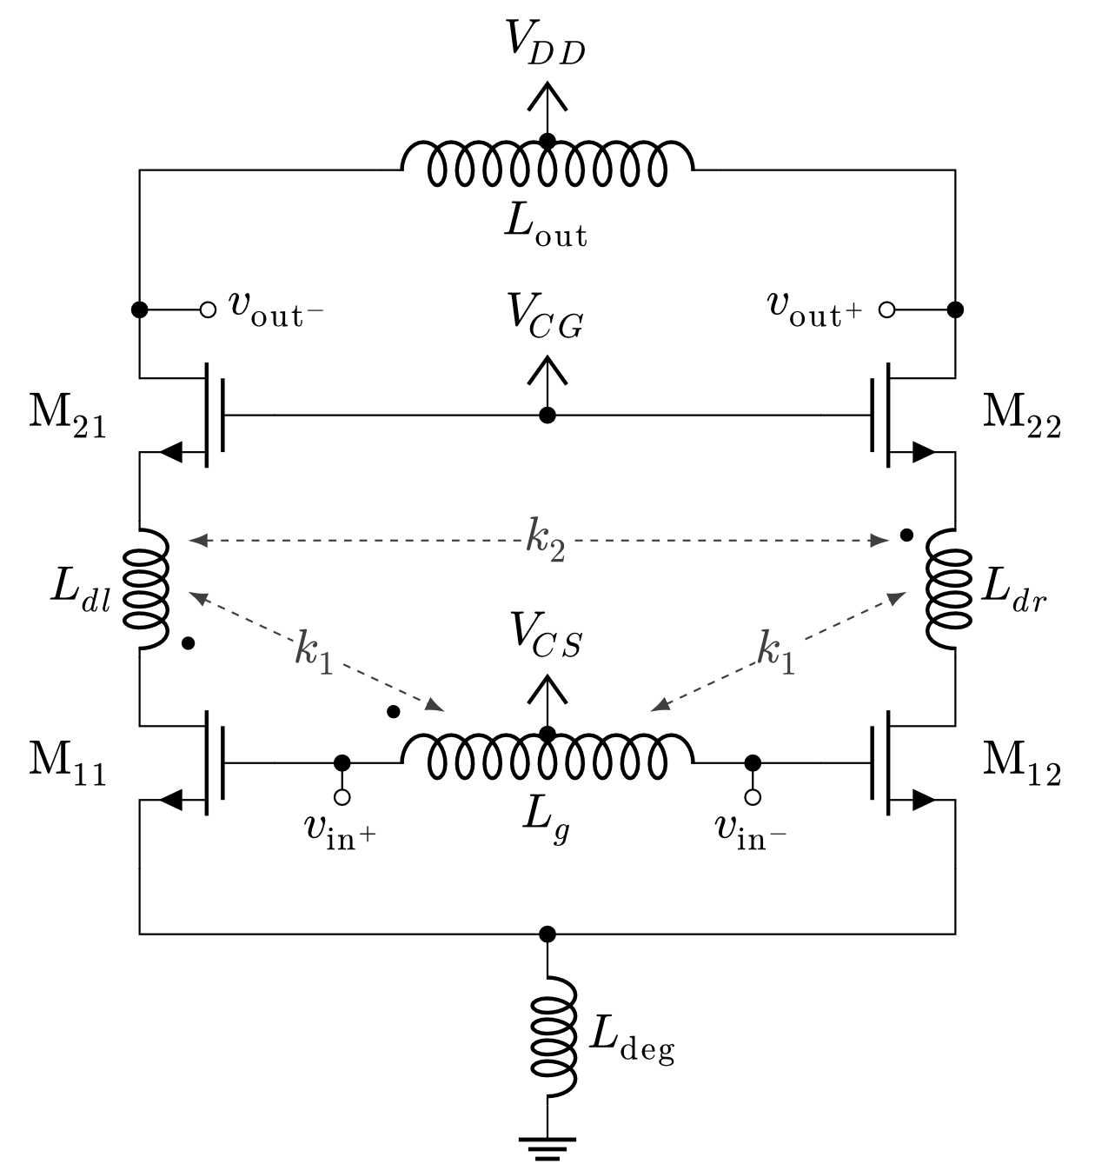
Rx Front-End: Low Noise Amplifier (LNA)
Fully differential structure.
Source degenerated M₁₁ & M₁₂ (input pair) for:
Improved input impedance matching [14],
Reduced common-mode gain.
Reactive feedback using transformers for improved:
Bandwidth,
Low additional noise.
L_{out} resonates with the output-node capacitances.
Figure FD-SOI.4: LNA schematic [4]. S_{1x}=0.9mm/28nm, S_{2x}=0.8mm/150nm.

Slide 24
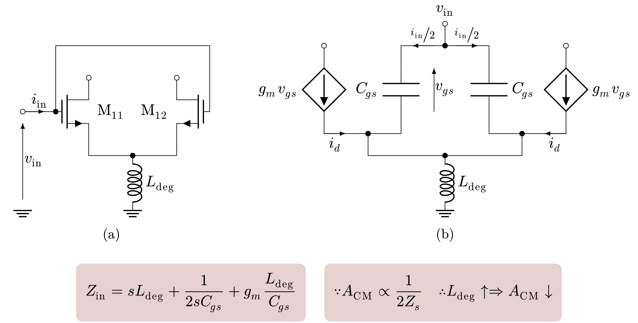
CS Amplifier: Source Degeneration in CM
Figure FD-SOI.5: (a) Differential common source (CS) nMOS pair in common-mode (CM). The CS amplifier is preceded by a system with output impedance $ℝ∋Z_{0}=R_{0}+j0$. (b) shows the small-signal equivalent of (a).

Slide 25
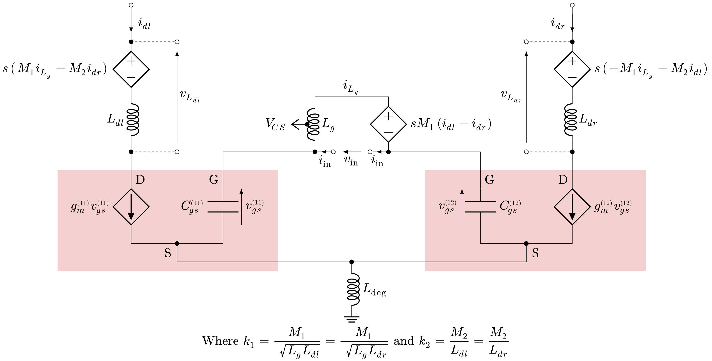
Reactive Feedback: Small Signal Model
Figure FD-SOI.6: Small signal equivalent of figure FD-SOI.4 with reactive feedback.

Slide 26
References
[1] K. Karimi, A. Fardoost, and M. Javanmard, “Comprehensive Review of FinFET Technology: History, Structure, Challenges, Innovations, and Emerging Sensing Applications,” Micromachines, vol. 15, no. 10, 2024. DOI: 10.3390/mi15101187.
[2] R. R. Das, T. R. Rajalekshmi, and A. James, “Fin-FET to GAA MBCFET: A Review and Insights,” IEEE Access, vol. 12, pp. 50 556–50 577, 2024. DOI: 10.1109/ACCESS.2024.3384428.
[3] H. Xie, Z. Wang, R. He, et al., “A Novel 1T-APSUsing 22nm FD-SOI Technology With Record High Tunable Sensitivity Range,” IEEE Electron Device Letters, Vol. 46, No. 7, pp. 1131–1134, Jul. 2025. DOI: 10.1109/LED.2025.3563988.
[4] C. Elgaard, M. Abdulaziz, T. Påhlsson, et al., “A Wideband Sub-6GHz Transceiver Front End for 5G Base Stations in 22-nm FD-SOI CMOS,” IEEE Journal of Solid-State Circuits, Vol. 60, No. 7, pp. 2367–2383, Jul. 2025. DOI: 10.1109/JSSC.2025.3552278.

Slide 27
[5] L. Nyssens, M. Rack, and J.-P. Raskin, “Chapter 2 - FD-SOI and RF-SOI Technologies For 5G,” in New Materials and Devices Enabling 5G Applications and Beyond, ser. Materials Today, N. Collaert, Ed., Elsevier, 2024, pp. 33–55, ISBN: 978-0-12-822823-4. DOI: 10.1016/B978-0-12-822823-4.00002-9. [Online].
[6] Georges Pananakakis, Gérard Ghibaudo, Sorin Cristoloveanu. “Threshold voltage in FD-SOI MOSFETs”. Solid-State Electronics, Vol. 217, 2024. DOI: 10.1016/j.sse.2024.108947.
[7] Mheen, B., Kim, M., Song, Y.-J., Hong, S.. “Operation Principles of 0.18-µm Four-Transistor, CMOS Image Pixels With a Nonfully Depleted Pinned Photodiode”. IEEE Transactions on Electron Devices, Vol. 53. 2006, pp. 2735-2740. DOI: 10.1109/TED.2006.883673.
[8] Liu, Q. and Yagishita, A., Loubet, N., Khakifirooz, A., Kulkarni, P., Yamamoto, T., Cheng, K., Fujiwara, M., Cai, J., Dorman, D., Mehta, S., Khare, P. and Yako, K., Zhu, Y., Mignot, S., Kanakasabapathy, S., Monfray, S., Boeuf, F., Koburger, C.,Sunamura, H., Ponoth, S., Reznicek, A., Haran, B., Upham, A., Johnson, R., Edge, L. F., Kuss, J., Levin, T., Berliner, N., Leobandung, E., Skotnicki, T., Hane, M., Bu, H., Ishimaru, K., Kleemeier, W., Takayanagi, M., Doris, B., Sampson, R.. “Ultra-thin-body and BOX (UTBB) fully depleted (FD) device integration for 22nm node and beyond”. 2010 Symposium on VLSI Technology. 2010, pp. 61-62. DOI: 10.1109/VLSIT.2010.555612.

Slide 28
[9] https://semiconductor.samsung.com/processor/mobile-processor/
[10] https://www.tsmc.com/english/dedicatedFoundry/technology/logic
[11] https://www.intel.com/content/www/us/en/foundry/process.html
[13] Shopov, Stefan and Voinigescu, Sorin P.. “A 3×60Gb/s Transmitter/Repeater Front-End With 4.3V_{PP} Single-Ended Output Swing in a 28nm UTBB FD-SOI Technology”. IEEE Journal of Solid- State Circuits, Vol. 51. 2016, pp. 1651-1662. DOI: 10.1109/JSSC.2016.2545703.
[14] R. H. Caverly, CMOS RFIC Design Principles.Artech House, 2007, ISBN: 9781596931336.
[15] Takayasu Sakurai, Akira Matsuzawa, Takakuni Douseki, Fully-Depleted SOI CMOS Circuits and Technology for Ultralow-Power Applications. Springer New York, NY, 2007, ISBN: 978-0-387- 29218-2. DOI: 10.1007/978-0-387-29218-2.
[16] Michael Steer, Microwave & RF Design: A Systems Approach, 2010, ISBN: 9781891121883.

