Slide 1
Data exploration on Credit Card Customers dataset
By Antony Garcia
Student ID: 901004615 | email: agarcia3@wpi.edu

Slide 2
Table of contents
01
Dataset description
02
Data exploration
03
Data analysis
04
Results and conclusions
A brief description of the dataset and its content
Analysis on the available information. Data cleanup and normalization.
Statistical analysis of the information from the dataset
Results and final thoughts

Slide 3
01
Dataset description
Credit Card Customers Dataset (Kaggle)

Slide 4
Credit Card Customers Dataset
The data set is focused on the problem of customer churn in the credit card services of a bank. The data set was obtained from a website that provides data sets for solving business problems.
The data set contains information on 10,000 customers, including their age, salary, marital status, credit card limit, credit card category, and other features. There are a total of 18 features in the data set.

Slide 5
Credit Card Customers Dataset
The objective of the data set is to predict which customers are likely to churn, so that the bank can proactively reach out to these customers and provide them with better services in an attempt to retain them as customers.
Overall, this data set provides an opportunity to explore and analyze factors that contribute to customer churn in the credit card services of a bank, and to build predictive models that can help the bank proactively address this issue.

Slide 6
02
Data exploration
Credit Card Customers Dataset (Kaggle)

Slide 7
List of features in dataset
Feature Name | Description
CLIENTNUM | Unique identifier for each customer
Attrition_Flag | Target variable indicating whether the customer has churned or is an existing customer
Customer_Age | Age of the customer in years
Gender | Gender of the customer (M or F)
Dependent_count | Number of dependents the customer has
Education_Level | Highest level of education the customer has completed
Marital_Status | Marital status of the customer
Income_Category | Income bracket of the customer
Card_Category | Type of credit card the customer has (Blue, Silver, Gold, Platinum)
Months_on_book | Number of months the customer has been a customer of the bank
Total_Relationship_Count | Total number of products the customer has with the bank
Months_Inactive_12_mon | Number of months the customer has been inactive in the past 12 months
Contacts_Count_12_mon | Number of contacts the customer has had with the bank in the past 12 months
Credit_Limit | Credit limit on the customer's credit card
Total_Revolving_Bal | Total amount of revolving credit the customer has
Avg_Open_To_Buy | Average amount of credit available to the customer
Total_Amt_Chng_Q4_Q1 | Change in transaction amount (Q4 over Q1)
Total_Trans_Amt | Total transaction amount in the last 12 months
Total_Trans_Ct | Total transaction count in the last 12 months
Total_Ct_Chng_Q4_Q1 | Change in transaction count (Q4 over Q1)

Slide 8
High-level summary of the most important features
Attrition_Flag: This is the target variable that indicates whether a customer has churned or is an existing customer. It is the most important feature in the dataset.
Total_Relationship_Count: Customers who have more products with the bank are generally more loyal and less likely to churn.
Months_Inactive_12_mon: Customers who have been inactive for a longer period of time are more likely to churn.

Slide 9
High-level summary of the most important features
Contacts_Count_12_mon: Customers who have had more contact with the bank are generally more engaged and less likely to churn.
Credit_Limit: Customers with higher credit limits are generally more valuable to the bank and less likely to churn.
Total_Trans_Amt: Customers who have higher transaction amounts are generally more valuable to the bank and less likely to churn
Avg_Utilization_Ratio: Customers with high utilization ratios are generally more risky and more likely to churn.

Slide 10
One-hot encoding
One-hot encoding is needed because many machine learning algorithms cannot handle categorical features directly. Most machine learning algorithms work with numerical data, and categorical features need to be converted to numerical format before they can be used for analysis or model training.
One common approach to converting categorical features into numerical features is one-hot encoding, which creates a binary column for each category in the feature.

Slide 11
Non-numerical features
 | Description | Example
Attrition Flag | Target variable indicating whether the customer has churned or is an existing customer | Existing customer Attrited customer
Gender | Gender of the customer | Male Female
Education | Highest level of education the customer has completed | Unknown Unedicated High School College Graduate Doctorate Post-Graduate

Slide 12
Non-numerical features
 | Description | Example
Marital Status | Marital status of the customer | Married Single Divorced Unknown
Income category | Income bracket of the customer | Unknown Less Than 40k 40k to 60k 60k to 80k 80k to 120k 120k +
Card category | Type of credit card the customer has | Blue Gold Platinum SIlver

Slide 13
Data Correlation Matrix
The data correlation matrix is a fundamental tool in data analysis and machine learning. It provides a matrix of all pairwise correlations between the features (or variables) in a dataset.
Each element in the matrix represents the correlation coefficient between two features, which indicates the strength and direction of the linear relationship between them.

Slide 14
Importance of data correlation
PESTLE
Relationships
R
I
Interpretation
Identify the relationships between pairs of variables in a dataset
Useful for interpreting the results of machine learning models
Feature selection
F
L
Exploratory analysis
Identify which features are highly correlated with the target variable
Gains insights into the data and identify new research question
Data pre-processing
Helps identify such features and guide data preprocessing steps
D
M
Multicollinearity detection
Identify which variables need to be removed or transformed

Slide 15
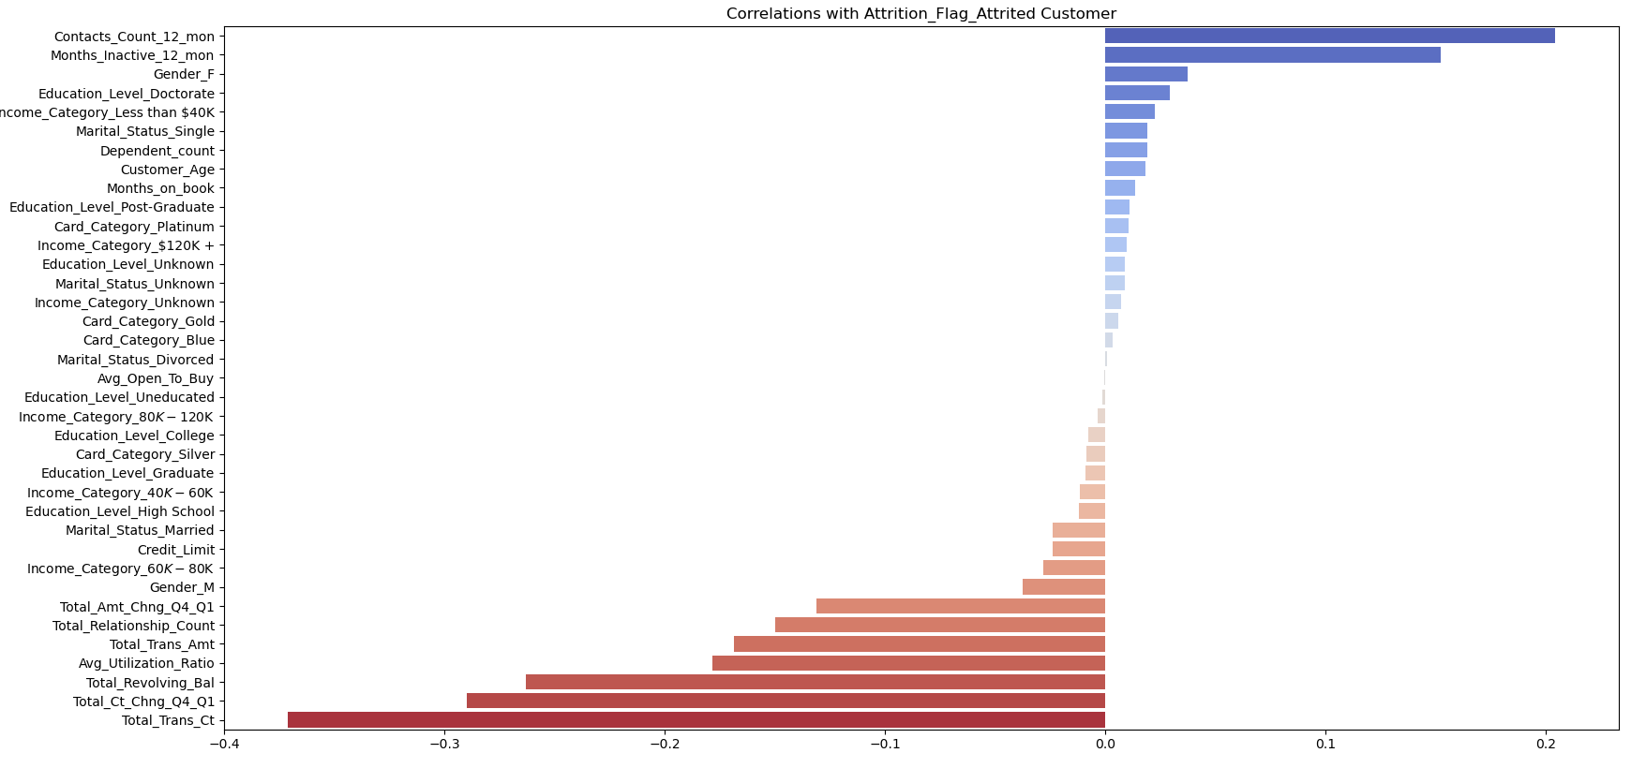
Data Correlation Matrix

Slide 16
Data correlation summary
Positively correlated features
Negatively correlated features
Contact count over 12 months
Inactive Months over the last 12 months
Gender (Female)
Education level (Doctorate)
Income (Less than 40k)
Marital Status (Single)
Dependent count
Total Transaction count
Change in transaction count (Q4 over Q1)
Total amount of revolving credit
Average Utilization Ratio
Total Transaction Amount
Total number of products with the bank
Change in transaction amount (Q4 over Q1)
A positive correlation means the variables that are more related with Client Attrition

Slide 17
03
Data analysis
Credit Card Customers Dataset (Kaggle)

Slide 18
A Machine Learning Approach
A probabilistic model can be developed using the provided dataset to predict client attrition.
The dataset contains features such as customer age, gender, income category, education level, marital status, and card category, which can be used to predict whether a customer is likely to leave or stay with the bank.

Slide 19
A Machine Learning Approach
By selecting important features, splitting the dataset into training and testing sets, selecting an appropriate machine learning algorithm, training and evaluating the model, fine-tuning the hyperparameters, and deploying the model, an accurate and effective probabilistic model can be built.
This model can be used by financial institutions to identify customers who are at risk of leaving and take proactive steps to retain them.

Slide 20
Machine Learning Classifiers
With Scikit-Learn it is possible to use the all_estimators tool to test multiple machine learning classifiers to look for the best model to fit the data.
This tools makes possible to test 38 estimators:
AdaBoostClassifier | ExtraTreesClassifier | MultiOutputClassifier | RandomForestClassifier
BaggingClassifier | GaussianNB | MultinomialNB | RidgeClassifier
BernoulliNB | GaussianProcessClassifier | NearestCentroid | RidgeClassifierCV
CalibratedClassifierCV | GradientBoostingClassifier | NuSVC | SGDClassifier
CategoricalNB | HistGradientBoostingClassifier | OneVsOneClassifier | SVC
ClassifierChain | KNeighborsClassifier | OneVsRestClassifier | StackingClassifier
ComplementNB | LinearSVC | OutputCodeClassifier | VotingClassifier
DecisionTreeClassifier | LogisticRegression | PassiveAggressiveClassifier
DummyClassifier | LogisticRegressionCV | Perceptron
ExtraTreeClassifier | MLPClassifier | QuadraticDiscriminantAnalysis

Slide 21
Machine Learning Classifiers
However, testing these models may be difficult due to biased samples, since there is an imbalance between classes for the Attrition_Flag feature.
Out of the total of 10127 customers, 1627 are categorized as Attrited Customers and 8500 are Active Customers, resulting in an 84:16 ratio. However, in order to achieve better results, it would be ideal to have a 50:50 ratio.

Slide 22
Machine Learning Classifiers
To address class imbalance, a Bagging mechanism was employed. This involved randomly selecting 1000 samples from each class to test each model.
The classifiers were tested 10 times using different datasets, and the average accuracy was recorded to assess the performance of the models.

Slide 23
Machine Learning Classifiers
Rank | Classifier | Average Accuracy
1 | HistGradientBoostingClassifier | 0.955
2 | GradientBoostingClassifier | 0.934
3 | RandomForestClassifier | 0.9308
4 | AdaBoostClassifier | 0.9317
5 | BaggingClassifier | 0.9222
6 | DecisionTreeClassifier | 0.9055
7 | ExtraTreesClassifier | 0.8985
8 | MLPClassifier | 0.856
9 | SVC | 0.8533
10 | NuSVC | 0.85
Out of all the algorithms that were tested, the HistGradientBoostingClassifier demonstrated the most favorable performance on the classification task. With 95.5% accuracy, this algorithm accurately predicted whether a client would remain with or leave the bank.

Slide 24
04
Results and conclusions
Credit Card Customers Dataset (Kaggle)

Slide 25
Results
1
Essential factors contributing to client attrition were determined and assessed
2
Various machine learning algorithms were evaluated for their ability to predict the probability of client attrition
3
A 95.5% accuracy rate was attained in predicting client attrition or retention using the HistGradientBoostingClassifier
4
Dynamic and critical factors influencing client attrition and loyalty were identified and incorporated into the model

Slide 26
Conclusions
1
Banks can leverage machine learning models to detect potential customers who may leave and identify the key features that contribute to attrition
2
The model that was developed can be utilized to proactively identify customers who may be at risk of leaving, enabling banks to take measures to retain them through early intervention
3
Targeted campaigns can be implemented to appeal to specific demographics that have shown a higher propensity to leave other banks, based on the insights provided by the model.
4
Client loyalty programs can be optimized by focusing efforts on customers who are less likely to leave the bank, as identified by the model

Slide 27
Thanks!
By Antony Garcia
Student ID: 901004615 | email: agarcia3@wpi.edu

