Slide 1
Functions in C++

Slide 2

Topics to be covered
Function Definitions and Function Prototypes
Inline Functions
Function-call stack and Activation Records
Default argument and object as function argument & returning object
Friend function
Static data member and static member function,
Constant member function
Function Overloading, Function Templates
Unary Scope Resolution Operator
Introduction to Functional-Style Programming
Recursion
Unit 2: Functions and Functions Templates

Slide 3
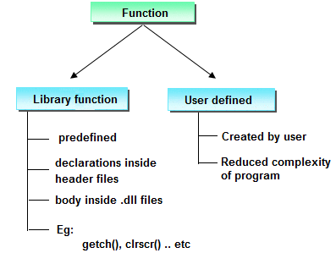
Function
A function is a group of statements that together perform a task.
Functions are made for code reusability and for saving time and space.
Unit 2: Functions and Functions Templates

Slide 4
Categories of User-defined Functions
Function with no argument and no return value.
Function with no argument but return value.
Function with argument but no return value.
Function with argument and return value.
Unit 2: Functions and Functions Templates

Slide 5
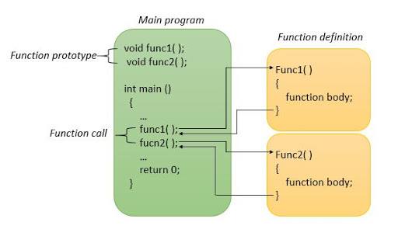
Elements of User-defined Functions
Unit 2: Functions and Functions Templates

Slide 6
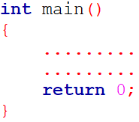
The main function
main() function is the entry point at which execution of program is started.
C allows main() function type to be void. C++ does not all main() function to be void.
In C++, main() returns an integer type value to the operating system. Therefore, every main() in C++ should end with a return(0) statement.
The explicit use of a return(O) statement will indicate that the program was successfully executed
Unit 2: Functions and Functions Templates

Slide 7
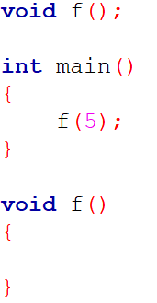
Function Prototyping / Declaration
Describes number and type of arguments and the type of return values.
When a function is called, the compiler ensure that proper arguments are passed, and the return value is treated correctly.
Any violation in matching the arguments or the return types will be caught by the compiler at the time of compilation itself.
These checks and controls did not exist in the conventional C functions.
NOTE:
Try above program in C and C++. Notice the difference
Unit 2: Functions and Functions Templates

Slide 8
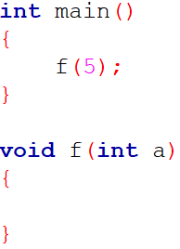
Function Prototyping / Declaration
It was introduced first in C++, ANSI C adopt it later on.
While C++ makes the prototyping essential, ANSI C makes it optional.
NOTE:
Try above program in C and C++. Notice the difference
Unit 2: Functions and Functions Templates

Slide 9
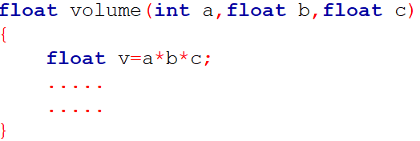
Simple Function
Function Prototyping / declaration
Syntax:
Example:
Function Calling
Function Definition
Function Prototyping / declaration
Syntax:
Example:
Function Calling
Function Definition
Unit 2: Functions and Functions Templates

Slide 10
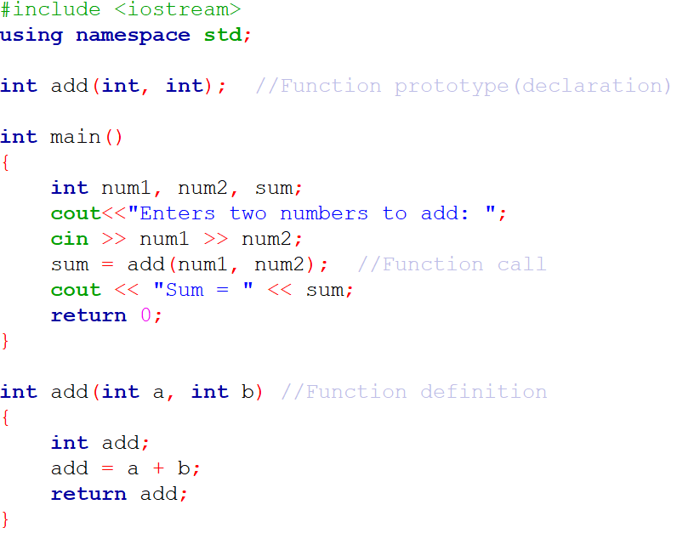

Simple Function
Unit 2: Functions and Functions Templates

Slide 11
Inline functions
One of the objectives of using functions in a program is to save some memory space.
However, every time a function is called, it takes a lot of extra time in executing a series of instructions for task such as
Jumping to functions, saving registers, pushing arguments into the stack, and returning to the calling function.
When a function is small, a substantial percentage of execution time may be spent in such overheads.
Unit 2: Functions and Functions Templates

Slide 12
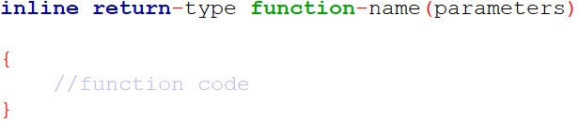
Inline functions
To eliminate the cost of calls to small functions, C++ proposes a new feature called inline function.
An inline function is a function that is expanded in line when it is invoked. That is, the compiler replaces the function call with the corresponding function code (something similar to macros expansion).
Syntax:
Unit 2: Functions and Functions Templates

Slide 13
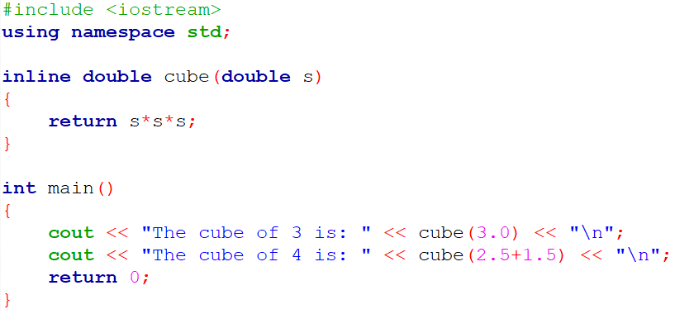

Inline functions
Unit 2: Functions and Functions Templates

Slide 14
Inline functions
NOTE:
All inline functions must be defined before they are called.
To make a function inline, prefix the keyword inline to the function definition.
Usually, functions are made inline when they are small enough to be defined in one or two lines.
If the function grows in size, the speed benefit of inline function diminish.
Unit 2: Functions and Functions Templates

Slide 15
Inline functions
Remember, inlining is only a request to the compiler, not a command.
Compiler can ignore the request for inlining if function definition is too long or too complicated and compile the function as a normal function.
Some situations where inline expansion may not work:
If a function contains a loop. (for, while, do-while)
If a function contains static variables.
If a function is recursive.
If a function return type is other than void, and the return statement doesn’t exist in function body.
If a function contains switch or goto statement.
Unit 2: Functions and Functions Templates

Slide 16
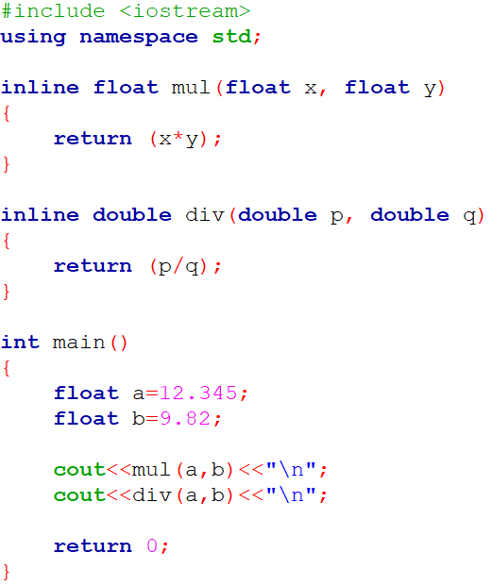

Inline functions
Unit 2: Functions and Functions Templates

Slide 17
Default Arguments
C++ allows us to call a function without specifying all its arguments.
In such cases, the function assigns a default value to the parameter which does not have a matching argument in the function call.
Default values are specified when the function is declared.
The compiler looks at the prototype to see how many arguments a function uses and alerts the program for possible default values.
Unit 2: Functions and Functions Templates

Slide 18
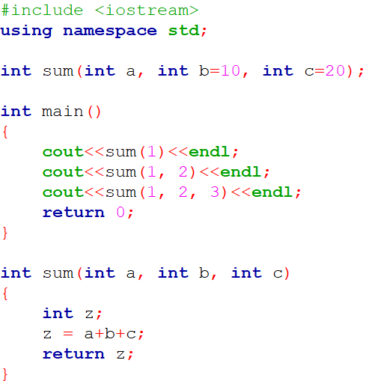
Default Arguments
Unit 2: Functions and Functions Templates

Slide 19
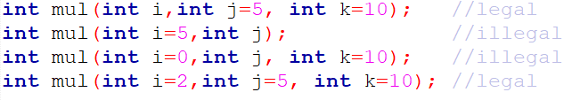
Default Arguments
NOTE: Only the trailing arguments can have default values and therefore we must add defaults from right to left.
Default arguments are useful in situations where some arguments always have the same value.
Example: bank interest may remain the same for all customers for a particular period of deposit.
Unit 2: Functions and Functions Templates

Slide 20
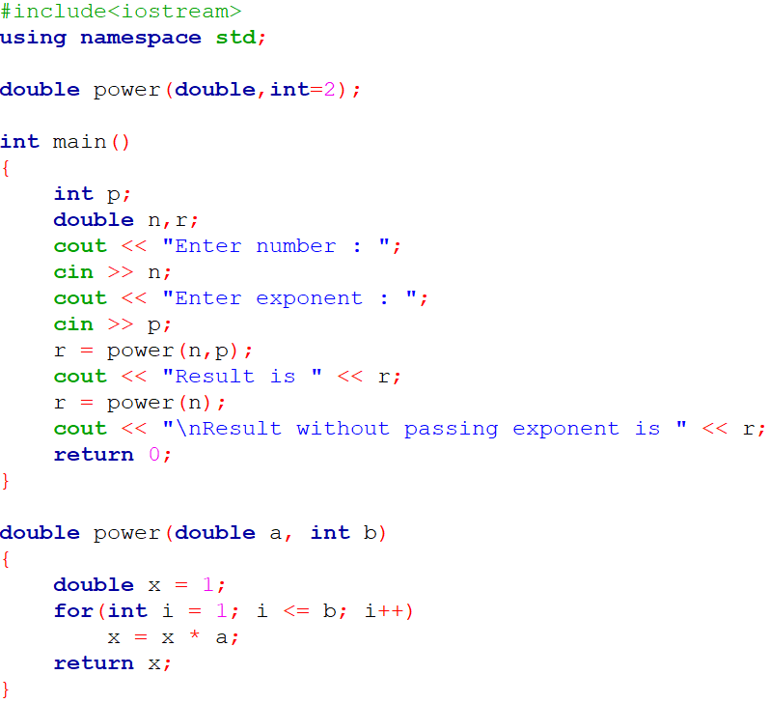

Practice Program : Default Arguments
Write a function called power () that takes two arguments: a double value for n and an int for p, and returns the result as double value. Use default argument of 2 for p, so that if this argument is omitted, the number will be squared. Write a main () function that gets values from the user to test this function.
Unit 2: Functions and Functions Templates

Slide 21

Default Arguments
Volume of Ellipsoid = (4/3) × pi × radius1 × radius2 × radius3. Write a program having function volume () which takes three float arguments: radius1, radius 2 and radius3 and returns the volume of an Ellipsoid. Use default argument of 2 for radius1, 3 for radius2 and 4 for radius3 so that if arguments are omitted then the volume of Ellipsoid is always 100.48. Write a main ( ) function that gets values from the user to test this function.
Unit 2: Functions and Functions Templates

Slide 22
Introduction to Class
The most important feature of C++ is the “class”
A class is an extension of the idea of structure used in C
It is a new way of creating and implementing a user-defined data type.
Unit 2: Functions and Functions Templates

Slide 23
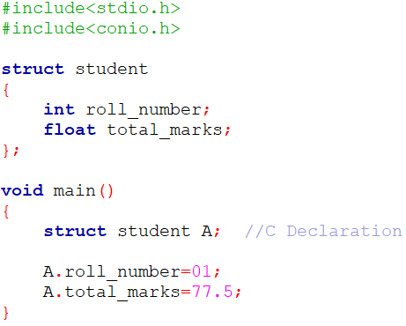
C Structure Revisited
C Structure provide a method for packing together data of different data types.
It is user defined data type.
Unit 2: Functions and Functions Templates

Slide 24
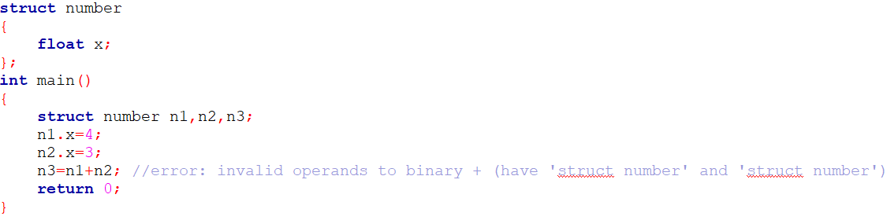
Limitation of C Structure
The C structure does not allow the struct data type to be treated like built-in data types
We cannot use operators like +,- etc. on Structure variables
Unit 2: Functions and Functions Templates

Slide 25
Limitation of C Structure
No Data Hiding
Structure members can be directly accessed by the structure variables by any function anywhere in their scope.
In other words, the structure members are public members.
Functions inside Structure
C structures do not permit functions inside Structure
Static Members
C Structures cannot have static members inside their body
Unit 2: Functions and Functions Templates

Slide 26
Limitation of C Structure
Access Modifiers
C Programming language do not support access modifiers. So they cannot be used in C Structures.
Construction creation in Structure
Structures in C cannot have constructor inside Structures.
Direct Initialization
We cannot directly initialize structure data members in C
Using struct keyword
In C, we need to use struct to declare a struct variable
Unit 2: Functions and Functions Templates

Slide 27
Limitation of C Structure
sizeof operator
This operator will generate 0 for an empty structure in C whereas 1 for an empty structure in C++.
Unit 2: Functions and Functions Templates

Slide 28
C++ Structure
C++ supports all the features of structure as defined in C
But C++ has expanded its capabilities further to suit its OOP philosophy.
It attempts to bring the user-defined types as close as possible to the built-in data types
Keyword struct can be omitted in the declaration of structure variables and can be used like any other type names.
Provides a facility to hide the data(using private declaration) which is one of the main principle of OOP.
In C++, a structure can have both data members and functions.
Unit 2: Functions and Functions Templates

Slide 29
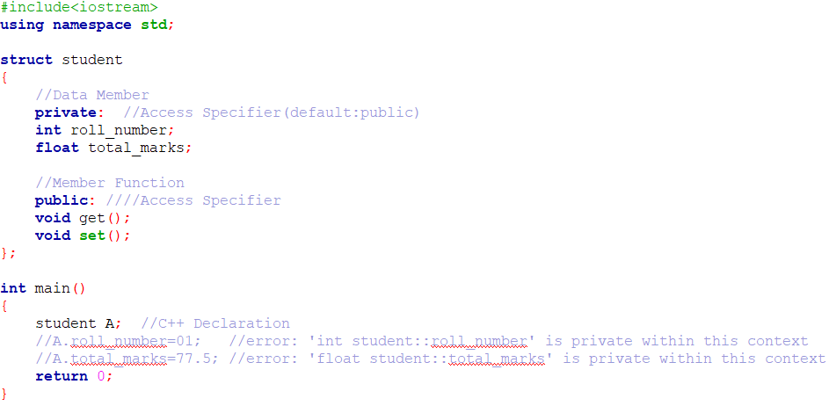
C++ Structure
Unit 2: Functions and Functions Templates

Slide 30
C++ Structure
Create a C++ Structure Weight having private data members: float kg, grams. A member function getvalue () should enter their values. Another member function putvalue () should display their values.
Unit 2: Functions and Functions Templates

Slide 31
C++ class
C++ incorporates all these extensions in another user-defined type known as class.
The only difference between a structure and a class in C++ is that,
By default, the members of a class are private
By default, the members of a structure are public.
Unit 2: Functions and Functions Templates

Slide 32
Specifying a Class
A class is a way to bind the data and its associated functions together(encapsulation).
It allows the data(and function) to be hidden, if necessary, from external use.
A class specification has two parts:
Class declaration
Class function definitions
Unit 2: Functions and Functions Templates

Slide 33
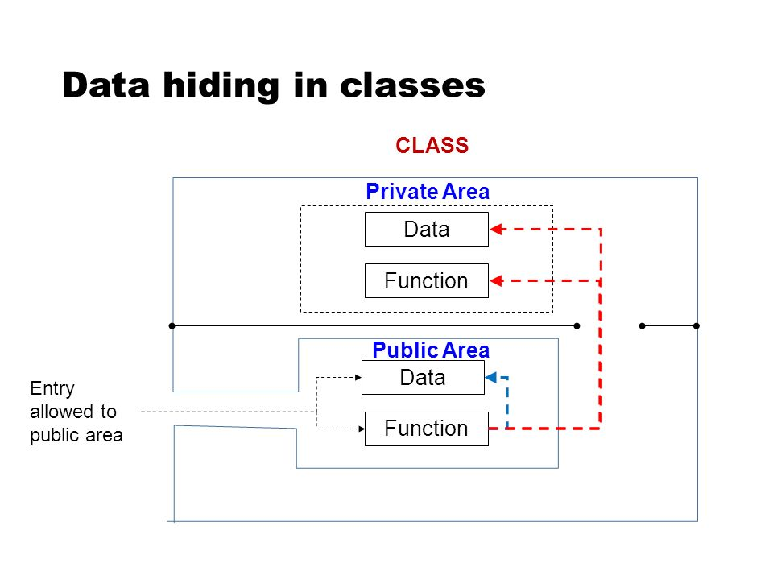
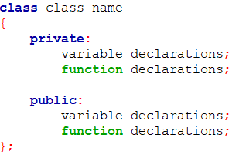
Class declaration
Syntax:
Unit 2: Functions and Functions Templates

Slide 34
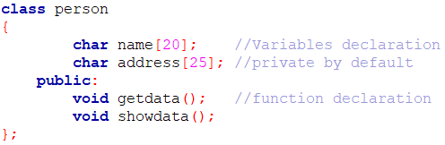
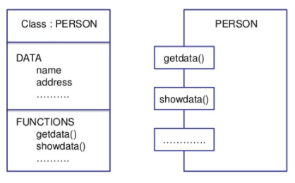
Class declaration
Example:
Representation of a class
Unit 2: Functions and Functions Templates

Slide 35
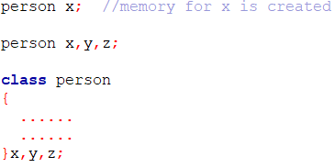
Creating Objects
Once a class has been declared, we can create variables(objects) of that type by using the class name(like any other built-in type variable)
Unit 2: Functions and Functions Templates

Slide 36


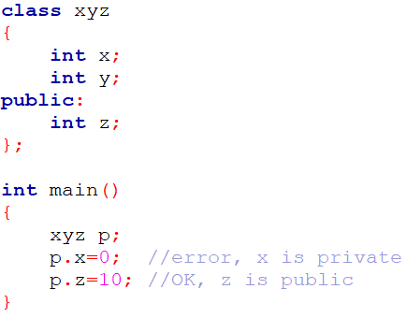
Accessing Class Members
Syntax:
Example:
Unit 2: Functions and Functions Templates

Slide 37
Defining Member Functions
Member functions can be defined in two places:
Outside the class definition
Inside the class definition
Unit 2: Functions and Functions Templates

Slide 38

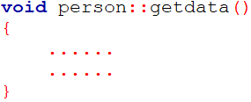
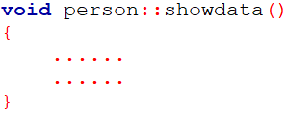
Outside the class definition
Syntax:
The membership label (class-name::) tells the compiler that the function function-name belongs to the class class-name.
That is, the scope of the function is restricted to the class-name specified in the header line.
Example:
Unit 2: Functions and Functions Templates

Slide 39
Outside the class definition
Characteristics of Member Function:
Several different classes can use the same function name. The ‘membership label’ will resolve their scope.
Member functions can access the private data of the class. A non-member function cannot do so.(However, an exception to this rule is a friend function)
A member function can call another member function directly, without using the dot operator.
Unit 2: Functions and Functions Templates

Slide 40
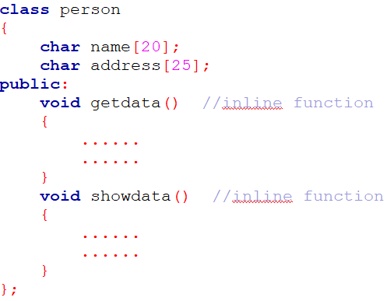
Inside the class definition
Replace the function declaration by the actual function definition inside the class.
NOTE:
Function defined inside a class is treated as an inline function.
All restrictions that apply to an inline function are also applicable here.
Normally, only small functions are defined inside the class definition
Unit 2: Functions and Functions Templates

Slide 41
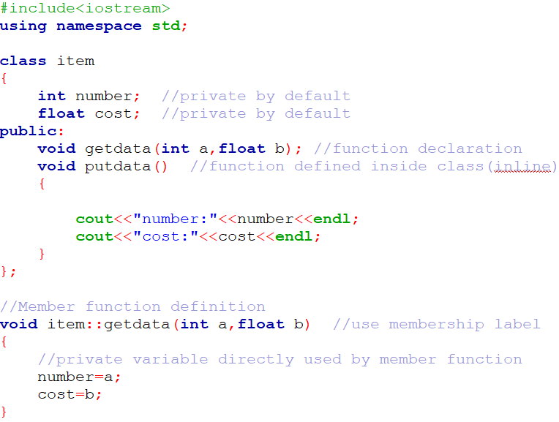
Unit 2: Functions and Functions Templates

Slide 42
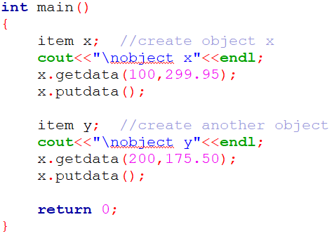
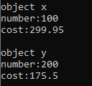
Unit 2: Functions and Functions Templates

Slide 43
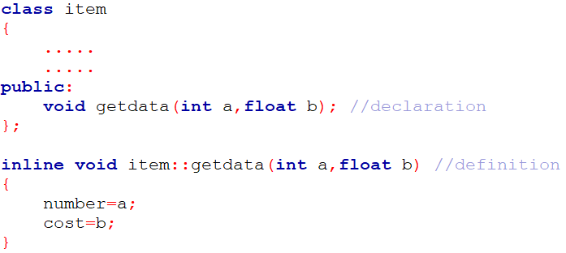
Making an outside Function Inline
One of the objective of OOP is to separate the details of implementation from the class definition.
It is therefore good practice to define the member functions outside the class.
Unit 2: Functions and Functions Templates

Slide 44
C++ Class
Create a C++ Class Weight having private data members: float kg, grams. A member function getvalue () should enter their values. Another member function putvalue () should display their values. Define both functions inside the class. Member function defined inside the class behaves like an inline function. Illustrate the difference between C++ Structure and C++ Class.
Unit 2: Functions and Functions Templates

Slide 45
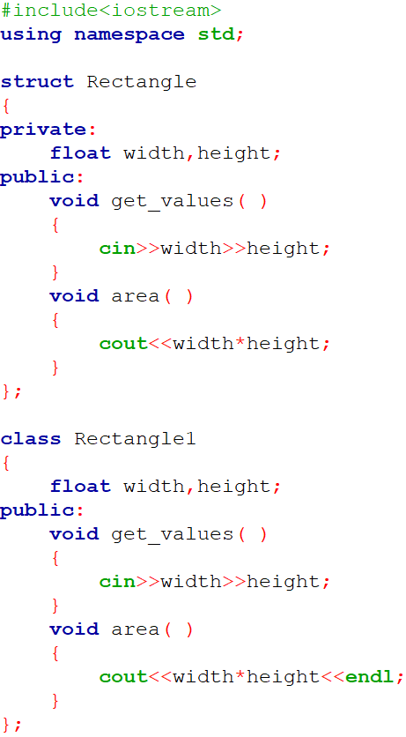
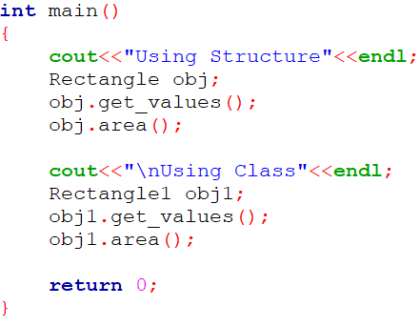
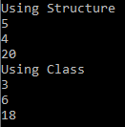
Practice Program: C++ struct and class
Define a C++ Structure Rectangle with data member’s width and height. It has get_values() member functions to get the data from user and area() member functions to print the area of rectangle. Also create a C++ Class for the above program. Define both functions inside the class. Member function defined inside the class behaves like an inline function and illustrate the difference between C++ Structure and C++ Class.
Unit 2: Functions and Functions Templates

Slide 46
Static Data Members
A data member of a class can be qualified as static.
Static data member has certain special characteristics:
It is initialized to zero when the first object of its class is created. No other initialization is permitted.
Only one copy of that member is created for the entire class and is shared by all the objects of that class, no matter how many objects are created.
It is visible only within the class, but its lifetime is the entire program.
Unit 2: Functions and Functions Templates

Slide 47

Static Data Members
A static variable is normally used to maintain value common to the entire class.
For e.g, to hold the count of objects created.
Note that the type and scope of each static member variable must be declared outside the class definition.
This is necessary because the static data members are stored separately rather than as a part of an object.
While defining a static variable, some initial value can also be assigned
Since they are associated with the class itself rather than with any class objects, they are also known as class variables.
Unit 2: Functions and Functions Templates

Slide 48
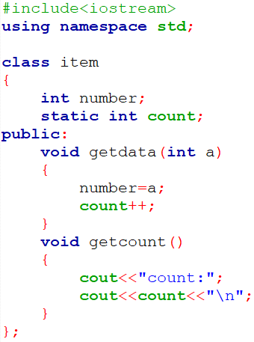
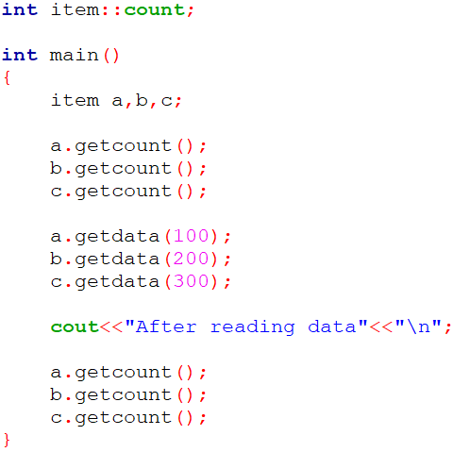
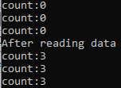
Static Data Members
Unit 2: Functions and Functions Templates

Slide 49
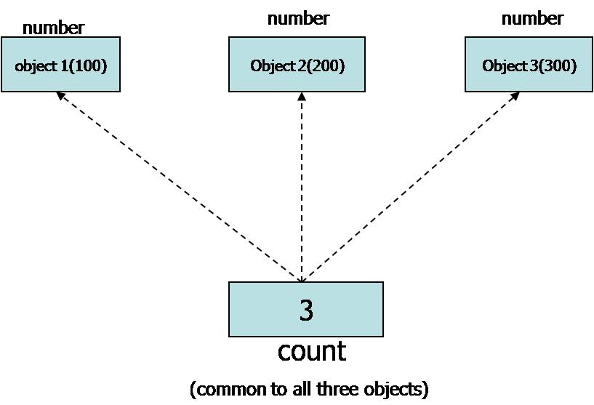
Static Data Members
Unit 2: Functions and Functions Templates

Slide 50
Static Member Functions
Like a static member variable, we can also have static member functions.
Static member function has certain special characteristics:
A static function can have access to only other static members (function or variable) declared in the same class.
A static member function can be called using the class name (instead of its object) as follows:
Unit 2: Functions and Functions Templates

Slide 51
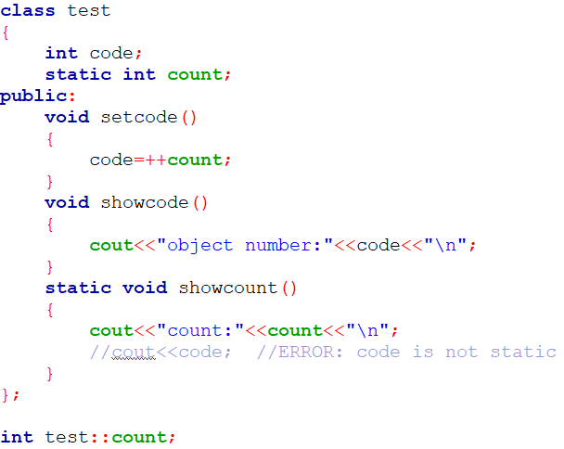
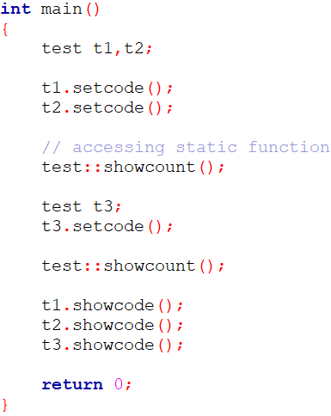

Static Member Functions
Unit 2: Functions and Functions Templates

Slide 52
Objects as Function Arguments
Like any other data type, an object may be used as a function argument.
This can be done in two ways:
Pass/Call By Value
A copy of the entire object is passed to the function
Any changes made to object inside function don’t affect original object
Pass/Call By Reference
Only the address of the object is transferred to the function.
Any changes made to object inside function are reflected in the original object
Unit 2: Functions and Functions Templates

Slide 53
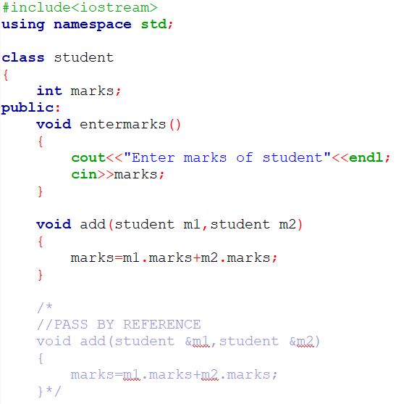
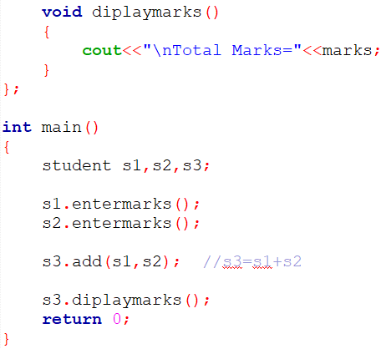

Objects as Function Arguments:Ex-1
Unit 2: Functions and Functions Templates

Slide 54
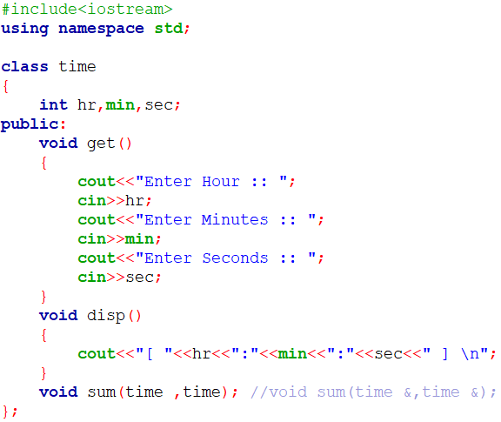
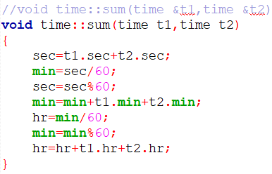
Objects as Function Arguments:Ex-2
Unit 2: Functions and Functions Templates

Slide 55
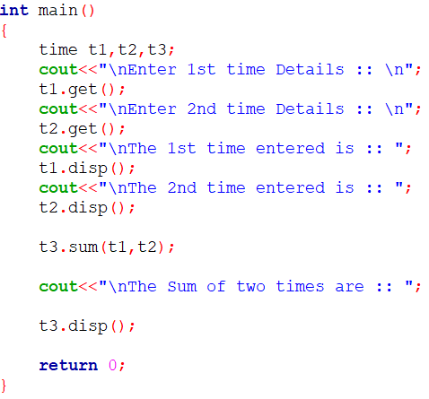
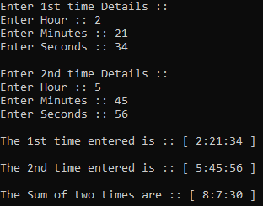
Objects as Function Arguments:Ex-2
Unit 2: Functions and Functions Templates

Slide 56
Objects as Function Arguments:Ex-3
Define class Digit having int ‘n’ as data member. Define member function enter() to enter the data and show() to print the data. A class has member function compare() that displays whether the first object is smaller, greater or same as compared to second object. (Function compare() should support: int x = d1.compare(d2); where d1 and d2 are objects of class Digit). Use Concept of Object as Function Arguments.
Unit 2: Functions and Functions Templates

Slide 57
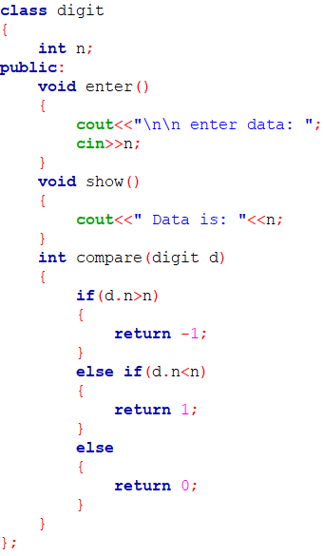
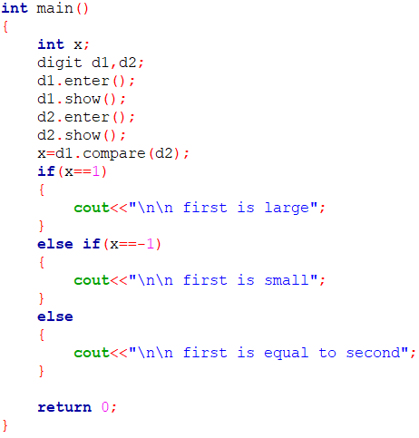
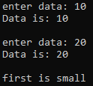
Objects as Function Arguments:Ex-3
Unit 2: Functions and Functions Templates

Slide 58
Practice Program
Define a class Dist with int feet and float inches. Define member function that displays distance in 1’-2.5” format. Also define member function scale ( ) function that takes object by reference and scale factor in float as an input argument. The function will scale the distance accordingly. For example, 20’-5.5” and Scale Factor is 0.5 then answer is 10’-2.75”
Unit 2: Functions and Functions Templates

Slide 59
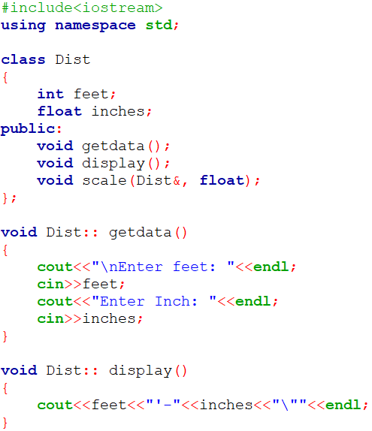
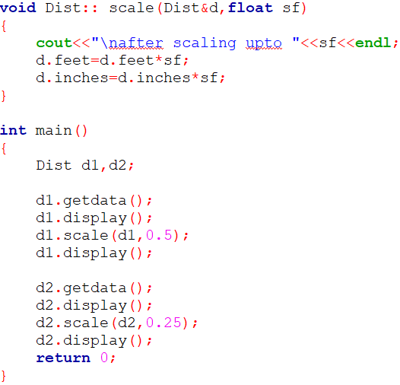
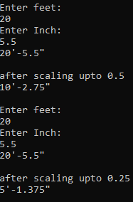
Practice Program
Unit 2: Functions and Functions Templates

Slide 60
Objects as Function Arguments
Write a C++ program having class Dist with private data member int feet and float inches. Define following public member functions for it.
1) getdata( ) to take feet and inches as input
2) putdata( ) to display distance in 1’2.5” format
3) add( ) to do addition of two distances such that it can handle function call d1.add(d2) where d1, d2 and d3 are objects of class. Use Concept of Object as Function Arguments.
Unit 2: Functions and Functions Templates

Slide 61



Function Returning Object
A function cannot only receive objects as arguments but also can return them.
Unit 2: Functions and Functions Templates

Slide 62

Practice Program
Define class Currency having two integer data members rupee and paisa. A class has member functions enter() to get the data and show() to print the amount in 22.50 format. Define one member function sum() that adds two objects of the class and stores answer in the third object i.e. c3=c1.sum (c2). The second member function should add two objects of type currency passed as arguments such that it supports c3.add(c1,c2); where c1, c2 and c3 are objects of class Currency. Also Validate your answer if paisa >100. Write a main( )program to test all the functions. Use concepts of Object as Function Arguments, function returning object and function overloading.
Unit 2: Functions and Functions Templates

Slide 63


Practice Program
Unit 2: Functions and Functions Templates

Slide 64
Friend Function
We have seen that the private members cannot be accessed from outside the class(non-member function)
There could be a situation when we want our private data to be shared by a non member function.
Then, we declare something as a friend, you give it access to your private data members.
Single functions or entire classes may be declared as friends of a class.
Unit 2: Functions and Functions Templates

Slide 65

Friend Function
To make a non-member function friendly to a class, we have to simply declare this function as a friend of the class
Syntax
Unit 2: Functions and Functions Templates

Slide 66
Friend Function
A friend function is a non-member function of the class that has been granted access to all private members of the class.
The function declaration should be preceded by the keyword friend.
Definition of friend function is specified outside the class body and is not treated as a part of class.
Function definition must not use keyword friend nor scope operator ::
The major difference between member function and friend function is that the member function is accessed through the object while friend function requires object to be passed as parameter.
Unit 2: Functions and Functions Templates

Slide 67
Friend Function
A friend function possesses certain special characteristics:
It is not in the scope of the class to which it has been declared as friend.
Since it is not in the scope of the class, it cannot be called using the object of that class.
It can be invoked like a normal function without he help of any object.
Unlike member functions, it cannot access the member names directly and has to use an object name and dot membership operator with each member name (e.g. A.x).
It can be declared in either the public or the private part of a class without affecting its meaning.
Usually, it has the objects as arguments
Unit 2: Functions and Functions Templates

Slide 68


A Function Friendly To One Class
Unit 2: Functions and Functions Templates

Slide 69
Practice Program: Friend Function
Create a Class Date having data members: int dd, mm, yyyy. Class has one member function to input the dates and another member function which prints the dates. Write a main() function which takes two dates as input. Write a friend function swapdates() which takes two objects by reference of type Date and swaps both the dates. Use the concept of Friend function which takes objects by reference
Unit 2: Functions and Functions Templates

Slide 70



Practice Program: Friend Function
Unit 2: Functions and Functions Templates

Slide 71


A Function Friendly To Two Classes: By Value
Unit 2: Functions and Functions Templates

Slide 72



A Function Friendly To Two Classes: By Reference
Unit 2: Functions and Functions Templates

Slide 73
Practice Program: Friend Function
Define a class Fahrenheit with float temp as data member. Define another class Celsius with float temperature as data member. Both classes have member functions to input and print data. Write a non-member function that receives objects of both the classes and declare which one is higher than another according to their values. Also define main() to test the function. Define all member functions outside the class. (Formula for converting Celsius to Fahrenheit is F = (9C/5) + 32). Use the concept of friend function.
Unit 2: Functions and Functions Templates

Slide 74


Practice Program: Friend Function
Unit 2: Functions and Functions Templates

Slide 75


Practice Program: Friend Function
Unit 2: Functions and Functions Templates

Slide 76
Friend Function
Create a class Corporate which contains name of employee and salary in float. Create another class Education which contains name of employee and salary in float. Both the class have member function to get and print data. Write a non-member function compare() which receives object of both the classes and compares the salary of employee in education and corporate field. Use the concept of friend function.
Unit 2: Functions and Functions Templates

Slide 77

Member function of one class, friend function of another class
Member functions of one class can be friend function of another class.
In such cases, they are defined using the scope resolution operator
NOTE:
Class containing member function should be defined first
Unit 2: Functions and Functions Templates

Slide 78
Member function of one class, friend function of another class
Create a class Customer having data members: name of the customer and customer number in integer and member function to get customer data. Create another class Manager having data members: name of manager and employee id in integer and member function to get managers data. Class Manager also have member function get_cust_data () which takes objects of class Customer as input and prints the customers details and is a friend function of class Customer . Write a main () function to test all this function. Use the concepts of Member function of one class can be a Friend Function of another class.
Unit 2: Functions and Functions Templates

Slide 79

Member function of one class, friend function of another class
Unit 2: Functions and Functions Templates

Slide 80


Member function of one class, friend function of another class
Unit 2: Functions and Functions Templates

Slide 81
Practice Program: Friend Function
Create a class LAND having data members: length, width, area1. Write member functions to read and display the data of land. Also, calculates the area of the land. Create another class TILES having data members: l, w, area2. Write a member function to get the data of tile. Calculate the area of one tile. Class TILE has a
member function named number_of_tiles() which is a friend of class LAND and takes the object of class LAND by reference which calculates the number of tiles which can be put over the land area. Write the main function to test all the functions. Use the concept of member function of one class can be a friend function of another class.
Unit 2: Functions and Functions Templates

Slide 82


Practice Program: Friend Function
Unit 2: Functions and Functions Templates

Slide 83


Practice Program: Friend Function
Unit 2: Functions and Functions Templates

Slide 84

Friend Class
We can also declare all the member functions of one class as the friend functions of another class.
In such cases , the class is called a friend class.
Unit 2: Functions and Functions Templates

Slide 85
Practice Program: Friend class
Create a class Child having data members: name of the child and gender and a member function to get and print child data. Create another class Parent which is a friend class of child class. Class Parent have member function ReadChildData() which takes child’s object by reference as input argument and Reads the childs data and DisplayChildData() which takes childs object as argument and displays childs data. Use the concepts of Friend Class.
Unit 2: Functions and Functions Templates

Slide 86

Practice Program: Friend class
Unit 2: Functions and Functions Templates

Slide 87


Practice Program: Friend class
Unit 2: Functions and Functions Templates

Slide 88

const Member Functions
If a member function does not alter any data in the class, then we may declare it as const member function
Syntax:
NOTE:
The qualifier const is appended to the function declarations well as definition.
The compiler will generate an error message if such functions try to alter the data values.
Unit 2: Functions and Functions Templates

Slide 89

const Member Functions
Unit 2: Functions and Functions Templates

Slide 90


Practice Prog: const member functions
Unit 2: Functions and Functions Templates

Slide 91
Overloaded functions
Overloading refers to the use of the same thing for different purposes.
Function overloading is a feature in C++ where two or more functions can have the same name but different parameters.
Function overloading is also known as Compile Time Polymorphism or static binding.
The correct function to be invoked is determined by checking the number and type of the arguments but not on the function type.
Unit 2: Functions and Functions Templates

Slide 92



Overloaded functions
Unit 2: Functions and Functions Templates

Slide 93
Overloaded functions
The function selection involves:
First, compiler tries to find an exact match. This is the case where the actual argument exactly matches the parameter type of one of the overloaded functions
If no exact match is found, C++ tries to find a match through promotion. (eg: char to int, float to double)
If no promotion is possible, C++ tries to find a match through standard conversion.
Finally, compiler tries to find a match through user-defined conversion
Reference:
https://www.learncpp.com/cpp-tutorial/function-overloading/
Unit 2: Functions and Functions Templates

Slide 94


Overloaded functions
Unit 2: Functions and Functions Templates

Slide 95


Overloaded functions
As per C++ standard, floating point literals (compile time constants) are treated as double unless explicitly specified by a suffix
Rectifying the error: We can simply tell the compiler that the literal is a float and NOT double by providing suffix f.
Unit 2: Functions and Functions Templates

Slide 96

Practice Program:Overloaded functions
Define three functions named divide(). First function takes numerator and denominator as an input argument and checks it’s divisible or not, Second function takes one int number as input argument and checks whether the number is prime or not and Third function takes 3 float number as argument and finds out average of the numbers. Use concept of Function Overloading / static binding.
Unit 2: Functions and Functions Templates

Slide 97


Practice Program:Overloaded functions
Unit 2: Functions and Functions Templates

Slide 98

Overloaded functions
Define four function void swap () which accepts two arguments by reference and swap the values. First function swaps two characters, second function swaps two integers, third function swaps two floats values and fourth function swaps two double values. Use the concept of call by reference in all four functions and function overloading and inline function.
Unit 2: Functions and Functions Templates

Slide 99


Overloaded functions
Unit 2: Functions and Functions Templates

Slide 100

Overloaded functions
Define three functions named convert (). First function takes rupees as an input argument and converts into paisa, second function takes meter as an input argument and converts into centimeter and last function takes character as an input argument and converts entered small character into capital. Here, rupee is in integer and meter is in float. Use concept of Function Overloading.
Unit 2: Functions and Functions Templates

Slide 101


Unit 2: Functions and Functions Templates

Slide 102
Function-call stack & Activation Records
The function-call stack (or simply call stack) is a special region of memory used by a program to manage function calls and returns.
It operates in a Last In, First Out (LIFO) manner, meaning the most recently called function is the first to complete and return control to its caller.
Whenever a function is called, an activation record (also known as a stack frame) is created and pushed onto the stack. This record contains information necessary for the function’s execution, such as:
Unit 2: Functions and Functions Templates

Slide 103
Function-call stack & Activation Records
Return address: the point in the program where control should return after the function completes.
Parameters: the values passed to the function.
Local variables: variables that are specific to that function call.
Saved registers: system registers that need to be preserved across function calls.
After the function finishes executing, its activation record is popped from the stack, and control is returned to the function that called it.
Unit 2: Functions and Functions Templates

Slide 104



Function-call stack & Activation Records
Unit 2: Functions and Functions Templates

Slide 105


Function-call stack & Activation Records
Stack frame of A() will be created and pushed into the Call Stack. It will save the address of where to return after executing A() as return address.
As B() is called by A(), Stack frame of B() will be created and pushed into to the Call Stack. The return address will be the point after the call of b() in A().
Unit 2: Functions and Functions Templates

Slide 106


Function-call stack & Activation Records
As C() is called by B(), Stack frame of C() will be created and pushed into to the Call Stack. The return address will be the point after the call of c() in B().
Unit 2: Functions and Functions Templates

Slide 107


Function-call stack & Activation Records
Unit 2: Functions and Functions Templates

Slide 108


Function-call stack & Activation Records
Unit 2: Functions and Functions Templates

Slide 109

Function-call stack & Activation Records
Unit 2: Functions and Functions Templates

Slide 110
Templates
A Template is a simple yet very powerful tool in C++.
The simple idea is to pass the data type as a parameter so that we don’t need to write the same code for different data types.
For example, a software company may need to sort() for different data types. Rather than writing and maintaining multiple codes, we can write one sort() and pass the datatype as a parameter.
Unit 2: Functions and Functions Templates

Slide 111

How Do Templates Work?
Templates are expanded at compiler time. This is like macros. The difference is, that the compiler does type-checking before template expansion. The idea is simple, source code contains only function/class, but compiled code may contain multiple copies of the same function/class.
Unit 2: Functions and Functions Templates

Slide 112


Function Templates
We write a generic function that can be used for different data types. Examples of function templates are sort(), max(), min(), printArray().
Unit 2: Functions and Functions Templates

Slide 113
Scope resolution operator
Scope resolution operator :: is used for following purposes:
To access a global variable when there is a local variable with same name
To define a function outside a class.
Refer to a class inside another class
For namespace
To access a class’s static variables.
In case of multiple Inheritance
Unit 3: Tokens and Expressions & Control Structure

Slide 114


Scope resolution operator
Use-1: To access global variable:
Unit 3: Tokens and Expressions & Control Structure

Slide 115

Scope resolution operator
Use-2: To define a function outside a class:
Unit 3: Tokens and Expressions & Control Structure

Slide 116


Scope resolution operator
Use-3: Refer to a class inside another class
Unit 3: Tokens and Expressions & Control Structure

Slide 117

Scope resolution operator
Use-4: Namespace
Use-5: To access a class’s static variables (Slide 51)
Use-6: In case of multiple Inheritance(Unit-4)
Unit 3: Tokens and Expressions & Control Structure

Slide 118
Recursion
Recursion in C++ is a technique in which a function calls itself repeatedly until a given condition is satisfied.
A function that calls itself is called a recursive function.
The base condition is the condition that is used to terminate the recursion. The recursive function will keep calling itself till the base condition is satisfied
Unit 2: Functions and Functions Templates

Slide 119



Recursion
Practice Program: Write C++ Program to Display Fibonacci Series using Recursion.
Unit 2: Functions and Functions Templates

Slide 120
End of Unit-2

