Slide 1
Constructor
A constructor in C++ is a special member function of a class that is automatically called when an object of the class is created. It is primarily used to initialize the objects of the class.
Characteristics:
Same Name as Class: A constructor has the same name as the class.
No Return Type: A constructor does not have a return type, not even void.
Automatic Invocation: It is automatically called when an object is created.
Overloading: Like other functions, constructors can be overloaded to create multiple constructors with different parameters.

Slide 2
Types of Constructors
Default constructor
Parameterized constructor
Copy constructor

Slide 3
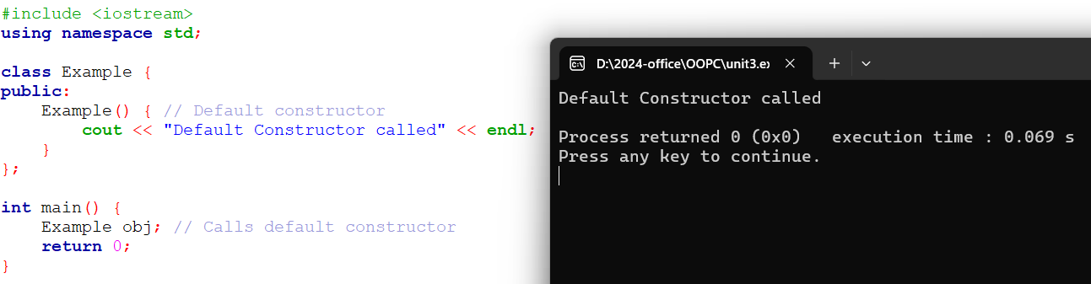
Default constructor
A constructor that takes no arguments.
Initializes the object with default values.

Slide 4
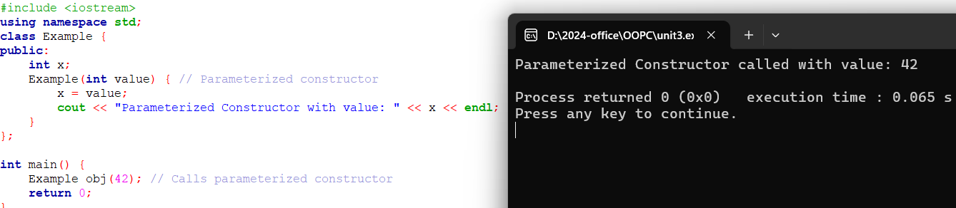
Parameterized Constructor
A constructor that takes arguments to initialize the object with specific values.

Slide 5
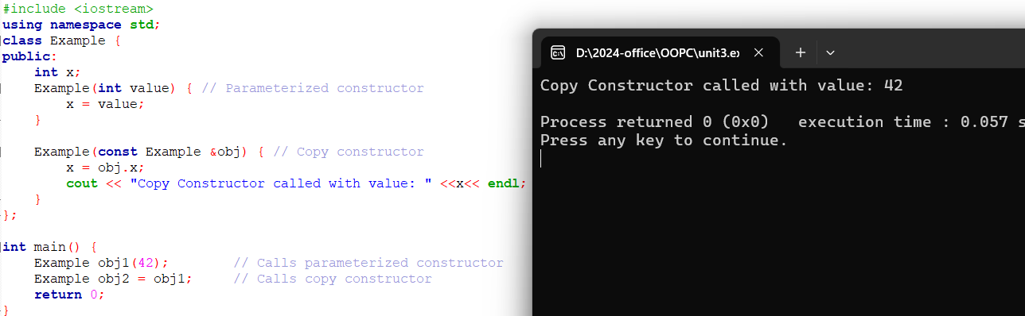
Copy Constructor
A constructor that initializes an object by copying another object of the same class.
The compiler provides a default copy constructor if not defined.

Slide 6
Important notes on constructor
If no constructor is defined in a class, the compiler automatically provides a default constructor.
Constructors cannot be const or static.
Constructors can have default arguments.

Slide 7
Destructor
A destructor in C++ is a special member function of a class that is automatically invoked when an object goes out of scope or is explicitly deleted. It is primarily used to perform cleanup tasks, such as releasing resources or memory allocated during the lifetime of the object.
Characteristics:
Same Name as Class: A destructor has the same name as the class but is preceded by a tilde (~).
No Arguments: A destructor cannot have parameters and, therefore, cannot be overloaded.
No Return Type: A destructor does not have a return type, not even void.
Automatic Invocation: It is automatically called when: The object goes out of scope. delete is used to destroy an object created with new.

Slide 8
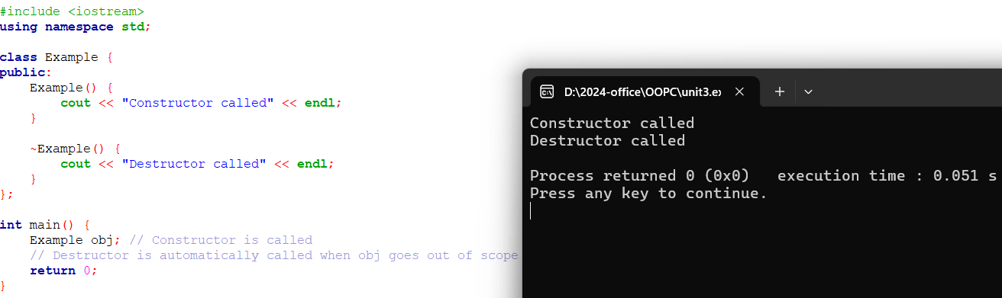
Example

Slide 9
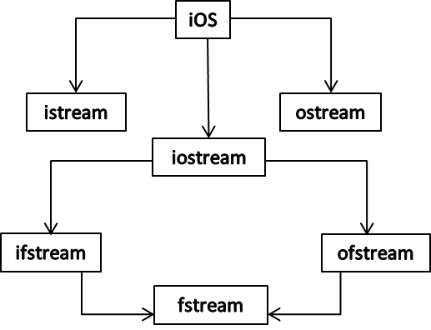
Stream classes for files
stream classes are part of the Standard Library, used for input and output (I/O) operations.
Specifically, file streams (fstream) enable reading from and writing to files. These classes are part of the <fstream> header and include:
ifstream: Input file stream for reading from files.
ofstream: Output file stream for writing to files.
fstream: File stream that allows both reading and writing.

Slide 10
Opening and Closing Files:
Use open() to explicitly open a file. File can be opened using constructor or open() function.
Always close a file after operations using close().
File Modes:
ios::in: Open file for input (default for ifstream).
ios::out: Open file for output (default for ofstream).

Slide 11
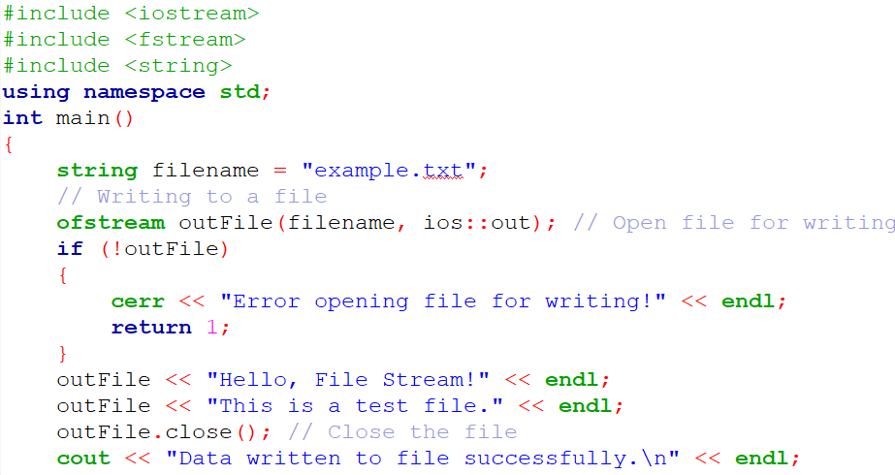
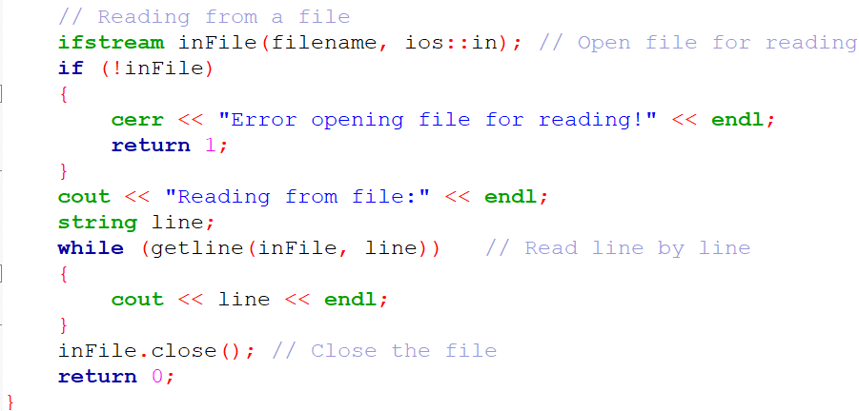
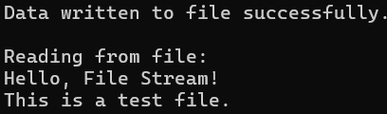
Example using constructor

Slide 12
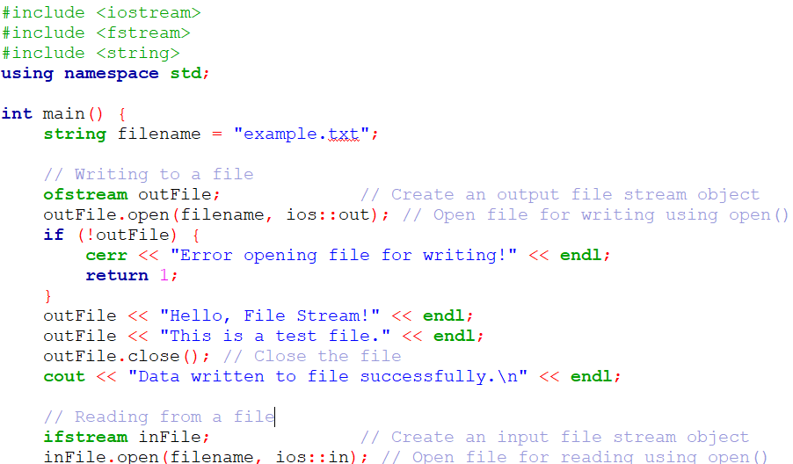
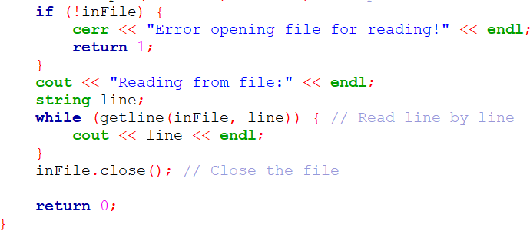
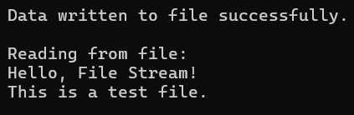
Example using open()

Slide 13
Usecase for accessing file
A company maintains employee salary details in a file named salaries.txt. Each entry in the file consists of an employee ID, name, and monthly salary, separated by commas.
For example:
salaries.txt:
201, John Doe, 4500
202, Jane Smith, 5200
203, Alice Johnson, 4800
204, Bob Brown, 5000
The company wants to calculate the total salary expense paid to employees.

Slide 14
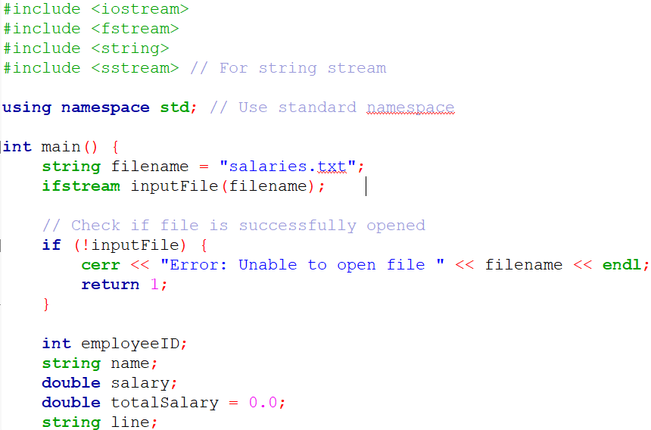
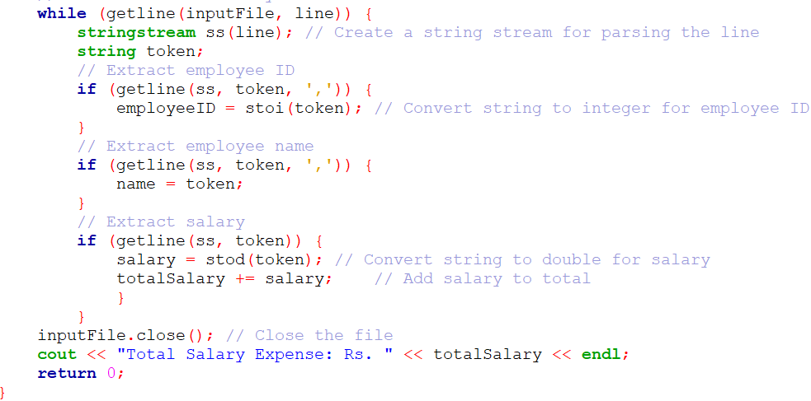
Input/Output

Slide 15
Sequential I/O operations
The file stream class support a number of member functions for performing the input and output operations on files.
put() and get(): used for handling a single character.
read() and write(): used for handling large blocks of binary data.

Slide 16
put() & get() functions
Function put() writes a single character to the associated stream
Function get() reads a single character from the associated stream.

Slide 17
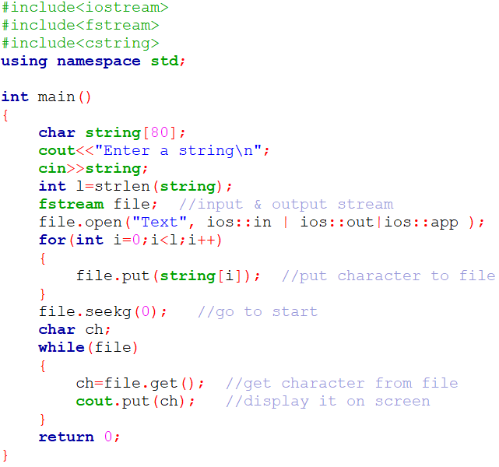

put() & get() functions

Slide 18
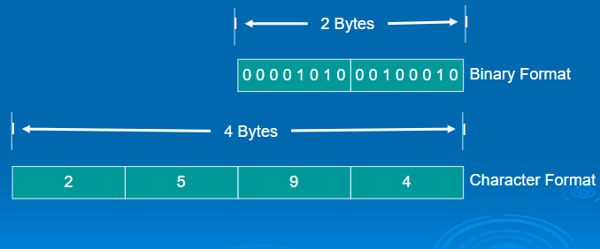
read() & write() functions
The functions read() and write() , handle the data in binary form.

Slide 19

read() & write() functions
The binary format is more accurate for storing the numbers as they are stored in the exact internal Representations.
There are not conversions while saving the data and therefore saving is much faster
Syntax:

Slide 20
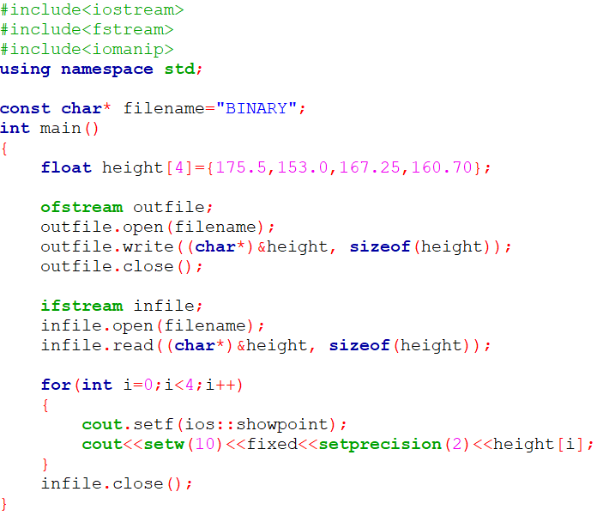
Example:

Slide 21
Reading & Writing a class object
C++ provides binary I/O functions, read() and write(), to read and write the objects directly from the disk files.
NOTE:
Only data members are written to the disk files and the member functions are not.

Slide 22
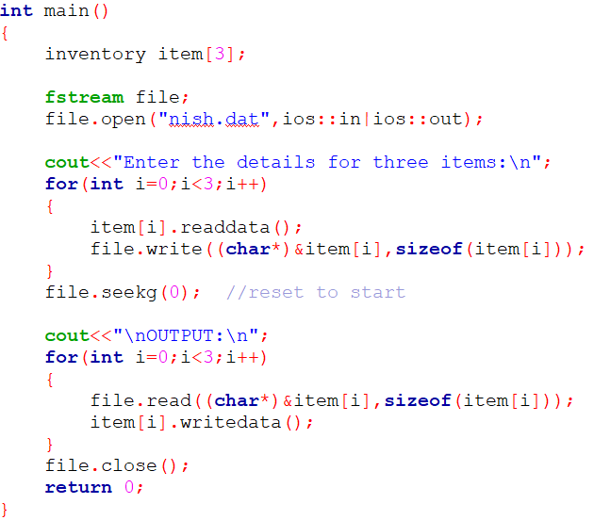
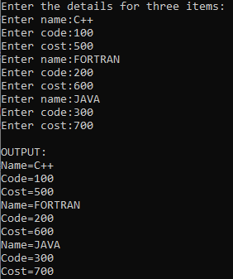
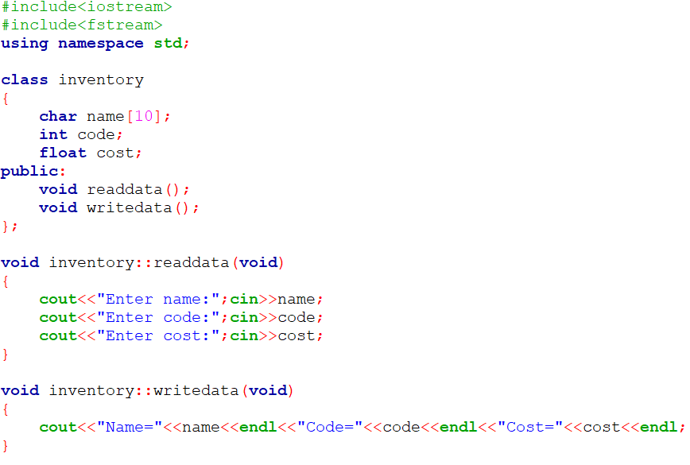
Example

Slide 23
Error Handling during File operations
Following conditions may arise while dealing with files:
A file which we are attempting to open for reading does not exists.
The file-name used for a new file may already exists.
We may attempt an invalid operations such as reading past the end-of-file.
There may not be any space in the disk for storing more data
We may use invalid filename.
We may attempt to perform an operation when the file is not opened for that purpose.

Slide 24
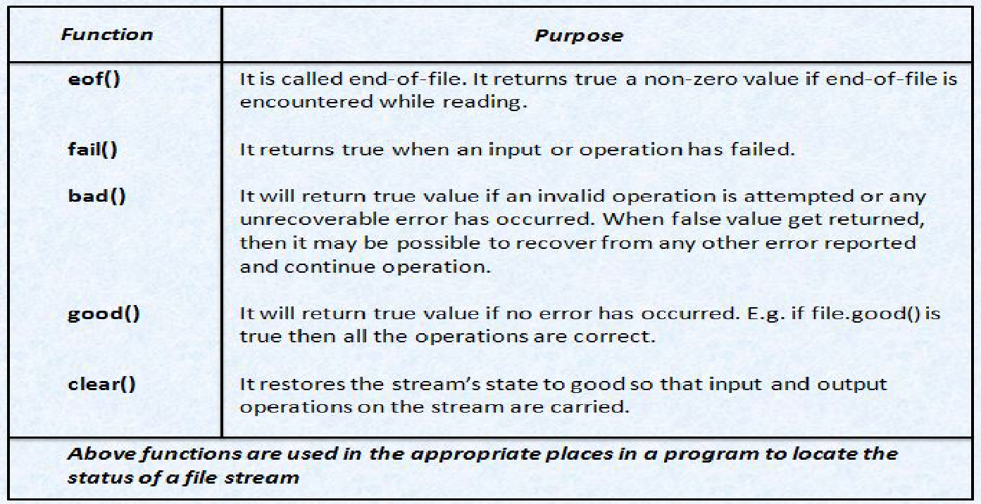
Error Handling during File operations
The ios class supports several member functions that can be used to read the status recorded in a file stream.

Slide 25
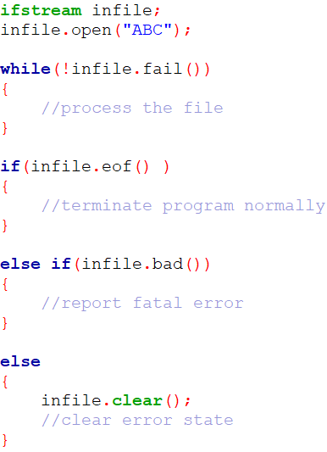
Error Handling during File operations

Slide 26
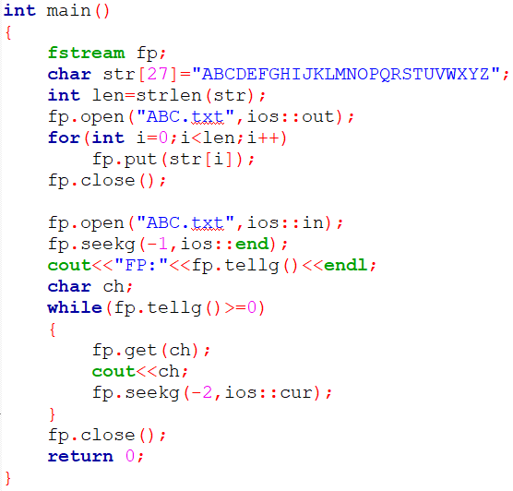


Example using open()

Slide 27
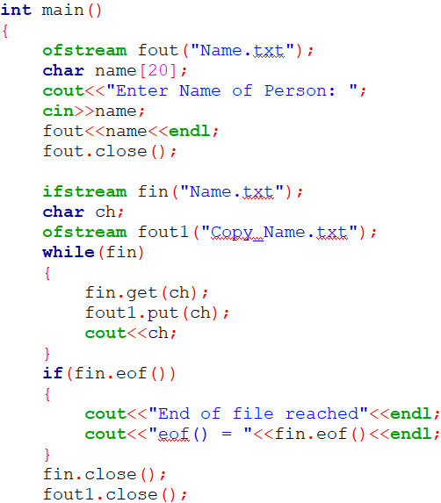
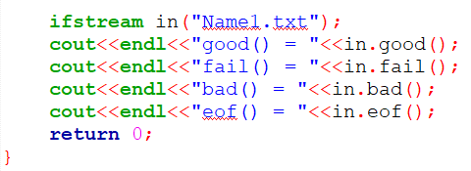
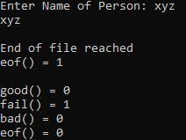


Example using constructor

Slide 28
Thank You.

