Slide 1

FACULTY OF COMPUTER SCIENCE
Sub:-Seminar
Submitted To,
Mr. Himanshu Chaplot
Submitted By,
Mr. Bhavesh Panchal
Class:- PGDCA (Ist Sem)

Slide 2
Computer Generations

Slide 3
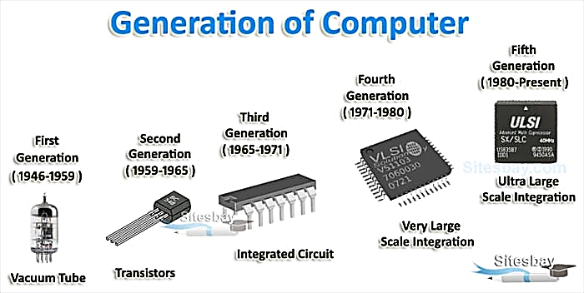
Introduction:- “Generation” in computer talk is a step in technology. It provide a framework for the growth of computer industry.
Originally it was used to distinguish between various hardware technologies, but now it has been extended to include both hardware and software.
There are totally five computer generations known till date.

Slide 4
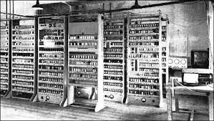
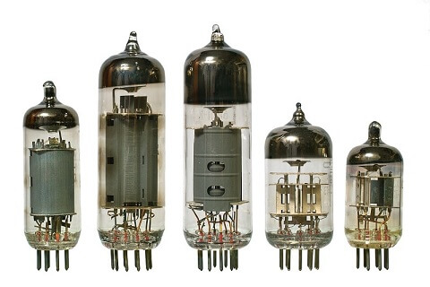
First Generation of Computer
The period of first generation was from 1940-1956. The computer of first generation used vacuum tubes as the basic components for memory and circuitry for CPU (Central Processing Unit). These tubes, like electric bulbs, produced a lot of heat and the installations used to fuse frequently.

Slide 5
Characteristics of first generation of computers:-
*Main electronic component- Vacuum tube
*Main memory- Magnetic drums and magnetic tapes
*Programming language- Machine language
*Power- Consume a lot of electricity and generate a lot of heat
*Speed and size- Very slow and very large in size
*Input/output devices-Punched cards and paper tape.
*Examples- ENIAC, UNIVAC 1, IBM 650, IBM 701, etc.

Slide 6
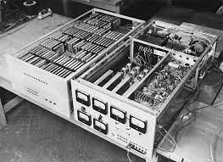
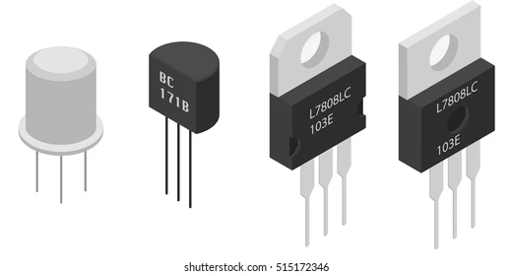
Second Generation of Computer
The period of second generation was from 1959-1965. In this generation, transistors were used that were cheaper, consumed less power, more compact in size, more reliable and faster than the first generation machines made of vacuum tubes. In this generation, magnetic cores were used as the primary memory and magnetic tape and magnetic disks as secondary storage devices.
In this generation, assembly language and high-level programming languages like FORTRAN, COBOL were used. The computers used batch processing and multiprogramming operating system.

Slide 7
Characteristics of second generation of computers:-
*Main electronic component- Transistor
*Main memory- Magnetic core and magnetic tape/disk
*Programming language- assembly language
*Power- low power consumption, generated less heat
*Size- small in size( in comparison with the first generation computers)
*Speed- improvement of speed and reliability
*Input/output devices-Punched cards and magnetic tape.
*Examples- IBM 1401, IBM 7090, and 7094, UNIVAC 1107, etc.

Slide 8
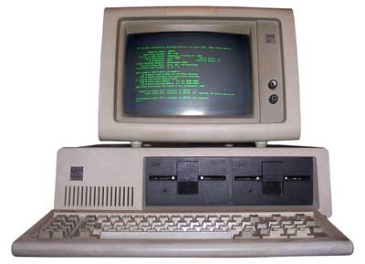
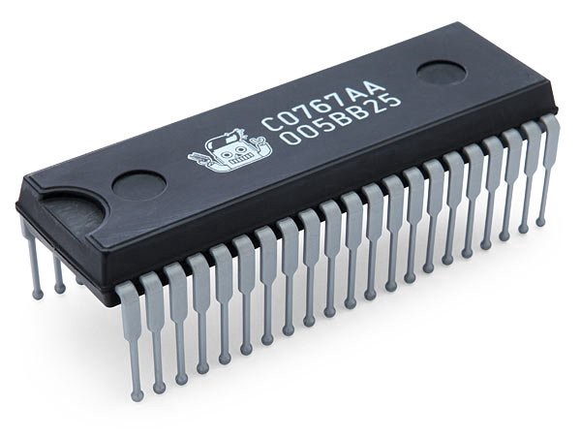
Third Generation of Computer
The period of third generation was from 1965-1971. The computer of third generation used Integrated Circuits (ICs) in place of transistors. A single IC has many transistors, resistors, and capacitors along with the associated circuitry.
The IC was invented by Jack Kilby. This development made computer smaller in size, reliable, and efficient. In this generation remote processing, time-sharing, multiprogramming operating system were used. High-level languages (FORTRAN-II TO IV, COBOL, PASCAL PL\1, BASIC, ALGOL-68 etc.) were used during this generation.

Slide 9
Characteristics of third generation of computers:-
*Main electronic component- Integrated circuits(ICs)
*Main memory- Large magnetic core and magnetic tape/disk
*Programming language- High level language
*Size-Smaller, cheaper, and more efficient than second generation computer( they were called mini computer)
*Speed- improvement of speed and reliability(in comparison with the second generation computers).
*Input/output devices-magnetic tape , keyboard , monitor, printer, etc.
*Examples- IBM 360, IBM 370, PDP-11, UNIVAC 1108, etc.

Slide 10
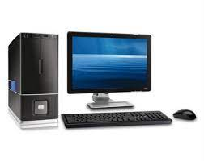
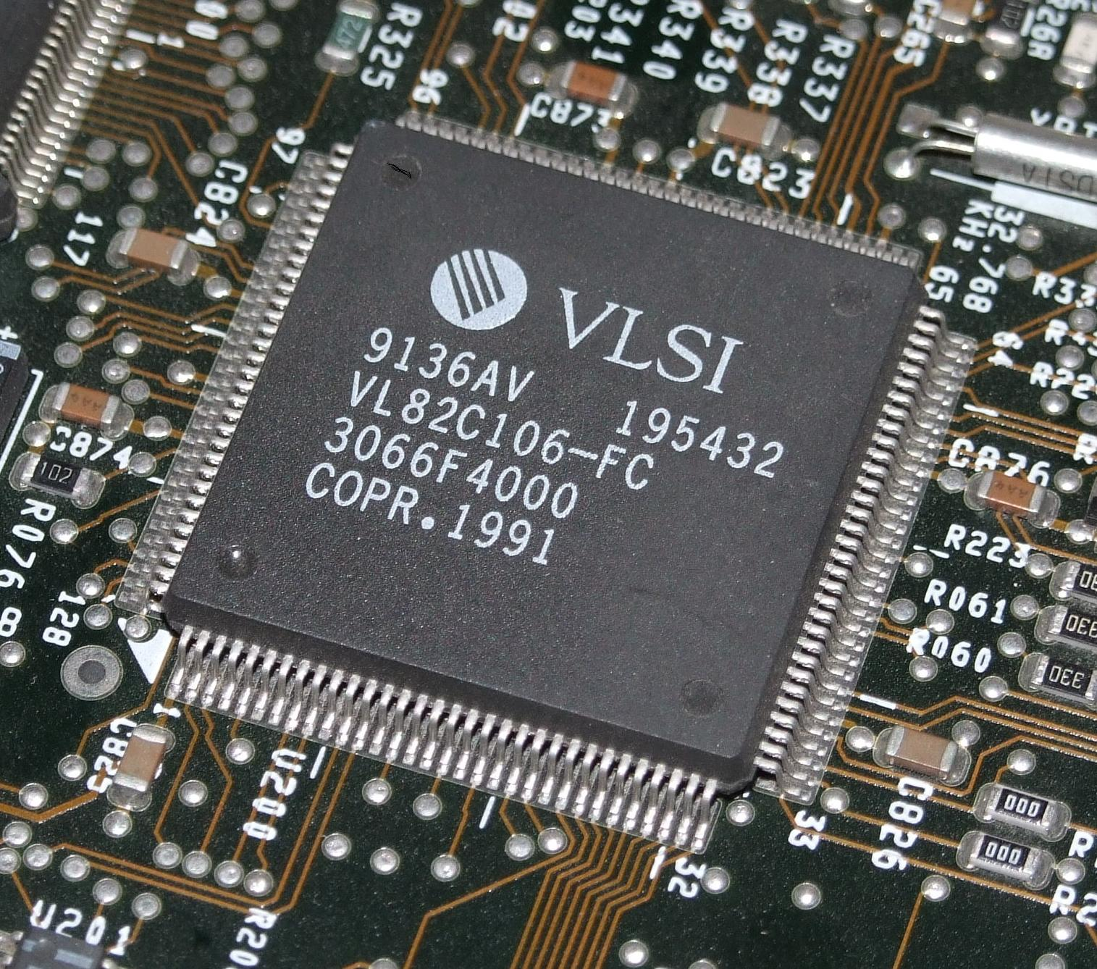
Fourth Generation of Computer
Fourth generation of computers was between 1971-1980. These computers used the VLSI technology or the Very Large Scale Integrated (VLSI) circuits technology. Therefore they were also known as the microprocessors. Intel was the first company to develop a microprocessor.

Slide 11
Characteristics of fourth generation of computers:-
*Main electronic component- Very large scale integration(VLSI)
VLSI- thousands of transistors on a single microchip
*Main memory- semiconductor memory (such as RAM, ROM, etc.)
*Programming language- high level language(python, c#, java, java Script, Rust, Kotlin etc.)
*Size- smaller, cheaper and more efficient than third generation computers.
*Speed- improvement of speed, accuracy and reliability(in comparison with the third generation computers)
*Input/output devices-keyboard, pointing devices, optical scanning, monitor, printer, etc.)
Network- a group of two or more computer systems linked together.
*Examples- IBM PC, STAR 1000, APPLE II, Apple Macintosh, etc.

Slide 12
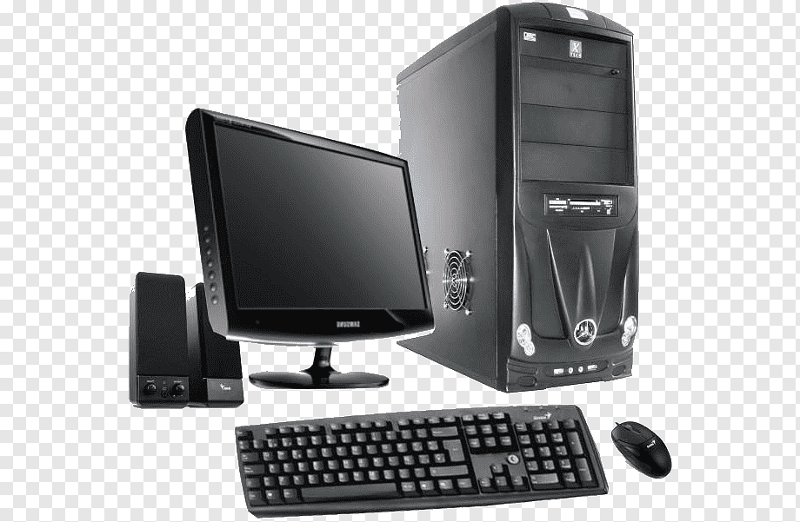
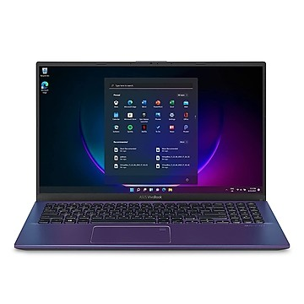
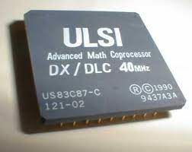
Fifth Generation of Computer
The period of fifth generation is 1980-till date. In the fifth generation, VLSI technology became ULSI (Ultra Large Scale Integration) technology, resulting in the production of microprocessor chips having ten million electronic components.
This generation is based on parallel processing hardware and Al (Artificial Intelligence) software. AI is an emerging branch in computer science. Which interprets the means and method of making computers think like human beings. All the high-level languages like C and C++, Java, Net etc., are used in this generations.

Slide 13
Characteristics of fifth generation of computers:-
*Main electronic component- Artificial intelligence, ULSI
ULSI-Millions of transistors on a single microchip
Parallel processing method- use two or more microprocessors to run tasks simultaneously.
*Programming language- Understand natural language (human language)
*Size-Portable and small in size and have a huge storage capacity
*Power-consume less power and generate less heat.
*Speed-remarkable improvement of speed, accuracy and reliability (in comparison with the fourth generation computers).
*Input/output devices-keyboard , monitor, mouse, trackpad, touchscreen, pen, light scanner, printer, etc.
*Examples- Desktop, laptops, tablets, smartphones, etc.

Slide 14
THANK YOU

