Slide 1
E-COMMERCE 360°
One Streaming Platform Across Four Systems
Clickstream · Order Management · Payment Management · Inventory Management
Streaming Data Analytics | Final Project | Section SDA-2
Group 1 · Anshjot Singh · Komal · Satish Chandra · Pancham Khullar
Notes:
Open with the framing sentence: four systems, each producing a defensible dashboard and a wrong conclusion. Replace the placeholders before presenting.

Slide 2
The Problem
Revenue leaks in four places at once — and each leak is owned by a different system
E-commerce runs on a continuous chain of customer, order, payment and inventory events. Those events are processed in functionally fragmented systems, so drop-offs, payment failures, fraud, stock shortages and order exceptions surface only after the revenue is already gone.
Clickstream
Order Mgmt
Payment
Inventory
Sees the shopper abandon a cart.
Cannot see the order never placed.
Sees an order cancelled.
Cannot see which system caused it.
Sees a 31% failure rate.
Cannot say: fraud, or gateway outage?
Sees a stock-out.
Cannot see the revenue it cancelled.
Why streaming, not batch — every decision here has a window of minutes
A SKU must be delisted the moment stock hits zero — overnight, the platform has already taken orders it cannot ship
A fraud pattern must be held before settlement; afterwards it is a chargeback, not a decision
Cart abandonment is detected by the ABSENCE of an event — batch has no record to join on, only a gap
Festive demand spikes several times over baseline within minutes; the ingestion layer must absorb it without loss
Notes:
Reason 3 is the strongest argument in the whole project. Say it slowly.

Slide 3
What We Built
Four systems wired together over Kafka — measured on one continuous run
7,383
1,110
251
22.6%
EVENTS INGESTED
across 14 Kafka topics
SHOPPER SESSIONS
top of the funnel
ORDERS CREATED
one journey document each
CHECKOUT CONVERSION
sessions reaching checkout
₹21.3 L
₹2.67 L
₹7.92 L
231
REVENUE RETAINED
delivered and kept
REVENUE LOST
11.2% of GMV
ABANDONED CART VALUE
37% of retained revenue
OPEN ALERTS
from all four systems
The point is not the dashboard. It is that these eight numbers come from four systems that previously could not be compared, and that every one of them is actionable within minutes rather than the next morning.
SO WHAT ₹2.67 L lost and ₹7.92 L abandoned on 251 orders. The loss is not one number — it has three different owners, and we can now name them.

Slide 4
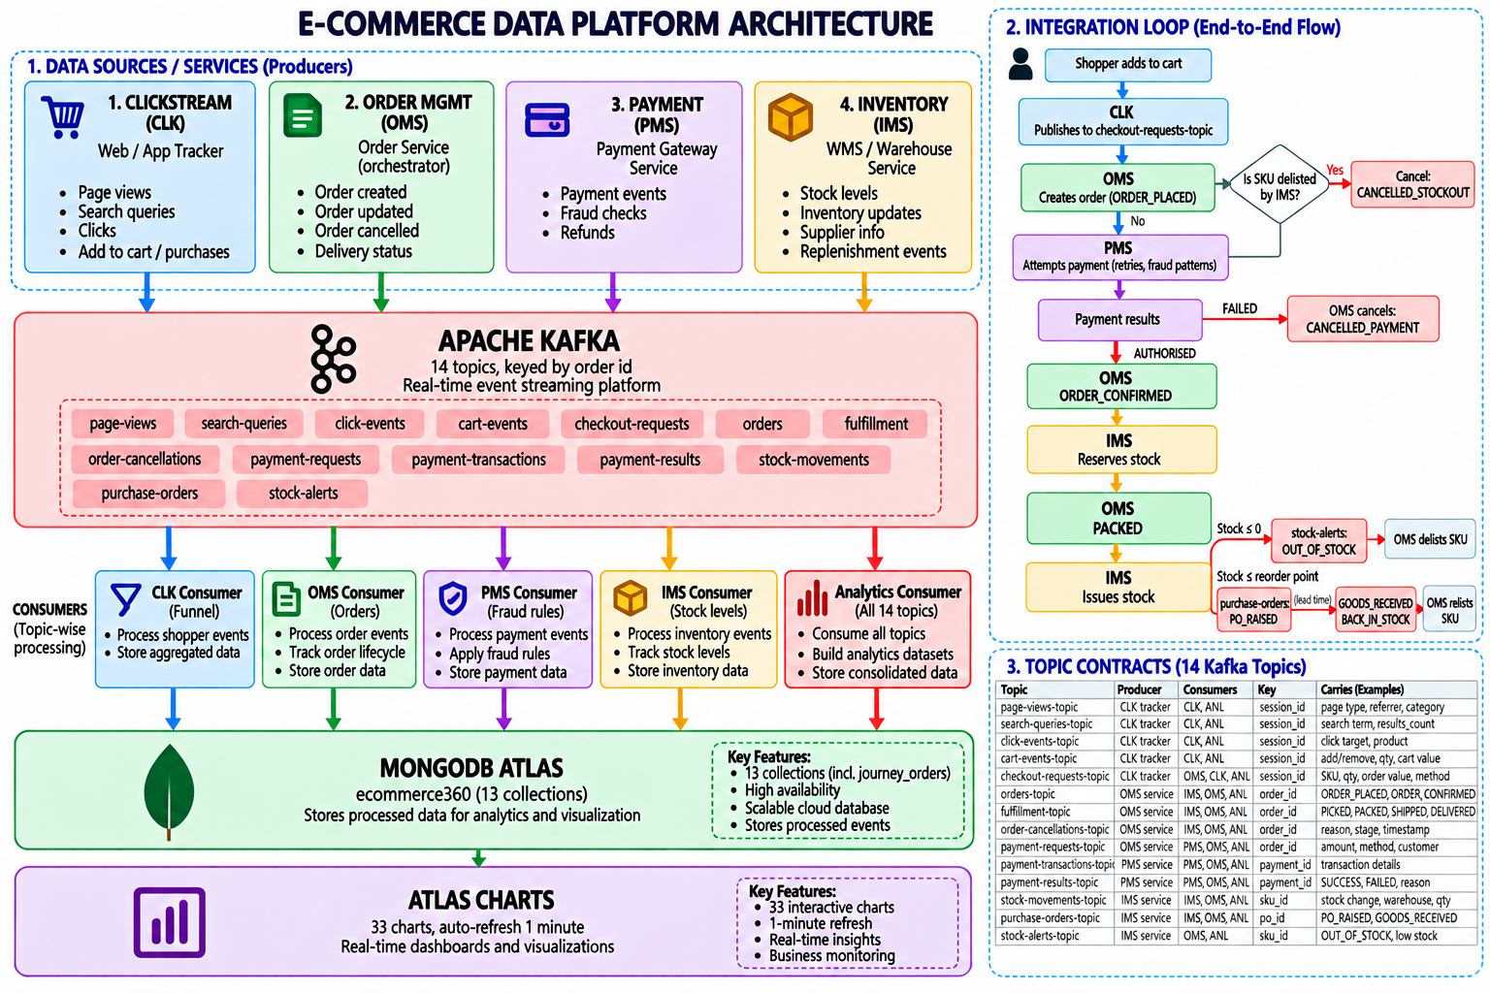
Architecture
9 services · 14 Kafka topics · 5 consumer groups · 13 MongoDB collections
Notes:
Trace one order aloud: checkout request to OMS, OMS asks PMS for money, PMS result decides confirm or cancel, confirmed order makes IMS reserve stock, stock hits zero so IMS publishes an alert, OMS delists the SKU and cancels what it cannot ship.

Slide 5
One Platform, Not Four Demos
The systems do not just share a database — they drive each other's decisions
CLK
Shopper checks out
publishes checkout intent
The decision no single system can make
Order created
When the Inventory system declares a SKU unsellable, the Order Management system — a consumer of IMS's own alert topic — delists it and cancels the open orders that cannot ship. When a purchase order lands, OMS relists it.
OMS
asks PMS to collect
PMS
Payment resolved
result decides confirm or cancel
Inventory alone cannot cancel an order.
Order Management alone cannot know the stock is gone.
An overnight batch job would learn both — after the platform had taken more orders it could not ship.
IMS
Stock reserved, then issued
available stock falls to zero
OMS
SKU delisted, orders cancelled
relisted when the PO lands
SO WHAT ₹11,821 of stock-out cancellations were caught and attributed automatically — demand that existed while the stock did not.

Slide 6
Data Sources and Volume
One shared master catalog — 4 warehouses, 6 categories — so every system refers to the same SKU
System | Key fields | Topics | Share of events
CLK — Clickstream | session, device, channel, search term, results_count, cart value | 5 | 2,451 page views · 840 clicks · 417 cart · 250 checkout
OMS — Order Mgmt | order_id, SKU, qty, order value, status, cancellation cause | 4 | 864 orders · 469 fulfilment · 48 cancellations
PMS — Payment | transaction, method, gateway, attempt no., failure reason, fraud tag | 2 | 321 transactions · 244 requests · 244 results
IMS — Inventory | SKU, warehouse, qty change, stock on hand, PO, supplier, fill rate | 3 | 633 stock movements · 44 POs · 26 stock alerts
Volume justification
Clickstream carried 2,451 page views against 244 payment transactions — a 10:1 ratio, which is why the two cannot share a consumer or a partition count
Messages run 0.4–1.5 KB; scaled to 50,000 orders/day the same ratios give roughly 2 million events and 0.6–2 GB per day — within a three-broker cluster
Keys: order_id, sku:warehouse, session_id — so all events for one entity land in one partition and stay in order

Slide 7
Insight 1 — Lost Revenue Has Three Owners
Chart 3.2 · lost revenue grouped by the cause recorded at cancellation
Each bar is a different team
₹1,61,172 · 60%
Payment failure — gateway and risk rules. Diagnosed in Insight 4.
₹94,396 · 35%
Returns — product quality and packaging, not a systems problem.
₹11,821 · 4%
Stock-out — procurement. Traced to supplier fill rate in Insight 6.
SO WHAT A single-system dashboard reports one aggregate cancellation rate. Joining the four systems splits ₹2.67 L three ways and sends each share to the team that can actually fix it.

Slide 8
Insight 2 — One Category Carries the Entire Business Risk
Charts 3.3, 2.5 and 5.3 read together · Electronics against everything else
42% of orders.
81% of revenue.
77% of the losses.
Electronics also holds ₹62.5 L of the ₹92.4 L tied up in stock, and ₹5.73 L of the ₹7.92 L sitting in abandoned carts.
Every lever in this business — revenue, leakage, working capital, recoverable demand — moves with one category.
SO WHAT Protecting Electronics availability and conversion is worth more than any platform-wide initiative. A 5% improvement here outweighs fixing every other category completely.

Slide 9
Insight 3 — The Largest Pool Is Recoverable Demand
Charts 2.4 and 2.5 · abandoned cart value by category
₹7.92 L
abandoned, against ₹21.3 L retained — 37% of everything the platform actually kept.
Detected by the absence of an event
No purchase ever happens, so there is no record for a batch job to join on — only a gap. A watcher in the clickstream consumer ages idle carts out and raises the alert while the shopper is still in the market.
95 of the 231 open alerts are abandoned carts: the single largest, and cheapest, recovery queue in the business.
SO WHAT Retargeting the Electronics abandonment pool alone addresses ₹5.73 L — more than twice the total revenue the platform actually lost.

Slide 10
Insight 4 — Same Failure Rate, Two Opposite Responses
Charts 4.2 and 4.3 · the diagnosis a single headline number cannot give you
Failure rate by gateway
The spread is 2.2 points
If one gateway were failing, its bar would stand alone and the fix would be to reroute traffic. All three sit at 31–33%, so the cause is not provider-specific.
The reasons confirm it
54% of failures are customer-side — bank declines, invalid CVV, insufficient funds. Only 46% are infrastructure. Blocking customers or switching provider would both be the wrong move.
Why payments fail — 102 failed attempts
Act on: retry orchestration, alternate-method prompts at the point of failure, and holding only the orders the fraud rules flag.
SO WHAT Payment failure is 60% of all lost revenue — ₹1.61 L. The live per-gateway split is what separates a routing fix from a checkout-experience fix.

Slide 11
Insight 5 — Fraud Detection Measured, Not Asserted
Chart 4.4 · the producer labels synthetic fraud; the consumer's rules never read that label
100%
0.4%
RECALL
all 13 fraud orders caught
FALSE POSITIVES
1 of 232 clean orders
Why the separation matters
A rule set can catch every high-value case, miss every card-testing case, and still report an impressive alert count. Measuring recall per fraud type is the only way to know which patterns you are blind to.
Four rules run in-stream: high value, repeated failure, card testing, method cycling.
SO WHAT Fraud orders are held before settlement rather than written off as chargebacks afterwards — and we can prove the rules work rather than claiming it.

Slide 12
Insight 6 — A Procurement Failure, Not a Forecasting One
Charts 5.4 and 5.2 read together · supplier fill rate against stock-out exposure
The chain the dashboard exposes
1
Reorder point fires correctly as stock falls
2
Supplier ships only 80% of the order
3
Replenishment cover is a fifth smaller than planned
8 POs · 240 units ordered
Apex delivered 80% — 48 units never arrived
4
Stock reaches zero before the next PO lands
4 POs · 120 units ordered
Sunrise delivered 95% — 6 units short
5
IMS delists the SKU · OMS cancels the orders
7 short-ship alerts raised
6
₹11,821 of demand lost — SKU-3003-BLK-42 out of stock in 25% of its warehouse positions
every incomplete delivery flagged in-stream
SO WHAT Raising the reorder point would not have prevented this. Fixing Apex's fill rate would. That conclusion needs the purchase-order stream and the stock ledger side by side.

Slide 13
Insight 7 — Where the Next Marketing Rupee Should Go
Charts 2.3 and 2.2 · checkout conversion by acquisition channel and device
Conversion by device
Device | Sessions | Reached click | Reached cart
Mobile | 664 | 74.8% | 33.0%
Desktop | 338 | 78.4% | 36.1%
Tablet | 108 | 72.2% | 39.8%
Two different problems
Email converts at 1.8× Paid Ads, yet Paid Ads carries the spend. That is a budget allocation decision.
Mobile is 60% of sessions but has the weakest cart rate of the three devices. That is a checkout UX defect, not a traffic problem.
SO WHAT Absolute session counts would have ranked Paid Ads and Mobile first. Normalising by conversion reverses both conclusions.

Slide 14
What a Daily Batch Report Could Not Have Produced
Each row is a decision with a window measured in minutes
Insight | Why batch fails | Value at stake
Delist a SKU the moment stock hits zero | Overnight, the orders are already taken and must be cancelled | ₹11,821
Cart abandonment | Triggered by the absence of an event — no record to join on | ₹7,92,271
Hold a fraud pattern before settlement | Retries resolve in seconds; by morning the money has moved | 13 orders, 100% caught
Lost revenue split by root cause | Requires four systems joined at the order level, live | ₹2,67,389
Gateway outage vs customer-side failure | Same headline rate, opposite responses | ₹1,61,172
Supplier short-ship before the stock-out | PO stream and stock ledger must be read together | 48 units of cover
SO WHAT ₹2.67 L already lost and ₹7.92 L recoverable, on 251 orders in a single run. At 50,000 orders a day the same ratios are the difference between a profitable quarter and an unprofitable one.

Slide 15
What We Would Not Claim
Stated upfront, because the method generalises and the numbers do not
1
Simulated, not production data
The pipeline is real — topics, partitioning, consumer groups, offset behaviour and the cross-system joins are exactly what production would use. The traffic is generated.
2
Compressed clock
Lifecycles run at a speed multiplier, so latency figures are in seconds of simulated time. Their ratios carry meaning; their absolute values do not.
3
Elevated fraud rate
Fraud is deliberately seeded well above a real platform's rate so the detection behaviour is observable in a ten-minute window.
4
Single broker locally
Replication factor 1 on the demo machine; the production design specifies 3.
SO WHAT The engineering claim is the pipeline and the joins. The business figures demonstrate what those joins make visible — not a forecast of a real platform.

Slide 16
Roadmap
Three changes, in the order we would make them
1
2
3
Kafka Streams
Schema registry
Alerting as a service
Move windowed aggregation out of our own consumer state and into the framework. Today a restarted consumer rebuilds its counters; Streams would make that durable.
A producer renaming a field currently breaks a consumer silently. Contracts should be enforced at publish time, not discovered in a dashboard.
231 open alerts live on a dashboard. A manager should not have to be looking at a screen for a stock-out to reach them — route HIGH severity to the on-call channel.
SO WHAT The platform answers what happened and why, live. The next step is making it act without a human watching.

Slide 17
IN CLOSING
Three Sentences to Remember
Four systems that each produced a defensible dashboard — and a wrong conclusion.
Cart abandonment is detected by the absence of an event. Batch processing cannot express that at all.
₹2.67 L lost, split three ways, each share pointing at a different team.
Questions
Notes:
Likely questions: why separate consumer groups; what happens if a service dies (demo the kill); is the data real; how do you know the fraud rules work; why 14 topics.

