Slide 1
Server Log Anomaly Finder
A mini SIEM built with regular expressions and DFAs
Theory of Computation (BIS503) | Project 8 | Team of 4

Slide 2
The problem: finding attacks in log files
Servers write one log line per request - millions per day
Attacks hide in the noise: scanning, brute-force logins, odd-hour access, attack tools
Humans cannot read this volume - we need automated pattern matching
Goal: scan an Apache/Nginx log, flag 4 anomaly types, report line numbers + severity

Slide 3
Theory: regular expressions = DFAs
Every regular expression describes a regular language; every regular language has an equivalent DFA
A DFA reads input one character at a time, in a single pass, with no backtracking - O(n)
That is why SIEM engines can scan huge log volumes quickly
Our patterns: regex for each anomaly type, DFA diagrams + transition tables (see docs/dfa_design.md)

Slide 4
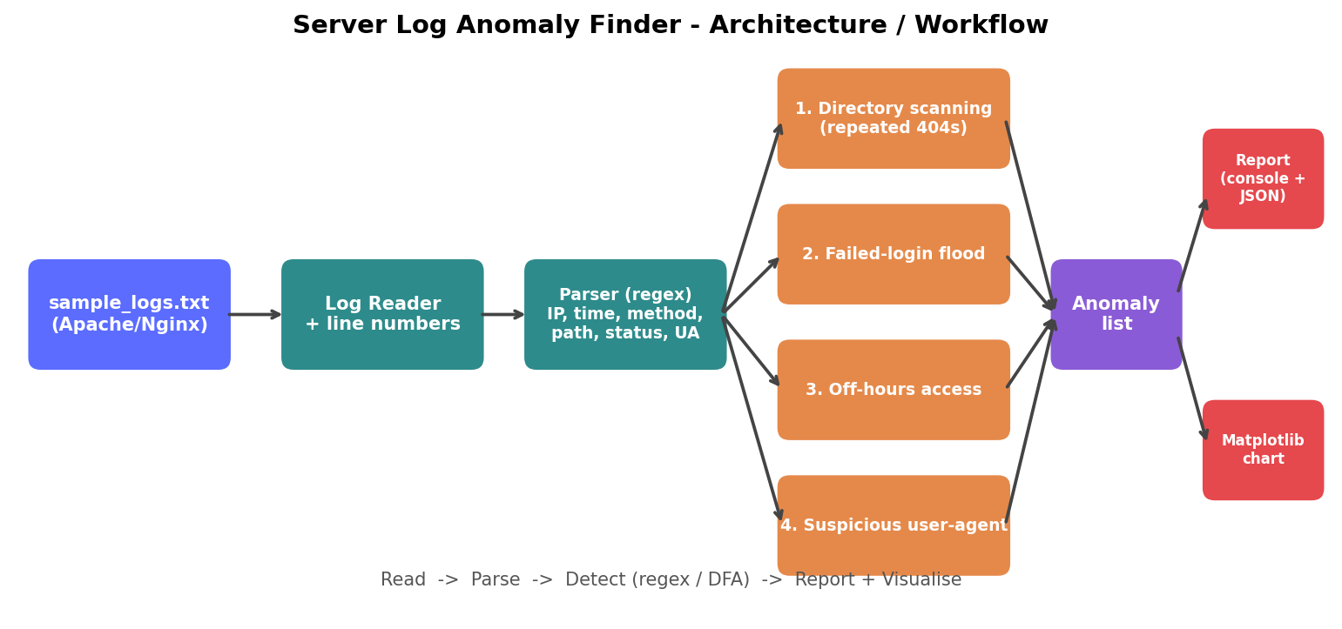
Architecture: Read > Parse > Detect > Report

Slide 5
Four anomaly detectors
Directory scanning
Failed-login flood
Repeated 404s from one IP in seconds
Many 401/403 on login in a short window
Off-hours access
Suspicious user-agent
Requests outside 09:00-18:00
sqlmap, nikto, empty or odd UA

Slide 6
Output: coloured report + JSON
[HIGH] ANOMALY DETECTED: Directory Scanning
IP: 192.168.1.5
Time: 03:21:00 - 03:21:02 (3 seconds)
Lines: 41, 42, 43
Details: 3 consecutive 404s on /admin paths
Severity: HIGH - possible reconnaissance attack
Also saved as reports/report.json for other tools to consume

Slide 7
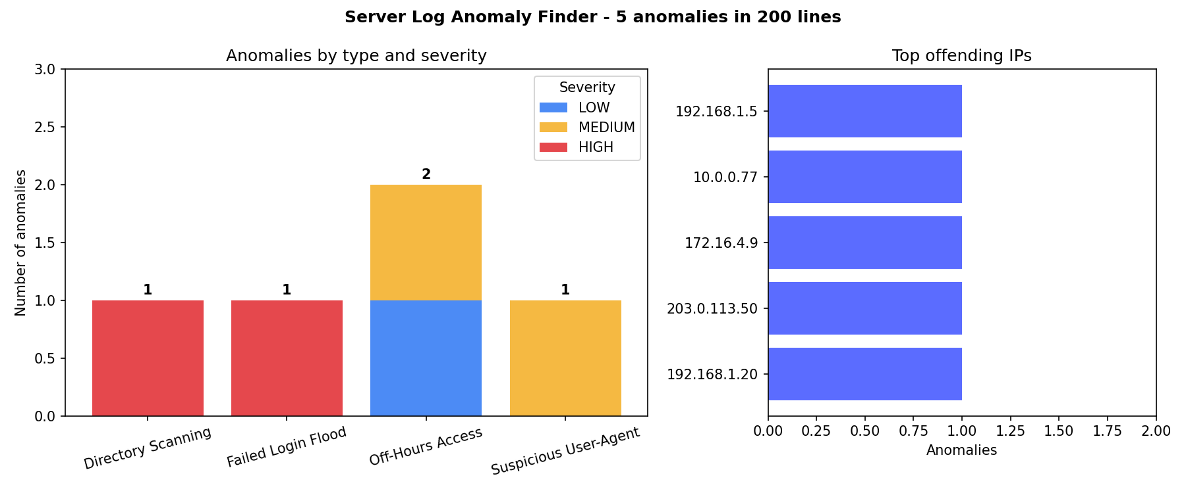
Visualization: anomaly distribution
Sample data shown - generated by Matplotlib on every run

Slide 8
Mini SIEM vs Splunk
 | Our mini SIEM | Splunk
Data source | One static log file | Many sources, live forwarders
Parsing | Python regex per line | Field extraction at index/search time
Detection | 4 fixed regex/DFA rules + thresholds | Searches (SPL), alerts, correlation, ML
Scale | ~200 lines, one machine | Distributed indexers, huge volumes
Output | Console report, JSON, PNG chart | Dashboards, alerts, reports

Slide 9
Scaling up & conclusions
Same idea at scale: single-pass automata matching, parallelised across files and servers
Next steps: streaming input, more rules, IP reputation, alerting/email, dashboard
Theory in practice: regex and DFAs are the foundation of real security tooling
Result: working scanner, JSON report, chart, tests and documentation in GitHub

