Slide 1
.NET Framework and C# language
.Net Core. 2017
by L.Klakovych

Slide 2
Agenda
.Net Framework
Common Language Runtime
C# - new .Net language
Visual Studio. Demo
C# First program. Demo
Reading-Writing in Console

Slide 3
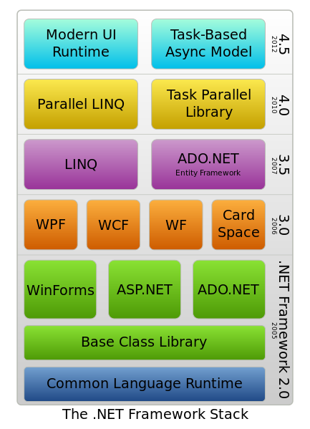
.NET Framework
.Net Framework is software technology developed by Microsoft to create applications for Windows and Web applications.
.Net Framework includes Framework Class Library (FCL) and provides language interoperability across several programming languages.
Programs written for .NET Framework execute in a software environment - Common Language Runtime (CLR), an application virtual machine.

Slide 4
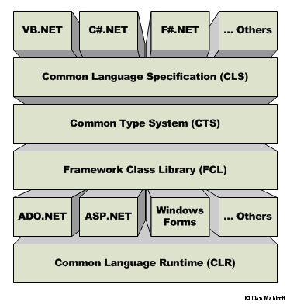
.NET Framework Architecture
Common Language Specification: (CLS) are guidelines, that language should follow for communicating with other .NET languages in a seamless manner. (does mapping)
Common Type System (CTS): is a base class library that contains all type information like Int32, Int64, String , Boolean etc.
Common Language Runtime (CLR): is the execution engine for .NET applications and serves as the interface between .NET applications and the operating system.

Slide 5
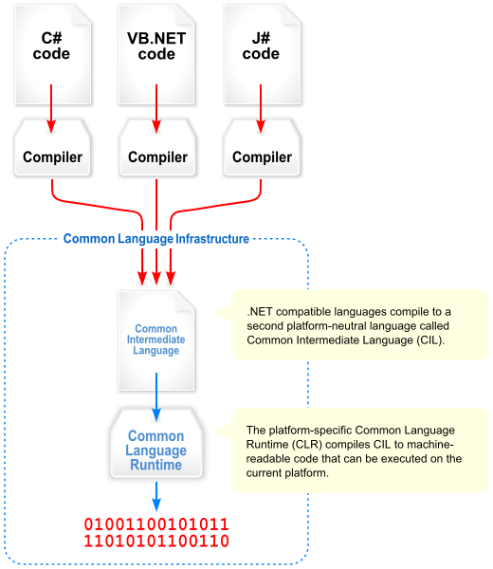
CLR - Common Language Runtime

Slide 6
C# Language
C# is a new language designed by Microsoft to work with the .NET framework
C# is a simple, modern, object oriented, and type-safe programming language derived from C and C++.
C# provides support for software engineering principles:
strong type checking,
detection of attempts to use uninitialized variables,
automatic garbage collection.

Slide 7
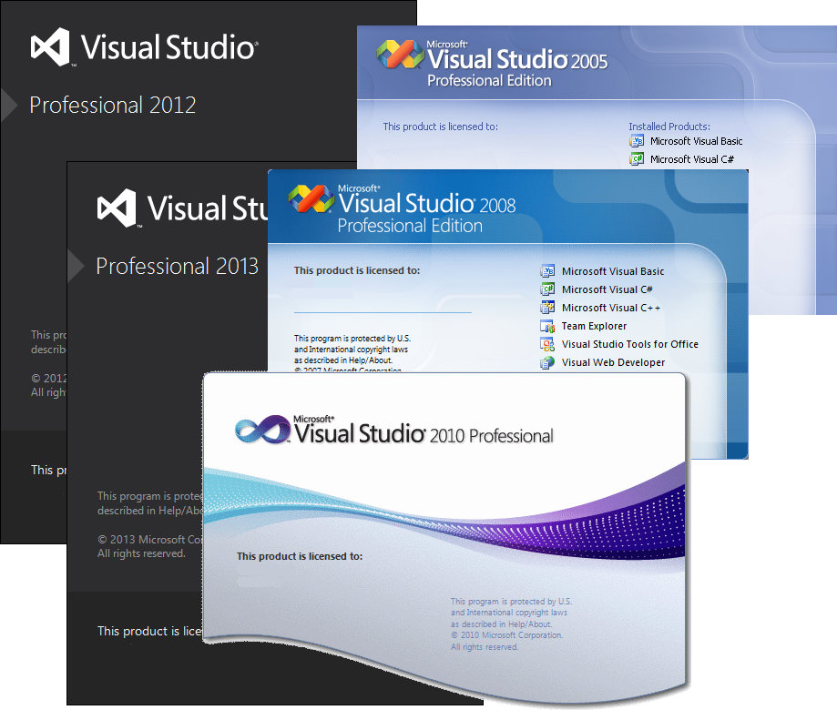
C# and Visual Studio .Net
C# Compiler
C# IDE in VS
Visual Studio.NET
.NET Framework
(ADO.NET, ASP.NET, Windows Forms, Web Services,)
Common Language Runtime
Operating System
Integrated development environment (IDE) is a collection of development tools exposed through a common user interface

Slide 8
Visual Studio 201☺. Demo

Slide 9
C# First Program
class definition
entry point
public class Program
{
static public int Main(System.String[] args)
{
System.Console.WriteLine("Hello World!");
return 0;
}
}
class is used to define new types.
C# code should be put in some class.
Method Main() is an entry point of program.

Slide 10
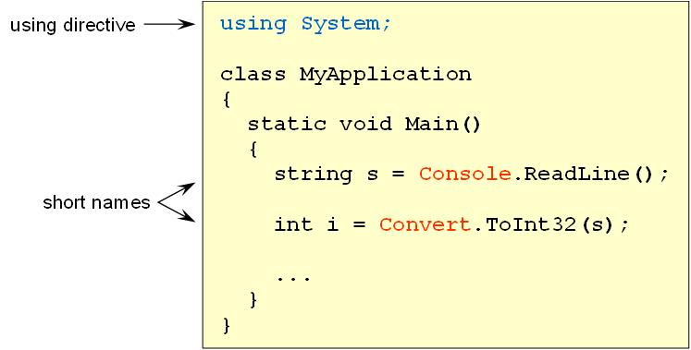
Namespaces and using directive
.NET Framework classes use namespaces to organize its many classes.
Declaring own namespaces can help control the scope of class and method names in larger programming projects.
Section of using directives lists the namespaces that the application will be using frequently, and saves the programmer from specifying a fully qualified name every time that a method that is contained within is used.

Slide 11
Writing into Console
Console .Write() and Console .WriteLine() put line of text (string) into the stream for writing on Console.
int i = 3;
double d = 5.2;
System.Console.WriteLine(i);
System.Console.WriteLine(d);
System.Console.WriteLine("first {0} second {1}", i, d);
int
double
multiple
format string
placeholder
value

Slide 12
Format output
The format item:
{ index [ :formatString] }
Index: The zero-based index of the argument whose string representation is to be included at this position in the string.
formatString: A string that specifies the format of the corresponding argument's result string.
FormatString | Description
С або с | Форматування валюти. Додає валюту по замовченню вашої ОС.
D або d | Форматування десяткових чисел. Також може використовуватися вказання мінімальної кількості цифр для доповнення.
Е або е | Використовується для експоненціального запису.
N або n | Використовується для форматування числових значень.
Х або х | Форматування у шістнадцятковому вигляді.

Slide 13
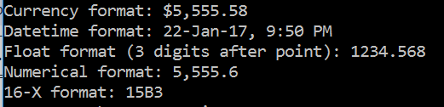
Format output
Console.WriteLine("Currency format: {0:C}", 5555.5812);
Console.WriteLine("Datetime format: {0:d}, {0:t}", DateTime.Now);
Console.WriteLine("Float format (3 digits after point): {0:F3}", 1234.56789);
Console.WriteLine("Numerical format: {0:N1}", 5555.5812);
Console.WriteLine("16-X format: {0:X}", 5555);

Slide 14
Reading from Console
Console.ReadLine() - reads line from console and return it as string type
Use methods from System.Convert class for converting string variable to other types
Or use Parse() methods from different system types
read entire line
string s = System.Console.ReadLine();
int i = System.Convert.ToInt32 (s);
double d = System.Convert.ToDouble(s);
int number = Int32.Parse(s);
Convert string to int
Convert string to double
Parse string into int

Slide 15
Reading from Console
Use TryParse() to avoid format exceptions
static bool TryParse(string s, out Int32 result);
string s = Console.ReadLine();
int number ;
bool rez = Int32.TryParse(s, out number);
Console.WriteLine("{0}-{1}",rez, number);

Slide 16
Task1
Create Console Application project in VS.
In method Main() write code for solving next tasks:
Define integer variables a and b.Read values a and b from Console and calculate: a+b, a-b, a*b, a/b. Output obtained results.
2) Output question “How are you?“. Define string variable answer. Read the value answer and output: “You are (answer)".
3) Read 3 variables of char type. Write message: “You enter (first char), (second char), (3 char)”
4) Enter 2 integer numbers. Check if they are both positive – use bool expretion

Slide 17
Homework
Homework 1
1. Practical task:
Create Console Application project in VS.
In method Main() write code for solving next tasks:
b) define integer variable a. Read the value of a from console and calculate area and perimetr of square with length a. Output obtained results.
c) define string variable name and integer value age. Output question "What is your name?";Read the value name and output next question: "How old are you,(name)?". Read age and write whole information
d) Read double number r and calculate the length (l=2*pi*r), area (S=pi*r*r) and volume (4/3*pi*r*r*r) of a circle of given r
2. Learn next C# topics:
a)reference and value types
b) intrinsic Data Types
c) C# operators
d) if, switch, loop statements

Slide 18


