Slide 1
Type System overview. Value types.
.Net Core. 2017
by L.Klakovych

Slide 2
AGENDA
Common Type System
Value and reference types
Built-it Data Types
Declaring Variables
Operators
Type casting
Enum and Struct

Slide 3
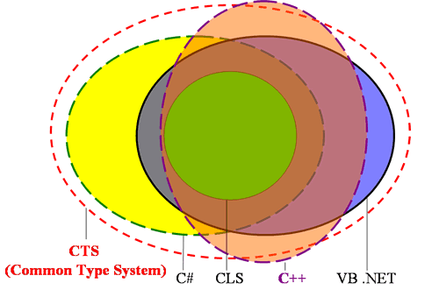
Common Type System
CTS – common type system:
defines how types are declared, used, and managed in the common language runtime,
is an important part of the runtime's support for cross-language integration.

Slide 4
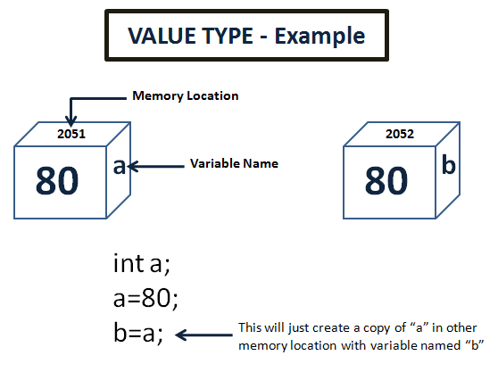
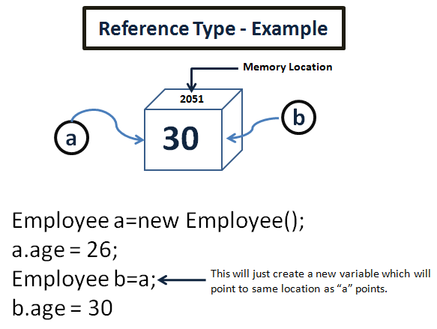
Value and Reference types
Value type holds the data within its own memory allocation.
Reference type contains a pointer to another memory location that holds the data.

Slide 5
Value types
Built-in types:
Integer types: long, int, byte
floating-point types: double, float
Boolean type: bool
Characters: char
User-defined types:
Struct
Enum

Slide 6
Built-it ValueTypes
CTS Type Name | C# Alias | Description | Range
System.SByte | sbyte | Signed 8-bit byte | [ -128, 127 ]
System.Byte | byte | Unsigned 8-bit byte | [ 0, 255 ]
System.Int16 | short | Signed 16-bit value | [ -32768, 32767 ]
System.UInt16 | ushort | Unsigned 16-bit value | [0, 65535 ]
System.Int32 | int | Signed 32-bit value | [ -2³¹, 2³¹-1 ]
System.UInt32 | uint | Unsigned 32-bit value | [ 0, 4 294 967 295 ]
System.Int64 | long | Signed 64-bit value | [ -2⁶³, 2⁶³-1 ]
System.UInt64 | ulong | Unsigned 64-bit value | [ 0, 18 446 744 073 709 551 615 ]
System.Single | float | IEEE 32-bit float | [ 1.4x10⁻ ⁴⁵ , 3.4x10³⁸ ] 6-7
System.Double | double | IEEE 64-bit float | [ 5.0x10⁻ ³²⁴ , 1.7x10³⁰⁸ ] 15-16
System.Decimal | decimal | 128-bit data | [ 1.0x10⁻ ²⁸ , 7.9x10²⁸ ] 28-29
System.Boolean | bool | Boolean value | true / false
System.Char | char | 16-bit Unicode char | [ u+0000, u+ffff ] ‘\u0058’

Slide 7
Variable naming
Letters, digits and underscore
Use digit as a first character
C# is case-sensitive
Use C# keywords
V
V

Slide 8

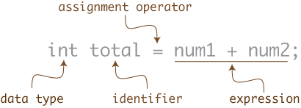
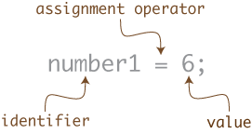
Declaring Variables

Slide 9
Variable Declaration and Initialization
class MyApplication
{
static void Main()
{
int width = 2;
int height = 4;
int area = width * height;
int x;
int y = x * 2;
...
}
}
literals
expression
error, x not set

Slide 10
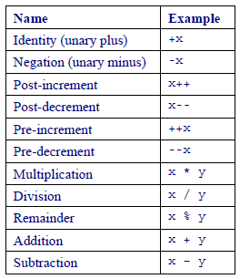
Operators
Basic arithmetic operators
Result of operators depends on the type of operands
Pre and Post Increments
x = 3 / 5 ;
x = 3.0 / 5 ;
x = 3.0 % 5;
0
0.6
error
int a = 4 ;
a ++ ;
int b = a++;
b = ++a;
a = 4
a = 5
a = 6 b = 5
a = 7 b = 7

Slide 11
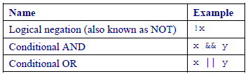
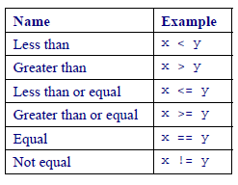
Operators
Operators for bool
Relational operators
bool rez;
int x ;
// read value of x
rez = ( x > 0 ) && ( ( x % 2 ) == 0 ) ;
rez = ( x > 0 ) || ( ( x % 2 ) == 0 ) ;
rez = ! ( x == 0);
rez = ( x != 0 );

Slide 12
Conditional (Ternary) Operator (?:)
test ? expression1 : expression2
returned if test is false
returned if test is true
string answer = (a < 0 ) ? “negative” : “positive” ;
string answer = (a < 0 ) ? “negative” : (a > 0) ? “positive” : “zero” ;

Slide 13
Assignment
x += 5 is equivalent to x = x + 5
x /= 2 is equivalent to x = x / 2

Slide 14
Type casting
Implicit and explicit type casting
sbyte
short
int
long
char
float
double
decimal
byte
ushort
uint
ulong
uint a = 10U;
ulong b = a;
// void f(ulong x){…}
f(a);
long a= 10L;
int b = (int) a;

Slide 15
Task 2-1
Ввести два цілих числа day та month і перевірити чи можуть вони представляти день та місяць. Вивести true чи false
Ввести дійсне число number і отримати 2 перші цифри після коми цього числа. Вивести суму цих цифр. Напр.: 3.456->4+5=9
Ввести ціле число h , які представляють час доби (година ). Залежності від часу доби вивести привітання («Доброго ранку!», «Доброго дня!», «Доброго вечора!», «Доброї ночі!»)

Slide 16
Enumeration type
Enum defines a set of named integral constants that may be assigned to a variable.
//Declaration
enum Days { Sun, Mon, Tue, Wed,Thu, Fri, Sat };
//Using
Days today = Days.Mon;
int dayNumber =(int)today;
Console.WriteLine("{0} is day number #{1}.", today, dayNumber);
Days day = (Days) 5;
Console.WriteLine("{0} is day number #{1}.", day, 5);

Slide 17
Struct
Struct is a custom value type that stores the values in each field together.
All value types (int, bool, char) are structs
struct Point
{
public int X;
public int Y;
};
public struct Book
{
public decimal price;
public string title;
public string author;
}
static void Main()
{
Point local;
local.X = 1;
local.Y = 2;
Book myBook;
myBook.price=120;
myBook.title=“Kobzar”;
}
Notes:
struct Point
{
public int X;
public int Y;
public override string ToString()
{
return string.Format("P=({0},{1})", X, Y);
}
};
class Program
{
static void Main(string[] args)
{
Point p;
p.X = 1;
p.Y = 2;
Console.WriteLine(p);
}
}

Slide 18
Task 2-2
Визначити перелічення TestCaseStatus (Pass, Fail, Blocked, WP, Unexecuted).
Змінній test1Status присвоїти значення Pass і вивести значення змінної на консоль.
Визначити структуру RGB, яка представляє колір з полями red, green, blue типу byte . Визначити дві змінні цього типу і ввести їх поля для білого та
чорного кольорів.

Slide 19
Homework -2
1. Practical task:
Create Console Application project in VS.
In method Main() write code for solving next task:
a) read 3 float numbers and check: are they all belong to the range [-5,5].
b) read 3 integers and write max and min of them.
c) read number of HTTP Error (400, 401,402, ...) and write the name of this error (Declare enum HTTPError)
d) declare struct Dog with fields Name, Mark, Age. Declare variable myDog of Dog type and read values for it. Output myDos into console. (Declare method ToString in struct)
2. Learn next C# topics:
1) Statements C# (if, switch, loops)
2) Reference type. Class object

Slide 20


