Slide 1

INSY 5339 001 Principles of Business Data Mining
Jayarajan Samuel
Notes:
3 main types. There are other types of diabetes that are out there.

Slide 2
Prediction of Prediabetic Patients Using Data Mining Techniques

Slide 3
Introduction
96 million adults in America, or more than one in three, have prediabetes. More than 80% of people with prediabetes are ignorant of their disease.
Prediabetes is a serious health condition where blood sugar levels are higher than normal but not yet high enough to be diagnosed as type 2 diabetes.
As an insurance company, we are targeting the diabetes problem. We can basically determine a person's diabetes status based on the data.
The insurance provider will suggest a high premium improvement plan to the impacted individuals after learning of such instances.
Notes:
http://www.mayoclinic.org/diseases-conditions/diabetes/basics/definition/con-20033091

Slide 4
Data Mining
To identify the individuals with borderline probabilities of having diabetes, we need to extract one more abstract layer of information from the dataset.
Inferring individuals with a high likelihood of developing diabetes soon based on their current lifestyle will help us identify cases with borderline probability.
A good contender for a dataset. Kaggle provided us with a dataset that was suitable for our use case
Notes:
3 main types. There are other types of diabetes that are out there.

Slide 5
Description of data
Source Of Dataset - Kaggle: https://www.kaggle.com/kandij/diabetes-dataset
The data gathered and published by "National Institute of Diabetes and Digestive and Kidney Diseases”.
Only female patient dataset
Every female at least 21 years old and of Pima Indian descent (a subset of Native Americans).
The dataset has independent variables and one target variable also called as the dependable variable. (Pregnancies, Glucose, BloodPressure, SkinThickness, Insulin, BMI, DiabetesPedigreeFunction, Age, outcome)
Based on the diagnostic measurements provided in the dataset, the main goal is to forecast whether the patient has diabetes or not.

Slide 6
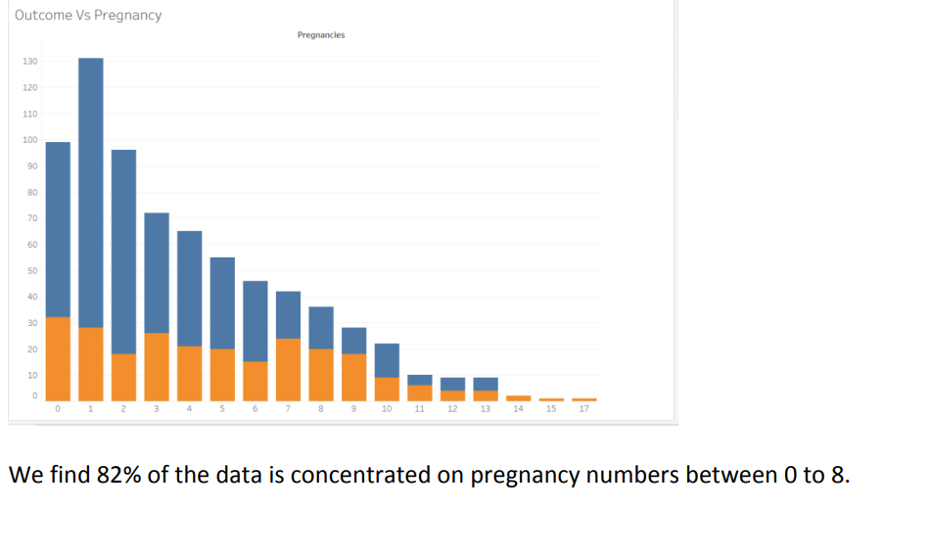
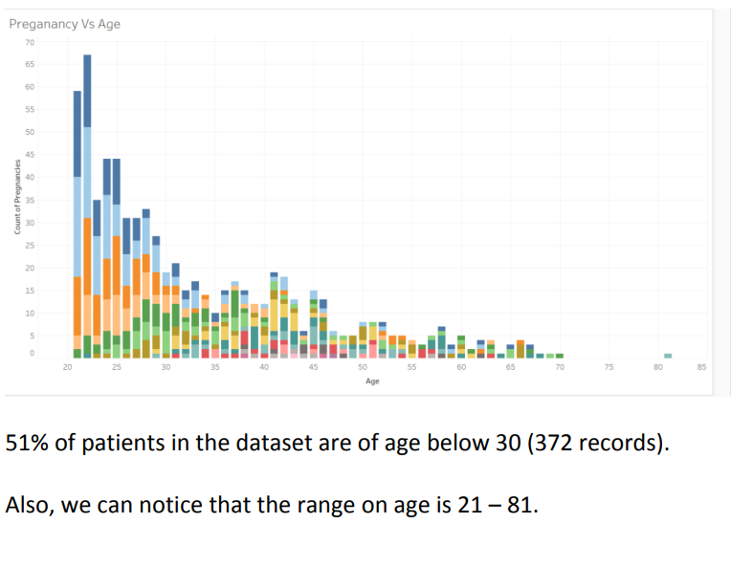
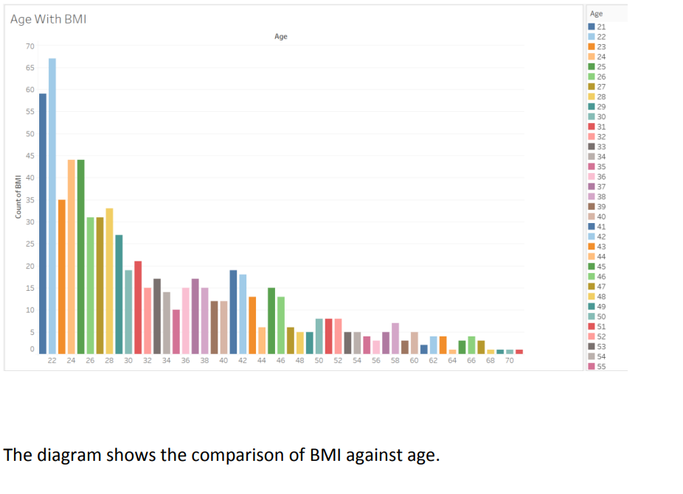
Data Visualization In Tbleau

Slide 7
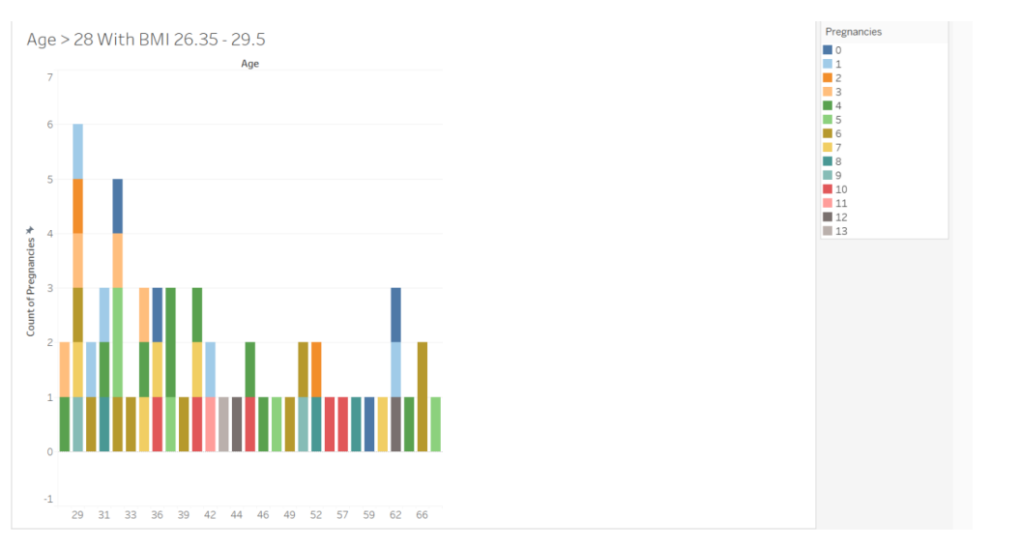
This is predictive diabetic group who we would like to give insurance under certain circumstances.
The graph shows the pregnancies against age.
This visualization tells us how pregnancies and age relate to each other.
As we can see that the tallest graph is when the age is less than 31.
The age category of 29-31 can be seen to have the highest number of pregnancies. We wanted to relate this data with our regression model.

Slide 8
Utilizing the Dataset to address the business needs
Decision Trees and Linear Regression were used in SAS Enterprise Miner to generate the model.
The data split for both models is set at 50% training and 50% validation.
We shall classify insurance into three categories:
- high premium
- low premium
- no insurance
Decision Trees:
Broke down the dataset into smaller and smaller branches
to find out the impacting vector. Result – BMI
Linear Regression:
Used this model to predict the value of target by using dependent variables. Result - BMI

Slide 9
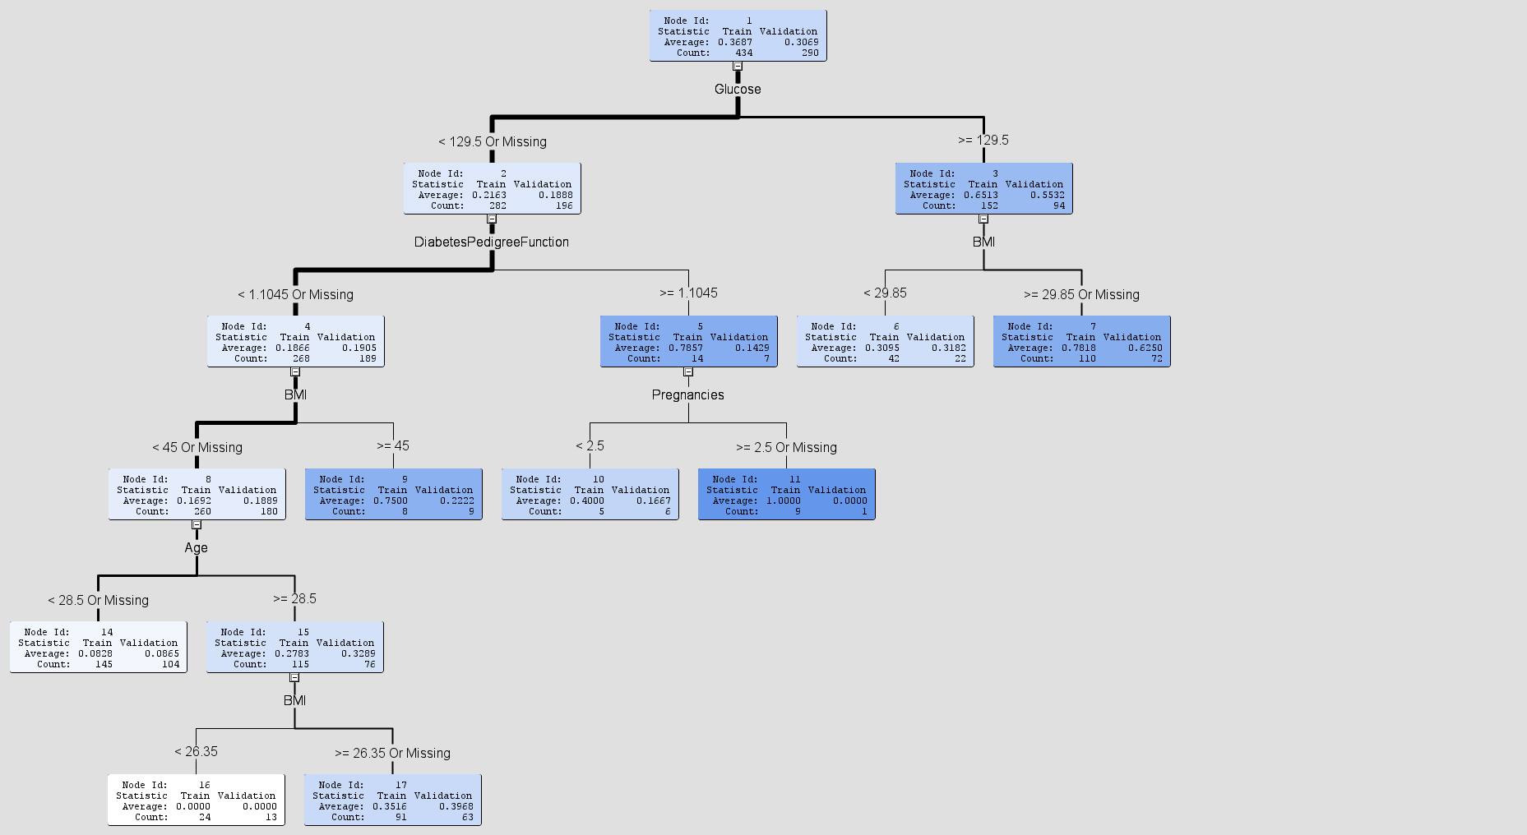
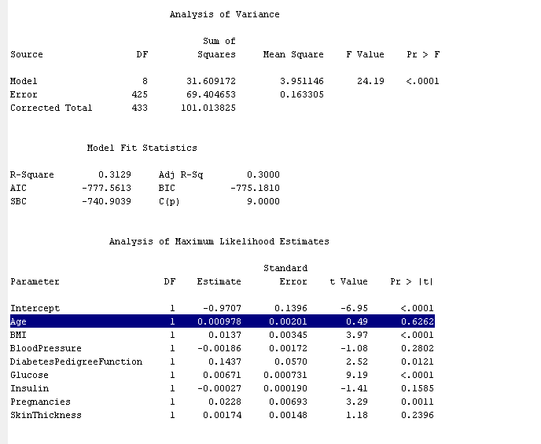
Decision Tree From SAS EM

Slide 10
Decision Tree
Looking at the decision tree from SAS EM
- Focusing on the group of people of
Age - greater or equal to 28.5
BMI - equal to or greater than 26.5 to 29.5.
These are the group of potential people to improve their diabetic condition, who will be given high premium at first and if they reduce their BMI to less than 26.5, their insurance will be lowered.
Linear Regression
From linear regression
- We found out the probability of 62% borderline diabetic people are
Age - greater than 28.5
BMI - higher than 26.35.
From the borderline patients i.e., age > 28.5 and BMI > 26.5, we chose 58 people with age > 28.5 and 26.35 <= BMI <= 29.5 to incentivize to lower their BMI by changing their lifestyle for a lower premium.

Slide 11
Predictive Borderline Diabetic Patients

Slide 12
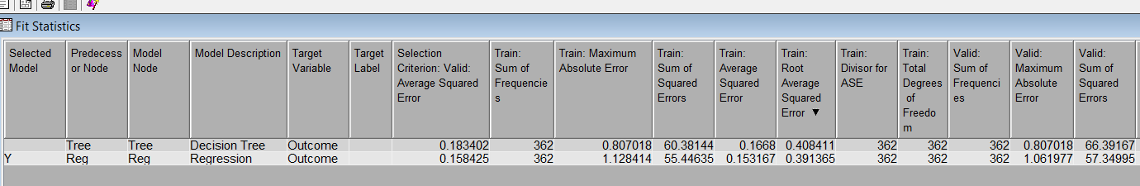
Conclusion - I
We compared the two models, linear regression and decision tree, and discovered that Linear Regression has a superior fit for our model due to its lower sum of squared errors.
Notes:
Fetus exposed to glucose for a long time in the wound are more likely to be diagnosed with diabetes.

Slide 13
Conclusion - II
We discovered from our model that among other factors in the sample, the outcome variable has a moderately significant link with BMI and a little correlation with Diabetes Pedigree Function.
Age, BMI, and Pregnancies all have a strong relationship to the outcome variable.
People who reduce their BMI as per insurance company’s requirements i.e less than 26.5 will have their insurance premiums reduced.

Slide 14
Thank You !

