Slide 1
KNN (k – nearest neighbors)

Slide 2
Definition:
The k-nearest neighbors (KNN) algorithm is a simple, easy-to- implement, lazy learning, supervised machine learning algorithm that can be used to solve both classification and regression problems using feature similarity.

Slide 3
K in KNN
K is a number used to identify similar neighbors for the new data point.
KNN takes K nearest neighbors to decide where the new data point with belong to.
This decision is based on feature similarity.

Slide 4
Steps of KNN
Step 1: Choose a value for K. K should be an odd number.
Step 2: Find the distance of the new point to each of the training data.
Step 3:Find the K nearest neighbors to the new data point.
Step 4: For Classification, count the number of data points in each category among the k neighbors. New data point will belong to class that has the most neighbors.

Slide 5
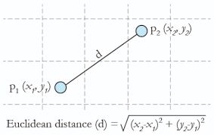
Distance can be calculated using
Euclidean Distance

Slide 6
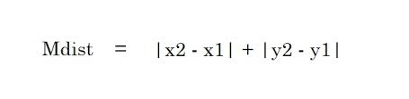
2. Manhattan Distance

