Slide 1

SA3 Project -Fluxx-
Aron Dalle Pezze
Nicolò Panciera
Alexandra Willi

Slide 2

Roles
Nicolò Panciera:
backend + Git management
Aron Dalle Pezze:
frontend + Project section management
Alexandra Willi:
Jolly

Slide 3
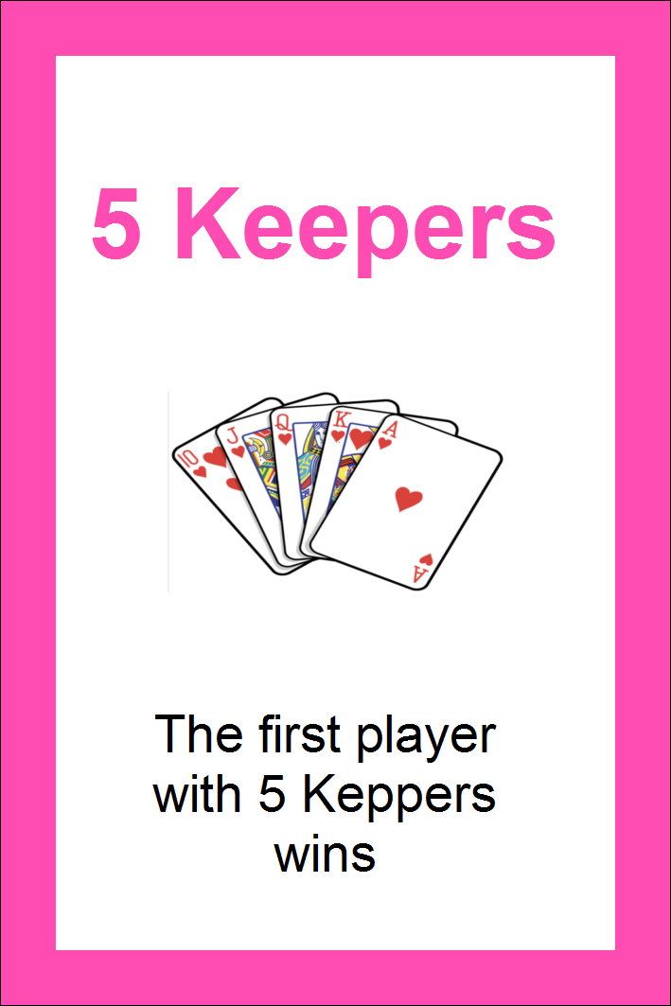
What we‘ve reached so far
Reformat html for ReactJS
Improve game css
Make first version of frontend scripts with ReactJS
Make real time chat
Put all cards in database
Make event listeners skeleton
Basic routing
Notes:
Alex: chat. Panci: carte nel database + basic routing. Aron: tutto il resto

Slide 4
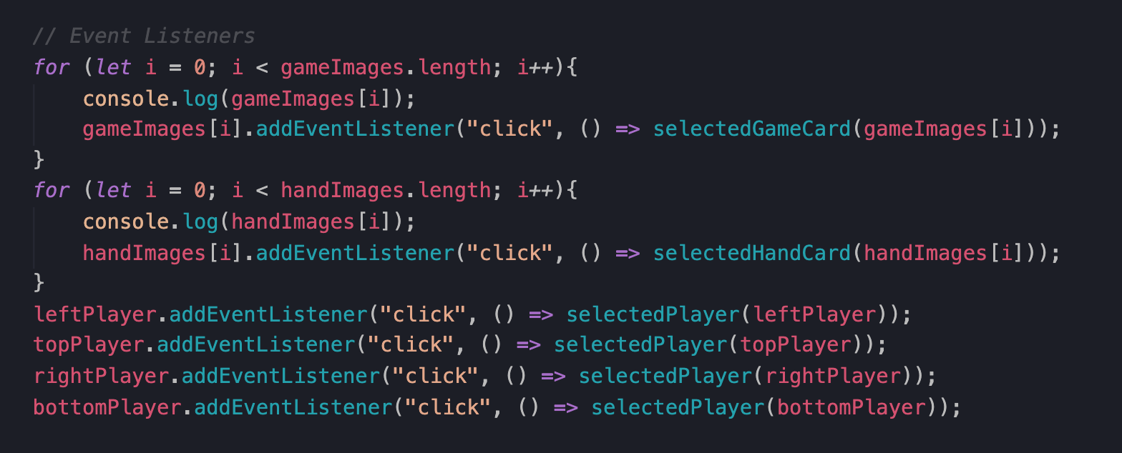

Slide 5
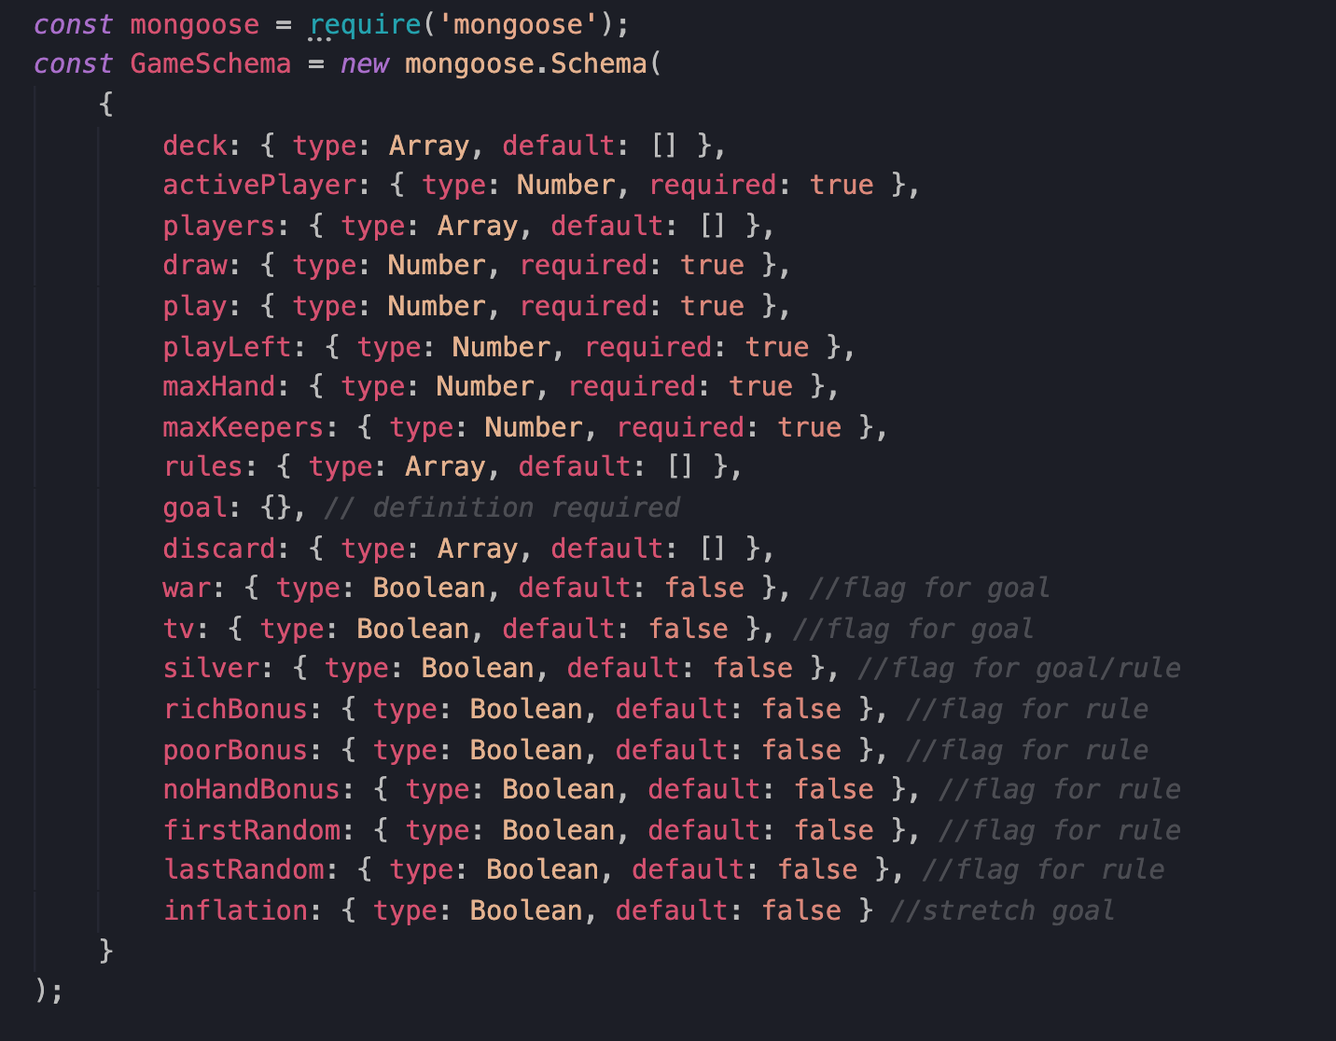
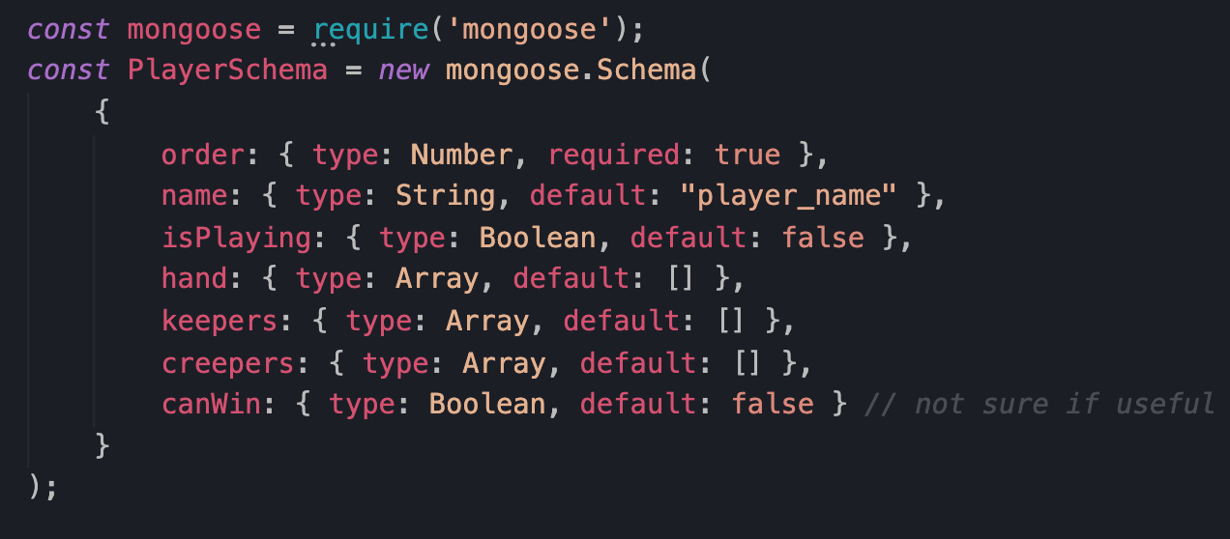

Slide 6
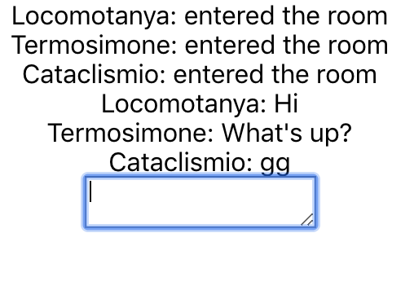
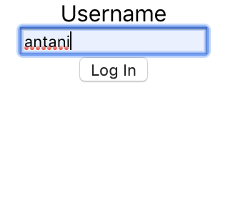

Slide 7
What we‘ll do this week
Finish rendering (ReactJS)
Make log
Finish JS event listeners
Create html and css for index and info
Complete routing as necessary
Integrate backend with frontend
Notes:
Aron:rendering, js listeners + html e css con me. Alex: log + aiutare aron con css+ html per nfo. Panci:

Slide 8
Issues
Absence of a member
Manage multiple actions on a single turn
Render each single player
Data base issue
Notes:
Also: una demo è difficile perchè ora che ne avremo una il gioco sarà praticamente finito.

