Slide 1

SA3 Project -Fluxx-
Aron Dalle Pezze
Nicolò Panciera
Alexandra Willi

Slide 2

Roles
Nicolò Panciera:
Back-end + Git management
Aron Dalle Pezze:
Front-end + Project section management
Alexandra Willi:
Jolly
Notes:
Jolly: specific task such as support with database setup, json, models…

Slide 3
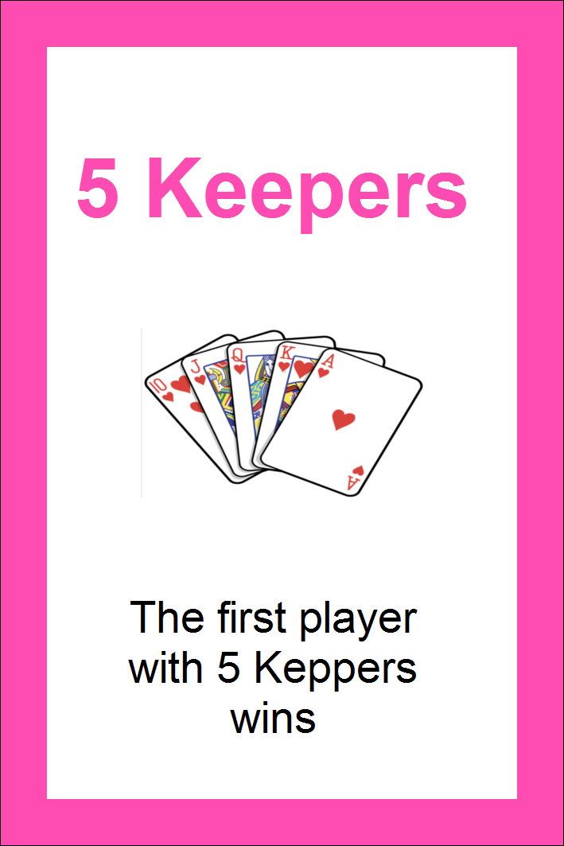
What we‘ve reached so far
Setup project structures
Setup Github and branches
Created deck of cards
html and css of what the game will look like
Visual basic Demo (without js)
Game design decisions
Notes:
Game design decisions: defined what is server-side (computations:turns, draw, play, general game state) and what is client-side (rendering: discard pile)

Slide 4
What we‘ll do this week
Put all the cards in the database
Make a real time chat
Make first version of frontend scriptswith ReactJS
Reformat html for ReactJS
Create html and css for index and info
Basic routing
Notes:
Eventually, add log as well. Note than Panciera will be absent for three days because of civil service, which

Slide 5
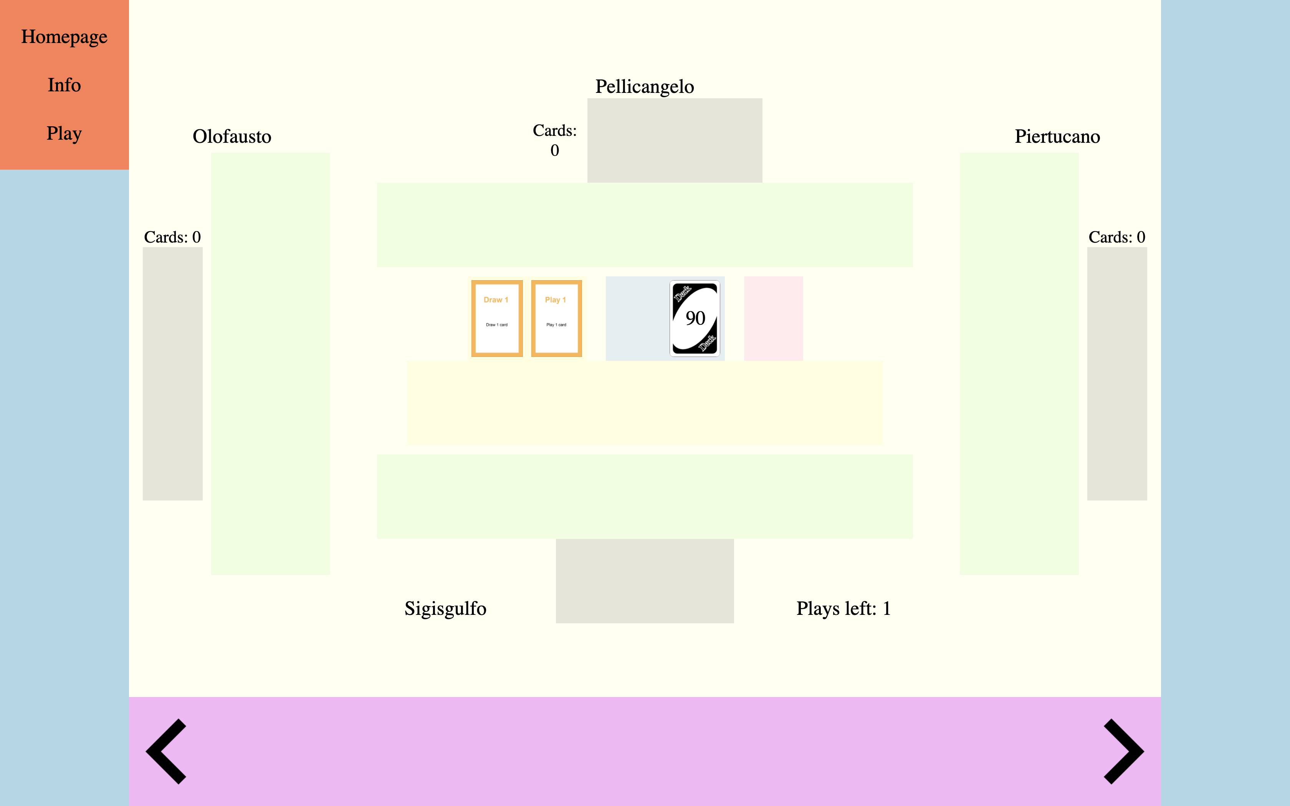

Slide 6
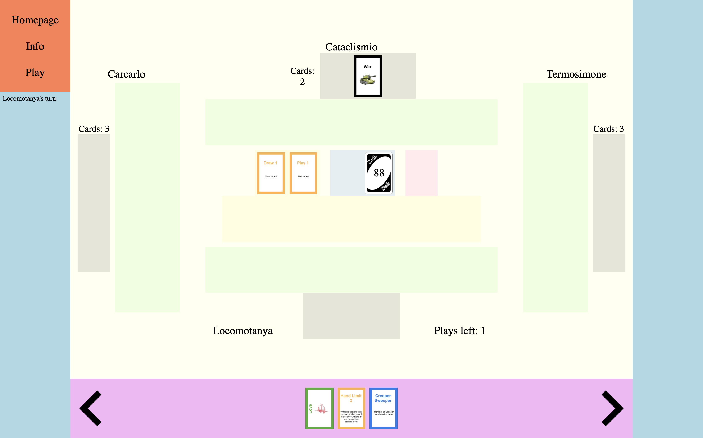
Deck cards left: 27

Slide 7
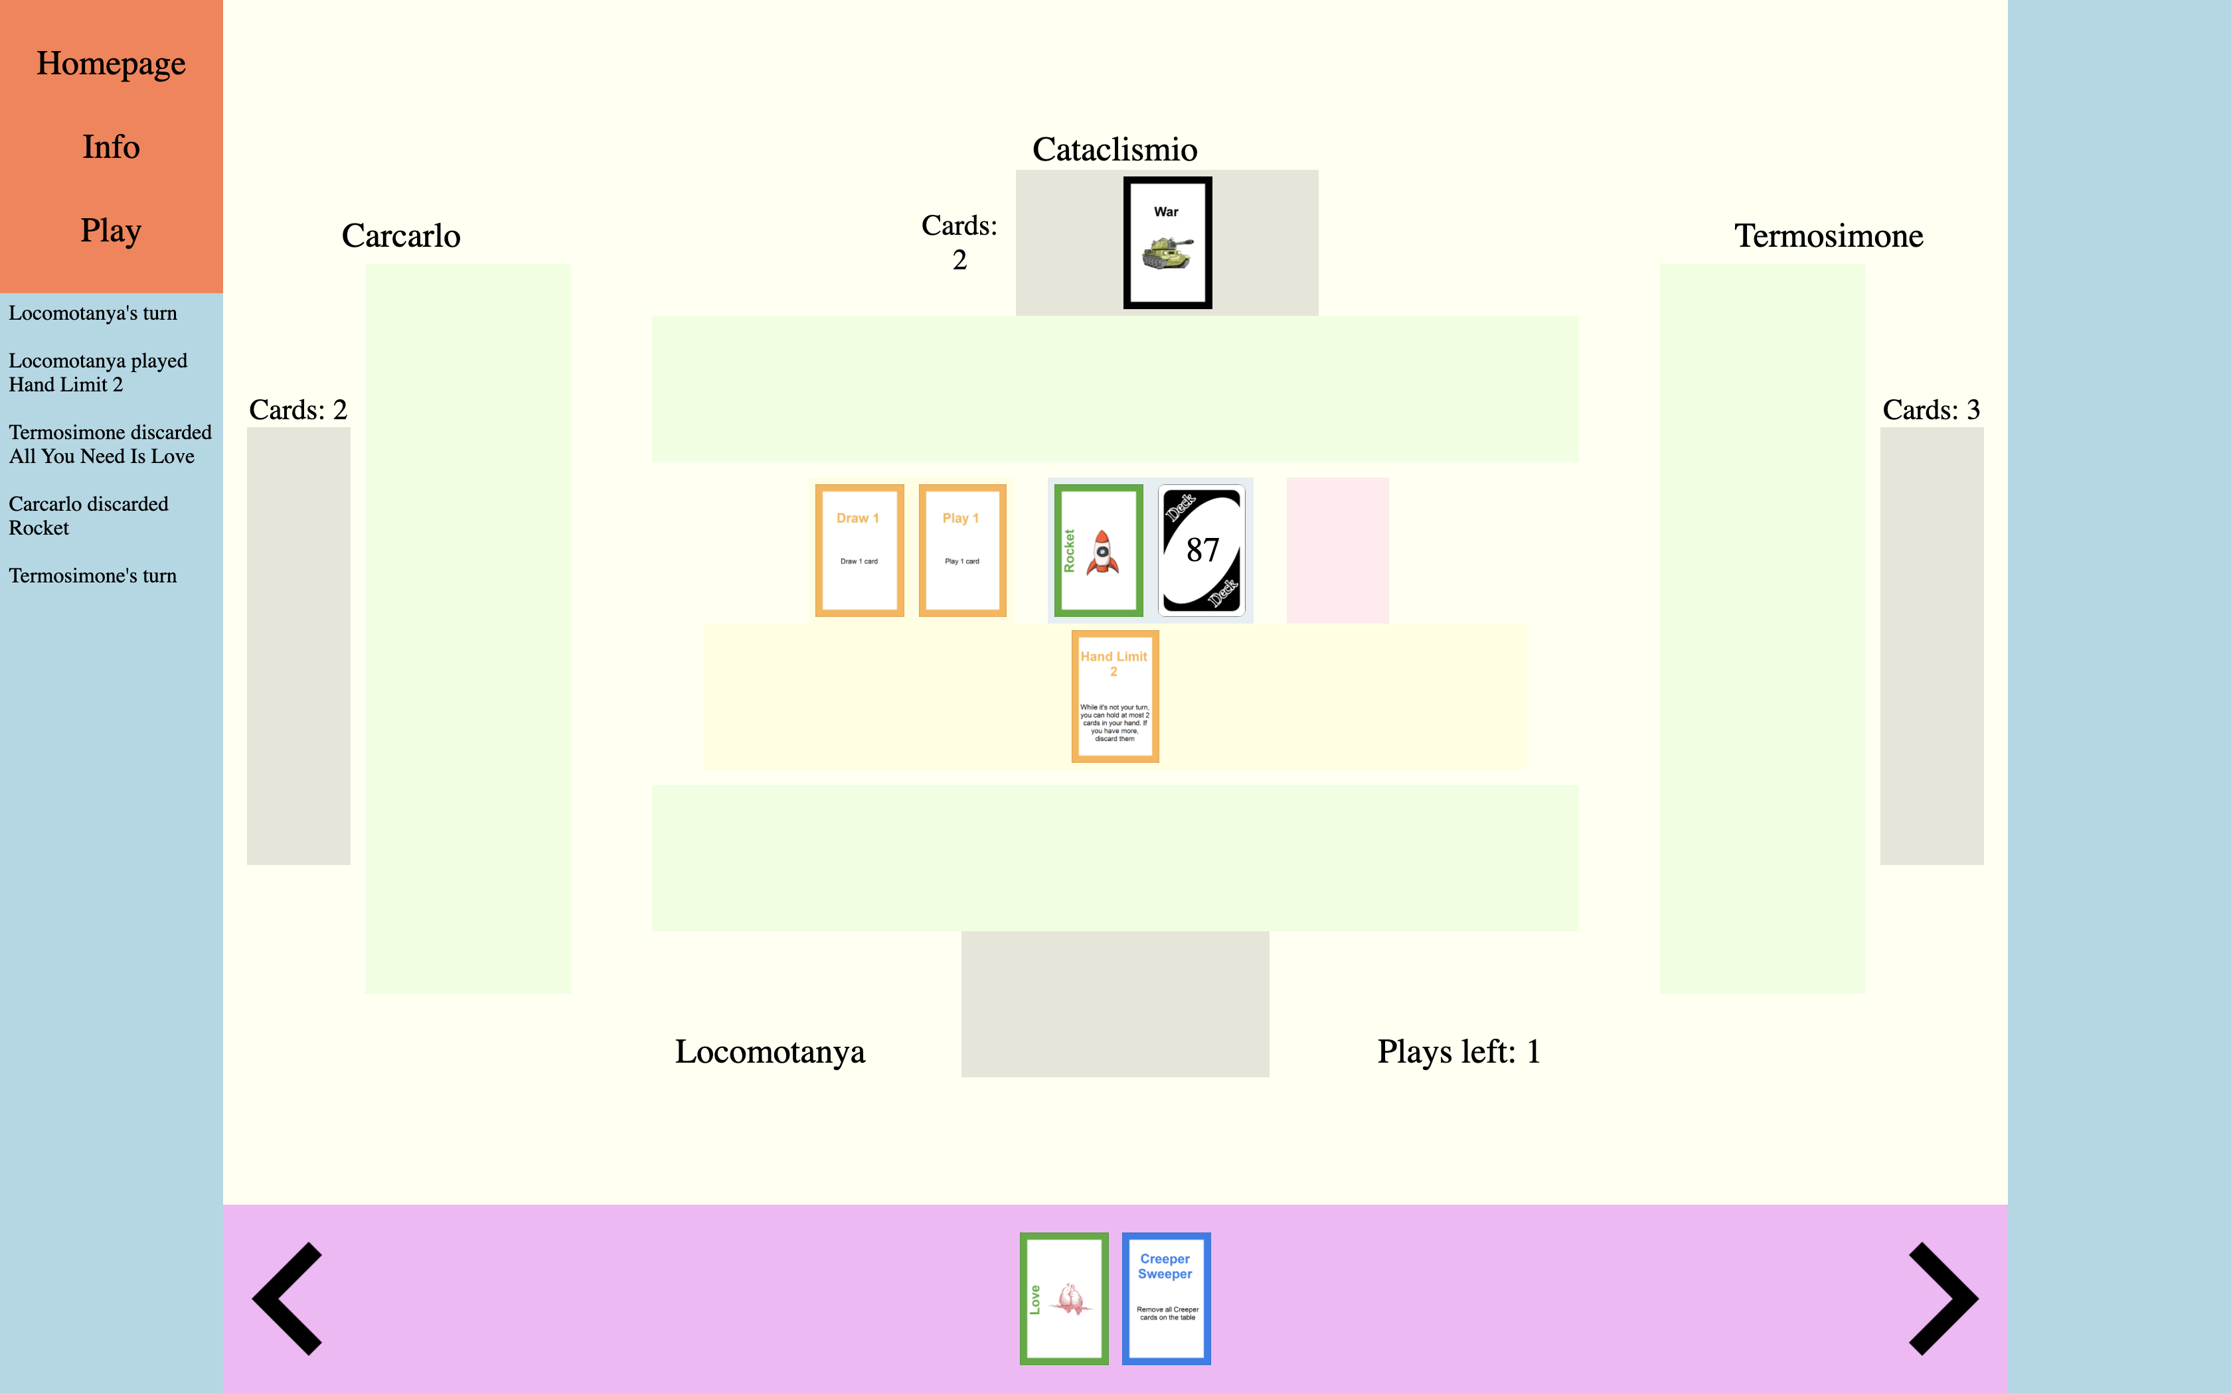
-Main Objectives-
Fluxx – Base rules and cards
Up to 4 players
In-game chat
Spectator view

Slide 8
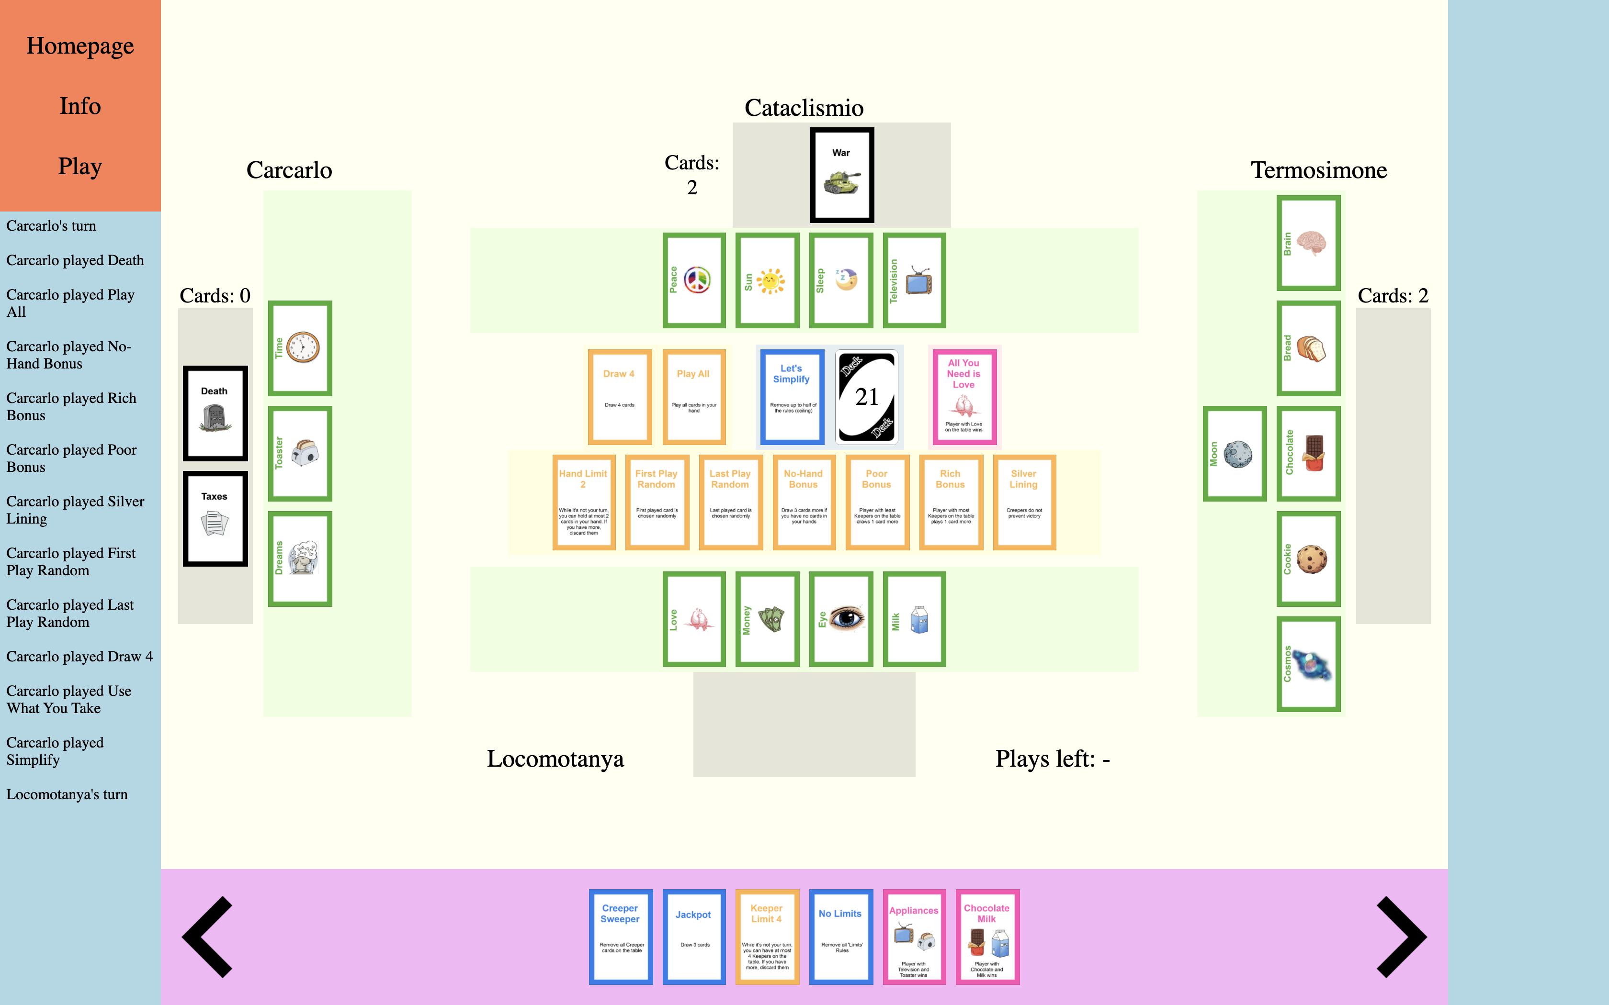
-Additional Features-
Themes
Multiple games
Accounts
Up to 6 players
Additional Fluxx rules and cards

