Slide 1

SA3 Project -Fluxx-
Aron Dalle Pezze
Nicolò Panciera
Alexandra Willi

Slide 2
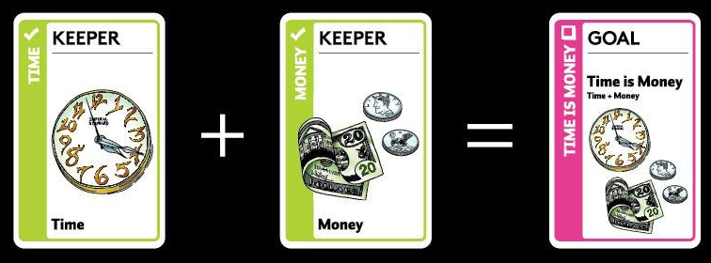

Fluxx -Cards-
Keepers
Creepers
Goals
Actions
New Rules
Silver
Lining

