Slide 1

SA3 Project -Fluxx-
Aron Dalle Pezze
Nicolò Panciera
Alexandra Willi

Slide 2
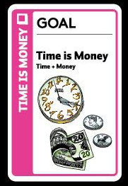
Goals:
Fluxx webapp
Up to 4 players
Desktop only

Slide 3
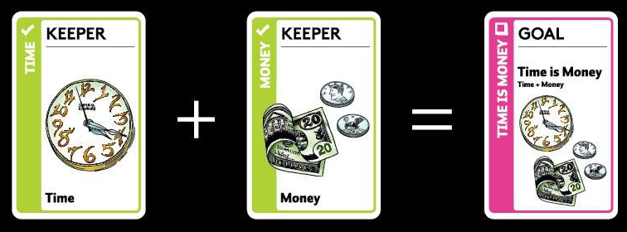
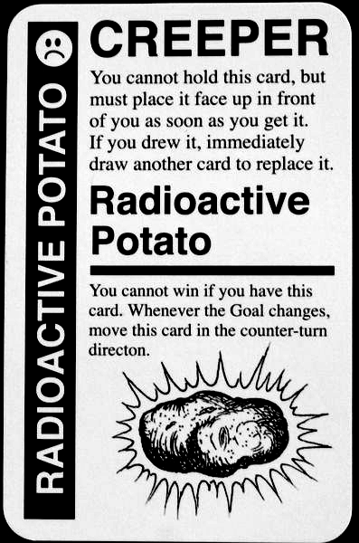
Fluxx -Cards-
Keepers
Creepers
Goals
Actions
New Rules
Silver
Lining

Slide 4
-Main Objectives-
Fluxx – Base rules and cards
Up to 4 players
In-game chat
Spectator view

Slide 5
-Additional Features-
Themes
Multiple games
Accounts
Up to 6 players
Additional Fluxx rules and cards

Slide 6
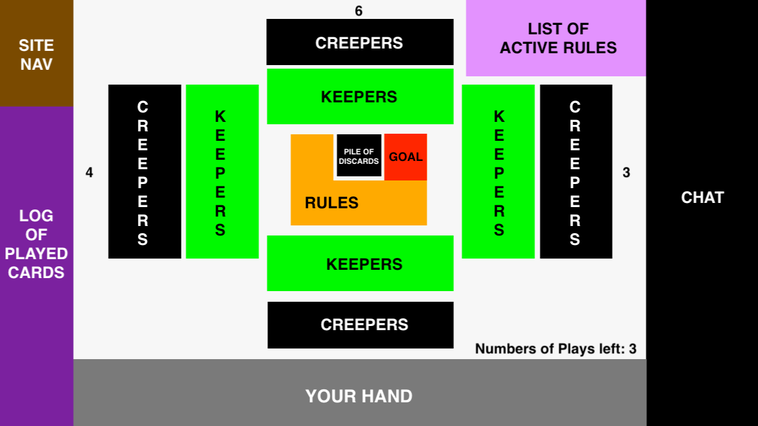
Deck cards left: 27

