Slide 1

SA3 Project -Fluxx-
Aron Dalle Pezze
Nicolò Panciera
Alexandra Willi

Slide 2
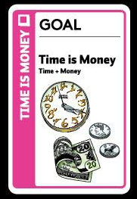
Last week:
Connect front-back
Merge all the pieces

Slide 3
Last week:
X
Connect front-back
Merge all the pieces

Slide 4
Last weekend:
VSC LiveShare
Mongoose -> Classes
HTMLs -> full ReactJS
Renunciations

Slide 5
-Demo-

Slide 6
-Looking back-

