Slide 1

SA3 Project -Fluxx-
Aron Dalle Pezze
Nicolò Panciera
Alexandra Willi

Slide 2

Roles
Nicolò Panciera:
backhand + Git management
Aron Dalle Pezze:
frontend + Project section management
Alexandra Willi:
Jolly

Slide 3
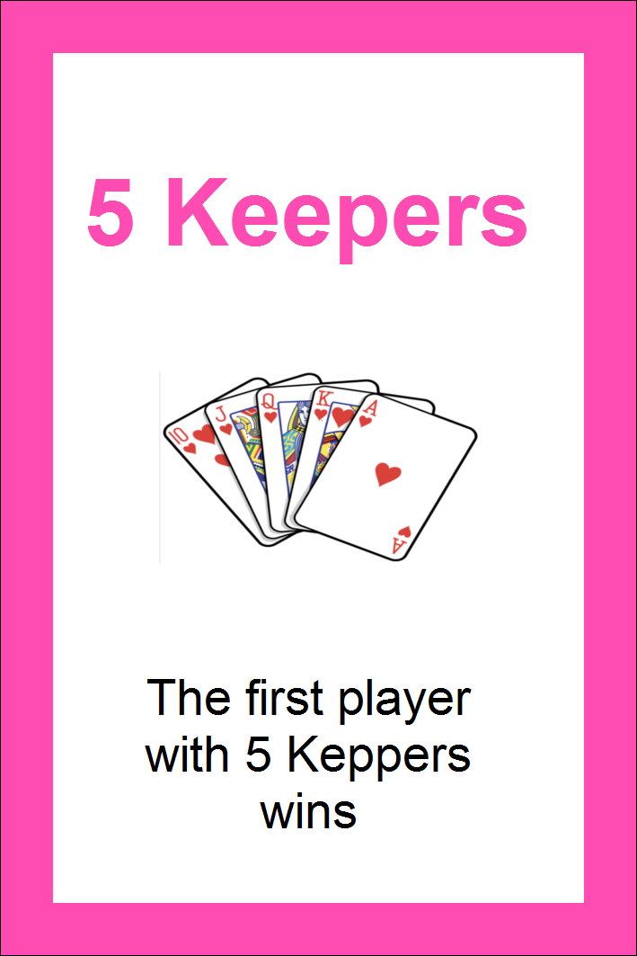
What we‘ve reached so far
Setup folder and sub-folders
Setup Github and branches
Created deck of cards
html and css of what the game will look like
Visual basic Demo (without js)
Game design decisions
Notes:
Game design decisions: defined what is server-side (computations:turns, draw, play, general game state) and what is client-side (rendering: discard pile)

Slide 4
What we‘ll do this week
Put all the cards in the database
Make a real time chat
Make first version of frontend scriptswith ReactJS
Reformat html for ReactJS
Create html and css for index and info
Basic routing
Notes:
Eventually, add log as well. Note that

Slide 5
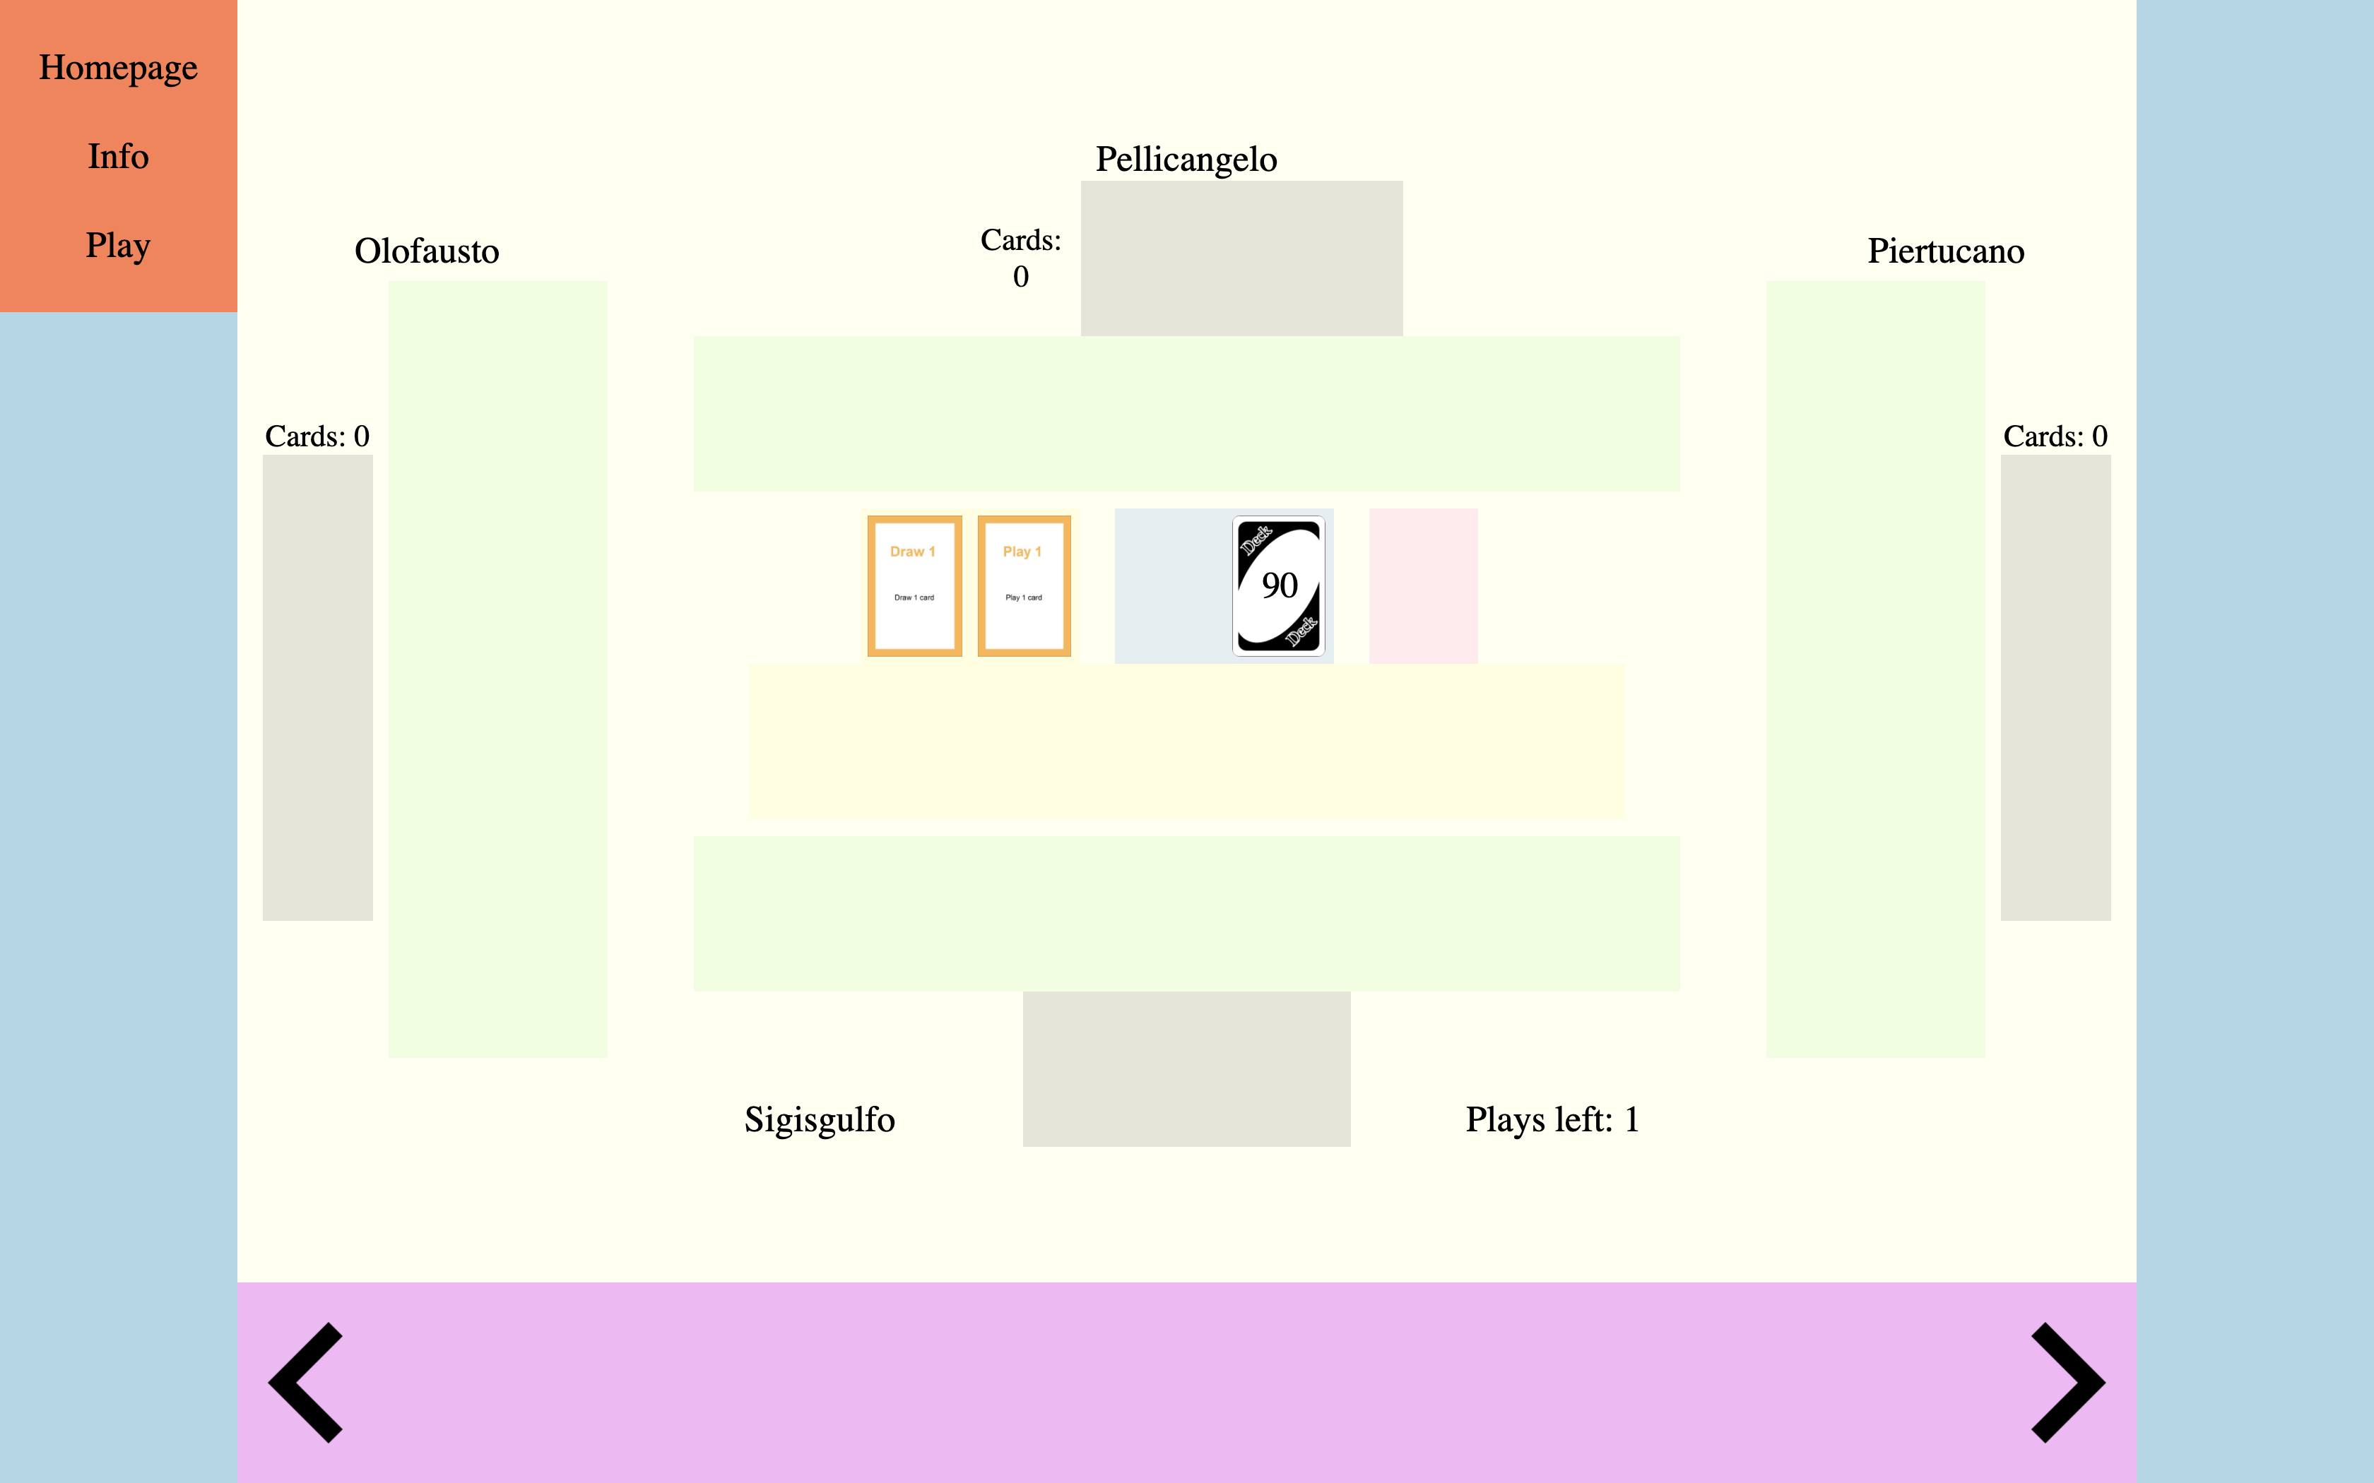

Slide 6
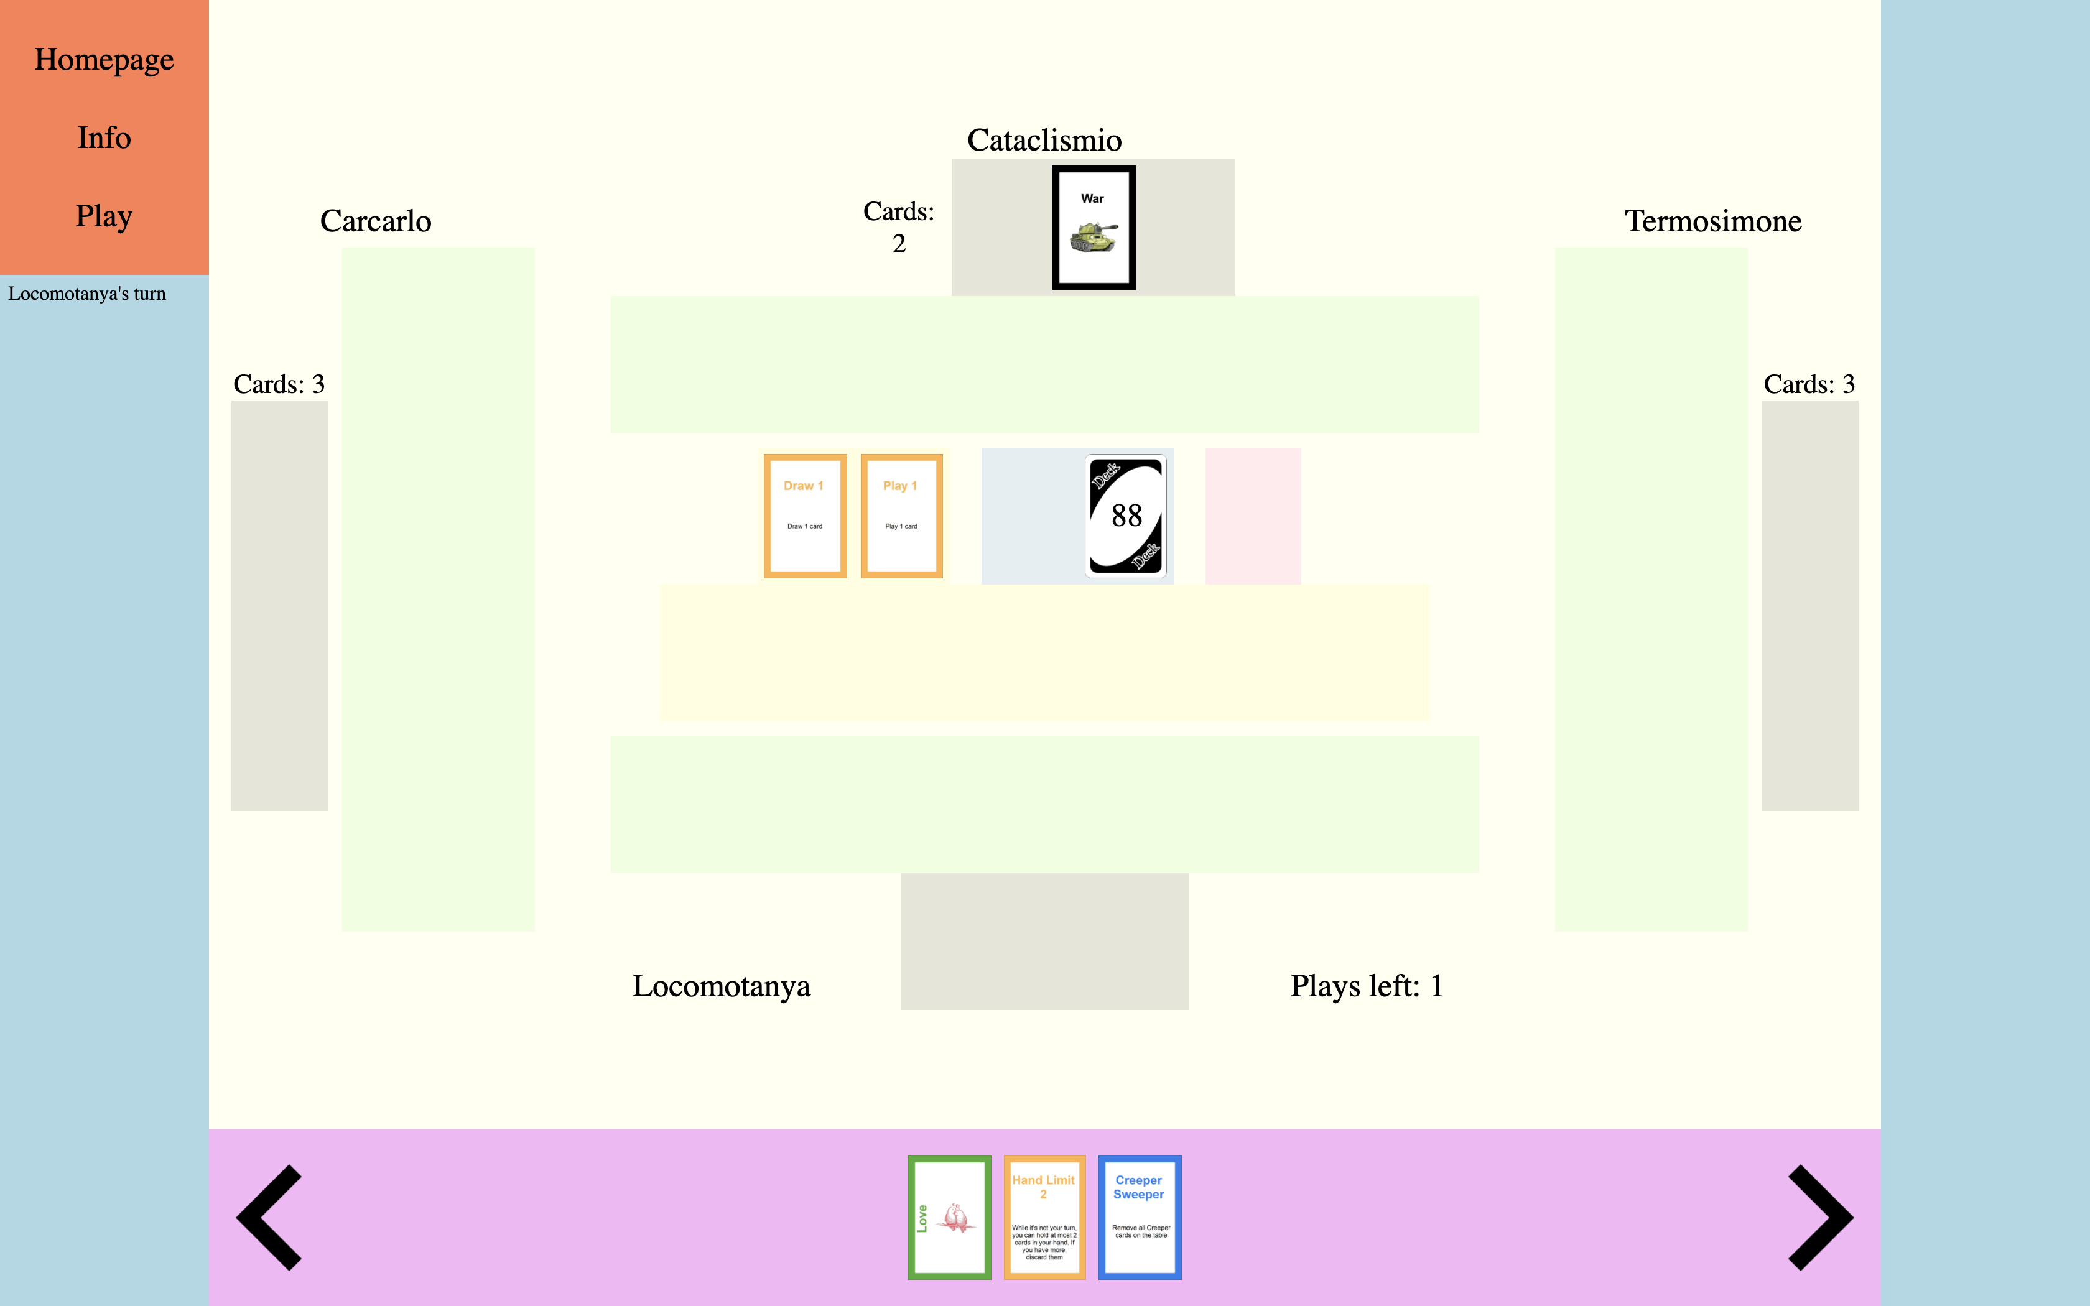
Deck cards left: 27

Slide 7
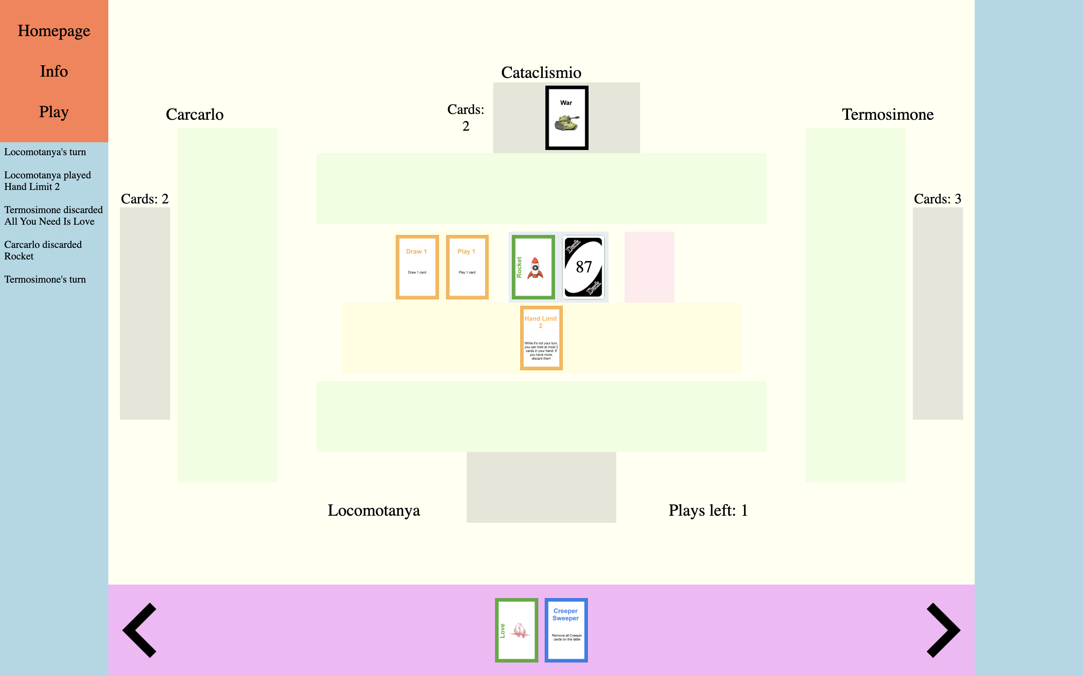
-Main Objectives-
Fluxx – Base rules and cards
Up to 4 players
In-game chat
Spectator view

Slide 8
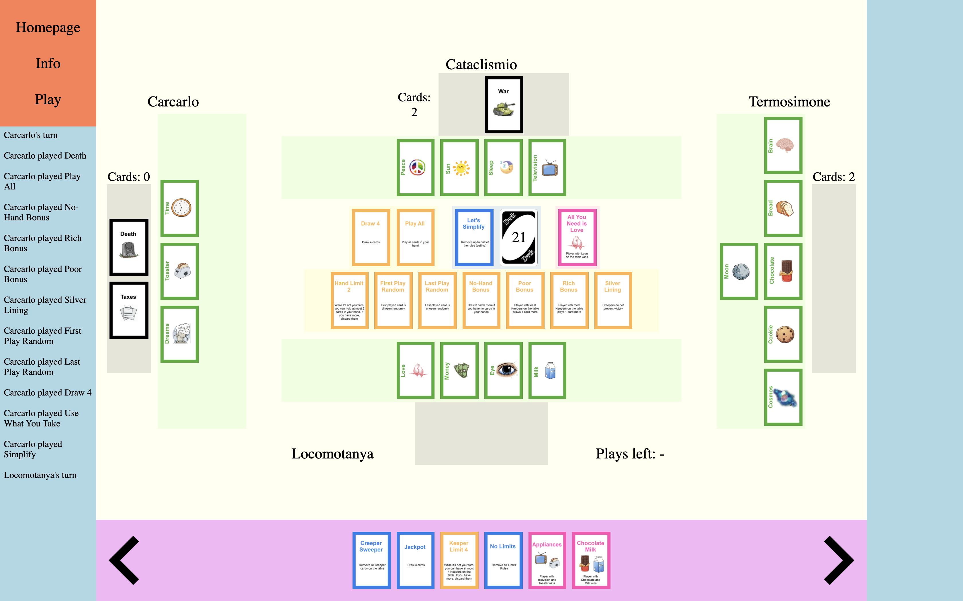
-Additional Features-
Themes
Multiple games
Accounts
Up to 6 players
Additional Fluxx rules and cards

