Slide 1


Faculty of Information engineering, Informatics and Statistics, Engineering in computer science, University of Rome Sapienza, Academic year 2022-2023 Andrea Panceri 1884749 Francesco Sudoso 1808353
Literature Review
Broadcast communication
Prof. Silvia Bonomi
Prof. Giovanni Farina
Notes:
‹#›

Slide 2
Dynamic Byzantine Reliable Broadcast
Literature review
Broadcast Communication

Slide 3
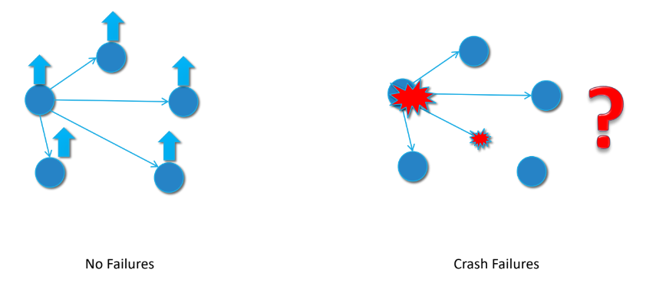
Broadcast Communication
Best Effort Broadcast
Regular Reliable Broadcast
Uniform Reliable Broadcast

Slide 4
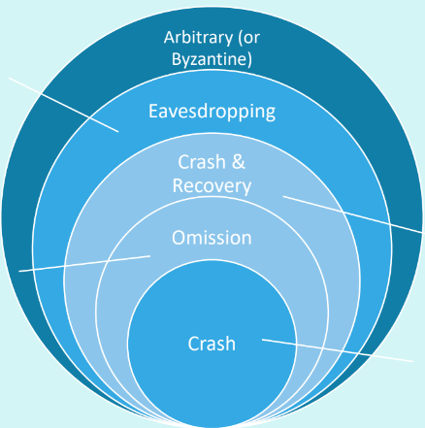

Byzantine Processes
Deviate arbitrarily from the instructions that an algorithm assigns to them
Act as if they were deliberately preventing the algorithm from reaching its goals

Slide 5
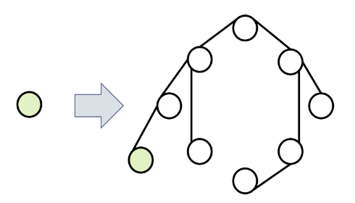
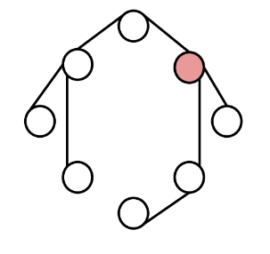
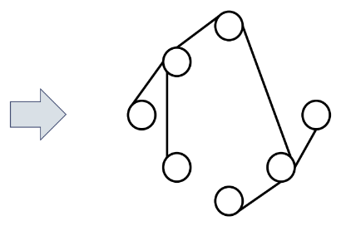
Reconfiguration in Dynamic Distributed Systems in byzantine environment
Nodes are changing over time
Flexibility and Scalability
Tolerance of malicious nodes

Slide 6
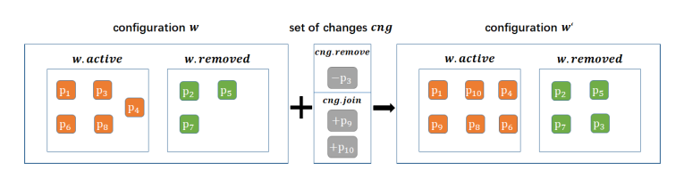
Dynamic Byzantine Broadcast in Asynchronous Message-Passing Systems by Jing Li , Tianming Yu , Ye Wang and Roger Wattenhofer
Goal of the paper
Distributed system model
Configuration
Liveness condition

Slide 7
The Dynamic Byzantine Broadcast
Two communication and one reconfiguration primitive:
broadcast_{p}(m), deliver_{p}(m), reconfig_{p}(cng)
Two events:
enable: allow the node p to execute operations such as broadcast_{p} and reconfig_{p};
halt_{p}: forbids the node p to execute operations such as broadcast_{p} and reconfig_{p}. After the event, p can still deliver messages that were broadcast before it left the system.
Four properties:
Validity: If a correct node (active node that follows the algorithm protocol) p broadcasts a message m, then every correct node q which joins the system before and does not leave until after the broadcast of m eventually delivers m.
No duplication: If a correct node p broadcasts a message m with label l, then every other correct node delivers at most one message with label l from p.
Integrity: If a correct node q delivers a message m from sender p and p is correct, then m was previously broadcast by p.
Consistency (Consistent broadcast): If a correct node q delivers a message m with label l from sender p, and another correct node s delivers a message m’ with label l from sender p, then m = m’ .
Agreement (Reliable broadcast): If a correct node q delivers a message m with label l from sender p in configuration w, then every other correct node in configuration w delivers a message m with label l from sender p eventually.

Slide 8
The weak snapshot abstraction
Five properties:
Integrity: Let o be a scan_{p}() operation that returns C. Then ∀ cng ∈ C, an update(cng) operation is invoked by some node q prior the completion of o;
Validity: Let o be a scan_{p}() operation that is invoked after the completion of an up-date(cng) operation and returns C. Then, C ̸= ∅ ;
Monotonicity of scans: Let o be a scan_{p}() operation that returns C and let o’ be a scan_{p}() operation that returns C’. If o’ is invoked after the completion of o ⇒ C ⊆ C’;
Non-empty intersection: There exists a change set cng such that ∀ scan() operation that return C ̸= ∅, it is stated that cng ∈ C;
Termination: If some majority M of nodes in P don’t crush, then every scan_{p}() operation and update(cng) invoked by any node p ∈ M eventually completes.
Three functions:
Collect_{p}(w): return a set of changes. In particular, for each active node in w.active, it executes a read on the register.
Update_{p}(w): returns True or False depending on whether the operation was successful. In particular, it first does a collectp(w) to read all updates written to the configuration register Mem[w].
Scan_{p}(w): returns a set of changes C. In particular, it first does a collect(w) to read all previous updates for w.
It uses an array of (1,N)-atomic registers as Mem[w] of size |w.active|

Slide 9
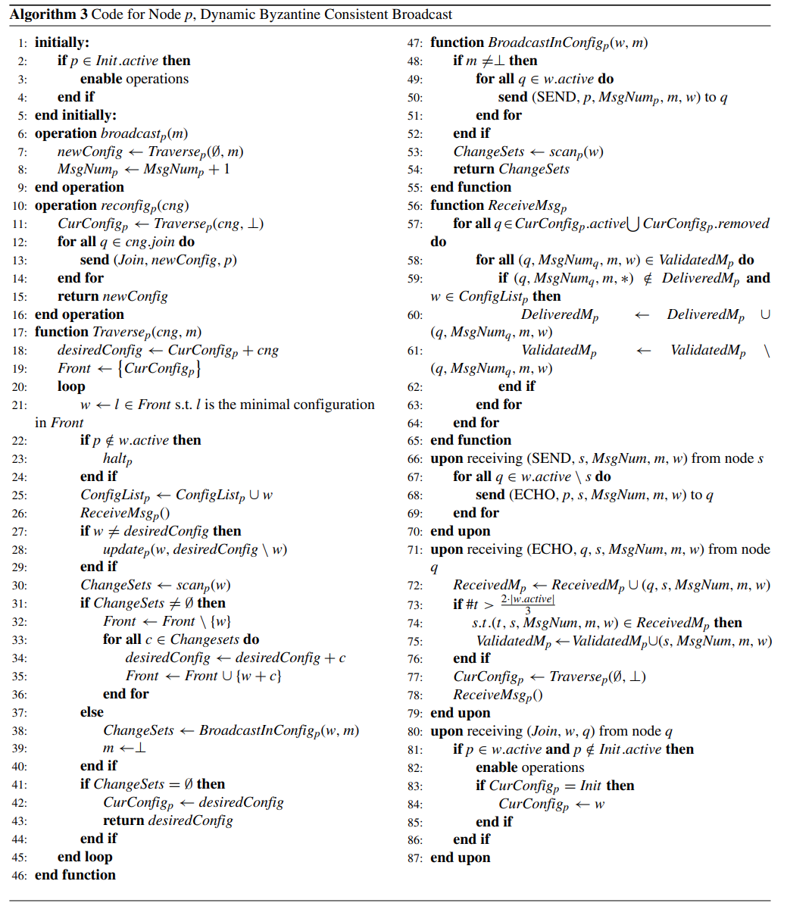
Dynamic Byzantine Consistent Broadcast
Local variables
MsgNum_{p}, initially 0,
ConfigList_{p}, initially ∅,
CurConfig_{p}, initially Init,
ReceivedM_{p}, initially ∅,
ValidatedM_{p}, initially ∅,
DeliveredM_{p}, initially ∅,
End local variables
Local variables description
The number of messages that p broadcasts to others.
The set of configurations that visited by node p.
Latest configuration found by p in the system.
The set of ECHO messages received by node p.
The set of messages validated by a quorum of a configuration, waiting for final delivery by node p
The set of messages delivered by node p
End local variables description

Slide 10
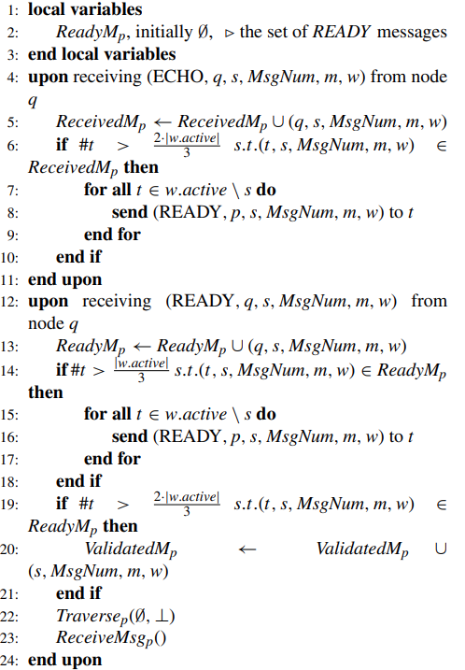
Dynamic Byzantine Reliable Broadcast

Slide 11
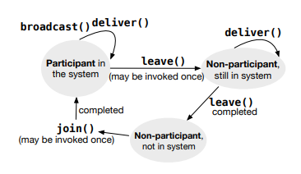
Dynamic Byzantine Reliable Broadcast by Rachid Guerraoui, Jo-van Komatovic, Petr Kuznetsov, Yvonne-Anne Pignolet,Dragos-Adrian Seredinschi and Andrei Tonkikh
Distributed System Model
Operation and properties of Dynamic Byzantine Reliable Broadcast
Building blocks
Algorithm of Dynamic Byzantine Reliable Broadcast

Slide 12
Operations and properties of DBRB
Three operations and one callback:
dbrb-join, dbrb-leave, dbrb-broadcast(m), dbrb-deliver(m)
Two assumptions:
In every execution, the number of processes that want to join or leave the system is finite. (Finite number of reconfiguration requests)
Initially, at time 0, the set of participants is nonempty and known to every process in U.
Six properties:
Validity: If a correct participant s broadcasts a message m at time t, then every correct process, if it is a participant at time t’ >= t and never leaves the system, eventually delivers m.
Totality: If a correct process p delivers a message m at time t, then every correct process, if it is a participant at time t′ >= t, eventually delivers m.
No duplication: A message is delivered by a correct process at most once.
Integrity: If some correct process delivers a message m with sender s and s is correct, then s previously broadcast m.
Consistency: If some correct process delivers a message < m>_{𝜎p} and another correct process delivers a message < m′ >_{𝜎p} then m = m’.
Liveness: Every operation invoked by a correct process eventually completes.

Slide 13
Building Blocks
Change: We define a set of system updates change = { +, - } × U, where the tuple < +, p > or < −, p > indicates that process p asked to join or leave the system. Due to the asynchrony, two processes may concurrently consider different sets of system participants to be valid. To avoid these conflicts, we will use the view abstraction, which defines the system membership through the point of view of the process at a specific point in time.
Views: A view v consists of two variables:
v.changes: which is a set of changes;
v.members: which is the set of the view membership. It is defined as v.members = {p ∈ U : < +, p > ∈ v.changes ∧ < −, p > ∉ v.changes}
Sequence of views: A sequence seq is a set of comparable views.
Reliable multicast: The algorithm is built and based on reliable Byzantine broadcast protocol. Indeed, the functions “R-multicast” and “R-delivery” make use of this protocol for broadcasting and delivering a message.

Slide 14
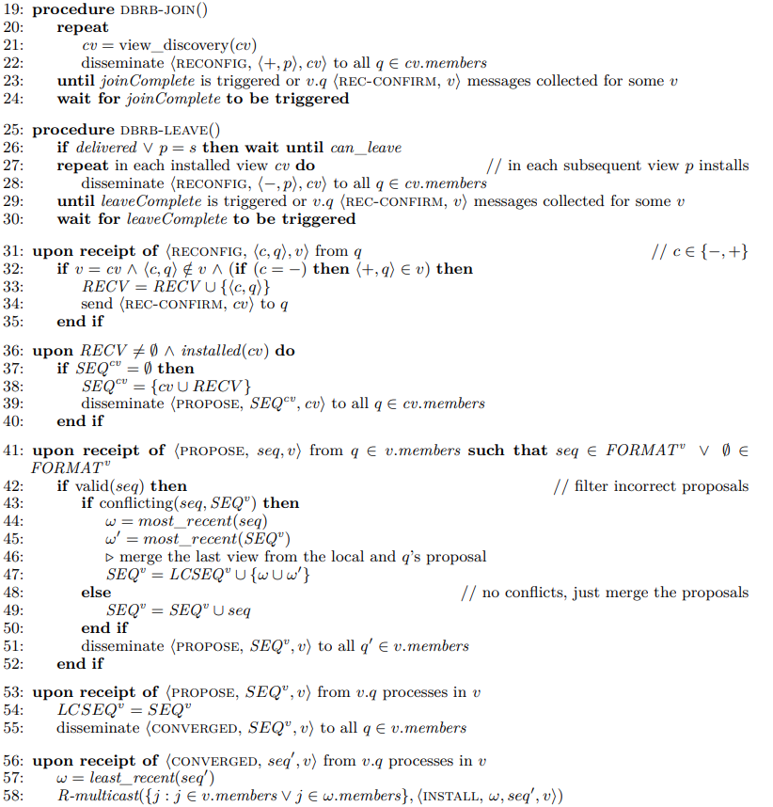
Dynamic Byzantine Reliable Broadcast
Local variables of process p:
cv = v₀, contains current view, v0 is the initial one.
REC^{v} = ∅, contains the set of pending updates, join or leave.
SEQ^{v} = ∅, contains the set of proposed set to update v.
LCSEQ^{v} = ∅, contains the last converged sequence for update v.
FORMAT^{v} = ∅, replacement sequence for view v.
cer = ⊥, contains the message certificate for m.
v_{cer} = ⊥, contains view in which the certificate is collected.
allowed ack = ⊥, indicate the set of messages allowed to be acknowledged.
stored = false
stored_value = ⊥
can_leave = false, indicate that a process is allowed to leave.
delivered = false, indicate if m is delivered or not.
Variable for every process q ∈ U and every valid view v:
acks[q, v] = ⊥.
Σ[q, v] = ⊥ .
deliver[q, v] = ⊥ .
State = ⊥, contain the state of the process.

Slide 15
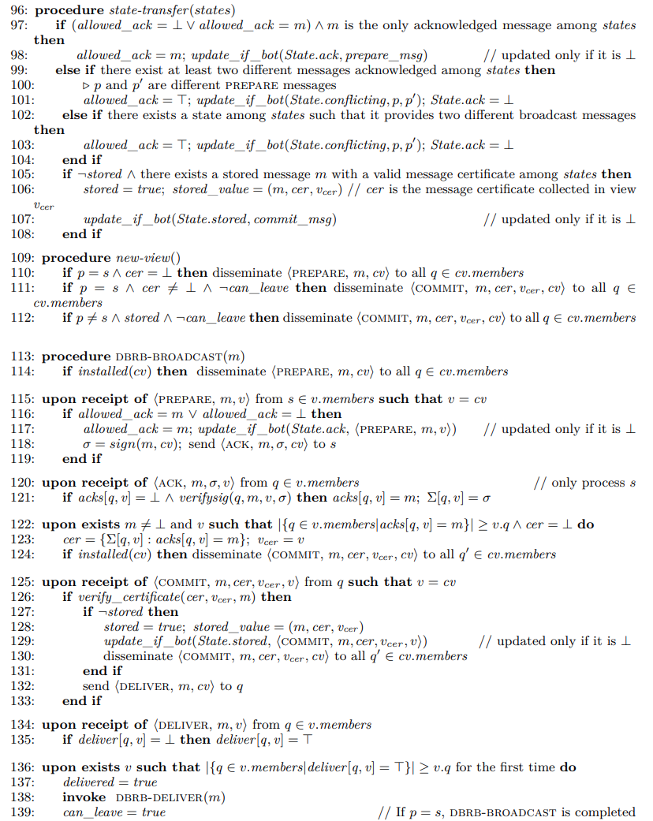
Dynamic Byzantine Reliable Broadcast

Slide 16
Comparison and comments
Introduction
Distributed System Model
Problem definition and assumption
Components used by the algorithms
Algorithms implementation
Addition
DynaStore
Previous solution of DBRB proposed by Guettaoui et al.
Applications
Open Issues
Centralized vs Distributed
Bulletin board

Slide 17
Faculty of Information engineering, Informatics and Statistics, Engineering in computer science, University of Rome Sapienza, Academic year 2022-2023 Andrea Panceri 1884749 Francesco Sudoso 1808353
Thanks for the attention!
Literature Review
Broadcast communication
Prof. Silvia Bonomi
Prof. Giovanni Farina
Notes:
‹#›

