Slide 1
Autonomous Gas Leak Detection In Distilleries Using A Mobile Robotic Sensor Platform
BSc Computer Science (Artificial Intelligence) - Aadham Ahmad
Supervised by Dr. Alistair McConnell

Slide 2
Problem & Motivation
Gas leaks in distilleries are dangerous
Ethanol => flammable
Methane => explosive
CO₂ => asphyxiation risk
Current monitoring is limited:
Fixed sensors => poor spatial coverage
Manual inspection => slow & unsafe
Problem: Monitoring is reactive, not proactive

Slide 3
Aim & Contributions
Develop an autonomous system to detect and localise gas leaks
Key Contributions for proposed mobile robotic platform including:
Sensor payload using low-cost sensors
Lightweight embedded firmware
Gas distribution mapping (GDM)
Gas source localisation (GSL)

Slide 4
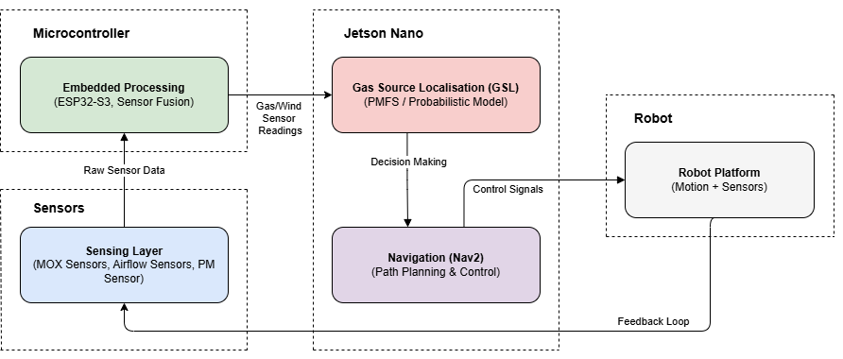
System Overview

Slide 5
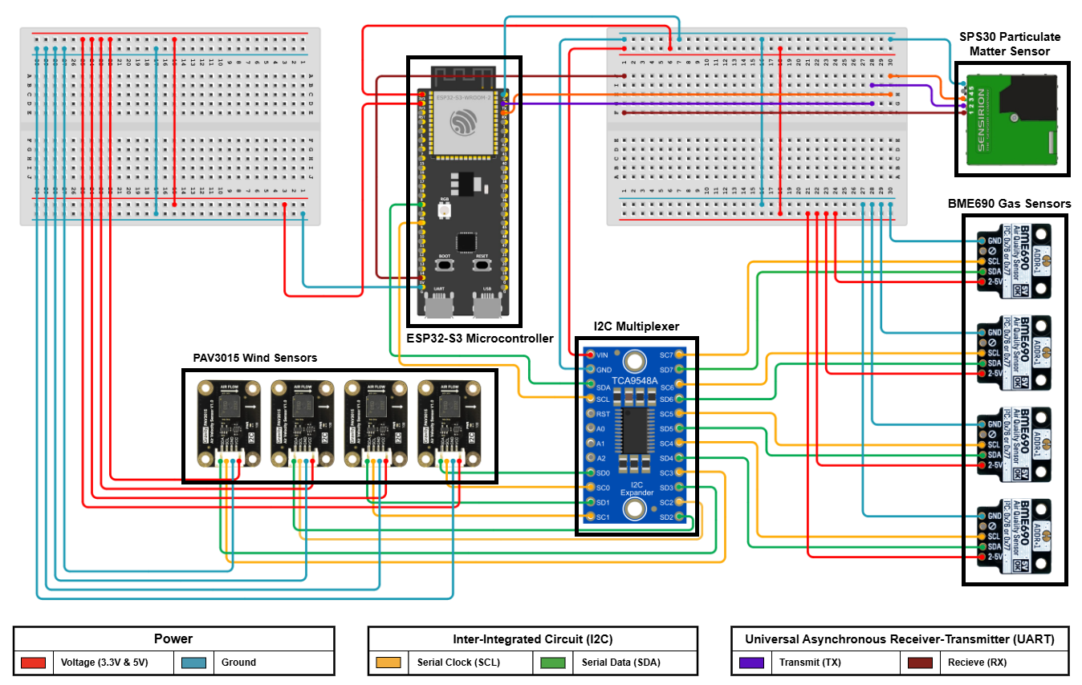
Hardware Setup
Robotic Platform
TurtleBot3 (LiDAR-based SLAM)
Sensor Payload
MOX gas sensors (BME690)
Wind sensors (air velocity)
Particulate sensor (SPS30)
Processing
ESP32 (sensor interface)
Jetson Nano (proposed onboard computation)

Slide 6
Gas Distribution Mapping (GDM)
Goal: Estimate gas concentration across space
Robot collects:
Gas readings
Position
Wind data
Builds a 2D gas map

Slide 7
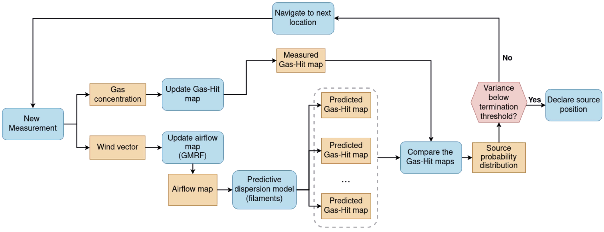
Gas Source Localisation (GSL)
GSL using PMFS strategy

Slide 8
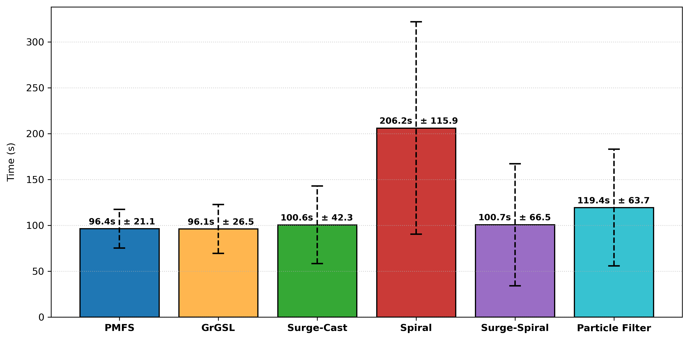
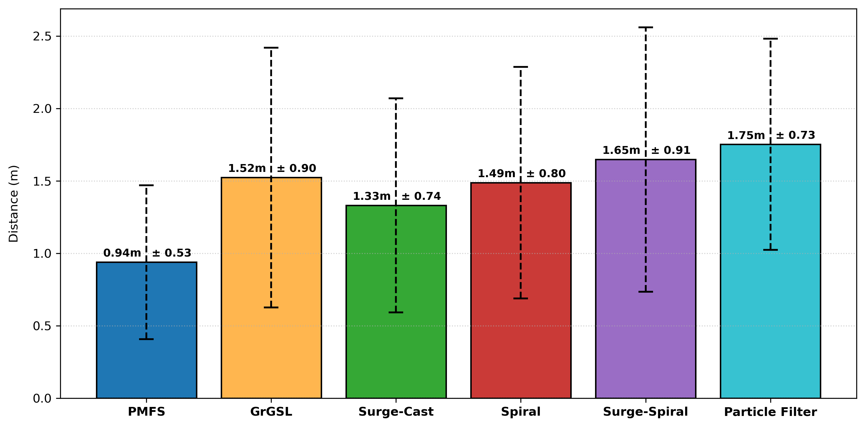
Comparative Evaluation of GSL Methods
Evaluated 6 GSL Methods:
Probabilistic Methods: PMFS, GrGSL
Reactive Methods: Spiral, Surge-Cast, Surge-Spiral, Particle Filter
Convergence Time for GSL Methods
Error Distance for GSL Methods

Slide 9
Limitations & Future Work
Limitations
Simulation-based evaluation
2D modelling of gas flow
Sensor noise & delay
Future Work
Real-world deployment
3D gas modelling
Improved sensor fusion

Slide 10
Conclusion
Developed an autonomous gas detection system
Demonstrated GDM + GSL
Shows potential for safer industrial monitoring

