Slide 1
Quickly
A messenger that gets students and instructors responding faster
Anik Joy
Tanzirul Islam
Delivery Lead · Frontend, UI/UX
Product and Quality Lead · Backend and Database
1 / 5
Notes:
Introduce yourselves. The product is Quickly, a messenger between university students and instructors. Anik Joy is the Delivery Lead and works on the frontend and the UI/UX: the repository, the Netlify deployment and CI, sign-in with a university ID, the availability toggle, ranked search, the accessibility checks and the messenger-style interface. Tanzirul Islam is the Product and Quality Lead and works on the backend and the database: the Supabase database and Row Level Security, live notifications, admin account creation, the teaching-assistant loop-in, assignment tags, the MCP search tool and the UX and test documentation. Say that you reviewed each other's pull requests and that you can each explain any file in the repository.

Slide 2
What we each built
Anik Joy
Tanzirul Islam
Delivery Lead · Frontend, UI/UX
Product and Quality Lead · Backend and Database
Messenger-style UI for desktop and phone
Sign-in page with university ID or email
Instructor availability toggle
Ranked search across conversations
Accessibility checks and contrast fixes
Netlify deployment and repository setup
Boundary test and pass-fail-pass exercise
Supabase database, Row Level Security
Live new-message and new-reply badges
Admin account creation (server function)
Institutions with two admins each
Teaching assistant loop-in per thread
Assignment tags, cross-user security test
Core messaging flows and MCP search tool
2 / 5
Notes:
Split by role. Anik, the Delivery Lead, took the frontend and UI/UX: the messenger-style interface for desktop and phone, the sign-in page with a university ID or email, the instructor availability toggle, ranked search, the accessibility checks and the contrast fixes they found, the Netlify deployment and repository setup, and the boundary test from the pass-fail-pass exercise. Tanzirul, the Product and Quality Lead, took the backend and database: the Supabase database with Row Level Security, the live new-message and new-reply badges, admin account creation through a server function, institutions with two admins each, the teaching-assistant loop-in per conversation, assignment tags with a documented cross-user security test, and the core messaging flows plus the MCP search tool. Both of you reviewed each other's pull requests and can explain any file.

Slide 3

The problem: a reply takes too long
TODAY
OUR GOAL
≈ 12 h
2 h
average wait for an instructor’s reply on Moodle or email
average reply time with Quickly
Instructors don’t keep Moodle or email open all day.
Students need answers before assignments and exams.
Nobody can tell whether a message was even read.
Quickly: one course-tagged channel with Sent, Seen and Replied status.
≈ 12 h is our team’s estimate from our own experience as students
3 / 5
Notes:
The client is university students and university instructors. Today a student with a course question posts on Moodle or sends an email. The instructor does not have either open all day, so the message sits unread. We estimate about 12 hours for a reply. That number is our own estimate from experience as students at this university, so say that if asked. We have not measured it with a survey. Our goal is two hours. Quickly is one place for course questions: every message is tagged to a course, shows Sent, Seen or Replied, notifies the instructor, and lets the student flag a message as urgent after two hours without a reply. Out of scope: voice or video calls (students and instructors keep using other platforms), grading, and hosting course files.

Slide 4

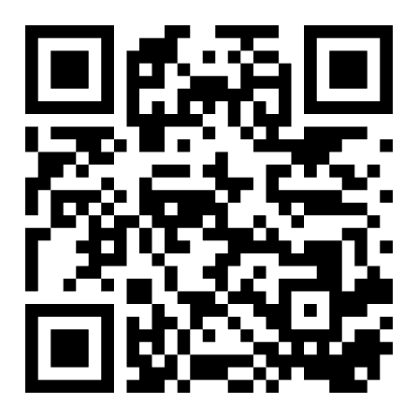
Where we are now
Sign in with a university ID or email
Course-tagged messages with an optional assignment tag
LIVE NOW
Sent, Seen and Replied with live new-message badges
Resolve threads, ranked search, 2-hour urgent flag
Instructor availability: Available or Away
Teaching assistant looped into a conversation
quickly-mainor.netlify.app
Admins create logins, profiles and course groups
English and Estonian, desktop and phone layouts
Scan to try it on your phone
35 unit, 15 end-to-end and 11 accessibility tests. Row Level Security on every table.
The AI summary and “Explain simply” are labeled demos. Real AI is next.
4 / 5
Notes:
This is the current stage. The product is deployed and live. Walk through the list: a student or instructor signs in with a university ID or an email, sends a message tagged to a course (optionally to an assignment), and the instructor sees a new-message badge. Status goes Sent, Seen, Replied. Threads can be resolved, searched with ranking, and flagged urgent after two hours. Instructors set Available or Away, a teaching assistant can be looped into a conversation, and admins create logins, profiles and course groups, with two admins per institution. The interface works in English and Estonian on desktop and phone. Be honest about AI: the summary and the Explain simply button are rule-based demos, clearly labeled Demo in the interface. The rule that AI never writes or sends a reply is enforced. Real AI behind a server function is the next step. Quality: 35 unit tests, 15 end-to-end tests and 11 accessibility tests run on every pull request. Axe found a real colour-contrast problem and we fixed it. Row Level Security is on every table and we documented a cross-user test. Invite the audience to scan the QR code to open the live app.

Slide 5
Milestones: done and next
Done
Done
Done
In progress
Next
Requirements closed
Core messaging live
Tests and accessibility
AI layer
AI integrated voice memos
Summary and reply explanation are labeled demos. Real AI comes next
Requirements, user stories and events written and handed in
Tagged messages, sign-in and admin accounts on Netlify with security rules
35 unit, 15 end-to-end and 11 accessibility tests on every pull request
Speak a message and get text, or turn text into a voice message
5 / 5
Notes:
These are our own milestones from the requirements document. Three are done: the requirements were written and handed in, core messaging is live on Netlify with sign-in, admin accounts and Row Level Security, and the automated tests and accessibility checks run on every pull request. The AI layer is in progress. Today the summary and the reply explanation are demos with clear labels. The next step is a real open-source model behind a server function, so no API key ever reaches the browser, with the same labels and the same rule that AI never writes or sends a reply. The last milestone is AI integrated voice memos: speak a message and the other person gets text, or write a message and the other person hears it as a voice message. Today the voice feature is only a demo with a fixed sample transcript. Still to do, in plain words: make the AI real, check how fast the app opens on a phone, fix security warnings in the libraries we use, and protect the main branch so every change is reviewed. Finish by inviting questions.

Slide 6
Questions?
THANK YOU
Quickly: getting students and instructors responding faster
quickly-mainor.netlify.app
Notes:
Thank the audience and invite questions. Anik covers the frontend, UI/UX and delivery questions: the interface, sign-in, search, accessibility, deployment and tests. Tanzirul covers the backend and database questions: Supabase, Row Level Security, notifications, the admin server function and the teaching-assistant loop-in. If a question is about something we have not built yet, such as real AI or voice memos, say so openly and describe the next step. The live app address is shown at the bottom of the slide.

