Slide 1
The Growing Counterfeit Crisis
Counterfeit goods are flooding markets worldwide, threatening consumer safety and brand integrity across critical sectors. From fashion and cosmetics to food and pharmaceuticals, fake products are becoming increasingly difficult to detect.
4
Major sectors affected
Countries like Bangladesh face particularly severe challenges, where counterfeit medicines and consumer goods put lives at risk. Traditional authentication methods are failing, and consumers deserve better protection.
Clothing, cosmetics, food, medicine
100%
The solution? Blockchain technology offers an immutable, transparent way to verify authenticity and track products throughout the supply chain.
Verification confidence
With blockchain authentication

Slide 2


How Blockchain Transforms Authentication
01
Secure QR Code Generation
Each product receives a unique blockchain-based QR code that cannot be duplicated or tampered with
02
Immutable Record Creation
Product information is permanently recorded on the blockchain, creating an unchangeable authenticity trail
03
Instant Verification
Consumers scan the QR code to instantly verify authenticity and view complete ownership history
04
Supply Chain Transparency
Every transaction and transfer is tracked, providing end-to-end visibility from manufacturer to consumer

Slide 3
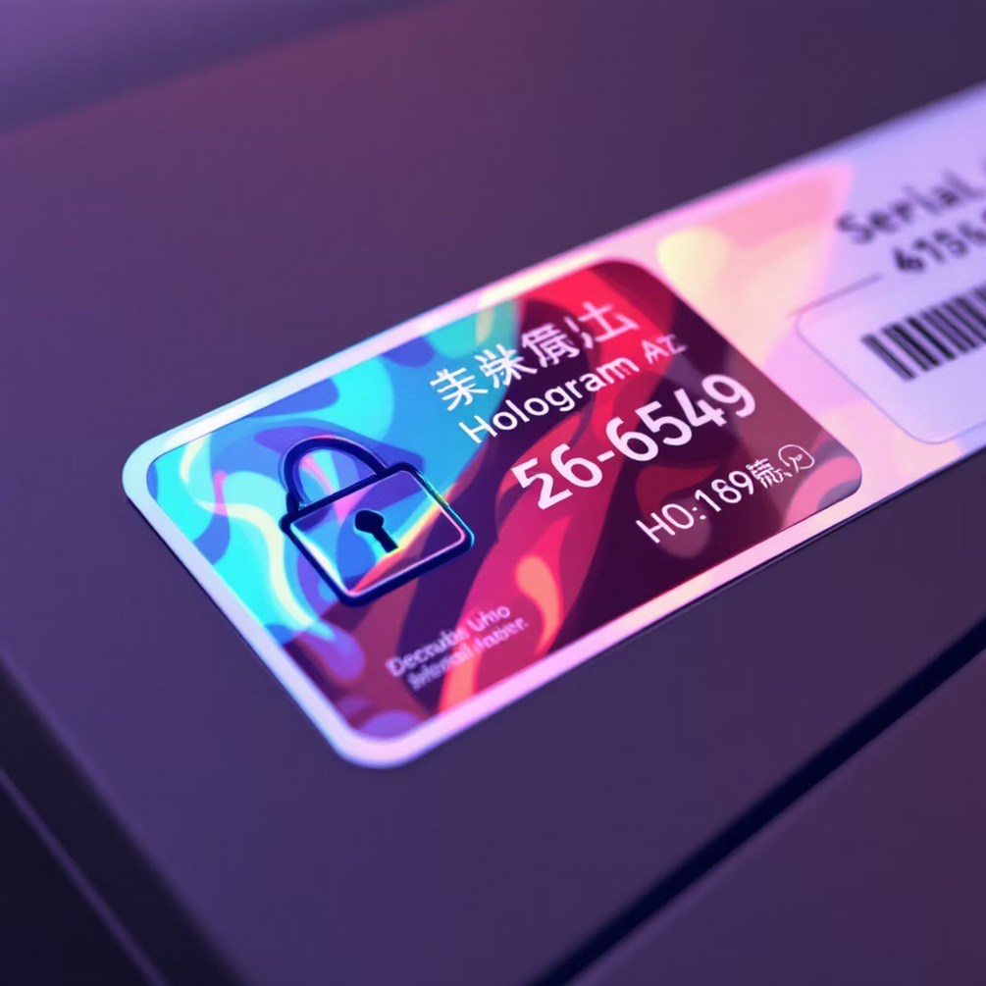
Existing System
Conventional Methods Are Failing
Traditional anti-counterfeit measures rely on physical features like holograms, serial numbers, and security labels. These methods seemed promising decades ago, but counterfeiters have evolved.
Today's sophisticated criminals can replicate nearly any physical security feature. Consumers are left manually checking features they don't fully understand, leading to uncertainty and mistakes.
The fundamental problem: physical authentication can always be physically copied.

Slide 4




Disadvantage of Existing Systems
Lack of Transparency
Data Tampering
Supply chains operate as black boxes, enabling counterfeits.
Centralized data is vulnerable to hacking and manipulation.
Inefficient Tracking
Limited Visibility
Manual tracking leads to delays, errors, and lost traceability.
Incomplete information makes tracing counterfeit origins impossible.

Slide 5
Literature Survey: Key Research
“A comparative study: Blockchain technology utilization benefits, challenges, and functionalities”
“Identifying Fake Product Through a QR Code Based Blockchain System”
“QR based Fake Product Detection using Blockchain”
Author: Rivaa Vadher, Rishith Vadher
Author: P.LokeshReddy, A.MuniKarthik, M.Pavitra, Mrs.M.S.Soundarya,M.E.,
Year: 2024
Author: Ali, Omar, et al
Year: 2022
Publisher: IJIRT
Year: 2021
Publisher: IEEE Access 9
Publisher: IRJET

Slide 6
Proposed System: Blockchain & QR Code Authentication
Our proposed system leverages blockchain and QR code technology to create a robust and transparent authentication solution, directly addressing the vulnerabilities of existing methods.
01
02
03
Unique QR Code Assignment
Secure Data Immersion
Instant Buyer Verification
Each product is assigned a unique, blockchain-generated QR code, serving as its digital identity.
Critical product information, including source and ownership history, is immutably recorded on the blockchain via the QR code.
Consumers can scan the QR code to instantly access comprehensive product details and verify authenticity, empowering informed decisions.
04
05
Tamper-Proof Integrity
Counterfeit Identification
Blockchain technology guarantees the integrity of all stored data, preventing unauthorized alterations and ensuring trust.
The system effectively identifies counterfeit products, enhancing market transparency and building consumer confidence.

Slide 7




Advantages
Immutable Product History
Real-time Tracking
Data cannot be altered or deleted, creating a permanent and trustworthy record.
Monitor product movement and status instantly across the entire supply chain.
Tamper-Proof Integrity
Increased Transparency
Decentralized and cryptographic nature prevents unauthorized alteration or forgery.
All participants can access verified product information, fostering trust.

Slide 8

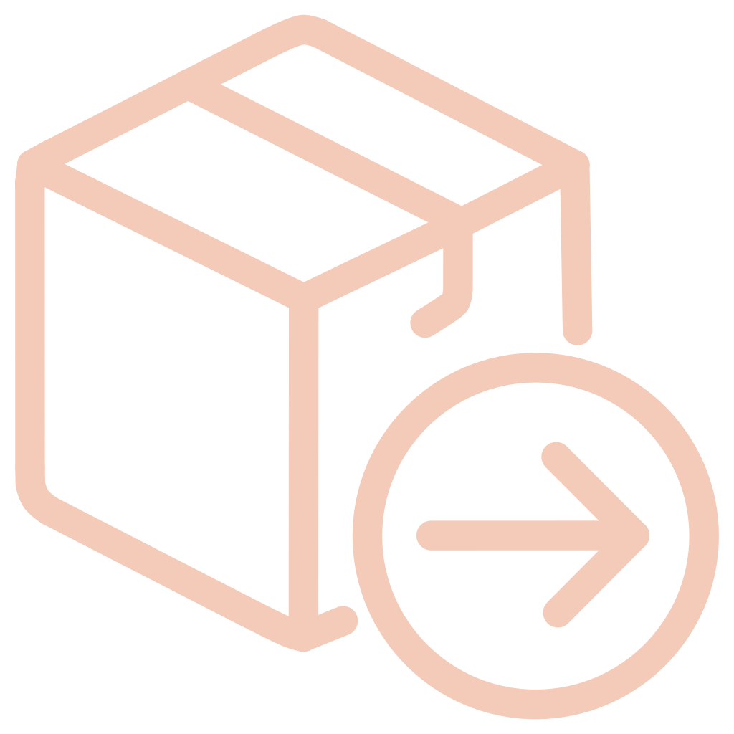



Objectives of the Project
Ensure Product Authenticity
Verify product originality and protect consumers from counterfeits.
Establish a Transparent Supply Chain
Record every product lifecycle stage on blockchain for stakeholder transparency.
Provide Tamper-Proof Data Storage
Store critical product data on blockchain, ensuring integrity and preventing modification.
Enable Real-Time Verification
Instantly verify product authenticity and history via mobile QR scanner.
Improve Trust Between Manufacturer & Consumers
Build consumer confidence through reliable product genuineness and origin checks.

Slide 9
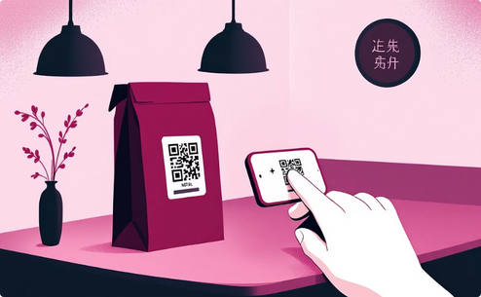






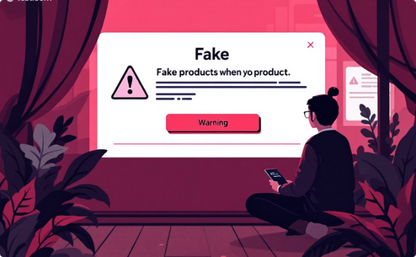
System Requirement Specifications
Functional Requirements
Product Registration
Blockchain Entry Creation
Authenticity Verification
Immutable Ledger
User Roles and Access Control
Transaction Logging
Ownership Transfer
Counterfeit Reporting

Slide 10

Non-Functional Requirements
Beyond core functionalities, specific technical components are vital for the system's performance, security, and scalability. These requirements ensure a robust and reliable platform.
Hardware Specifications
Software Stack
Processor: Intel Core i5 or equivalent
RAM: 4GB minimum
Operating System: Windows 11
Blockchain Development: Ganache (personal blockchain), Solidity (smart contracts), MetaMask (browser extension)
IDE: Visual Studio Code (VS Code)
Backend: Flask (Python web framework)
Frontend: HTML, CSS, JavaScript, ReactJS
Databases: SQLite, MySQL
Additional: Anaconda (Python/R distribution)

Slide 11
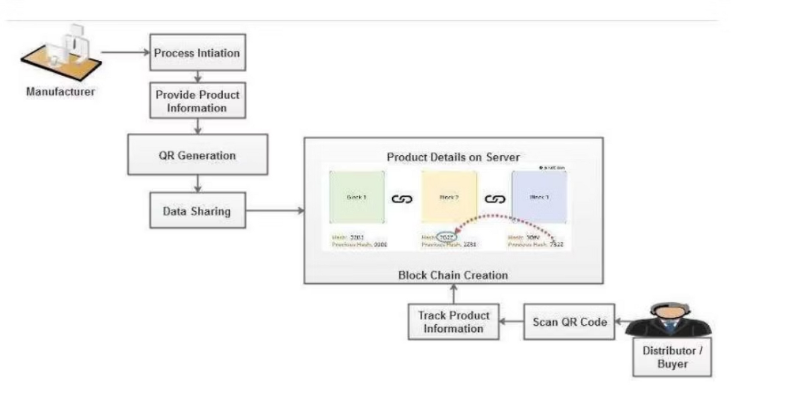
SYSTEM DESIGN
System Architecture

Slide 12
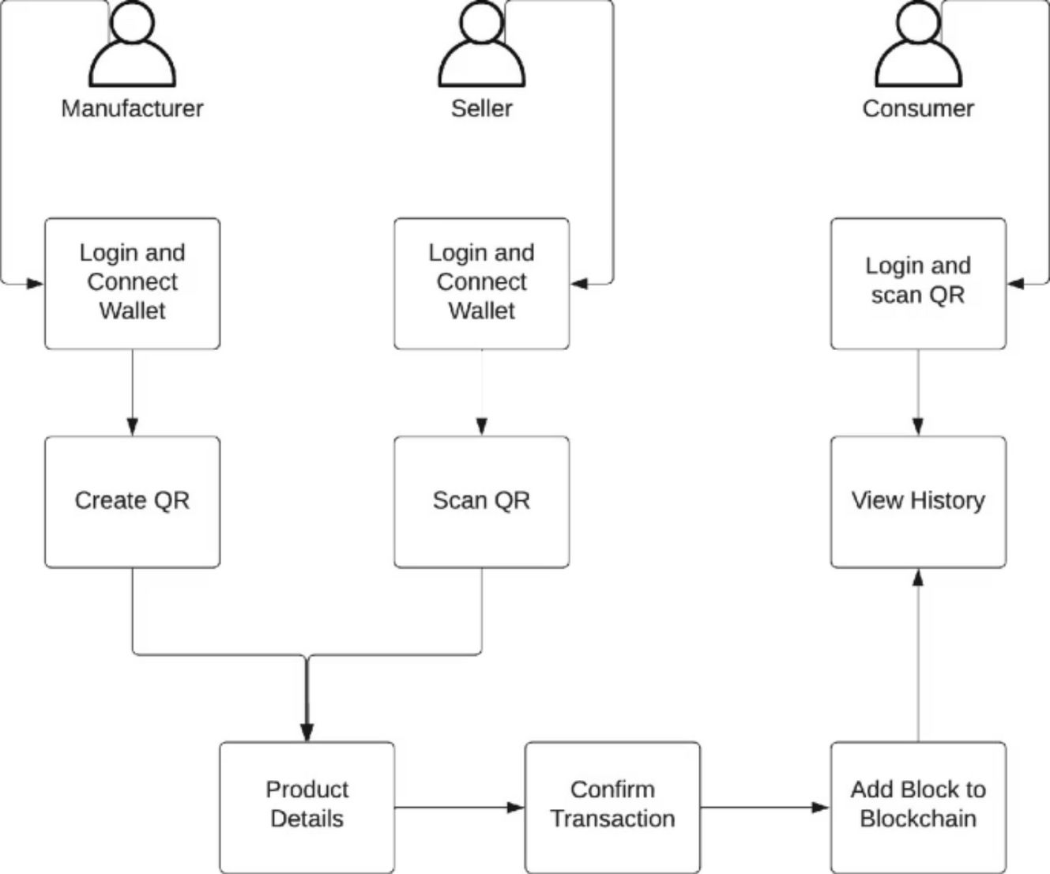
Block Diagram

Slide 13




Implementation
Our system is designed with a modular approach, ensuring robust, maintainable, and scalable operations. Each component performs specific functions, contributing to overall system integrity and efficiency.
Manufacturer Module
Seller Module
Consumer Module
Blockchain Verification Module
Manages product origin, manufacturing details, and initial registration onto the blockchain.
Handles product listing, sales transactions, and updates product status on the blockchain.
Allows users to verify product authenticity, track its journey, and provide feedback.
Ensures data integrity, immutability, and transparency across all transactions within the system.

Slide 14
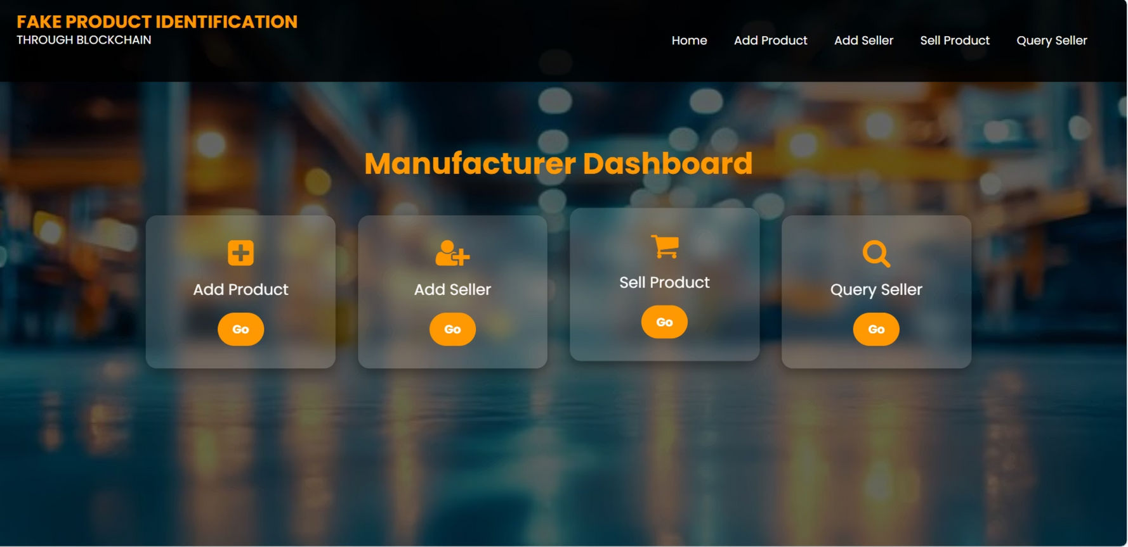

Slide 15

System Testing & Quality Assurance
Testing is the systematic evaluation of a system, application, or component to identify discrepancies between expected and actual behavior. It ensures the software meets specified requirements, functions correctly, and delivers desired outcomes, guaranteeing robustness and reliability.

Slide 16
System Test Cases
To ensure the robustness and reliability of our system, we conducted a series of focused test cases for each core module. These tests confirm that each component performs as expected, validating the system's overall integrity and functionality.
1
Manufacturer Module
Takes data from the manufacturer
Generates code for initial product registration
Information is successfully passed to the distributor
2
Seller Module
Receives data from the manufacturer
Accesses and provides product information
Input is processed, and information is passed to the next module
3
Consumer Module
Receives output from the retailer and family
QR code generation and full information display
QR code is generated, and consumer receives product history
All test cases were successful, confirming the seamless integration and proper functioning of the Manufacturer, Seller, and Consumer modules. This rigorous testing ensures data accuracy and user confidence across the platform.

Slide 17

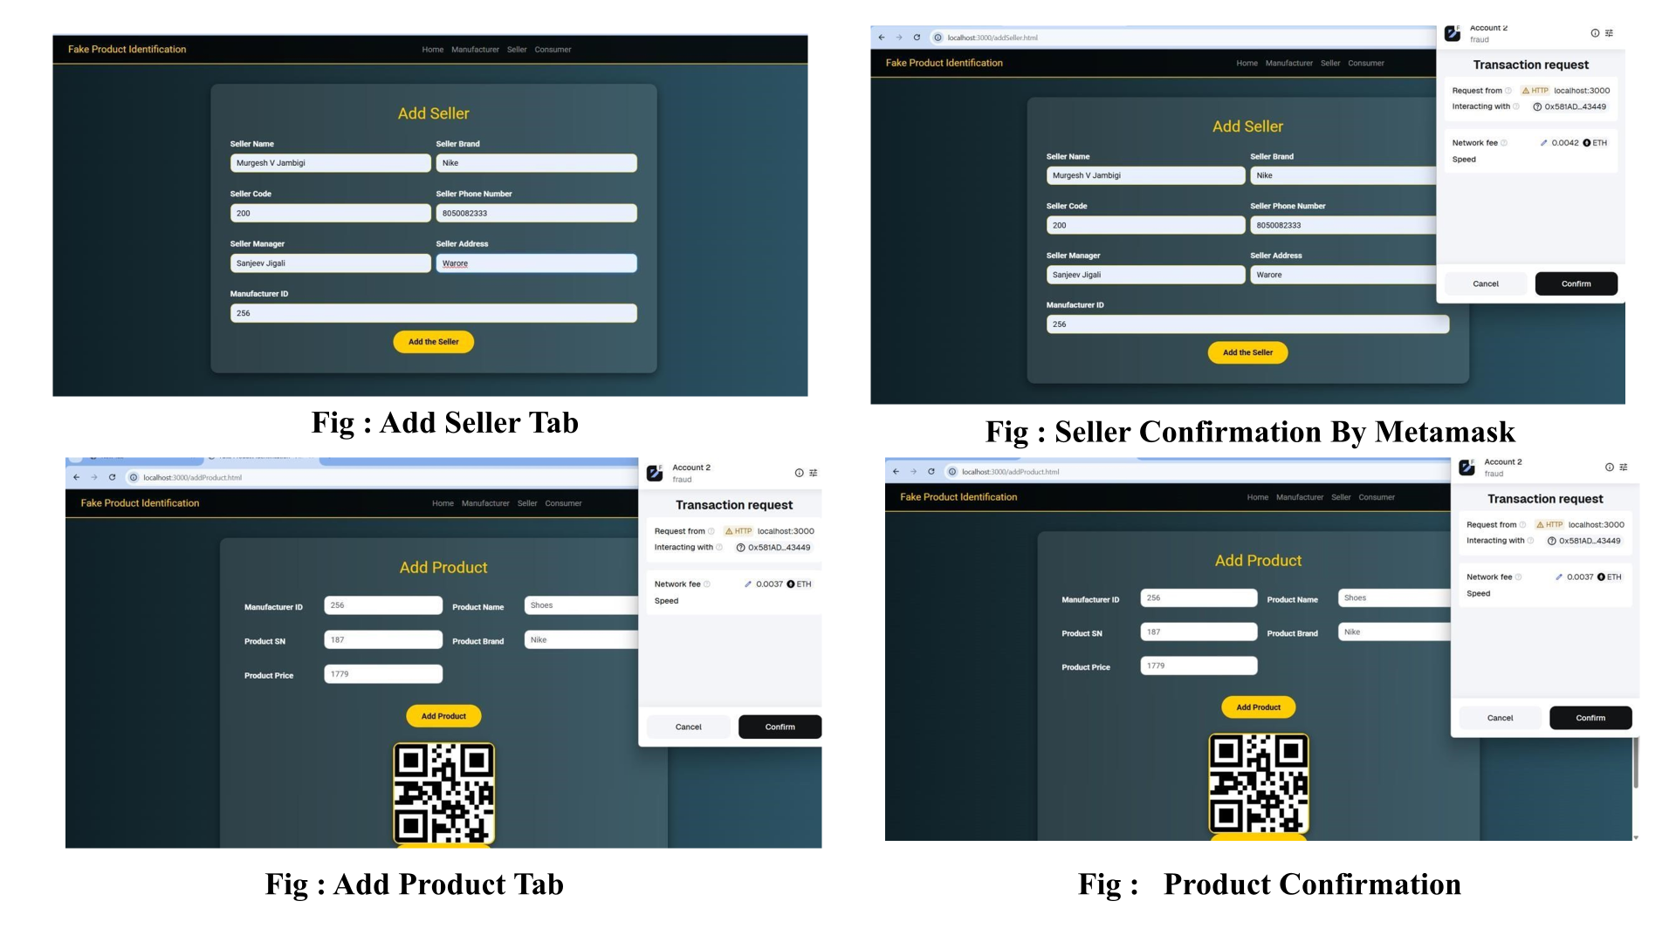

Slide 18
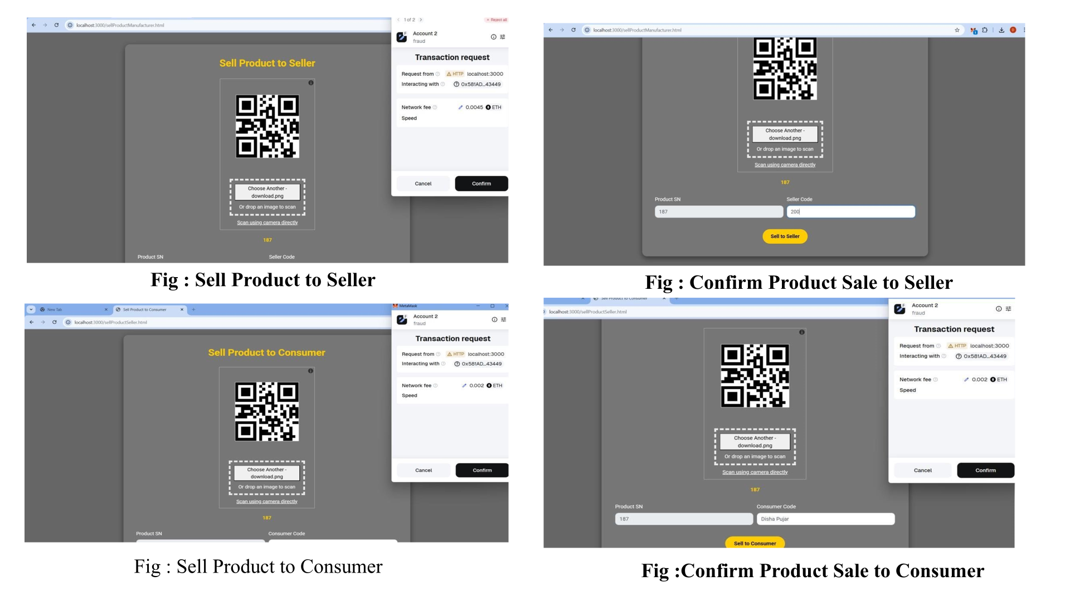

Slide 19
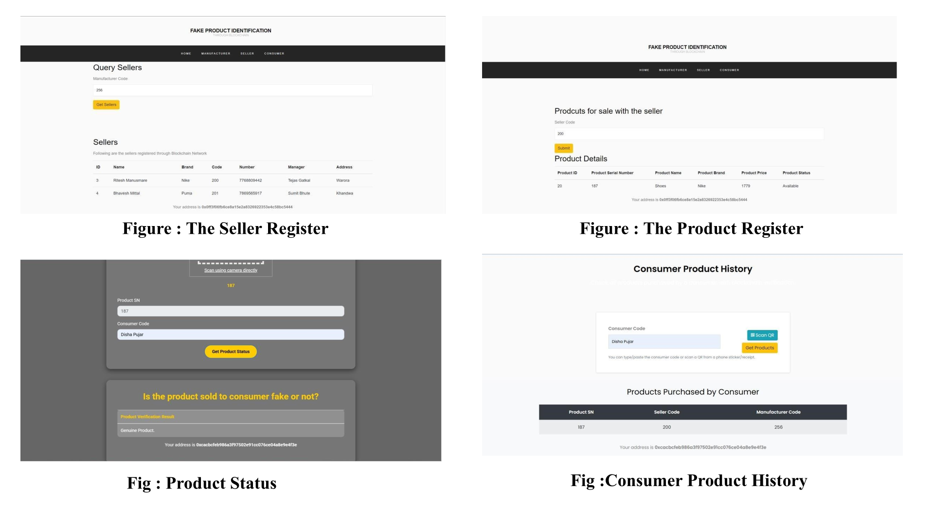

Slide 20
CONCLUSION
Our blockchain-based system revolutionizes product traceability and authenticity, offering significant benefits to both businesses and consumers.
Unrivaled Product Traceability
Empowering Consumer Verification
Blockchain assigns immutable digital identities to products, ensuring complete transparency from origin to consumer.
Consumers can easily verify product authenticity, drastically reducing the threat of counterfeit goods and boosting confidence.
Secure & Private Data Management
Broadened Fraud Prevention
Manufacturers and suppliers benefit from secure and private storage of product details, enhancing data integrity.
This technology holds immense potential for expansion into healthcare, voting, banking, and online commerce to prevent fraud.

