Slide 1
CV RAMAN HALL BOOKING SYSTEM
Computer Project On Hall Booking System

Slide 2
What is C?
C is general purpose language which is very closely associated with UNIX for which it was developed in Bell Laboratories
C is developed by Dennis Ritchie
C supports functions that enables easy maintainability of code, by breaking large file into smaller modules
C consists of various pre-defined header files that consists of functions that helps in easier development of the program
C's primary use is for system programming, including implementing operating systems and embedded system applications

Slide 3
Hall Booking System
The main objective of hall booking system is to manage the details of booking dates, booking, payment, customers, hall etc.
It is totally built at administrative end and thus only the administrator is guaranteed the access
It increases the efficiency of managing the details related to the bookings and customers
It helps prevent booking errors that normally show up when recording those details in file by hand

Slide 4
Outline Of Project
Our project is based on the hall booking system for Kathmandu University CV Raman Auditorium to organize events for different departments. We did case study on different real life applications relevant to our project such as Trivago’s hotel booking system, Bus Sewa Nepal, and Pathao.

Slide 5
Program Features
Use of C programming language
Book CV Raman Auditorium to organize events for different departments
Stores booking time, name of event, and corresponding departments through the use of file handling in C
Edits, updates, and deletes previously stored data
Provides an excel sheet of all the reservations

Slide 6
Program Description
The program takes multiple inputs required to book the hall. The inputs are: Date, Booking time, Event, and Name of department.
The program checks whether the given booking time is available or not
If the booking time is available, the program takes all the information and saves it in a file for further use
The previously stored bookings can be viewed and deleted if necessary
The program generates a CSV file which can be viewed in excel for easier representation and tracking of the stored data

Slide 7
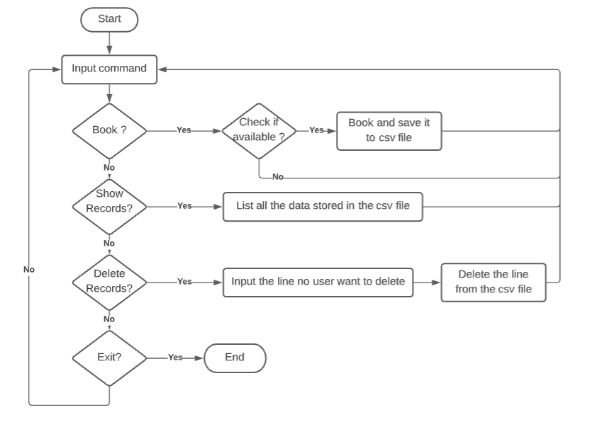
Working of program
Below is a simple flowchart to describe the working nature of a program

Slide 8
Limitations and Future Enhancements
Limitations:
Our program does not have search function
We cannot edit specific field value from the data using the program
Since it is a console application, the input, process and output is done sequentially
Future Enhancement:
Graphics could be added to make the program more user friendly
Log in system can be introduced
The booked time can be connected with goggle calendar or if a calendar is provided to user in the application, the user would be able to see the dates available for booking and make his decision on the available information.
The option to edit a specific booking time can be added

