Slide 1








AWS Lambda
PyPI
Discover from PyPI
Amazon Simple Notification Service
RubyGems
Discover from RubyGems
toCrawl topic
NPM CouchDB
CouchDB follower container
AWS Fargate

Slide 2
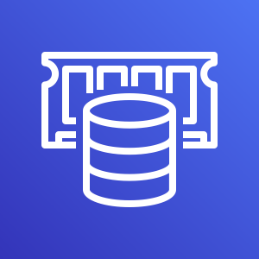





Amazon ElastiCache
Amazon Simple Notification Service
AWS Lambda
Redis Publish
toCrawl topic
Crawl Repo
Amazon DynamoDB
Static HTML and JSON content
changelogs
search index
Amazon Simple Storage Service (S3)

Slide 3

AWS Fargate
Amazon ElastiCache
Application Load Balancer
Socket.io edge server
Redis Pub/Sub

Slide 4

Amazon DynamoDB
AWS Lambda
changelogs
Amazon API Gateway
Autocomplete Search
search index

Slide 5


AWS Fargate
Amazon ElastiCache
Application Load
Balancer
Socket.io edge server
Redis Pub/Sub
AWS Lambda
SNS
Discover from PyPI
Static HTML and JSON content
toCrawl
Discover from RubyGems
Users
Amazon CloudFront
Crawler
CouchDB follower container
Autocomplete
Search
Amazon DynamoDB
AWS Fargate
changelogs
Amazon API Gateway
AWS Lambda
search index

