Slide 1
Static analysis
Why, where, when & how !

Slide 2
Static analysis
Static program analysis is the analysis of computer software that is performed without actually executing programs.
Wikipedia

Slide 3
Static analysis
Static analysis is a technique for analyzing code that doesn’t execute the program, and is used to detect quality and security issues before the software is released.
Looking at code line by line, static analysis tools search for weaknesses or bugs that could lead to vulnerabilities, when discussing static analysis from an application security perspective. When it’s used for finding security vulnerabilities only, static code analysis is also referred to as Static Application Security Testing, or SAST.
The fact that static analysis in testing, sometimes referred to as “linting,” doesn’t actually execute the code is what differentiates it from dynamic methods, where the code needs to be executed to be analyzed. Because they’re not actually executing the program, static analysis tools can be used early on in the SDLC, as opposed to dynamic tools, which can only be used in a runtime environment. With that level of flexibility, static analysis tools can be used at any point while code is being developed and again before an application is released.
Static Analysis Tools: All You Need to Know
By Sarah Vonnegut

Slide 4

Output sample (clang)
warning: Result of 'malloc' is converted to a pointer of type 'char', which is incompatible with sizeof operand type 'int'
warning: statement should be inside braces
warning: both side of operator are equivalent
warning: Value stored to 'x' is never read
note: Value stored to 'sj' during its initialization is never read
warning: potentially unintended semicolon
warning: The left operand of '!=' is a garbage value
note: Loop condition is true. Entering loop body
note: 'c' declared without an initial value
note:do not use 'else' after 'break'

Slide 5


Why ?
You may find bugs
You may find future bugs
It may help your code style
You need to tweak it to avoid too much false positives
It’s hard to start using it on big projects
It takes time

Slide 6

When ?
Once in while
Before a release
Always (automated)
Just keep in mind, if you fix minor issues as soon as they appear you won’t have to filter through them to find major ones.

Slide 7

When ?

Slide 8
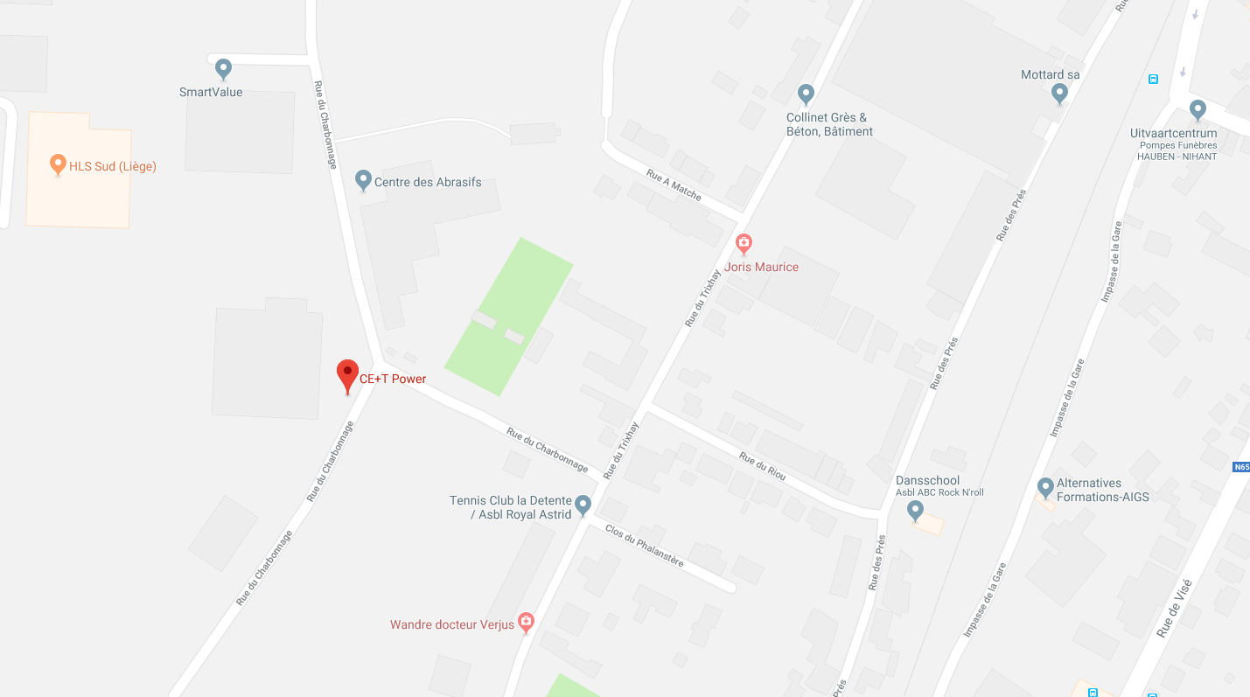
Where ?

Slide 9
Tools
We will try some free tools on some very bad code
https://github.com/PandaChauve/StaticAnalysisTests/blob/master/main.c

Slide 10
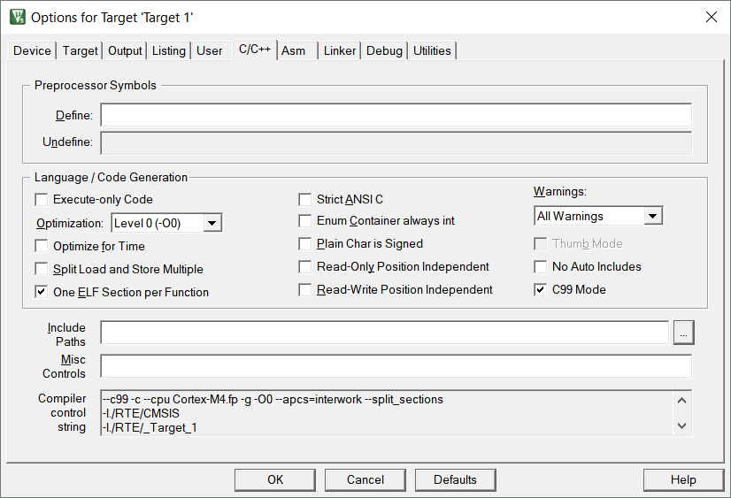
Tools : Keil (compiler V5)

Slide 11
Tools : Keil (compiler V5)
Better than nothing
Few false positives
Without warnings this compiler is dangerous
Keil required
http://www.keil.com/

Slide 12
Tools : Keil (compiler V5)
main.c(109): warning: #940-D: missing return statement at end of non-void function "findWinningPlay"
}
main.c(186): warning: #181-D: argument is incompatible with corresponding format string conversion
printf("'%s' has won ! \n", currentPlayer ? 'X' : 'O');
main.c(216): warning: #223-D: function "strcmp" declared implicitly
if (strcmp(buff, "no") == 0)
main.c: 3 warnings, 0 errors

Slide 13
Tools : Keil (compiler V5)
Ln13 : memory leak
Ln27 : invalid malloc size
Ln45 : high overflow risk
Ln73 : ...[i] == [i]
Ln140 : NULL check after usage
Ln106/107 : pointer used as int | Compiler error
Ln113 : missing return | Warning
Ln125 : use int as char
Ln151 : use of si instead of sj
Ln170 : infinite loop
Ln172 : trailing ;
Ln191 : %s for char | Warning
Ln212 : char c redefined
Ln230 : string not NULL terminated

Slide 14
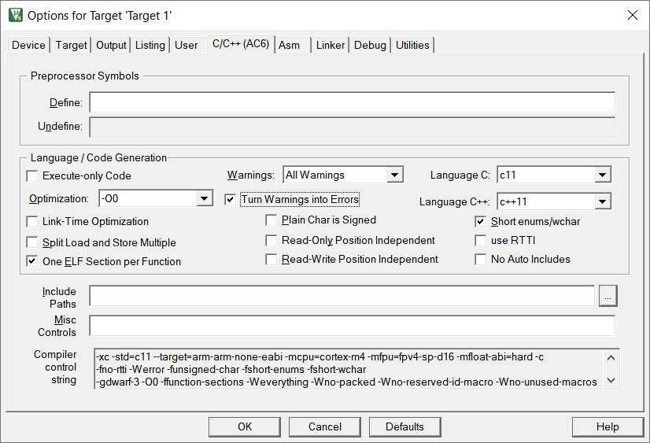
Tools : Keil (compiler V6)

Slide 15
Tools : Keil (compiler V6)
Better than V5
Few false positives
Clang based
Verbose
You’ll need to configure it or adopt its code style
Keil ClangV6 required
http://www.keil.com/

Slide 16
Tools : Keil (compiler V6)
main.c(5): warning: no previous extern declaration for non-static variable 'gameBoard' [-Wmissing-variable-declarations]
main.c(7): warning: no previous extern declaration for non-static variable 'currentPlayer' [-Wmissing-variable-declarations]
main.c(9): warning: no previous prototype for function 'freeGameBoard' [-Wmissing-prototypes]
main.c(15): warning: no previous prototype for function 'initGame' [-Wmissing-prototypes]void initGame()
main.c(39): warning: no previous prototype for function 'seededPosition' [-Wmissing-prototypes]
main.c(46): warning: no previous prototype for function 'printBoard' [-Wmissing-prototypes]
main.c(61): warning: no previous prototype for function 'isWon' [-Wmissing-prototypes]
main.c(87): warning: no previous prototype for function 'findWinningPlay' [-Wmissing-prototypes]
main.c(104): warning: incompatible integer to pointer conversion assigning to 'int *' from 'int'; take the address with & [-Wint-conversion]
main.c(111): warning: control may reach end of non-void function [-Wreturn-type]
main.c(122): warning: implicit conversion loses integer precision: 'int' to 'char' [-Wconversion]
main.c(113): warning: no previous prototype for function 'play' [-Wmissing-prototypes]
main.c(169): warning: if statement has empty body [-Wempty-body]
main.c(160): warning: no previous prototype for function 'canPlay' [-Wmissing-prototypes]
main.c(167): warning: loop will run at most once (loop increment never executed) [-Wunreachable-code-loop-increment]
main.c(188): warning: format specifies type 'char *' but the argument has type 'int' [-Wformat]
main.c(178): warning: no previous prototype for function 'playGame' [-Wmissing-prototypes]
main.c(209): warning: declaration shadows a local variable [-Wshadow]
main.c(210): warning: variable 'c' is used uninitialized whenever 'if' condition is true [-Wsometimes-uninitialized]
main.c(207): warning: variable 'c' is used uninitialized whenever 'for' loop exits because its condition is false [-Wsometimes-uninitialized]

Slide 17
Tools : Keil (compiler V6)
Ln13 : memory leak
Ln27 : invalid malloc size
Ln45 : overflow risk
Ln73 : ...[i] == [i]
Ln140 : NULL check after usage
Ln106/107 : pointer used as int | Warning
Ln113 : missing return | Warning
Ln125 : use int as char | Warning
Ln151 : use of si instead of sj
Ln170 : infinite loop
Ln172 : trailing ; | Warning
Ln191 : %s for char | Warning
Ln212 : char c redefined | Warning
Ln230 : string not NULL terminated

Slide 18
Tools : GCC 6.4 (InviewS)
set(CET_C_WARNINGS -pedantic -Wall -Wextra -Wcast-align -Wcast-qual -Wdisabled-optimization -Wformat=2 -Winit-self -Wlogical-op -Wredundant-decls -Wshadow -Wundef -Werror -Wpointer-arith -Wunreachable-code -Wunused)

Slide 19
Tools : GCC 6.4 (InviewS)
Few false positives
Free
GCC based (…)
Configurable
Not strict enough
No easy preset
GCC required
https://gcc.gnu.org/

Slide 20
Tools : GCC 6.4 (InviewS)
main.c:72:25: error: self-comparison always evaluates to true [-Werror=tautological-compare]
main.c:106:13: error: assignment makes pointer from integer without a cast [-Werror=int-conversion]
main.c:107:13: error: assignment makes pointer from integer without a cast [-Werror=int-conversion]
main.c:171:33: error: suggest braces around empty body in an ‘if’ statement [-Werror=empty-body]
main.c:171:7: error: this ‘if’ clause does not guard... [-Werror=misleading-indentation]
main.c:190:15: error: format ‘%s’ expects argument of type ‘char *’, but argument 2 has type ‘int’ [-Werror=format=]
main.c:211:14: error: declaration of ‘c’ shadows a previous local [-Werror=shadow]
main.c:208:12: note: shadowed declaration is here
main.c:113:1: error: control reaches end of non-void function [-Werror=return-type]
cc1: all warnings being treated as errors

Slide 21
Tools : GCC 6.4 (InviewS)
Ln13 : memory leak
Ln27 : invalid malloc size
Ln45 : overflow risk
Ln73 : ...[i] == [i] | Warning
Ln140 : NULL check after usage
Ln106/107 : pointer used as int | Warning
Ln113 : missing return | Warning
Ln125 : use int as char
Ln151 : use of si instead of sj
Ln170 : infinite loop
Ln172 : trailing ; | Warning
Ln191 : %s for char | Warning
Ln212 : char c redefined | Warning
Ln230 : string not NULL terminated

Slide 22
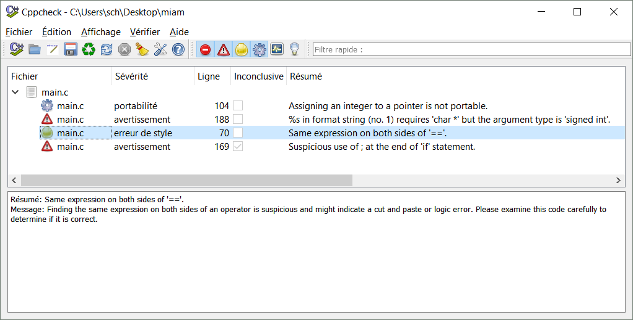
Tools : CppCheck

Slide 23
Tools : Cppcheck
Free
Super easy to use
Easy to configure for basic usage
Gui or command line
No compiler required
You must try it !
Not very good
Lots of false positives in some categories
Hard to configure for advanced usage
http://cppcheck.sourceforge.net/

Slide 24
Tools : GCC 6.4
Ln13 : memory leak
Ln27 : invalid malloc size
Ln45 : overflow risk
Ln73 : ...[i] == [i] | Warning
Ln140 : NULL check after usage
Ln106/107 : pointer used as int | Warning
Ln113 : missing return
Ln125 : use int as char
Ln151 : use of si instead of sj
Ln170 : infinite loop
Ln172 : trailing ; | Warning
Ln191 : %s for char | Warning
Ln212 : char c redefined | Warning
Ln230 : string not NULL terminated

Slide 25
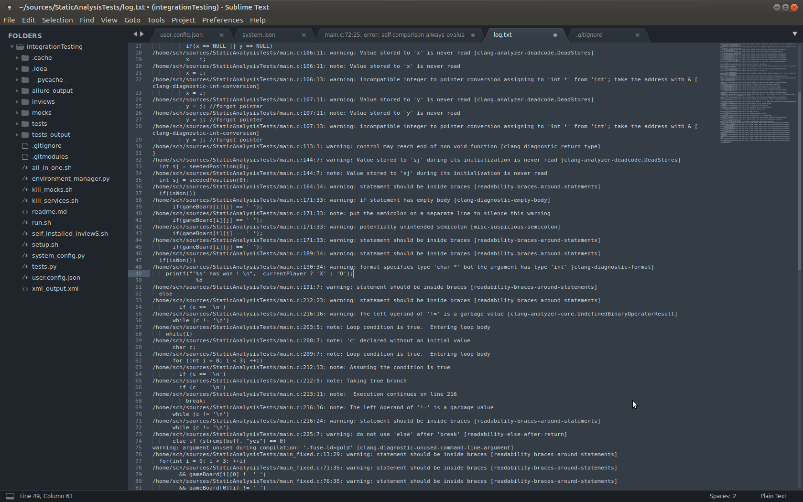
Tools : Clang Tidy

Slide 26
Tools : Clang Tidy
Will find tons of stuff
Can be used with GCC
Clang based
Verbose
Soooo verbose
No good preset (?)
Need Clang or GCC
http://clang.llvm.org/extra/clang-tidy/

Slide 27
Tools : Clang tidy
Ln13 : memory leak
Ln27 : invalid malloc size | Warning
Ln45 : overflow risk
Ln73 : ...[i] == [i] | Warning
Ln104 : NULL check after usage
Ln106/107 : pointer used as int | Warning
Ln113 : missing return | Warning
Ln125 : use int as char | Warning
Ln151 : use of si instead of sj | Warning
Ln170 : infinite loop
Ln172 : trailing ; | Warning
Ln191 : %s for char | Warning
Ln212 : char c redefined | Warning
Ln230 : string not NULL terminated

Slide 28
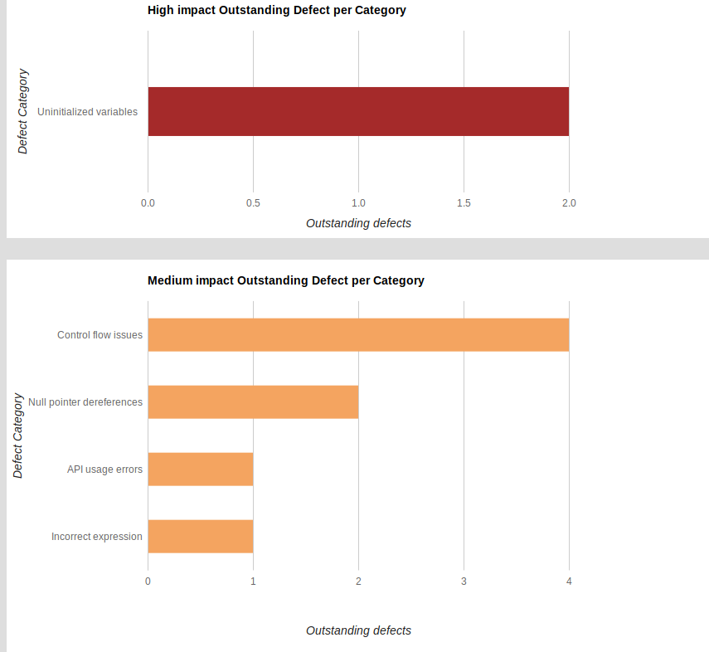
Tools : Coverity scan

Slide 29
Tools : Coverity scan
Detailed results
Free for open source projects on github/travis
Tons of restrictions on the free version
Online only
https://scan.coverity.com/

Slide 30
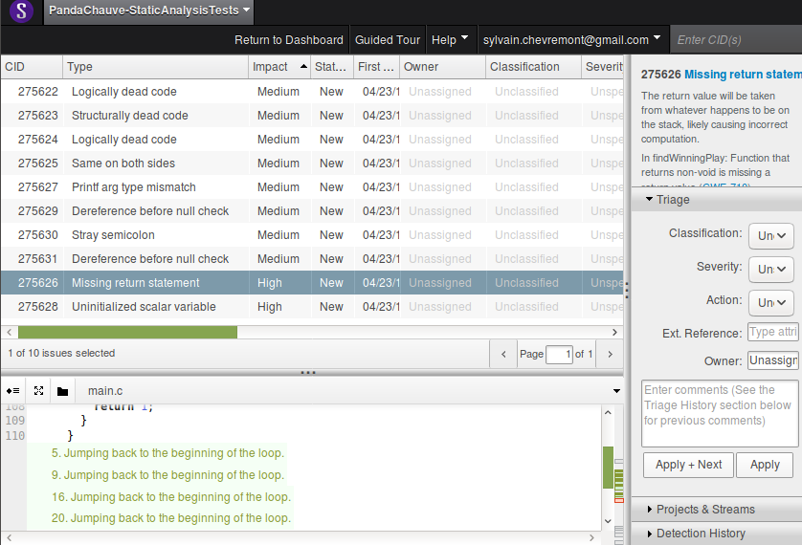
Tools : Coverity scan

Slide 31
Tools : Coverity scan
Ln13 : memory leak
Ln27 : invalid malloc size
Ln45 : overflow risk
Ln73 : ...[i] == [i] | Warning
Ln104 : NULL check after usage | Warning
Ln106/107 : pointer used as int
Ln113 : missing return | Warning
Ln125 : use int as char
Ln151 : use of si instead of sj
Ln170 : infinite loop | Warning
Ln172 : trailing ; | Warning
Ln191 : %s for char | Warning
Ln212 : char c redefined | Warning
Ln230 : string not NULL terminated

Slide 32
Tools : a good IDE
Should provide some basic analysis
Should display compiler warnings in the code
Is there to help you
(Shouldn’t cost $$$$$ and crash 8 times a day like Keil)

Slide 33
Tools : a good IDE
Free
Ex: Eclipse or Visual Studio Code
Warnings in the code + minor analysis
$$$
Ex: CLion or Visual Studio*
Warnings in the code + additional static analysis
* Visual Studio community is free with restrictions

Slide 34
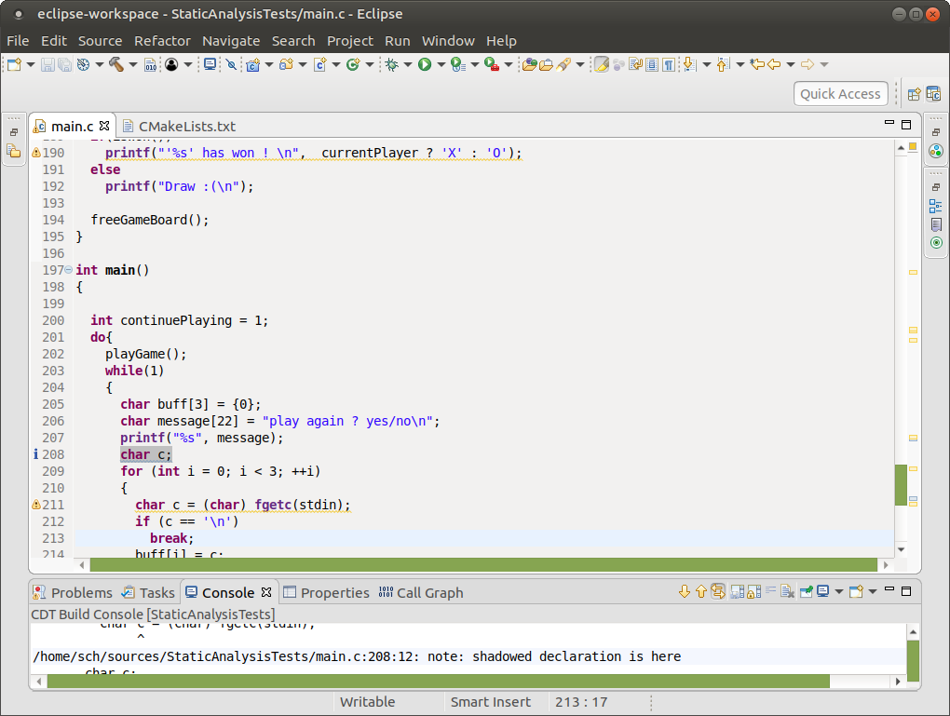
Tools : a good IDE
Compiler warning in the code (Eclipse)

Slide 35
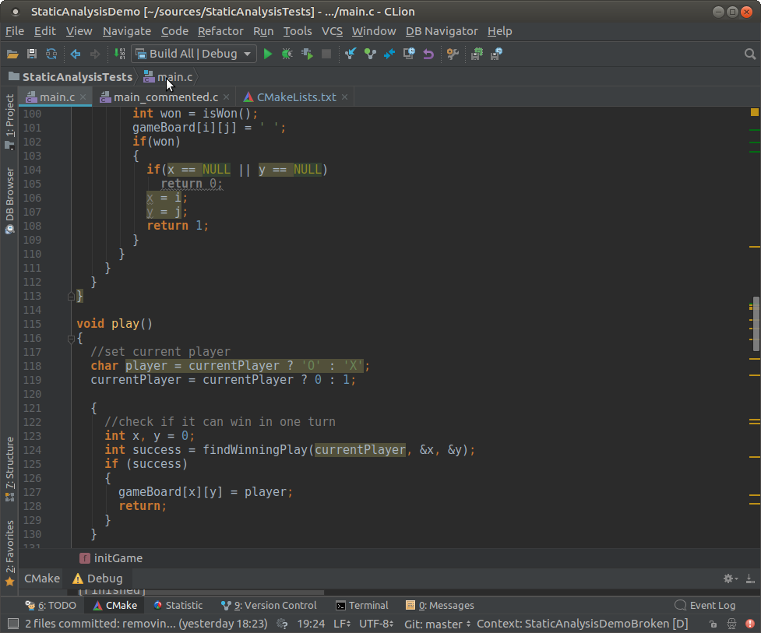
Tools : a good IDE
Custom analysis + clang tidy without compiling (CLion)

Slide 36
Tools : others
Coverity
Fortify
…
https://en.wikipedia.org/wiki/List_of_tools_for_static_code_analysis#C,_C++

Slide 37

Conclusion
Use right & automated tools to do your work !

Slide 38
Dynamic analysis
Google sanitizers (ASAN, TSAN, USAN)
Valgrind (memcheck)

