Slide 1

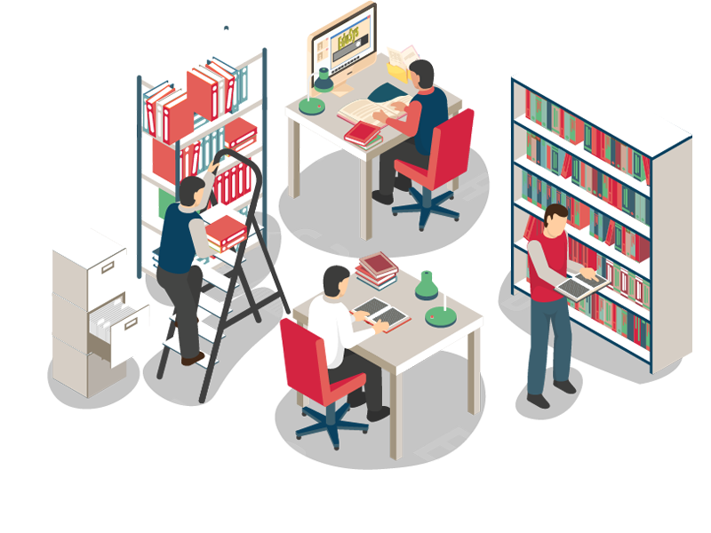
Library Management System
Grade 12's C programming based project work

Slide 2

Horizon Gautam Buddha Secondary School
Grade 12 C -2078 Batch
Team Members :
1. Samrat Ghimire (L)
7. Surendra Yadav
2. Aashish Panta
8. Aakash Gupta
3. Mausam Chhetri
9. Raj Ghimire
4. Sandesh Kandel
10. Samir Ghimire
5. Madan Kandel
11. Awadhesh Gupta
6. Pradip K. Jaiswal
12. Shishir Regmi

Slide 3
What is Library Management System
It is a computer program or application that helps keeping the data of a library safe maintaining the process of keeping records easy and standard through the use of computer.
This project is designed keeping us limited to the knowledge taught to us by our syllabus of NEB's Grade 12.

Slide 4

Our Methodologies
1. Feature Analysis
2. Team's Work Division
3. UI Design
4. Coding
5. Debugging/Testing
6. Program Illustration
7. Report Writing

Slide 5
Feature Analysis
During the feature analysis process, we discussed what features can/should we add and we came to a conclusion of adding:
1. Take Book 5. Remove Book
2. Submit Book 6. Search
3. View Book
4. Add Book

Slide 6
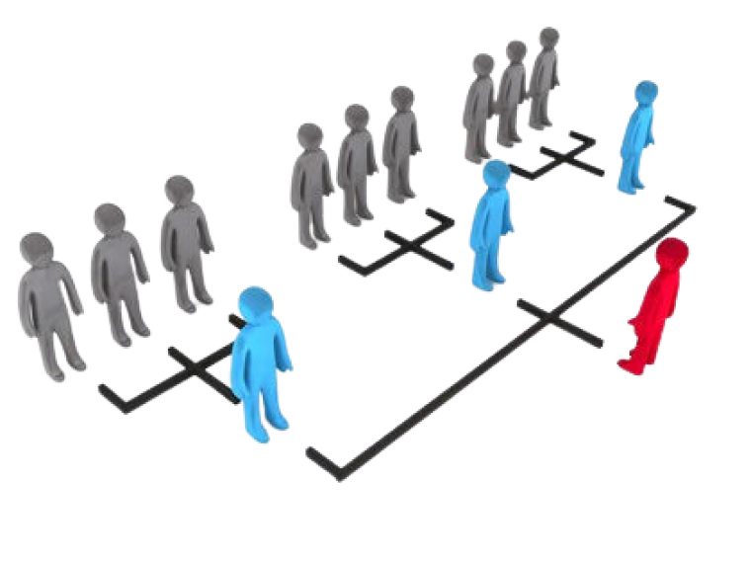
Team Division
We discussed on our own and separated the part where we could give our best based on the experience we have and as a conclusion, we were clear on what are our task in this project.

Slide 7
UI Design
We already had our requirement clear so we planned to follow Top Down programming paradigm for this process dividing the big parts into smaller parts. The Designer and programmers were majorly involved in this process.

Slide 8
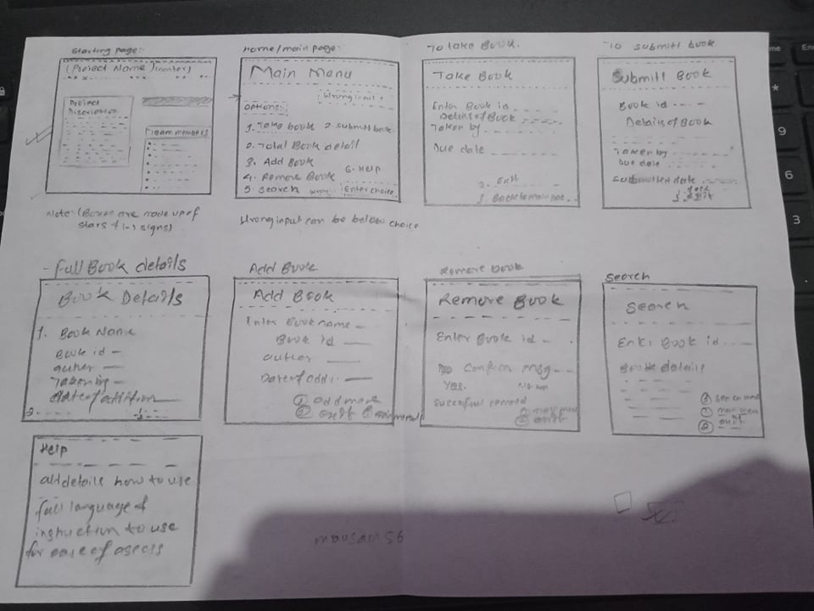
Here is the UI Design

Slide 9
Coding
We were all set to go and so were our passionate programmers and we decided to choose Dev C++ as Standard IDE for this project because it is majorly designed for C and C++and also because we could share the code easily among each other.
We ended up having 500 lines of code.

Slide 10

Debugging
We didn't had much bug over our program but we were facing an issue where our data weren't saving to .txt file so, we later on fixed it by changing the mode of file.

Slide 11

Program Illustration
So now let's switch to our program so that we can explain you how it looks internally.

Slide 12

Report Writing
We already had the format of report so we just edited the report and added the summary, introduction etc that were to be written.

Slide 13

The hard part
The hard part is when you are facing an error and you cannot figure out where is the problem. The solution at that time would be to seek for someone experienced who can help you.
Tech communities like ITSNP can help you during this time, it is simply a Facebook group with a group of experts are present to help in any tech problem freely.

Slide 14
Conclusion
As a conclusion, it is a good experience working with classmates which promoted our bond of mutual co-operation. It was the first standard program we ever built which helped take some experience about the process of building a program.
Finally, Thanks to every of our team members for their dedicated work throughout this project.

Slide 15

Project available on GitHub
https://github.com/samrat-gh/libraryManagementSystem

Slide 16

Thank you

