Slide 1
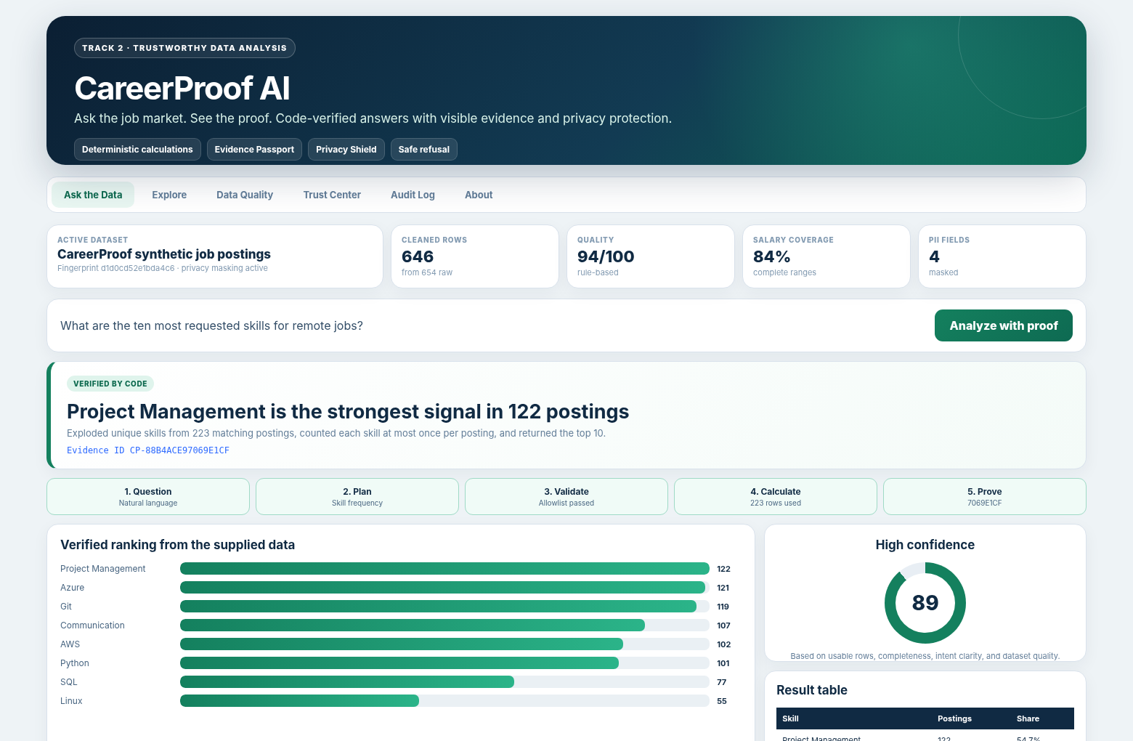
CP
CAREERPROOF AI
CareerProof AI
Ask the job market. See the proof.
A trustworthy data-analysis assistant for students and early-career job seekers.
TRACK 2 · TRUSTWORTHY DATA ANALYSIS
AI interprets the question. Code calculates the answer.
Every result includes visible calculations, masked evidence, confidence, and a safe refusal when the dataset cannot answer.
SYNTHETIC DEMO DATA
Secure AI Hackathon · Track 2 · CareerProof AI
Notes:
[Sources] - CareerProof AI repository and bundled synthetic dataset, generated July 30, 2026. - Participant_Guide_Updated(1).pdf, Track 2 requirements on pages 7-8.

Slide 2
CP
CAREERPROOF AI
THE PROBLEM
Job seekers have data, not answers
The risk is not only information overload. It is receiving a confident answer with no proof.
Too many listings
Students must compare hundreds of postings across skills, locations, salaries, and experience levels.
THE TRUST GAP
“Which skills are most common in remote jobs?”
Typical chatbot
Answers in natural language
May invent or blur the calculation
No source table or reproducible plan
CareerProof AI
Interprets the question
Runs an allowlisted Pandas calculation
Shows chart, rows, confidence, and Evidence ID
Unsupported AI
A general chatbot can produce a plausible number without actually calculating from the uploaded dataset.
Weak decision support
A number without sample size, source rows, or data-quality context can mislead a career decision.
TARGET USERS
High school and college students · recent graduates · career counselors · workforce programs
Clear user problem + practical value directly support the highest-weight judging category.
Notes:
[Sources] - Participant_Guide_Updated(1).pdf, page 7: Track 2 asks teams to calculate or verify answers from the actual dataset. - Participant_Guide_Updated(1).pdf, page 11: Problem and usefulness is 25% of judging.

Slide 3
CP
CAREERPROOF AI
HOW IT WORKS
A simple flow with a hard trust boundary
Language understanding helps route the question. Only deterministic code is allowed to create factual answers.
1
CSV / XLSX
Bundled or uploaded data
2
Validate + clean
Schema, dates, salaries, duplicates
3
Local AI router
Intent and entity extraction
4
Query plan
Structured and allowlisted
5
Pandas executor
Deterministic calculation
6
Proof output
Chart, table, confidence, audit
TRUST BOUNDARY
The AI never writes or executes Python, SQL, `eval`, or `exec`.
AI side
TF-IDF + logistic regression
Entity matching
Closest supported questions
Code side
Validated filters
Pandas grouping and math
Evidence + confidence rules
It creates a typed query plan. The validator rejects unsupported columns, operations, filters, and unsafe requests before calculation.
Architecture is intentionally understandable: input → validation → AI routing → deterministic calculation → evidence.
Notes:
[Sources] - CareerProof AI source code: src/careerproof/question_router.py, query_validator.py, query_executor.py, evidence.py, confidence.py. - Participant_Guide_Updated(1).pdf, pages 3 and 11: architecture should support a working trust mechanism, not replace the product.

Slide 4
CP
CAREERPROOF AI
LIVE RESULT
A question becomes a verified answer
What are the ten most requested skills for remote jobs?
HIGH CONFIDENCE
Project Management is the strongest signal in 122 postings
Exploded unique skills from 223 matching postings, counted each skill at most once per posting, and returned the top 10.
223
matching remote postings
89/100
evidence-based confidence
Evidence Passport
CP-88B4ACE97069E1CF
The same result can be inspected as a chart, table, source-row preview, query-plan JSON, masked CSV, and portable HTML report.
Demo result is calculated from the bundled synthetic dataset, not generated from model memory.
Notes:
[Sources] - CareerProof synthetic dataset fingerprint d1d0cd52e1bda4c6. - Verified analysis CP-88B4ACE97069E1CF: 223 matching postings, confidence 89/100.

Slide 5
CP
CAREERPROOF AI
EVIDENCE PASSPORT
The answer is only the beginning
Each result exposes how it was produced, what data it used, and where uncertainty remains.
TOP SIGNALS IN REMOTE POSTINGS
VISIBLE QUERY PLAN
Project Management
122
{
"intent": "skill_frequency",
"filters": ["work_mode = Remote"],
"skill_columns": ["required_skills"],
"limit": 10,
"chart_type": "bar"
}
Azure
121
Git
119
Communication
107
AWS
102
Calculation
223 rows after filters
Each skill counted once per posting
Sorted by posting count
Confidence
89/100
Driven by row count, completeness, intent certainty, and data-quality score
Privacy
Names, emails, phone numbers, and source IDs are masked before the UI, report, export, or audit log.
Evidence ID CP-88B4ACE97069E1CF changes when the dataset, query plan, or result changes.
Notes:
[Sources] - CareerProof verified result CP-88B4ACE97069E1CF generated from bundled synthetic data. - CareerProof AI source code: evidence.py, privacy.py, confidence.py, query_executor.py.

Slide 6
CP
CAREERPROOF AI
BEYOND THE MINIMUM
Four features that make the product memorable
Each feature adds practical value without weakening the trust model.
Evidence Passport
Refusal Coach
ID
?
Recompute the ID, then replay the validated plan when the active dataset matches.
Explains why a question is unsupported and suggests the closest answerable alternatives.
Career Signal Lab
Cleaning Ledger
SK
QL
Compares a user skill list with transparent role-level frequency signals. It is not a hiring score.
Shows every cleaning action, invalid row, missing field, and quality warning instead of hiding them.
Also included
SCENARIO COMPARE
MASKED AUDIT LOG
HTML REPORT EXPORT
NO API KEY REQUIRED
CSV / XLSX UPLOAD
Unique does not mean unsafe: every advanced feature still uses the same validated calculation pipeline.
Notes:
[Sources] - CareerProof AI user interface and source modules: ui.py, insights.py, evidence.py, audit.py, data_quality.py. - Participant_Guide_Updated(1).pdf, page 8: optional Track 2 layers include masking, unsupported-question handling, natural language to Pandas, confidence labels, and report export.

Slide 7
CP
CAREERPROOF AI
TRUST + QUALITY
Designed to fail safely and prove it
The product is tested against normal questions, malformed data, private-data requests, and prompt-injection attempts.
RISK
VISIBLE CONTROL
62
automated tests passed
12/12
judge-ready checks passed
Invented numbers
Deterministic Pandas executor
Arbitrary code
Typed query plan + operation allowlist
94/100
bundled data-quality score
0
API keys required
PII exposure
Mask before UI, export, report, or log
Tiny samples
Minimum group size + confidence downgrade
SAFE REFUSAL DEMO
Missing fields
Unsupported-question refusal
“Which company has the happiest employees?”
The dataset cannot support that conclusion. The dataset has no employee-satisfaction field.
CP-7AEBDAFC270C6B2F
Known limitations are shown in the product and presentation rather than hidden.
Notes:
[Sources] - CareerProof AI pytest result: 62 passed. Demo checker result: 12/12 passed. - Safe refusal proof CP-7AEBDAFC270C6B2F. - Participant_Guide_Updated(1).pdf, pages 7-8 and 11: unsupported-question handling and meaningful trust controls are explicit evaluation priorities.

Slide 8
CP
CAREERPROOF AI
WHY IT IS SUBMISSION-READY
Built around what the judges actually score
A useful end-to-end product first, with trust, evidence, clear architecture, and a concise story.
Problem + usefulness
25%
Clear early-career user problem
READY TO SUBMIT
Working prototype
25%
Upload → question → proof → export
CareerProof AI
Data + AI quality
15%
Local intent AI + deterministic math
Ask the job market.
See the proof.
Trust + safety
15%
Masking, refusal, confidence, audit
646 CLEANED ROWS
Architecture clarity
10%
Simple input-to-output flow
12 / 12 DEMOS
Demo + storytelling
10%
Success case + limitation case
This dataset is synthetic. Limitations disclosed. No external API required.
Final manual steps
Push public GitHub history · record the ≤10-minute video · add team details · upload the verified ZIP
CareerProof AI · Trustworthy answers require visible proof.
Notes:
[Sources] - Participant_Guide_Updated(1).pdf, page 11: participant-facing judging weights. - Participant_Guide_Updated(1).pdf, pages 14-15: repository, presentation, video, ZIP, disclosure, and no-secret requirements. - CareerProof AI repository: verified local build and bundled synthetic dataset.

