Slide 1
Finding Trend in Stock Market with RobustPCA
Liang Zhicong 20485672
Department of Mathematics
Hong Kong University of Science and Technology

Slide 2
Introduction
Stock fluctuation = general trend + individual factor
In this report, we will try to separate out the general trends from the noise.
Basic assumption:
Stocks in the same class will have similar trends.
For better evaluation, we convert our problem into recognizing stocks’ underlying classes (10 classes in total, e.g. Industries, Information Technology, etc.)
Notes:
Volatility is one of the main character of stock market that people love and hate. Intuitively, the fluctuation of a stock can be decompose into the general trend of its class and its individual factor.
For example, the stock price of an oil company maybe influenced by the inter-national oil price and its own management
We refer the first one as the background and second one as noise.
IN this report, we will try to capture the main trend of different stock classes.
This is based on the assumption that stocks from the same class will have similar trend while stocks from different classes will have different trend
For better evaluation, we will convert our problem into a classification task. That is, we will try to recognise the underlying class of given stocks.
The better we characterise the stocks trend, the higher classification accuracy we will achieve

Slide 3
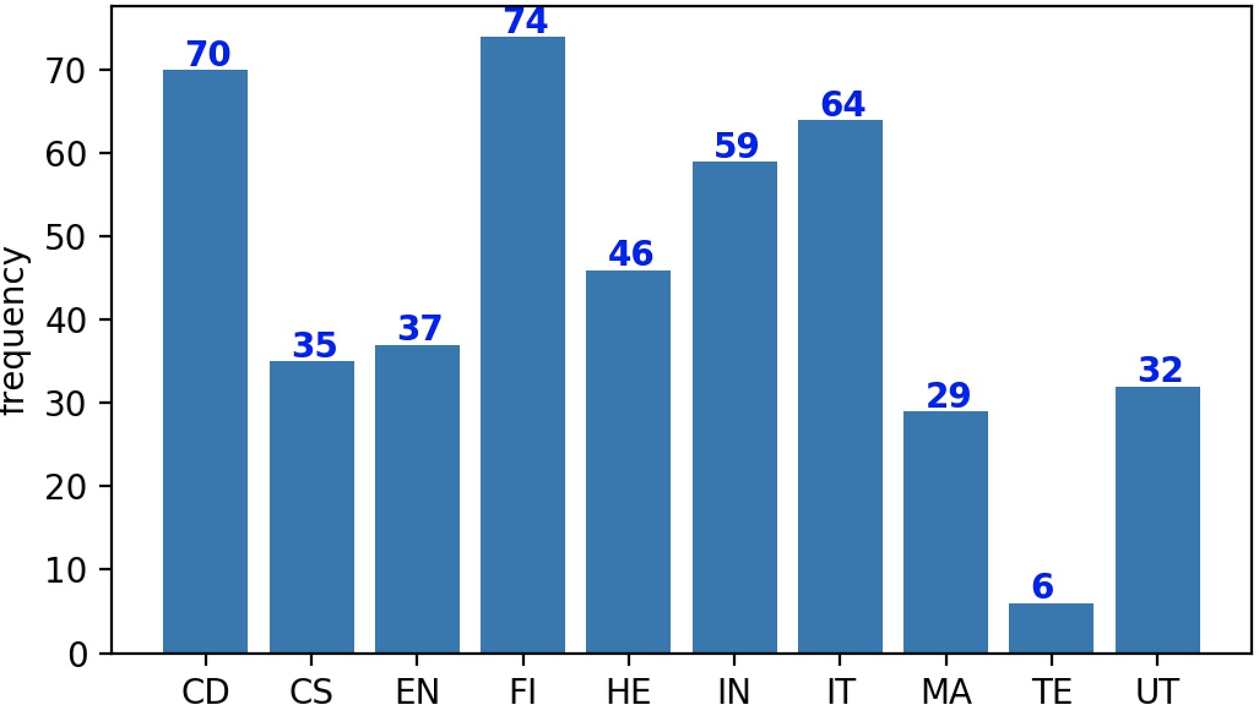
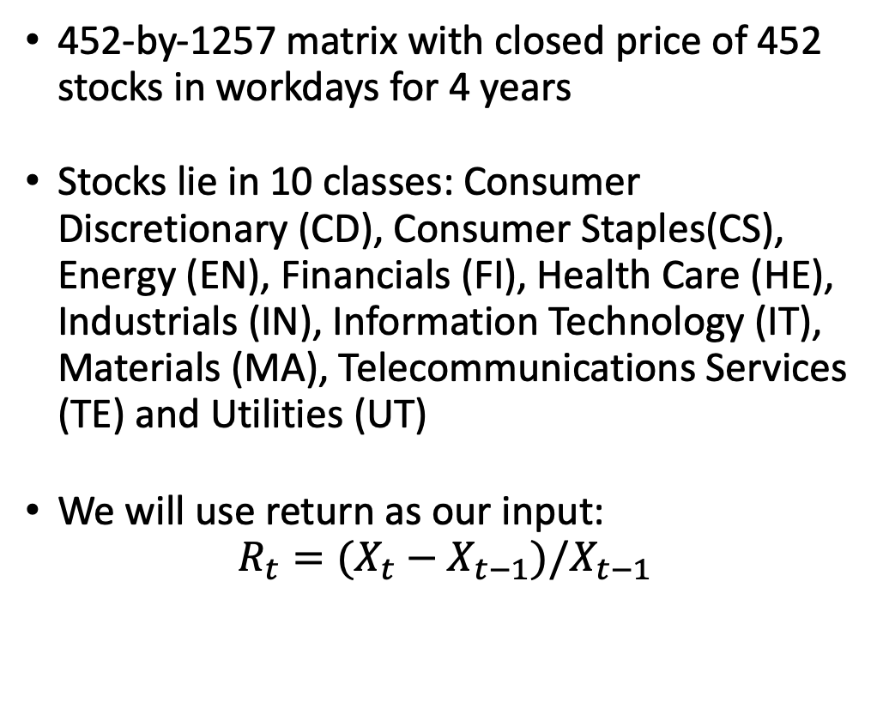
Dataset: SNP500
452-by-1257 matrix with closed price of 452 stocks in workdays for 4 years
Stocks lie in 10 classes: Consumer Discretionary (CD), Consumer Staples(CS), Energy (EN), Financials (FI), Health Care (HE), Industrials (IN), Information Technology (IT), Materials (MA), Telecommunications Services (TE) and Utilities (UT)
We will use return as our input:
$$R_{t}=(X_{t}−X_{t−1})/X_{t−1}$$
Notes:
Here we will use SNP500 as our dataset
It consists of a matrix with closed price of 452 stocks in workdays for 4 years
And stocks are categorised into 10 classes. And there distribution are shown on the right figure,
Instead of directly using the price, we will use the return defined as the increase or decrease ratio, as our input data.

Slide 4
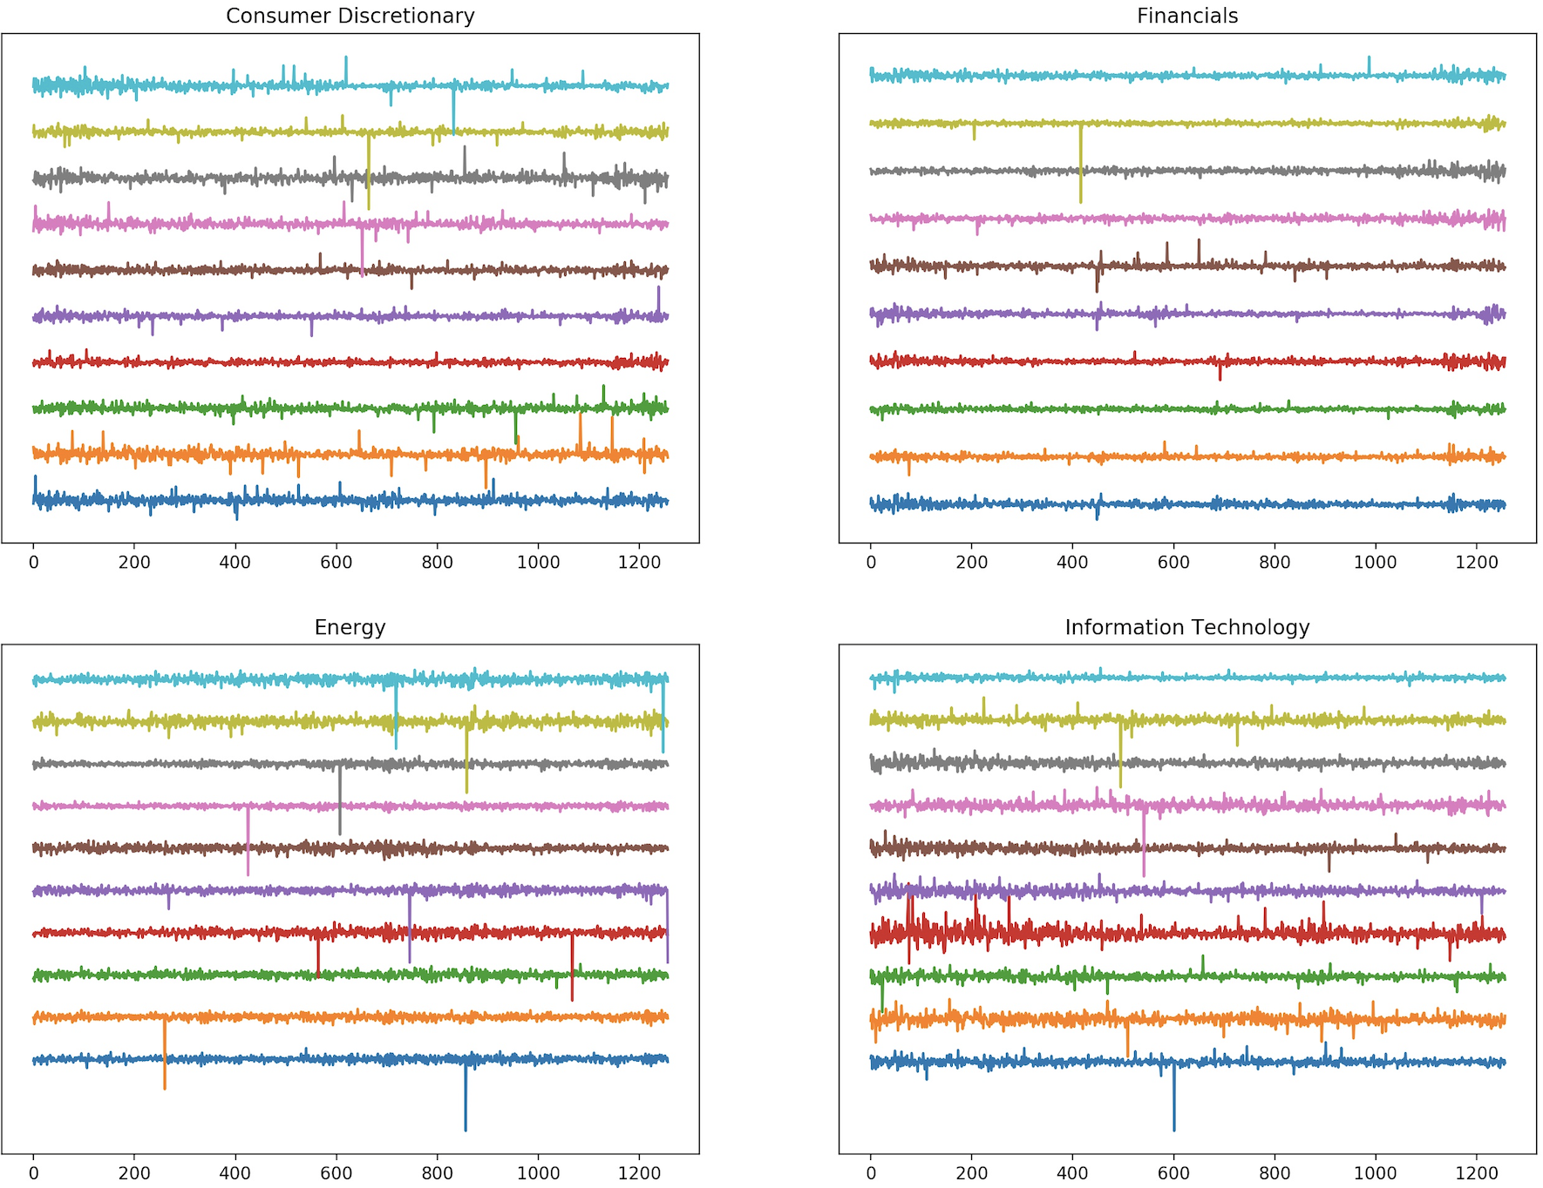
Visulisation by class
Notes:
Here we show the return of the 10 stocks of 4 classes,
For example, comparing to the others, stocks of information technology are more volatile, and consumer discretionary comes the second.
As for energy, it suffer more from significant drop.
And financial stocks have a similar pattern after the 1000th day.
This give us a hint about our basic assumption that different classes of stocks have different trends.

Slide 5
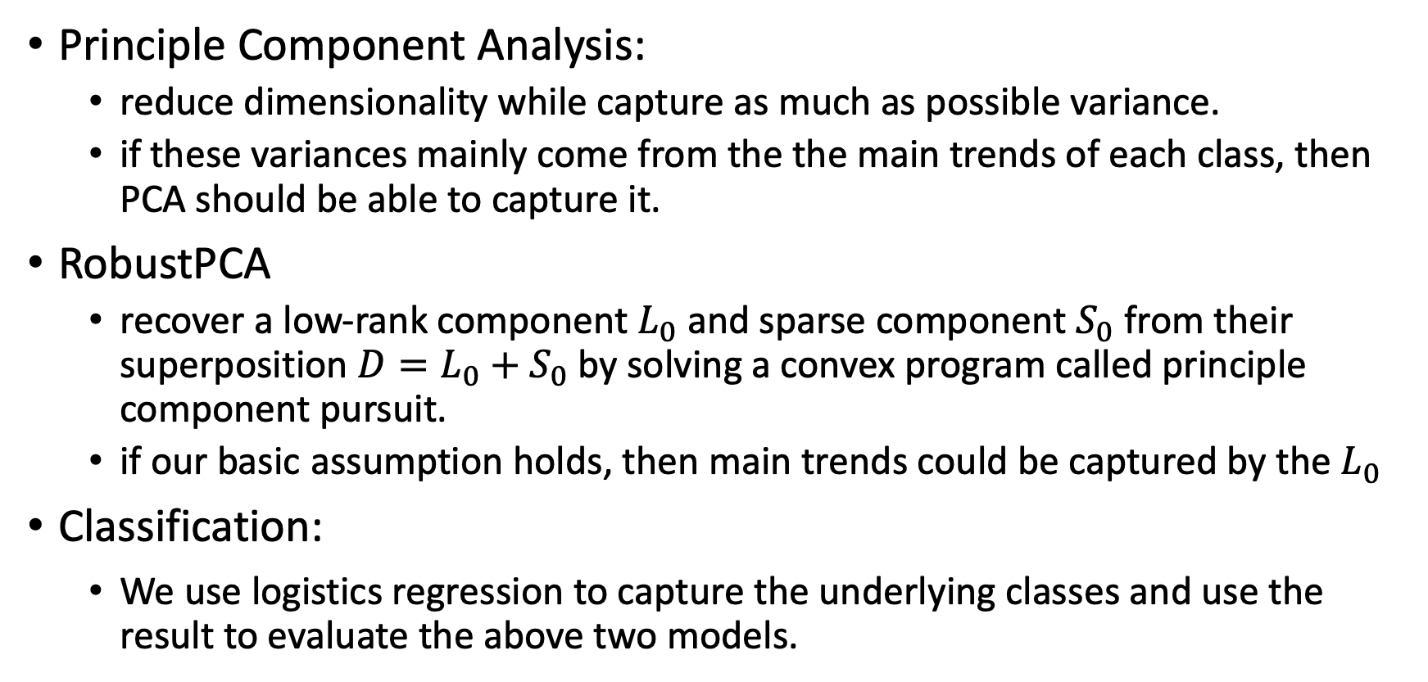
Methodology
Principle Component Analysis:
reduce dimensionality while capture as much as possible variance.
if these variances mainly come from the the main trends of each class, then PCA should be able to capture it.
RobustPCA
recover a low-rank component $L_{0}$ and sparse component $S_{0}$ from their superposition $D=L_{0}+S_{0}$ by solving a convex program called principle component pursuit.
if our basic assumption holds, then main trends could be captured by the $L_{0}$
Classification:
We use logistics regression to capture the underlying classes and use the result to evaluate the above two models.
Notes:
Here we introduce our methodology.
Principle component analysis is one of the most widely use dimension reduction method in the world.
It tries to reduce dimensionality while capture as much as possible variance.
In our case, if these variances in stock price mainly come from the the main trends of each class, then PCA should be able to capture it
RobustPCA tries to recover a low-rank component and sparse component from their superposition by solving a convex program called principle component pursuit
if our basic assumption holds, then main trends could be captured by the low rank component L_0
with these features in hands, we will use logistics regression to capture the underlying classes and use the result to evaluate the above two models

Slide 6
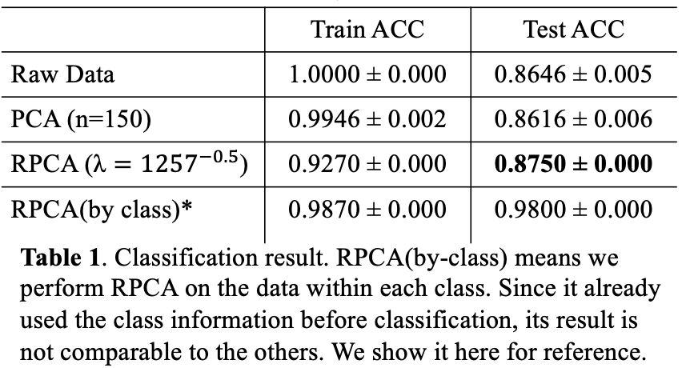
Experiment and Analysis
PCA: phase transition – law signal noise ratio
RobustPCA: successfully captures the trends
Notes:
The classification result is shown in Table 1, where we find that PCA performs even worse than raw input. We attribute this underperformance to the phase transition of PCA. That is, since PCA tries to capture variance as much as possible, they may fails when the noise play a non-negligible role. And we refer this phenomenon as phase transition of PCA.
However, RobustPCA achieve the best result by successfully capturing the low rank information of class trends. We will visual it in the next slice.

Slide 7
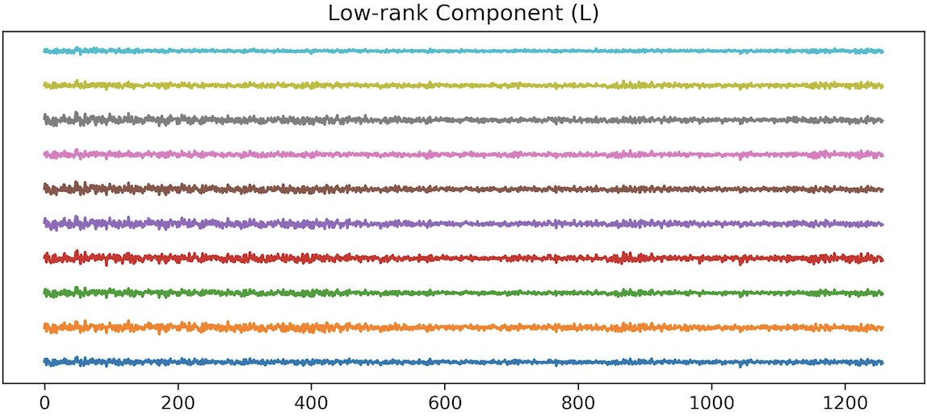
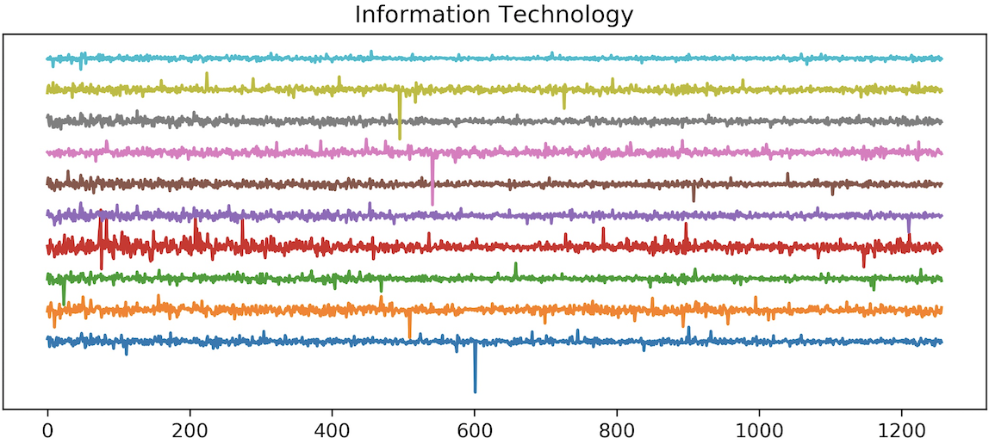
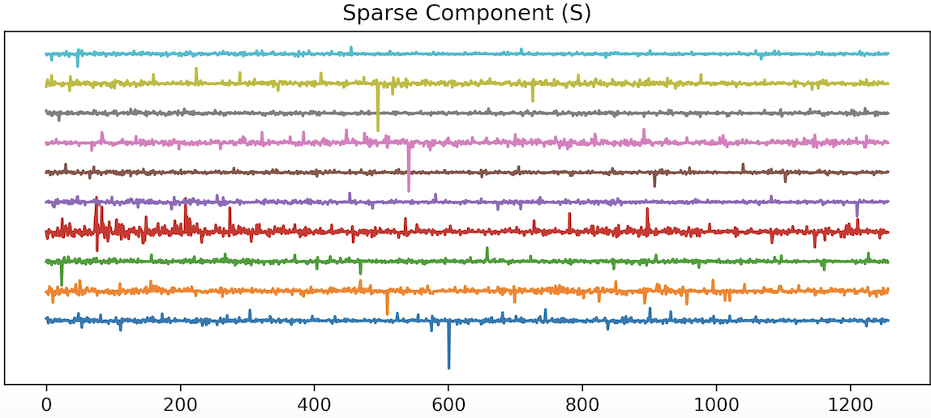
Decomposition by RobustPCA
Notes:
Here we use robustPCA decompose 10 stocks of in Information technology into low rank component at upper right the sparse component at the bottom right
In the low rank component, we can find some similar pattern shared by the 10 stocks, which we enclosed by black boxes. This patterns are difficult to notice in the original data since they are masked by the noise.

Slide 8
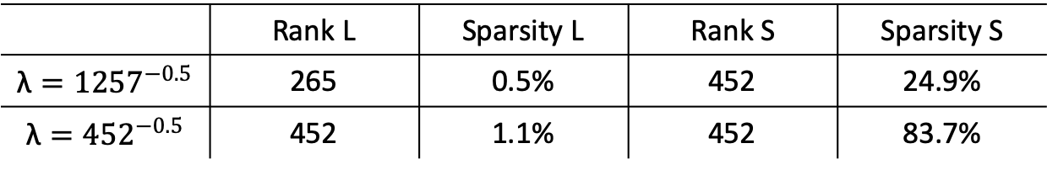
Others
Rank-sparsity trade-off:
Industrial Stocks are highly related to stocks from other classes, resulting in large classification error
 | Rank L | Sparsity L | Rank S | Sparsity S
$$\text{λ}={1257}^{−0.5}$$ | 265 | 0.5% | 452 | 24.9%
$$\text{λ}={452}^{−0.5}$$ | 452 | 1.1% | 452 | 83.7%
Notes:
There are two interesting we would like to mention here.
For one thing, we find that the selection of lambda in robust PCA matters a lot. If we follow the suggestion in the paper and use the long edge of the matrix to estimate lambda, we will have a low rank L and relatively dense S.
However, if we use the short edge to estimate lambda, our L will have large rank but we got a more sparse S.
This demonstrate the rank-and-sparsity trade off in robust PCA.
In our case, we prefer the our L to have low rank since this align more with our basic assumption that stocks are have a few main trends.
Another founding is that a large proportion (47.4%) of classification error relates to industrial stocks. We attribute this phenomenon to the fact that industries are highly correlated to other fields like materials, IT and consumer goods. In this case, industrial stocks have weaker identity and are easily influenced by other stocks, resulting a higher classification error.

Slide 9
Conclusion
RobustPCA can capture the main trend underlying each stock class
PCA suffers from small signal noise ratio data like stock price
Industrial stocks are highly correlated with other stocks and have weak identity
Notes:
Finally, we will conclude our project into 3 main points.
That is, RobustPCA can capture the main trend underlying each stock class thus achieve a high classification accuracy.
And PCA suffers phase transition for small signal noise ratio data like stock price
Finally, Industrial stocks are highly correlated with other stocks and have weak identity

