Slide 1
Lecture 6. Model Assessment and Selection

Slide 2
Outline
Introduction – Generalization Error
Bias-Variance Decomposition
Optimism of Training Error Rate
AIC, BIC, MDL
Cross Validation
Bootstrap

Slide 3
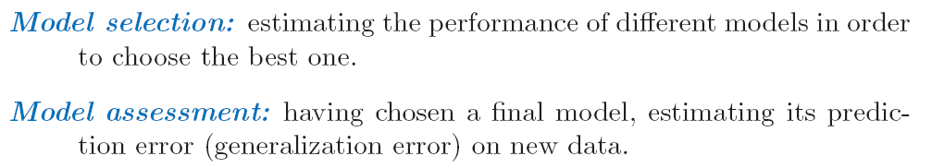
What we will learn?
Assessment of generalization performance: prediction capability on independent test data
Use this assessment to select models

Slide 4
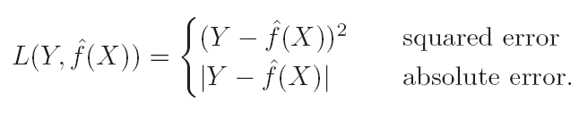

Loss Function
Y: target variable
X: predictors, inputs
$\hat{f}\left(X\right):$ prediction model that is estimated from a training set
$L(Y,\hat{f}(X))$: Loss function.

Slide 5


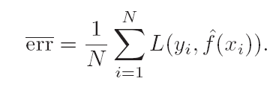
Test Error
Test error, also referred to as generalization error
Here the training set is fixed, and test error refers to the error for this specific training set.
Expected prediction error:
Training error:

Slide 6
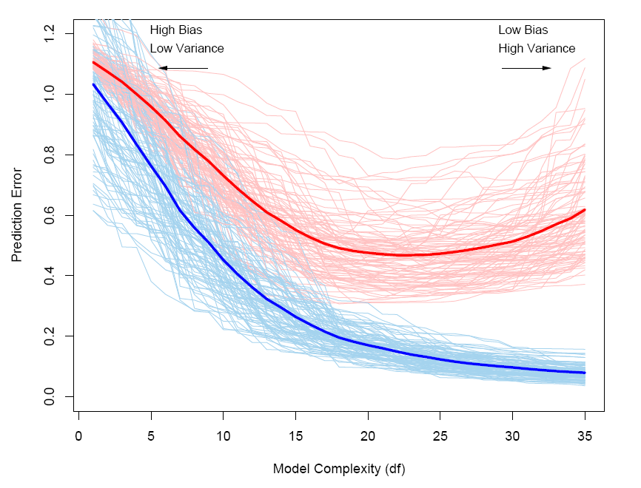
Behavior of Errors
Red: conditional test error
Blue: train error

Slide 7
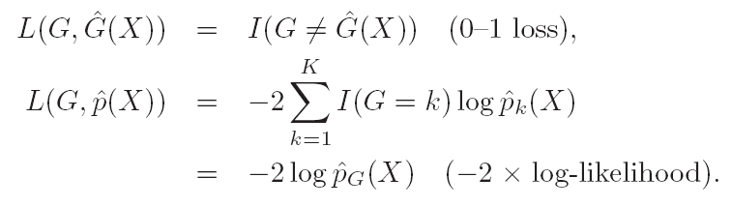
Categorical data
-2loglikelihood is referred to deviance

Slide 8

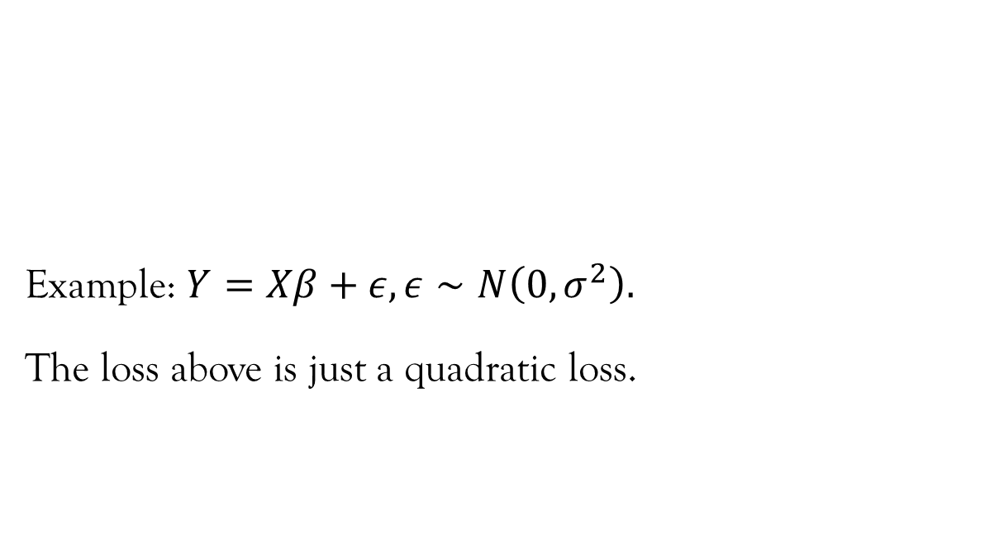
General response densities
Example: $Y=Xβ+ε, ε∼N\left(0,σ^{2}\right).$
The loss above is just a quadratic loss.

Slide 9

Ideal Situation for Performance Assessment
Enough data
Train – for fitting
Validation – for estimate prediction error used for Model selection
Test– for assessment of the generalization error of the final chosen model

Slide 10
What if insufficient data?
Approximate generalization error via
AIC, BIC, CV or Bootstrap

Slide 11



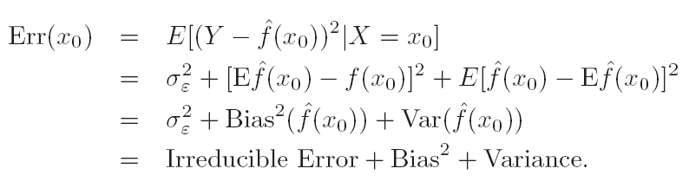

The Bias-Variance Decomposition
Typically, the more complex we make the model $\hat{f}$, the lower the bias, but the higher the variance.

Slide 12
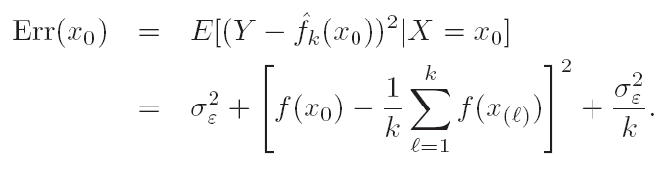


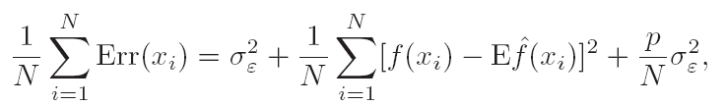
Bias-Variance Decomposition
For the k-nearest-neighbor regression fit,
For linear fit,
In-sample error:

Slide 13

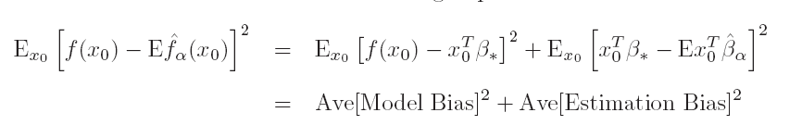
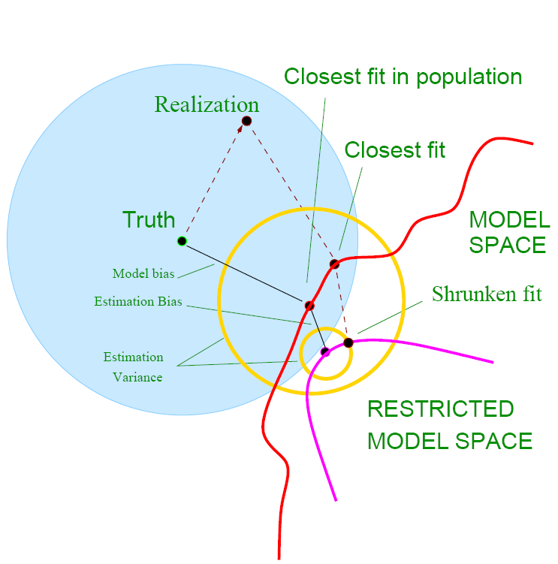
Bias-variance Decomposition

Slide 14
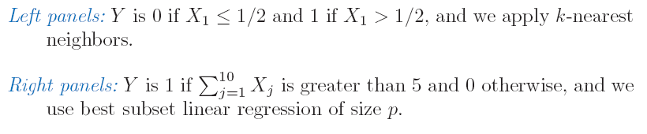
Example: Bias-variance Tradeoff
80 obs, 20 predictors ~ U[0,1]^20

Slide 15
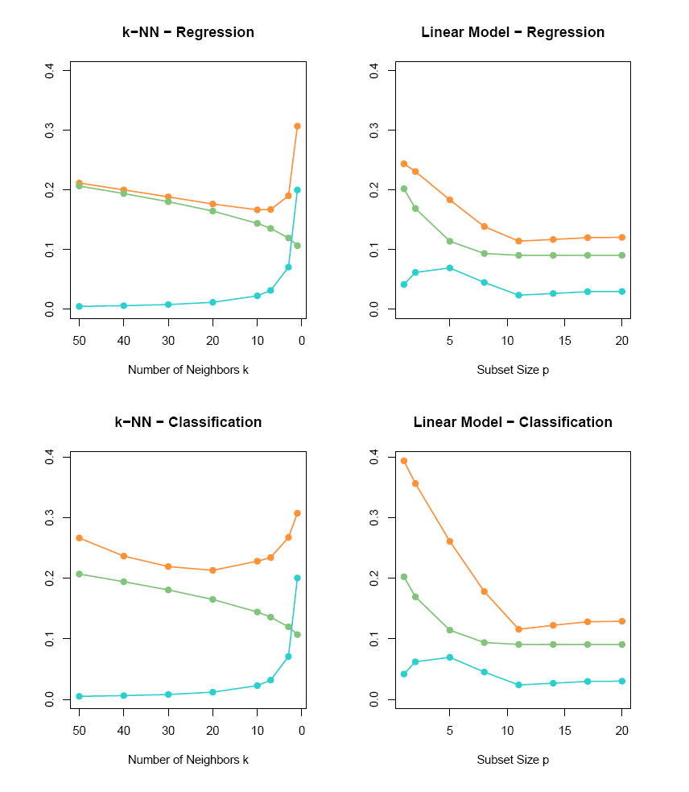
Example: Bias-variance Tradeoff
Expected prediction error
Squared bias
variance

Slide 16




Optimism of the Training Error Rate
Given a training set
Generalization error is
Note: training set is fixed, while is a new test data point
Expected error:

Slide 17
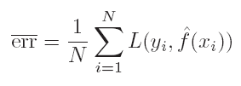
Optimism of the Training Error rate
Training error
will be less than test error
Hence, training error will be an overly optimistic estimate of the generalization error.

Slide 18




Optimism of the Training Error Rate
In-sample Error:
Generally speaking, op > 0
Average optimism:

Slide 19





Estimate of In-sample Prediction Error
For linear fit with d predictors:
AIC =

Slide 20
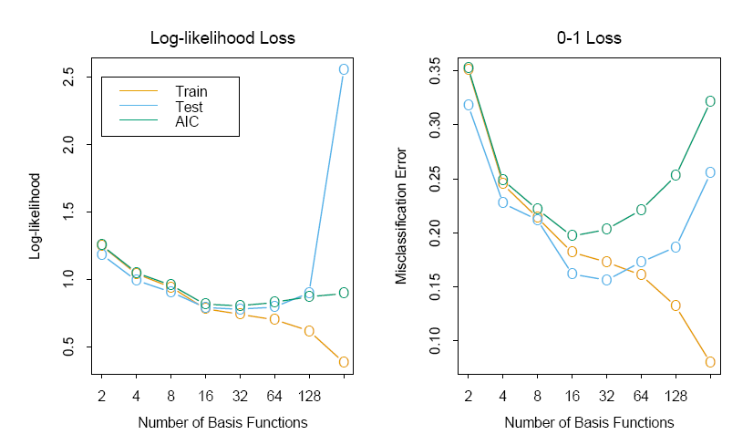

Slide 21


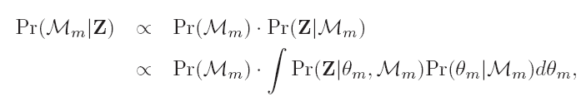
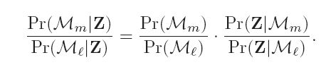

The Bayesian approach and BIC
Gaussian model
Laplace approximation

Slide 22
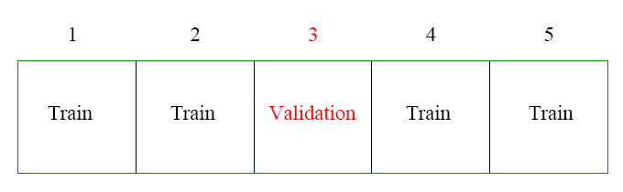

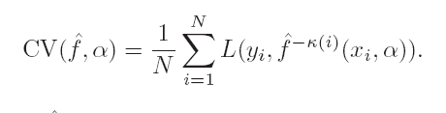
Cross Validation

Slide 23
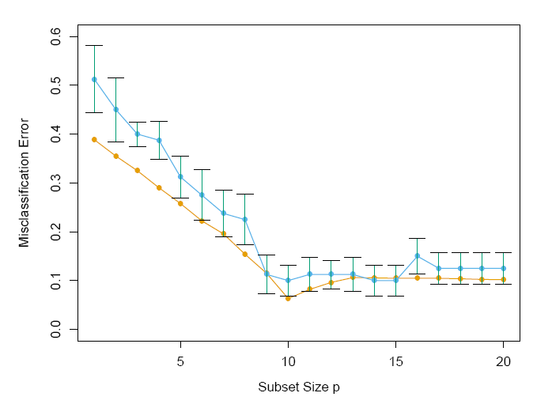
Cross Validation
Prediction Error
Ten-fold CV

Slide 24

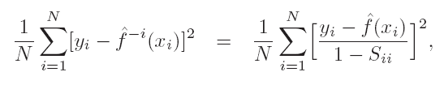
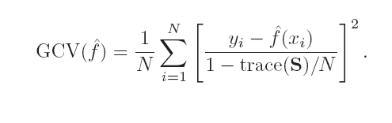
GCV
For linear fit:

Slide 25
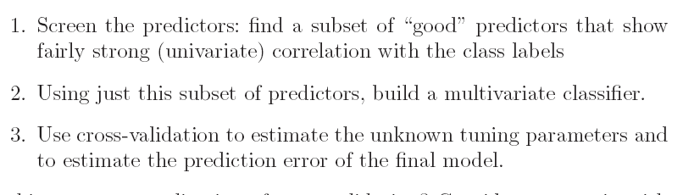
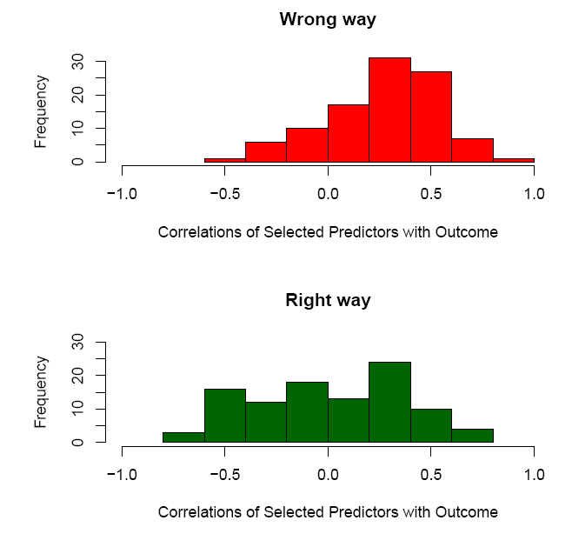
The wrong way to do CV

Slide 26
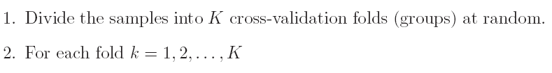
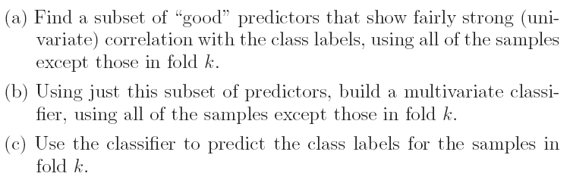
The Right Way

Slide 27
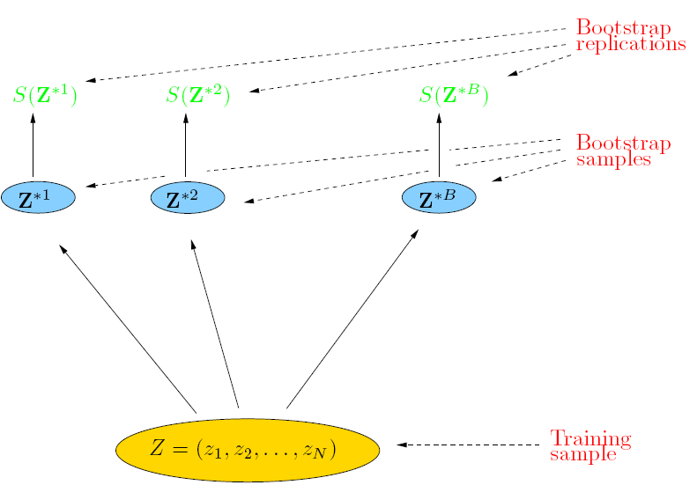
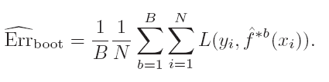
Bootstrap

Slide 28
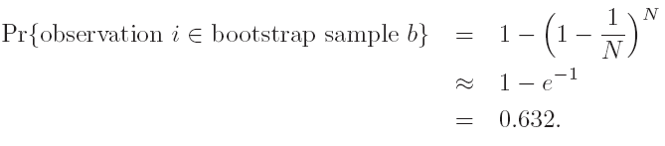
Bootstrap

Slide 29
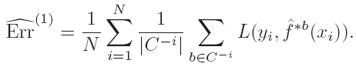

Bootstrap

Slide 30
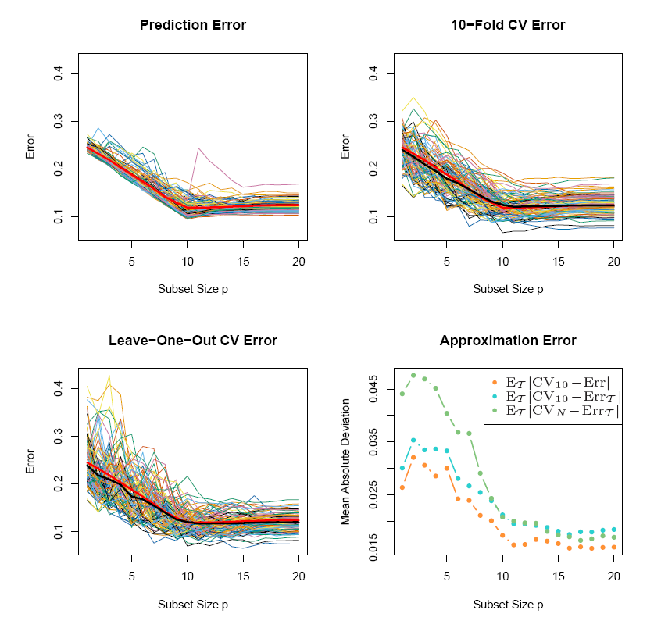
Conditional or Expected Test Error

Slide 31
Homework
Due May 16
ESLII_print 5, pp216. Exercise 7.3, 7.9, 7.10, Reproduce Figure 7.10

