Slide 1
Support Vector Machines and Flexible Discriminants

Slide 2
Best 3 Algorithms in Machine Learning
Support Vector Machines
Boosting (AdaBoost, Random Forests)
Neural Networks

Slide 3
Outline
Separating Hyperplanes – Separable Case
Extension to Non-separable case – SVM
Nonlinear SVM
SVM as a Penalization method
SVM regression

Slide 4
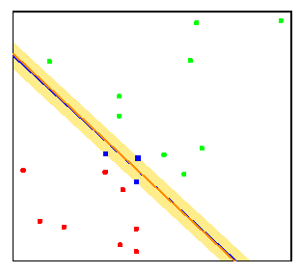
Separating Hyperplanes
The separating hyperplane with maximum margin is likely to perform well on test data.
Here the separating hyperplane is almost identical to the more standard linear logistic regression boundary

Slide 5
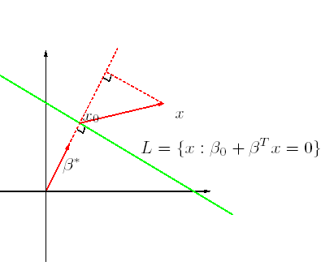
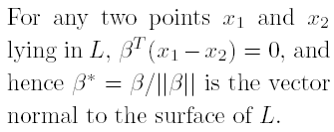
Distance to Hyperplanes
For any point x₀ in L,
β^{T} x₀ = -β₀
The signed distance of any point x to L is given by

Slide 6
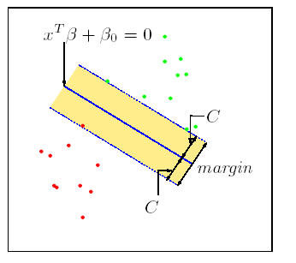
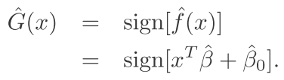
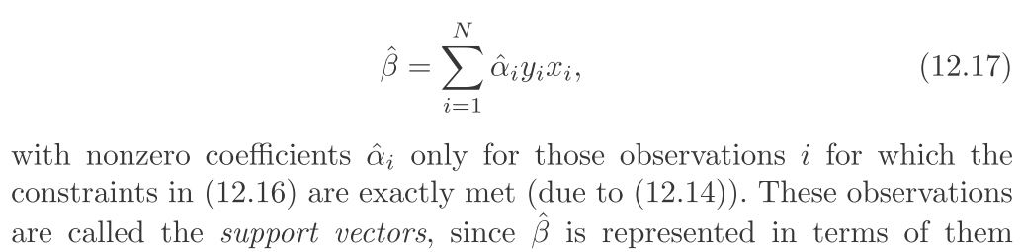
Maximum Margin Classifier
Decision function
Found by quadratic programming (Convex optimization)
Solution determined by just a few points (support vectors) near the boundary
Sparse solution in dual space

Slide 7
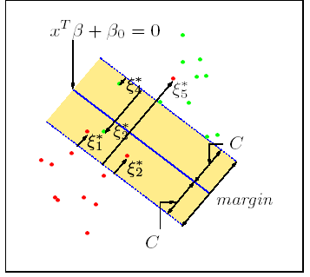
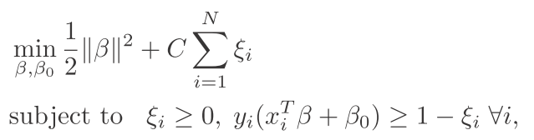
Non-separable Case: Standard Support Vector Classifier
This problem is computationally equivalent to

Slide 8
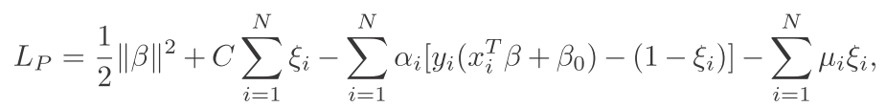
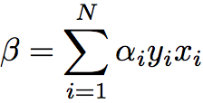
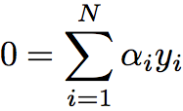


Computation of SVM
Lagrange (prime) function:
Minimize w.r.t β, β₀ and ξ_{i,} a set derivatives to zero:

Slide 9
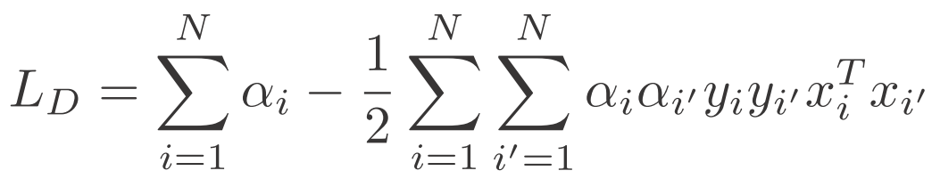

Computation of SVM
Lagrange (dual) function:
with constraints:
Karush-Kuhn-Tucker conditions:

Slide 10
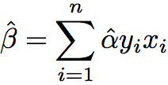




Computation of SVM
The final solution:
Support vectors
Decision rule

Slide 11
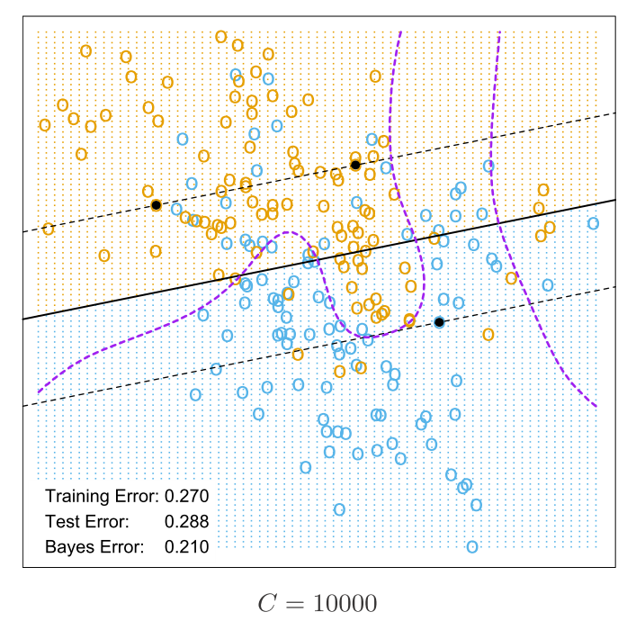
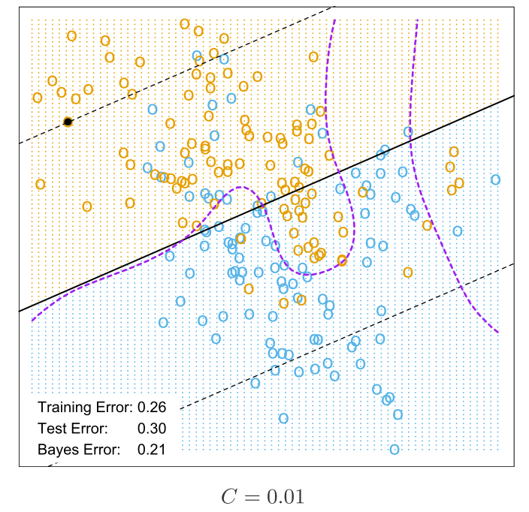
Cost parameter tuning in example

Slide 12
SVMs for large p, small n
Suppose we have 5000 genes(p) and 50 samples(n), divided into two classes
Many more variables than observations
Infinitely many separating hyperplanes in this feature space
SVMs provide the unique maximal margin separating hyperplane
Prediction performance can be good, but typically no better than simpler methods such as nearest centroids
All genes get a weight, so no gene selection
May overfit the data

Slide 13
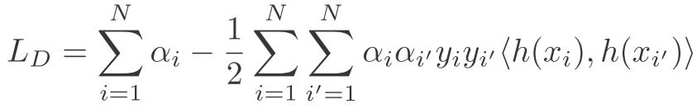
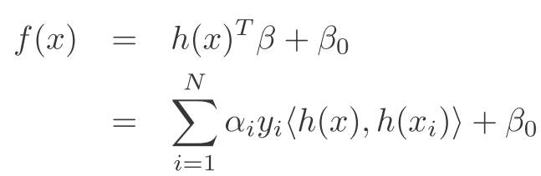
Non-Linear SVM via Kernels
Note that the SVM classifier is decided by inner products
<x_{i}, x_{j}>=x_{i}^{T}x_{j}
Enlarge the feature space
Replacing x_{i}^{T} x_{j} by appropriate kernel K(x_{i},x_{j}) = <h(x_{i}), h(x_{j})> provides a non-linear SVM in the input space
e.g. Dual
New Dual
Nonlinear Decision

Slide 14
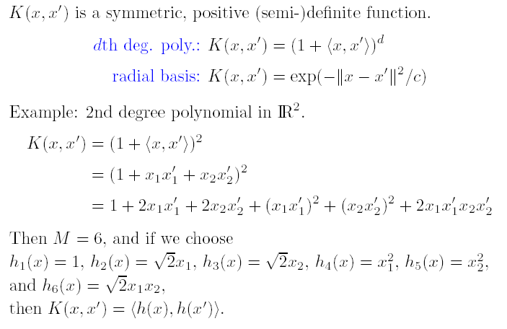
Popular kernels
Neural Network:

Slide 15

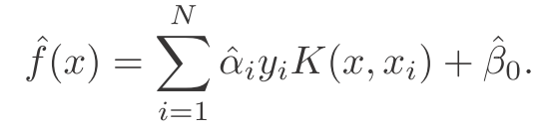
Kernel SVM
Given kernel
You don’t need to know the nonlinear feature map h explicitly

Slide 16
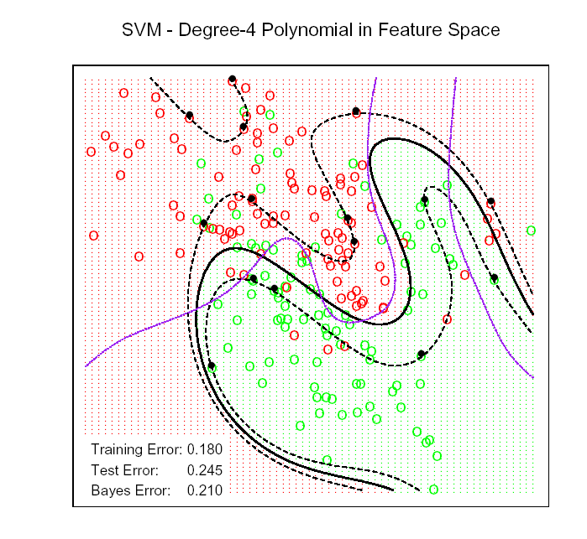
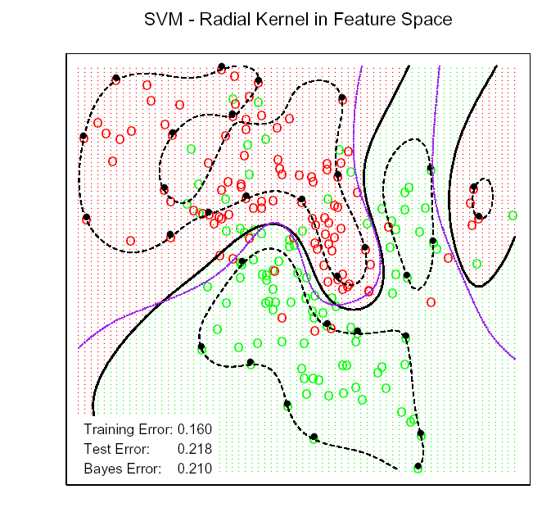
Kernel SVM: Gaussian Mixture Data
Purple curve is the Bayesian optimal decision boundary

Slide 17
Radial Basis Kernel
Radial Basis function has infinite-dim (VC dimension) basis: φ(x) are infinite dimension.
Smaller the Bandwidth parameter, more wiggly the boundary and hence Less overlap
Kernel trick doesn’t allow coefficients of all basis elements to be freely determined, e.g. sparse basis selection

Slide 18

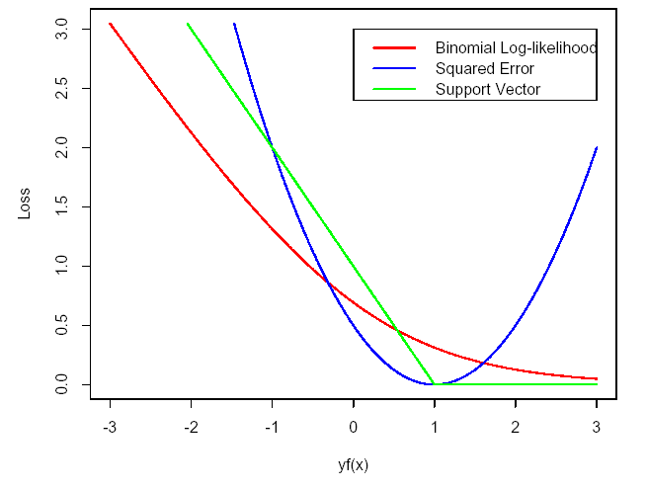
SVM as penalization method
For , consider the problem
Margin Loss + Penalty
For , the penalized setup leads to the same solution as SVM.

Slide 19
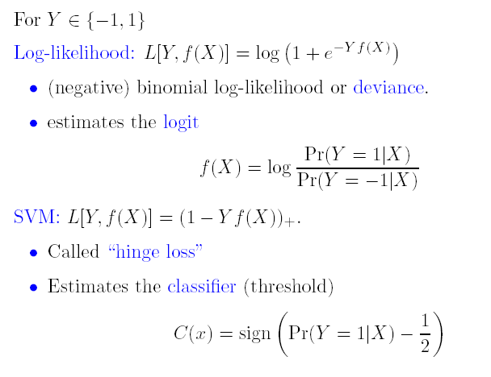
Population Minimizers for Two Loss Functions

Slide 20
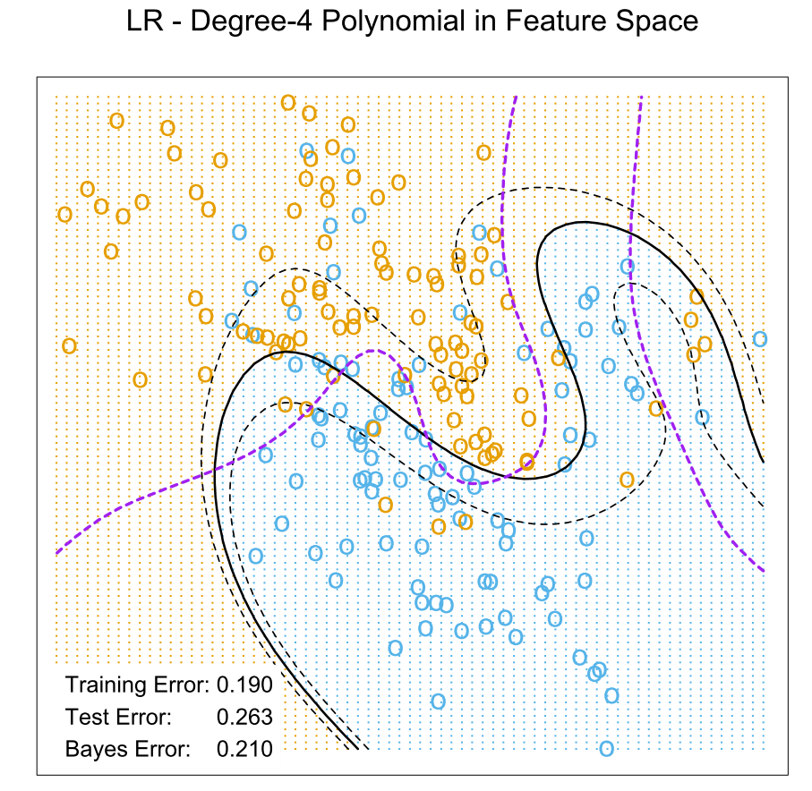
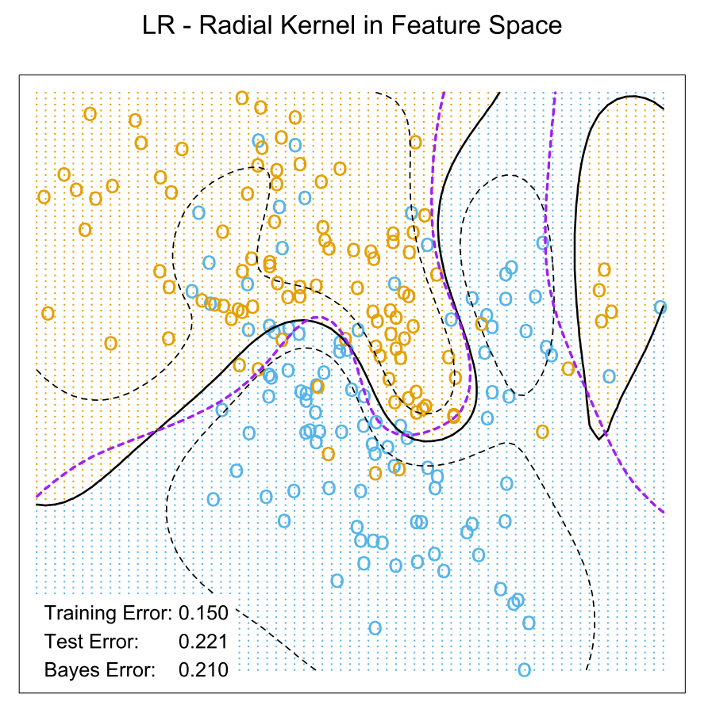
Logistic Regression with Loglikelihood Loss

Slide 21
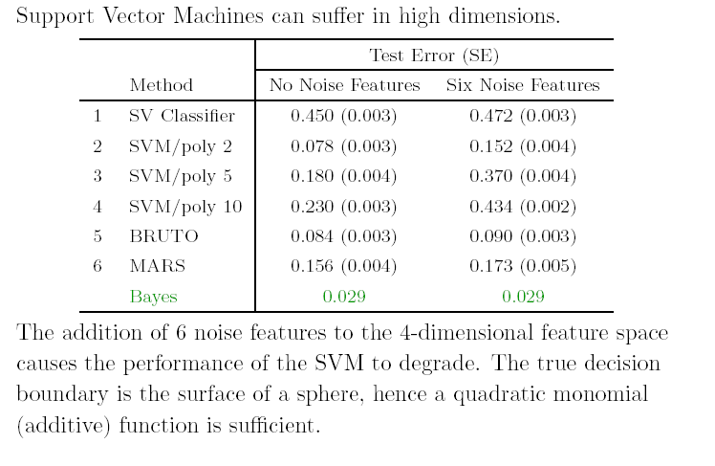
Curse of Dimensionality in SVM
Adaptive Feature selection is needed in this setting, e.g. gene expression

Slide 22
Support Vector Machines for Regression
where
V is ε-insensitive loss

Slide 23
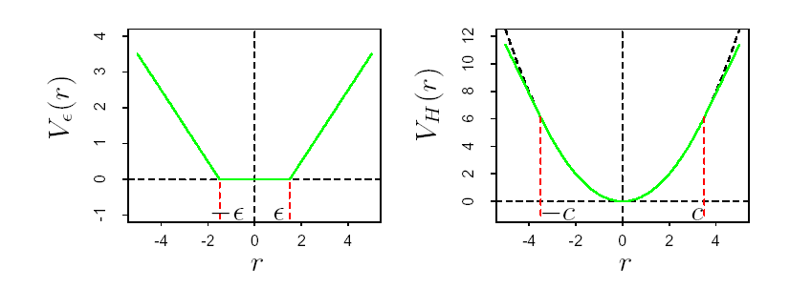
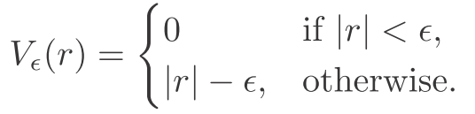
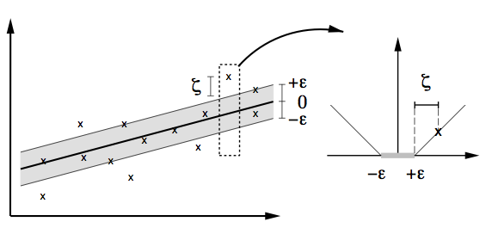
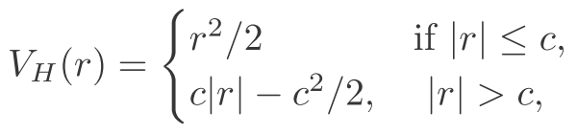
SVM Loss-Functions for Regression

Slide 24
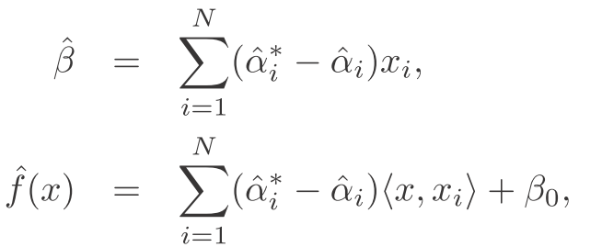
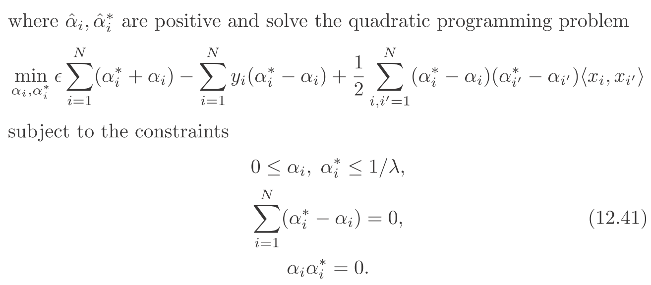
Dual Solution

Slide 25
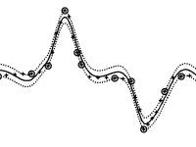
Example

Slide 26
Generalized Discriminant Analysis

Slide 27
Outline
Flexible Discriminant Analysis(FDA)
Penalized Discriminant Analysis
Mixture Discriminant Analysis (MDA)

Slide 28



Linear Discriminant Analysis
Let P(G = k) = π_{k} and P(X=x|G=k) = f_{k}(x)
Then
Assume f_{k}(x) ~ N(μ_{k}, Σ_{k}) and Σ₁ = Σ₂ = …= Σ_{K}= Σ
Then we can show the decision rule is:

Slide 29


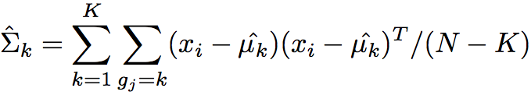
LDA (cont)
Plug in the estimates:

Slide 30
Virtues and Failings of LDA
Simple prototype (centriod) classifier
New observation classified into the class with the closest centroid
But uses Mahalonobis distance
Simple decision rules based on linear decision boundaries
Estimated Bayes classifier for Gaussian class conditionals
But data might not be Gaussian
Provides low dimensional view of data
Using discriminant functions as coordinates
Often produces best classification results
Simplicity and low variance in estimation

Slide 31
Failings of LDA
LDA may fail in number of situations
Often linear boundaries fail to separate classes. May want to model even more irregular (non-linear) boundaries
May have many (correlated) predictors for digitized analog signals.
Too many parameters estimated with high variance, and the performance suffers
May want to regularize
Single prototype per class may not be sufficient

Slide 32
Generalization of LDA
Flexible Discriminant Analysis (FDA)
LDA in enlarged space of predictors via basis expansions
Penalized Discriminant Analysis (PDA)
With too many predictors, do not want to expand the set: already too large
Fit LDA model with penalized coefficient to be smooth/coherent in spatial domain
With large number of predictors, could use penalized FDA
Mixture Discriminant Analysis (MDA)
Model each class by a mixture of two or more Gaussians with different centroids, all sharing same covariance matrix
Allows for subspace reduction

Slide 33
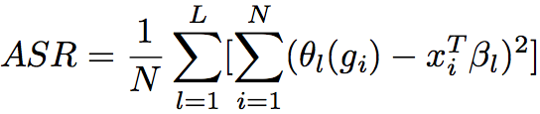

Flexible Discriminant Analysis
Linear regression on derived responses for K-class problem
Define indicator variables for each class (K in all)
Using indicator functions as responses to create a set of Y variables
Obtain mutually linearly independent score functions as discriminant (canonical) variables
Classify into the nearest class centroid
Mahalanobis distance of a test point x to kth class centroid

Slide 34
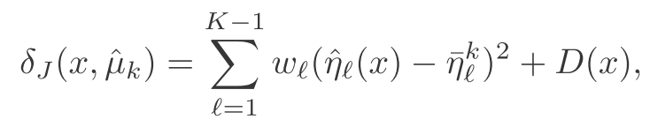
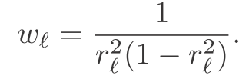
Flexible Discriminant Analysis
We can replace linear regression fits by non-parametric fits, e.g., generalized additive fits, spline functions, MARS models etc., with a regularizer or kernel regression and possibly reduced rank regression
Mahalanobis distance
of a test point x to kth
class centroid

Slide 35
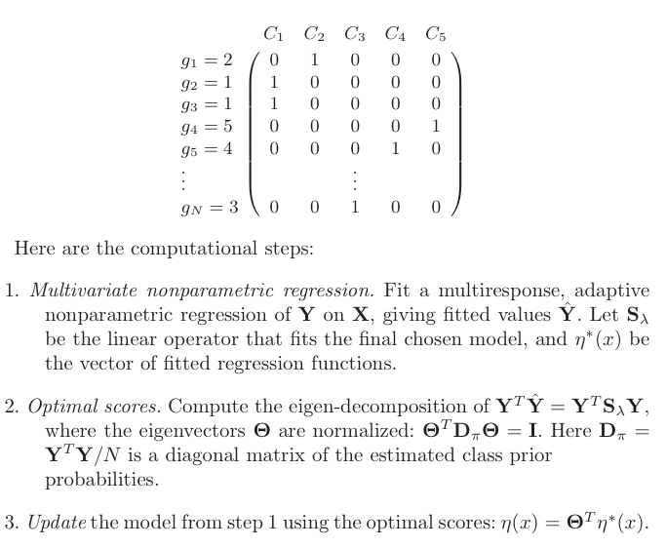
Computation of FDA

Slide 36
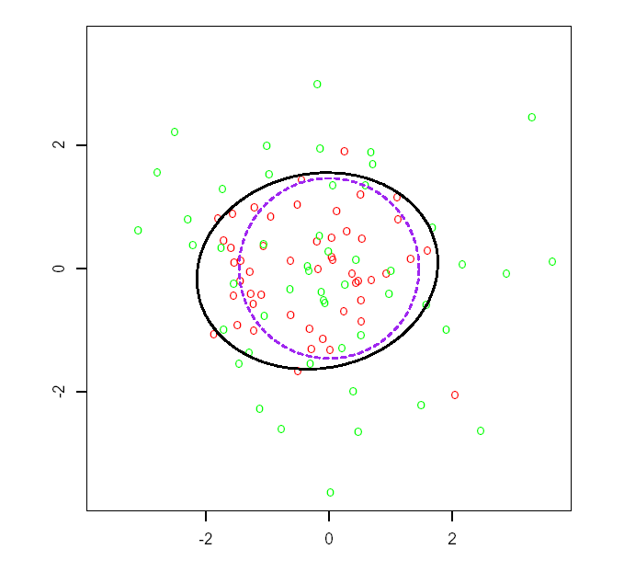
Example of FDA
N(0, I)
N(0, 9I/4)
Bayes decision boundary
FDA using degree-two
Polynomial regression

Slide 37
Speech Recognition Data
K=11 classes
spoken vowels sound
p=10 predictors extracted from digitized speech
FDA uses adaptive additive-spline regression (BRUTO in S-plus)
FDA/MARS Uses Multivariate Adaptive Regression Splines; degree=2 allows pairwise products

Slide 38
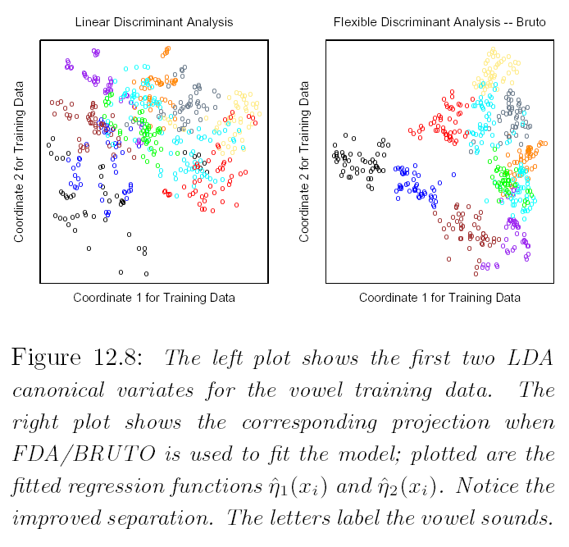
LDA Vs. FDA/BRUTO

Slide 39
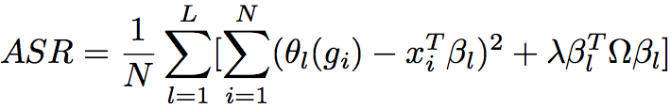
Penalized Discriminant Analysis
PDA is a regularized discriminant analysis on enlarged set of predictors via a basis expansion

Slide 40
Penalized Discriminant Analysis
PDA enlarge the predictors to h(x)
Use LDA in the enlarged space, with the penalized Mahalanobis distance:
with Σ_{W} as within-class (common) Cov

Slide 41


Penalized Discriminant Analysis
Decompose the classification subspace using the penalized metric:

Slide 42
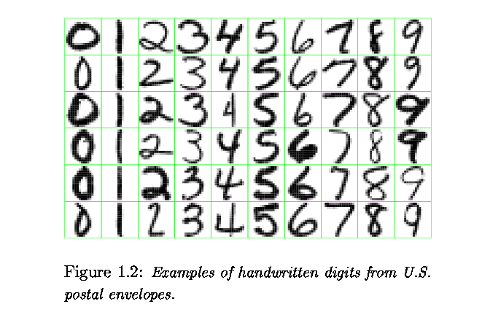
USPS Digit Recognition

Slide 43
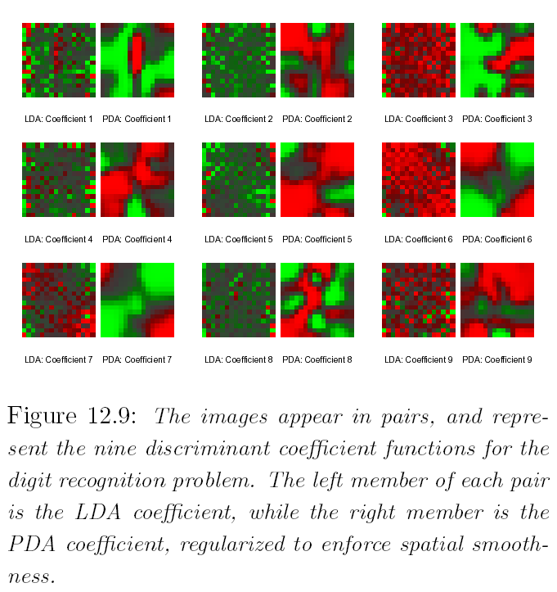
Digit Recognition-LDA vs. PDA

Slide 44
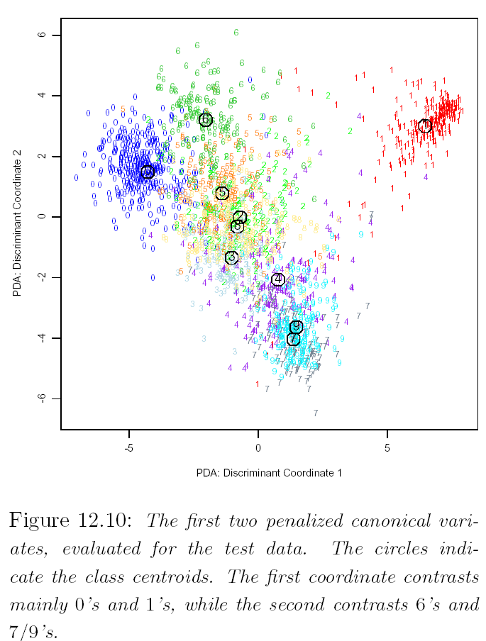
PDA Canonical Variates

Slide 45
Mixture Discriminant Analysis
The class conditional densities modeled as mixture of Gaussians
Possibly different # of components in each class
Estimate the centroids and mixing proportions in each subclass by max joint likelihood P(G, X)
EM algorithm for MLE
Could use penalized estimation

Slide 46
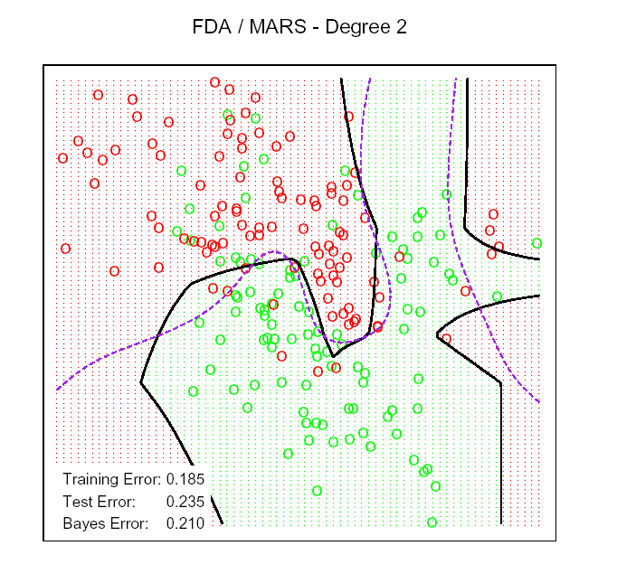
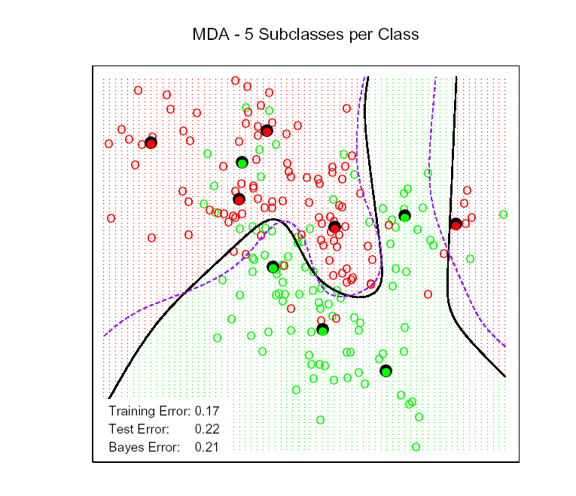
FDA and MDA

Slide 47
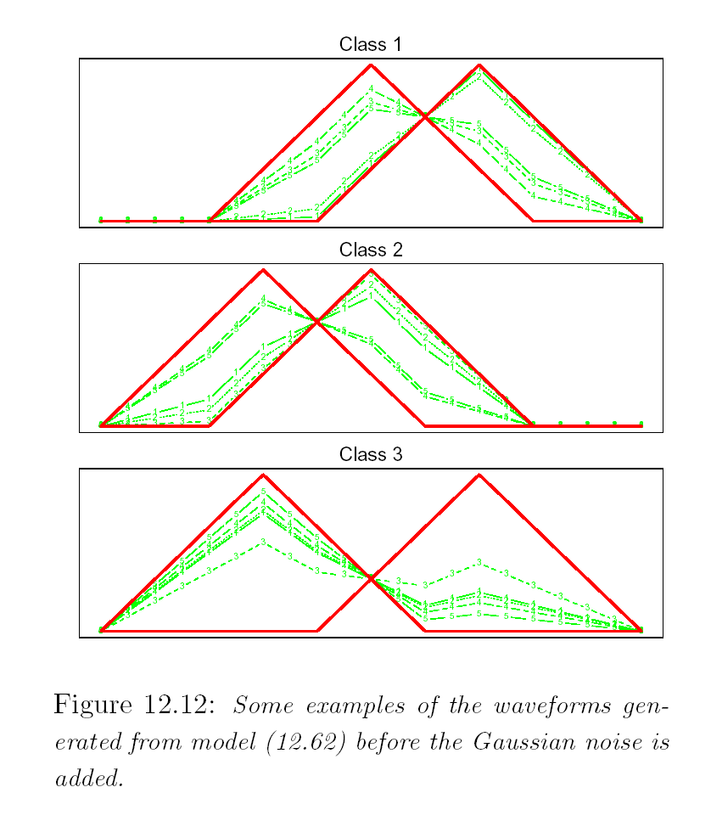
Wave Form Signal with Additive Gaussian Noise
Class 1: X_{j} = U h₁(j) + (1-U)h₂(j) +ε_{j}
Class 2: X_{j} = U h₁(j) + (1-U)h₃(j) +ε_{j}
Class 3: X_{j} = U h₂(j) + (1-U)h₃(j) +ε_{j}
Where j = 1,L, 21, and U ~ Unif(0,1)
h₁(j) = max(6-|j-11|,0)
h₂(j) = h₁(j-4)
h₃(j) = h₁(j+4)

Slide 48
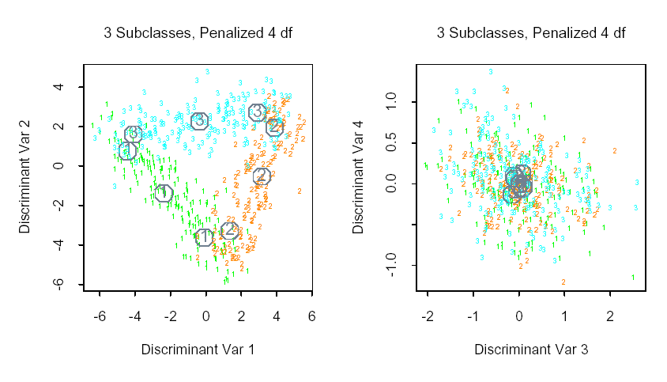
Wave From Data Results

Slide 49
Homework Due: 11/16/2015
12.1
12.2
12.3
12.5

